Slide 1
Association Rule Mining
Beiyu Lin

Slide 2
Association Rule Mining
Given a set of transactions, find rules that will predict the occurrence of an item based on the occurrences of other items
Market transactions
Example of Association Rules
{Beer} → {Eggs}, {Milk, Bread} → {Diaper, Beer},

Slide 3
Association Rule Mining
Itemset (set / subset)
A collection of one or more items
Example: {Milk, Bread, Diaper}
k-itemset
An itemset that contains k items
Support count (σ)
Frequency of occurrence of an itemset
E.g. σ({Milk, Bread,Diaper}) = 2
Support
Fraction of transactions that contain an itemset
E.g. s({Milk, Bread, Diaper}) = 2/5
Frequent Itemset
An itemset whose support is greater than or equal to a minsup threshold

Slide 4
Definition: Association Rule
Association Rule
An implication expression of the form X → Y, where X and Y are itemsets
Example: {Milk, Diaper} → {Beer}
Rule Evaluation Metrics
Support (s)
Fraction of transactions that contain both X and Y
Confidence (c)
Measures how often items in Y appear in transactions that contain X
Example:
=# of itemset / total # transactions
= # of itemset of Xand Y/ # of itemset of X

Slide 5
Frequent Itemset Generation
Brute-force approach:
Each itemset in the lattice is a candidate frequent itemset
Count the support of each candidate by scanning the database
Match each transaction against every candidate
Complexity ~ O(NMw) => Expensive since M = 2^{d} !!!

Slide 6
Frequent Itemset Generation Strategies
Reduce the number of candidates (M)
Complete search: M=2^{d}
Use pruning techniques to reduce M
Reduce the number of transactions (N)
Reduce size of N as the size of itemset increases
Used by DHP and vertical-based mining algorithms
Reduce the number of comparisons (NM)
Use efficient data structures to store the candidates or transactions
No need to match every candidate against every transaction

Slide 7
Reducing Number of Candidates
Apriori principle:
If an itemset is frequent, then all of its subsets must also be frequent
Apriori principle holds due to the following property of the support measure:
Support of an itemset never exceeds the support of its subsets
This is known as the anti-monotone property of support
Support
s({Milk, Bread, Diaper}) = 2/5

Slide 8










Illustrating Apriori Principle
Found to be Infrequent
Pruned supersets

Slide 9
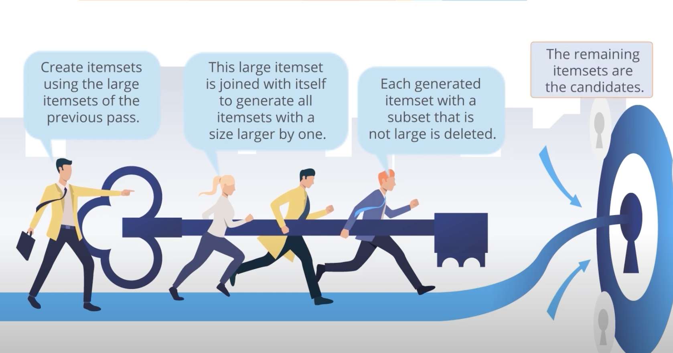
Apriori Principle

Slide 10
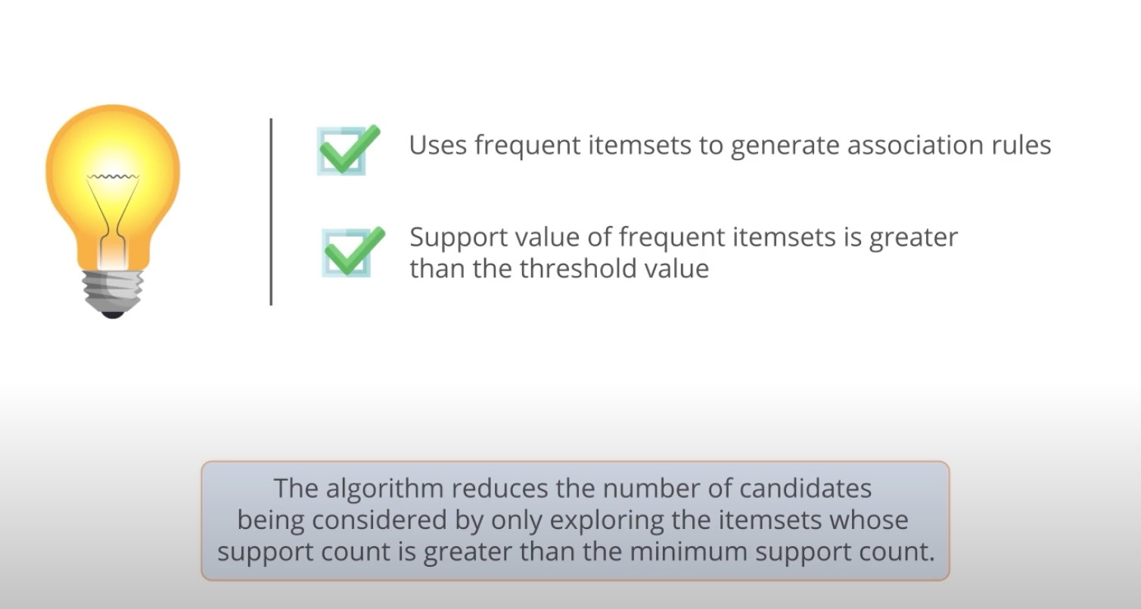
Apriori Principle

Slide 11
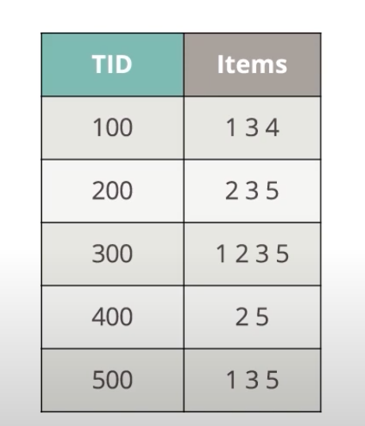
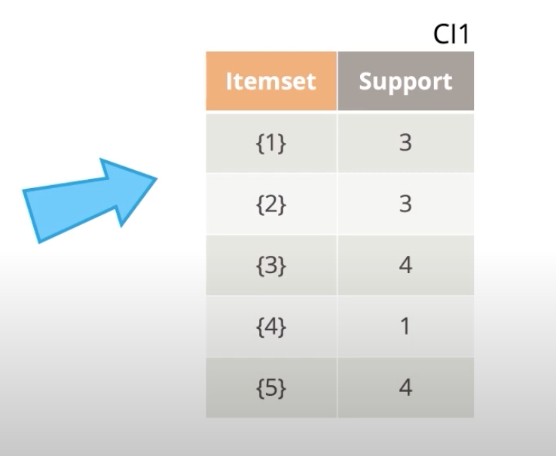
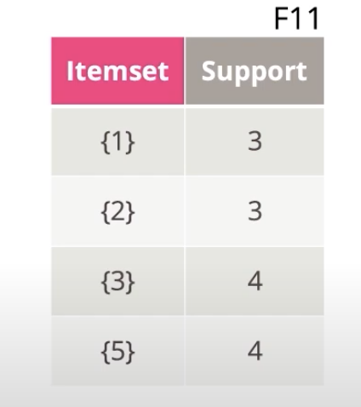
Apriori Principle Example

Slide 12
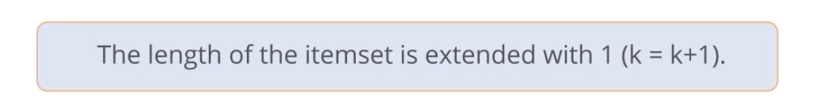
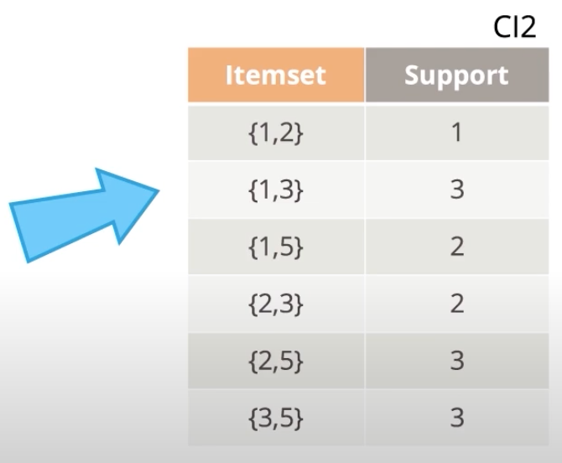
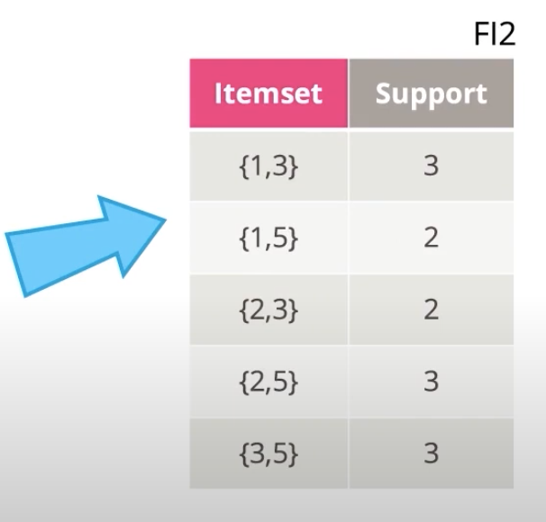
Apriori Principle Example

Slide 13
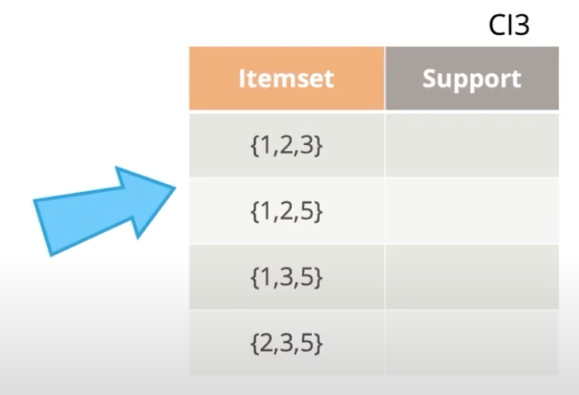
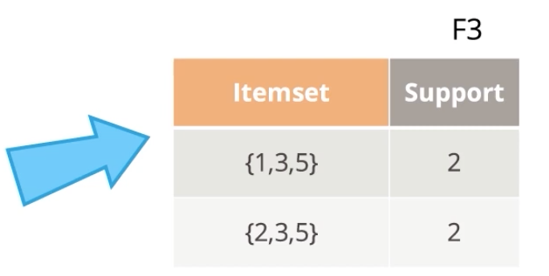
Apriori Principle Example
List the F itemsets with k = 2
{1, 3}, {1, 5}, {3,5}, {2,3}, {2, 5} F

Slide 14
Apriori Principle Example

Slide 15
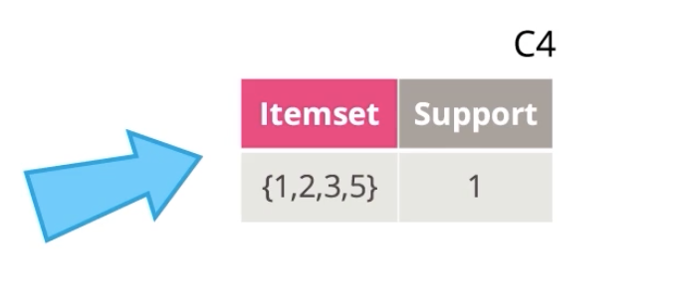

Apriori Principle Example

Slide 16
Illustrating Apriori Principle
TID | ITEMS
1 | A, B
2 | A, C, D, E
3 | B, C, D
4 | B, C, E
5 | C, B, D

Slide 17
Weka
Dataset: https://storm.cis.fordham.edu/~gweiss/data-mining/weka-data/contact-lenses.arff

