Slide 1
Introduction To Sports and others
Beiyu Lin

Slide 2
WHY IT IS IMPORTANT?
Sports Analytics Market Worth $4.7 Billion by 2021
Sports Analytics Market Growing at 37.9% CAGR to 2021
Worldwide $3.97 Billion Sports Analytics Market 2016-2022

Slide 3
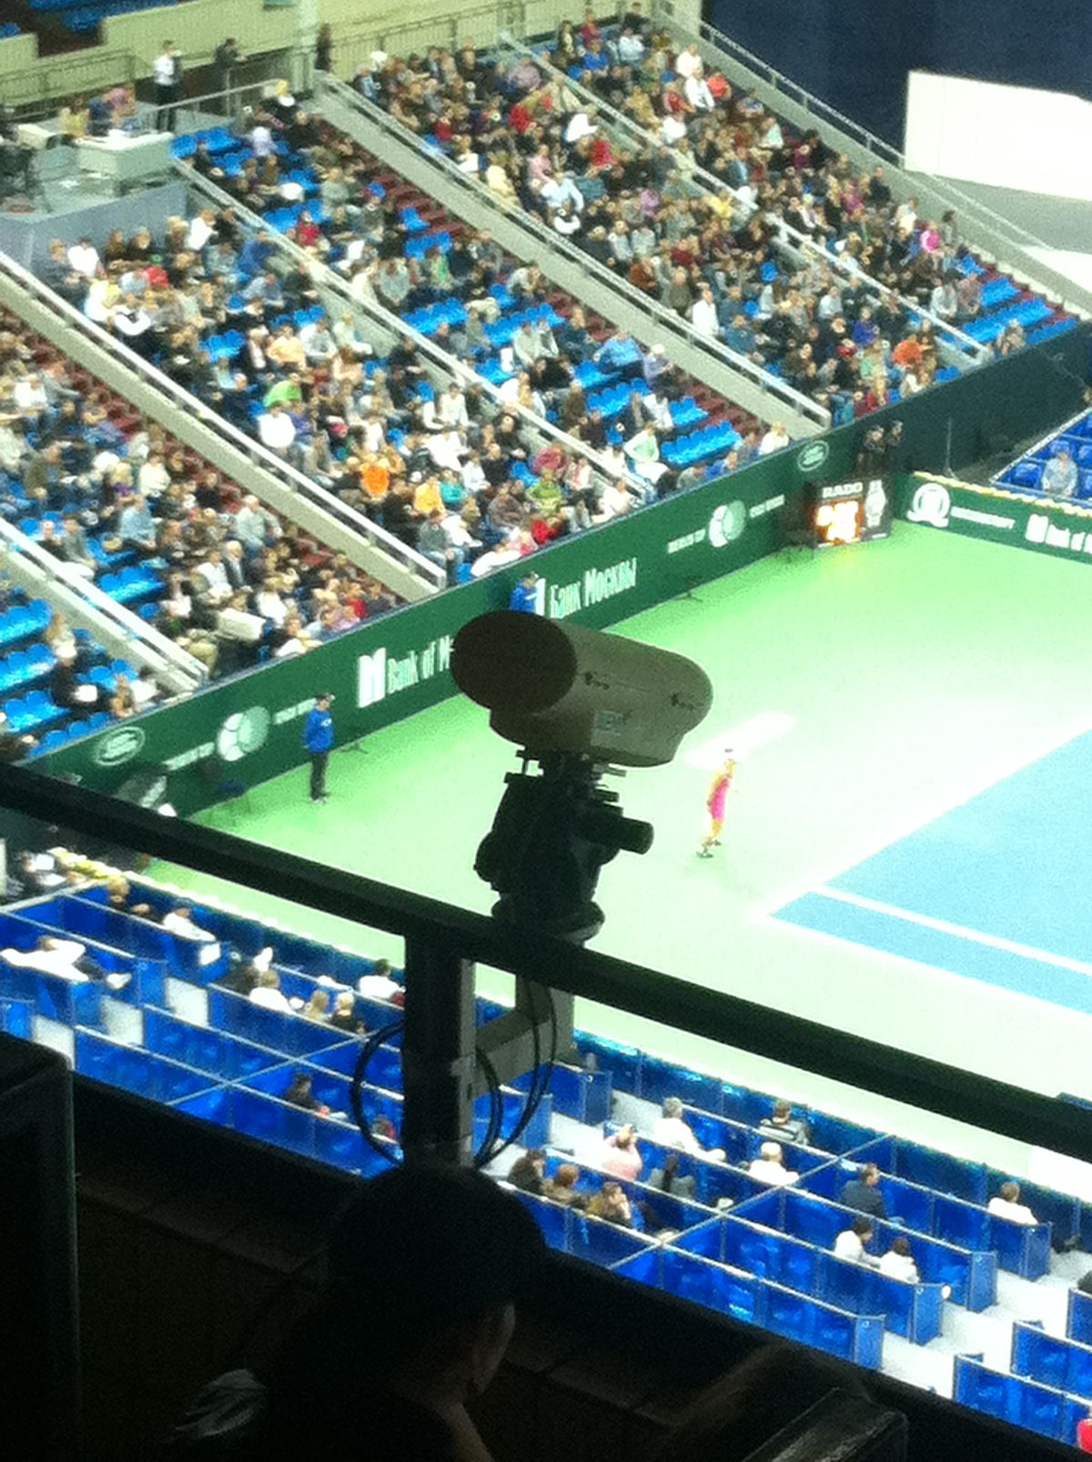
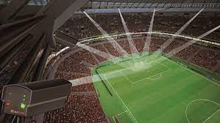
Examples
Hawk-Eye:
Multiple hi-speed cameras to track ball, bat, players
Link : 0-3:20’

Slide 4
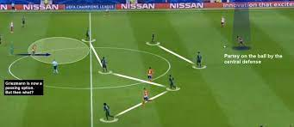
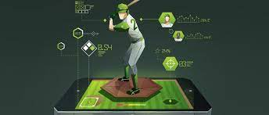
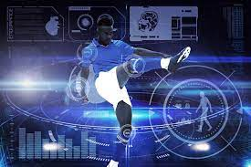
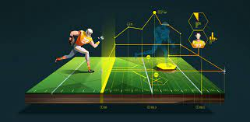
Tremendous Innovation in Sports analytics

Slide 5
Good parts
Decision Making
Game analysis
Coach / Train Players
Media enhancement
Prediction

Slide 6
CONCERNS
Very expensive: $500k – million
multiple hi-speed cameras
High-resolution
Highly sensitive to light
Run high performance vision algorithms

Slide 7
embed io devices
Can IoT devices (cheap sensors and wireless radios) be used to solve motion tracking problems
Instead of computer vision or other expensive tech

Slide 8
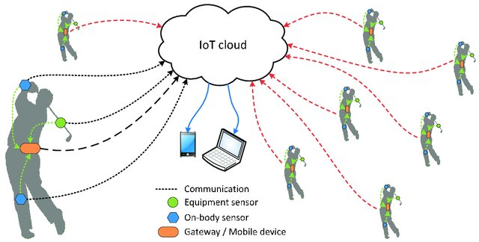
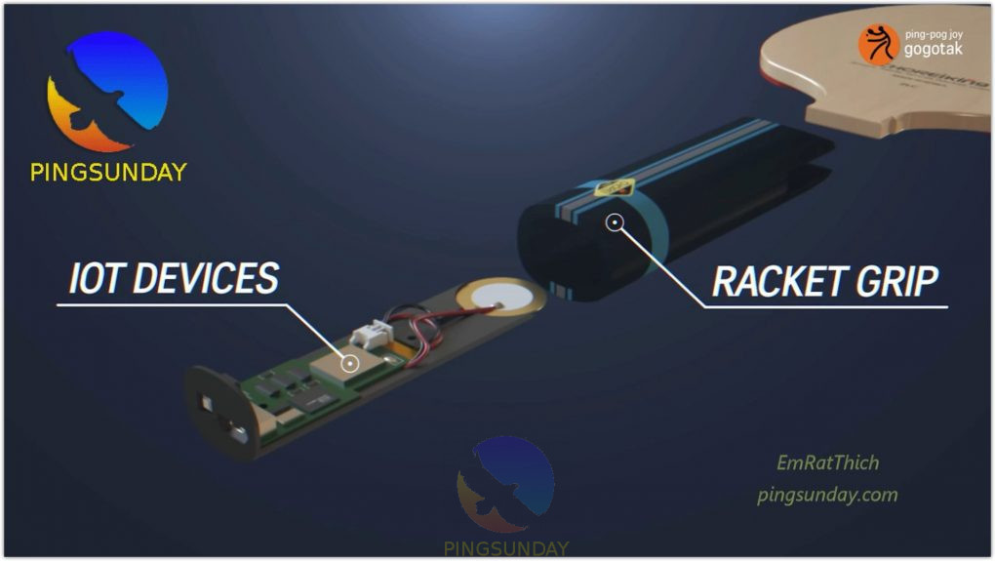
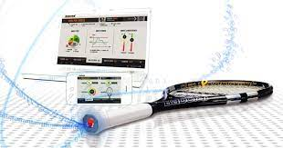
Example: IoT in the context of sports
Tracking the location and spin
Cost: $60

Slide 9
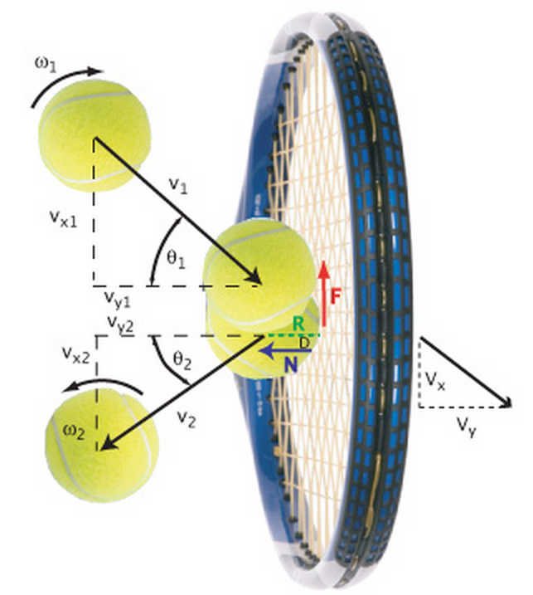
CORE TECHNICAL APPROACH
Combine diverse piece of information from multimodal sensory information
Challenges:
High-speed of the ball
Noise in the data
Solutions
Physics models of motion

Slide 10
CORE TECHNICAL APPROACH
Solutions
Physics models of motion
Trajectory and speed
Spin and orientation
Human arm and body motion
Group behavior

Slide 11
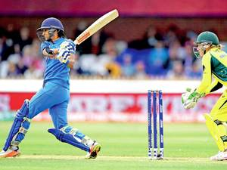
Example: ball tracking
Game of Cricket
Notes:
Cri-kit

Slide 12
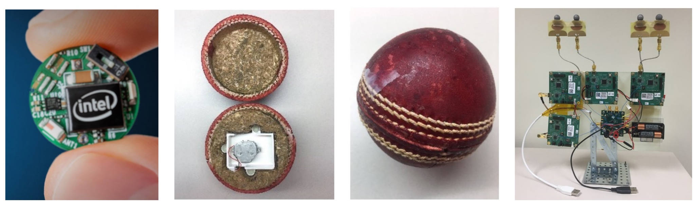
Track spin
Similar sensors in smart phones or watches: e.g., accelerometers;

Slide 13
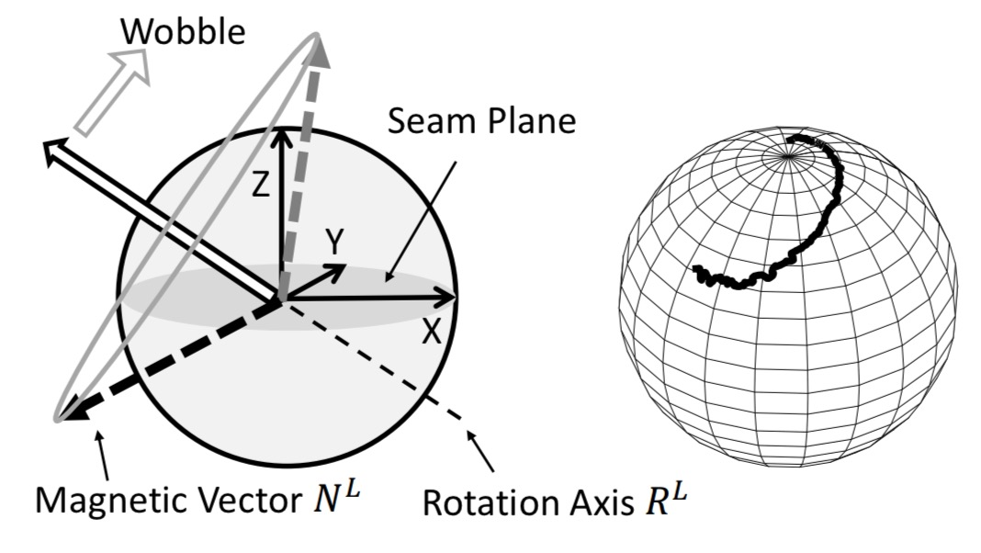
Track spin

Slide 14
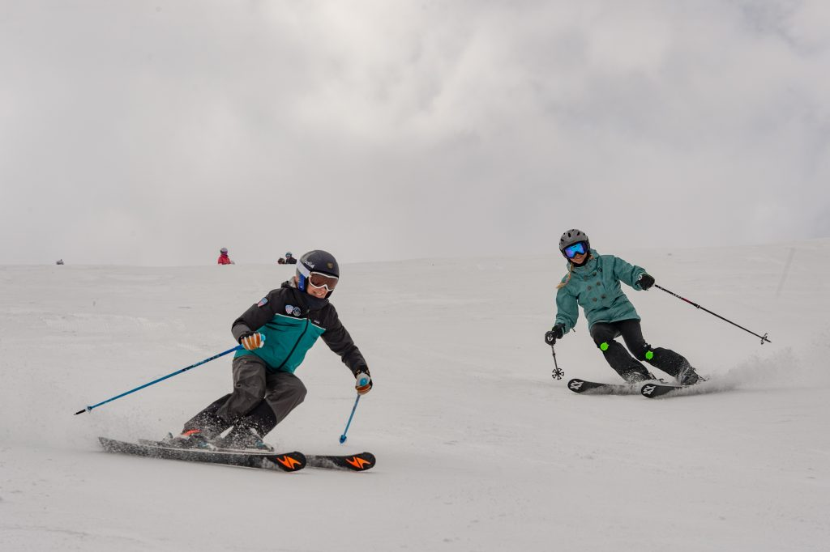
IoT Human Sensor Data Enables Skill Measurement
create data to help characterize this expertise level
With wearable IoT sensors, we can
collect positional and motion data
measure this expertise level distinction between professionals and amateurs with high precision and accuracy.

Slide 15
How to do it
compare amateurs own skiing data to the professional’s
classify their skill level
examine specific positional and gestural differences in their skill performance

Slide 16
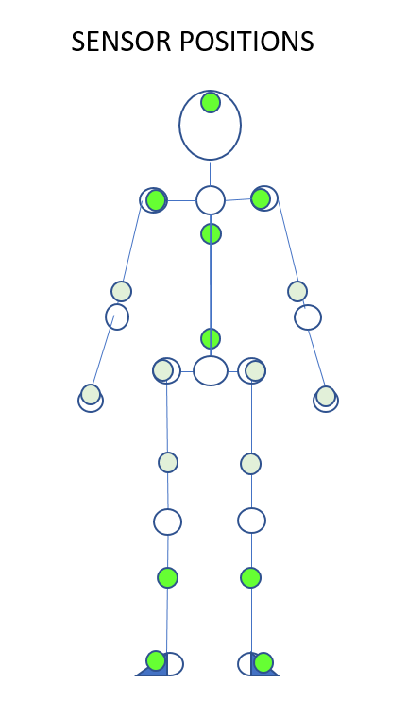
Human Sensor Placement
The data from the bright green sensors were used in the final classification model
as features generated from these sensors’ data were highly predictive of skier expertise.
the features derived from the light green colored sensors’ data were not as predictive and were discarded from the final model.

Slide 17
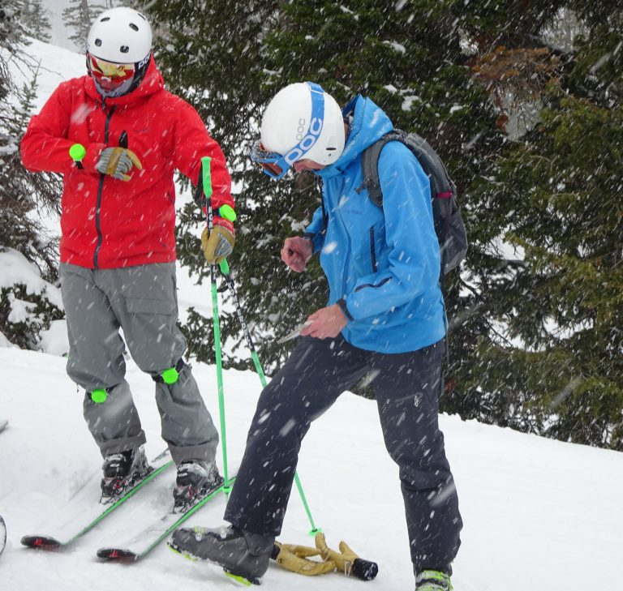
Experimental Design
several professional-level skiers and several intermediate skiers
they performed a number of skill drills.
skill drills included:
short, medium and large radius turns.
note the start of the actual drill in order to exclude non-drill data from the data model.
note the name, drill and skill level of the skier in order to annotate the data file later.

Slide 18
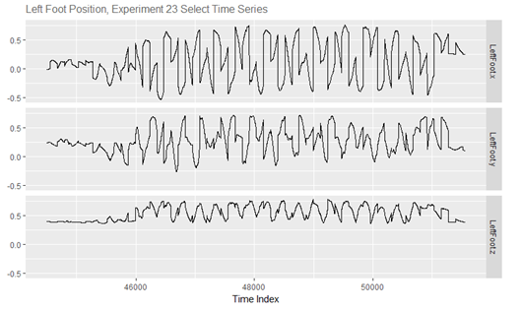
Clean and transform the data
link

Slide 19
SPORTS AND FITNESS
Wearable Fitness Trackers
IP connected Sports Equipment
Treadmills, Bikes, etc.…

Slide 20
Question
When would be a good time to go to the gym in UNLV?

