Slide 1
IOT data

Slide 2
What is good research?
How do I know this article is methodological sound?
Are the findings practically meaningful
Statistical versus practical significance
Design of research is a compromise
Use best possible methods
Avoid as many confound or other interpretations of you data
Look for convergence among research methods

Slide 3
Research Method
What approaches do scientists use to measure behavior modeling?
What specific designs are unique to behavior modeling research?
What are general designs for doing research?

Slide 4
Conducting Research Ethically
Collaborative Research Training Initiative
Institutional Review Board (IRB)
Informed Consent

Slide 5
Reliability & Validity of Measures
Choice of outcome measures is important.
Reliability of a measure: extent to which is provides a consistent index of the behavior of interest (measurement error).
Validity of a measure: extent to which it measures what researchers think it measures.

Slide 6
Reliability & Validity of Measures
Choice of outcome measures is important.
Reliability of a measure: extent to which is provides a consistent index of the behavior of interest (measurement error).
Validity of a measure: extent to which it measures what researchers think it measures.

Slide 7
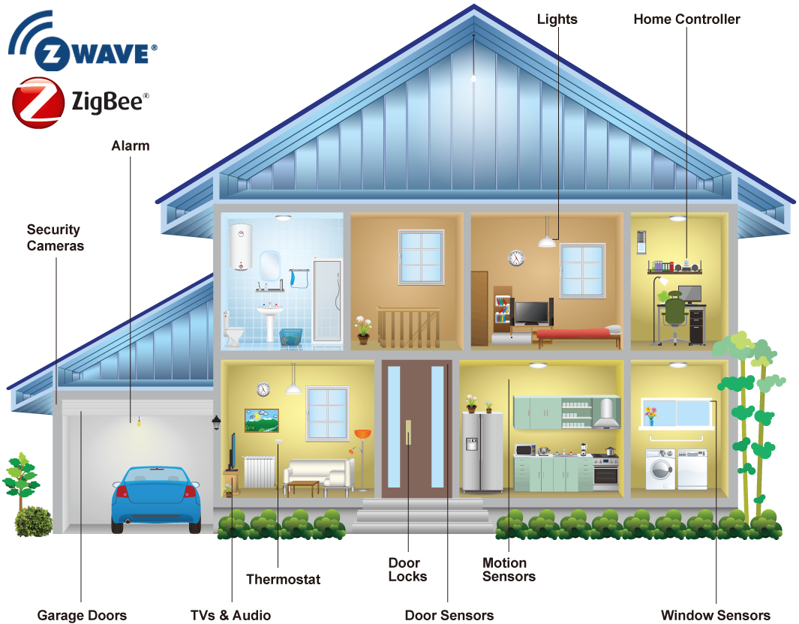
Example
Data from smart watch
2016-04-01 12:39:44.825323 MainEntryway OFF Other_Activity
2016-04-01 12:40:20.932096 BathroomASink ON Take_Medicine
2016-04-01 12:40:21.219997 BedroomABed ON Relax
2016-04-01 12:40:22.435275 MainEntryway ON Other_Activity
2016-04-01 12:40:23.53145 MainEntryway OFF Other_Activity
2016-04-01 12:40:23.62437 BedroomABed OFF Relax
2016-04-01 12:40:25.521123 BedroomABed ON Relax
2016-04-01 12:40:26.099618 BathroomASink OFF Bed_Toilet_Transition
2016-04-01 12:40:26.532888 MainEntryway OFF Other_Activity
2016-04-01 12:40:29.812875 BedroomABed OFF Relax
2016-04-01 12:40:30.058532 BathroomAArea OFF Bed_Toilet_Transition
2016-04-01 12:40:31.500912 BedroomABed ON Relax
2016-04-01 12:40:31.820019 BedroomDArea OFF Relax
2016-04-01 12:40:35.434451 BedroomABed OFF Relax
2016-04-01 12:40:38.343873 EntrywayB OFF Other_Activity

Slide 8
Example
Data from smart watch
2016-04-01 12:39:44.825323 MainEntryway OFF Other_Activity
2016-04-01 12:40:20.932096 BathroomASink ON Take_Medicine
2016-04-01 12:40:21.219997 BedroomABed ON Relax
2016-04-01 12:40:22.435275 MainEntryway ON Other_Activity
2016-04-01 12:40:23.53145 MainEntryway OFF Other_Activity
2016-04-01 12:40:23.62437 BedroomABed OFF Relax
2016-04-01 12:40:25.521123 BedroomABed ON Relax
2016-04-01 12:40:26.099618 BathroomASink OFF Bed_Toilet_Transition
2016-04-01 12:40:26.532888 MainEntryway OFF Other_Activity
2016-04-01 12:40:29.812875 BedroomABed OFF Relax
2016-04-01 12:40:30.058532 BathroomAArea OFF Bed_Toilet_Transition
2016-04-01 12:40:31.500912 BedroomABed ON Relax
2016-04-01 12:40:31.820019 BedroomDArea OFF Relax
2016-04-01 12:40:35.434451 BedroomABed OFF Relax
2016-04-01 12:40:38.343873 EntrywayB OFF Other_Activity
Questions:
Data Collection
Approval from IRB
Activity recognition
Measure choice
Feature extraction

Slide 9
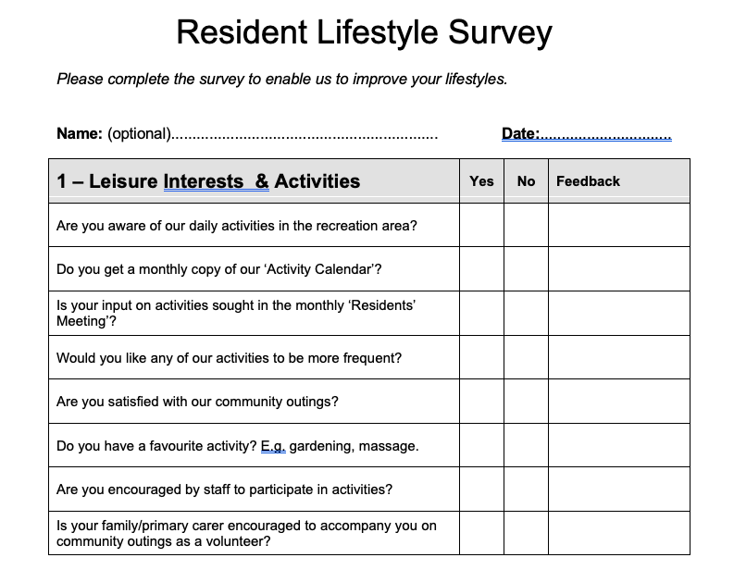
Example
Questionnaire Design
The time to get up
The time to eat breakfast
The time to start work
The time to go to bed

Slide 10
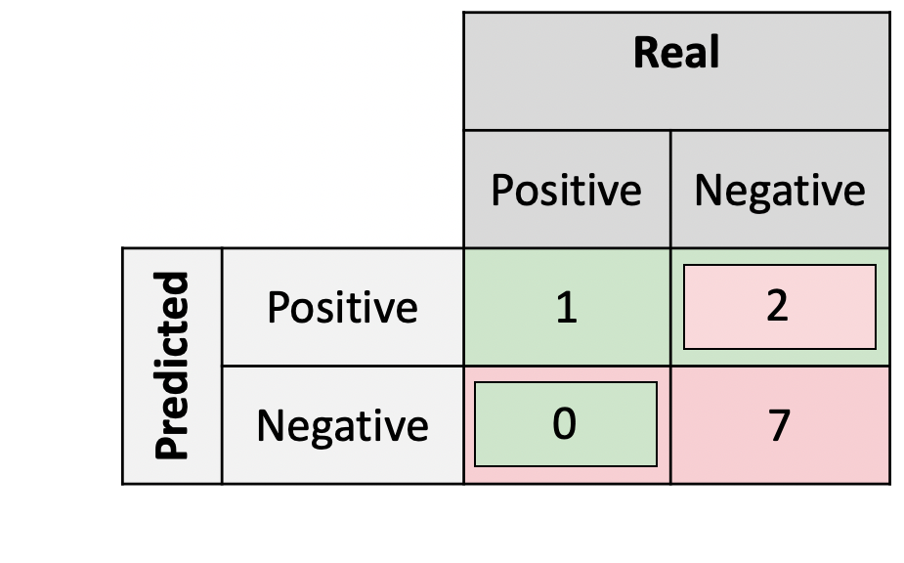
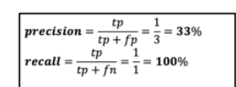

Example
Measures
Activity recognition measures:
Accuracy
p-value of t-test
F1 score

Slide 11
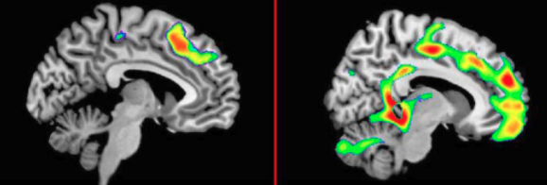
Example
Measures
To distinguish between diagnostic groups

Slide 12
Example
2016-04-01 12:39:44.825323 MainEntryway OFF Other_Activity
2016-04-01 12:40:20.932096 BathroomASink ON Take_Medicine
2016-04-01 12:40:21.219997 BedroomABed ON Relax
2016-04-01 12:40:22.435275 MainEntryway ON Other_Activity
2016-04-01 12:40:23.53145 MainEntryway OFF Other_Activity
2016-04-01 12:40:23.62437 BedroomABed OFF Relax
2016-04-01 12:40:25.521123 BedroomABed ON Relax
2016-04-01 12:40:26.099618 BathroomASink OFF Bed_Toilet_Transition
2016-04-01 12:40:26.532888 MainEntryway OFF Other_Activity
2016-04-01 12:40:29.812875 BedroomABed OFF Relax
2016-04-01 12:40:30.058532 BathroomAArea OFF Bed_Toilet_Transition
2016-04-01 12:40:31.500912 BedroomABed ON Relax
2016-04-01 12:40:31.820019 BedroomDArea OFF Relax
2016-04-01 12:40:35.434451 BedroomABed OFF Relax
2016-04-01 12:40:38.343873 EntrywayB OFF Other_Activity
Feature Extraction
Temporal
Duration
Frequency
Distance
…
Spatial
Location
Transition between locations
…

Slide 13

Behavior modeling programs
Modeling
Traffic
Crowd Flow
Home/Building/City
Nature
Health

Slide 14
Behavior modeling programs
Modeling
Traffic
Crowd Flow
Home/Building/City

Slide 15


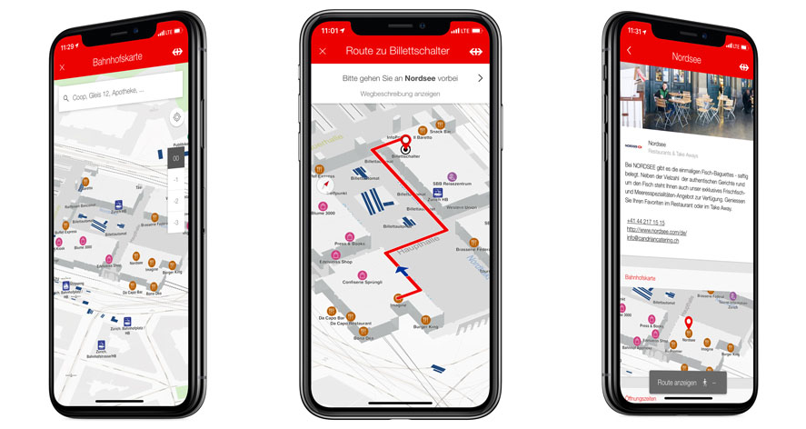
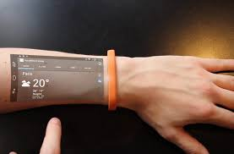
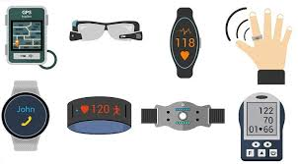
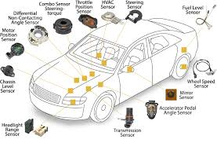
The meaning of behavior

Slide 16
IOT Sensor data

Slide 17
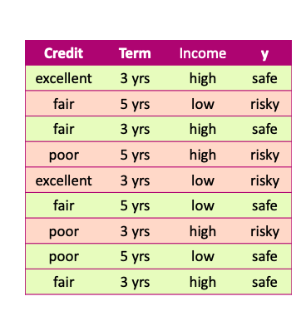



Data
x and y values are known

Slide 18
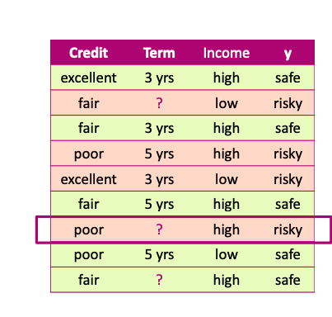
Missing values
Unknown values

Slide 19
Missing values Impact
Missing values impact both training and prediction
Training data: unknown values
Prediction: input for prediction has unknown values

Slide 20
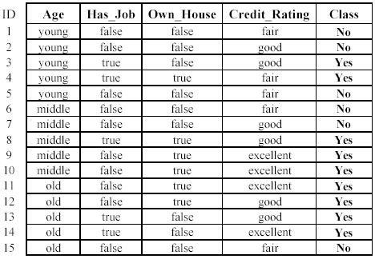
Missing values Impact
Training data: “unknown” values

Slide 21
Missing values Impact
Prediction: input at prediction time with “unknown” values

Slide 22
Handling missing values
Strategy 1: Purification by skipping

Slide 23
Purification by skipping / removing

Slide 24
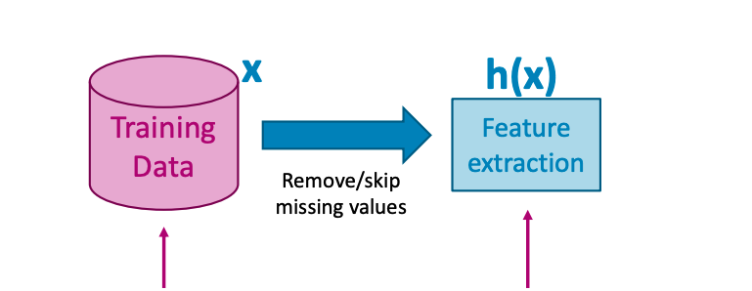
Purification by skipping / removing
Original data with missing values
Data without any missing values

Slide 25
The challenge with skipping / revoming

Slide 26
The challenge with skipping / revoming
Warning: more than 50% of the data are removed!

Slide 27

The challenge with skipping / removing
Idea 2: Skip features with many missing values

Slide 28


The challenge with skipping / removing
Strategy 1: Skip data points with a missing value
- make sure only a few points are skipped
Strategy 2: Skip features with many missing values
- make sure only a few features are skipped

Slide 29
skipping / removing missing values: pros and cons
Pros:
Easy to understand and implement
Applied to all machine learning model
Cons:
Removing data points and features may take off some important information
Unclear when it’s better to remove data points or features
Doesn’t help if data is missing at prediction part

Slide 30

Handling missing values
Strategy 2: Purification by imputing

Slide 31



Main drawback of skipping method
Data is precious.
Do not throw it away.

Slide 32
Can we keep all the data?
Use other data point in the column to “guess” the “missing part”.

Slide 33
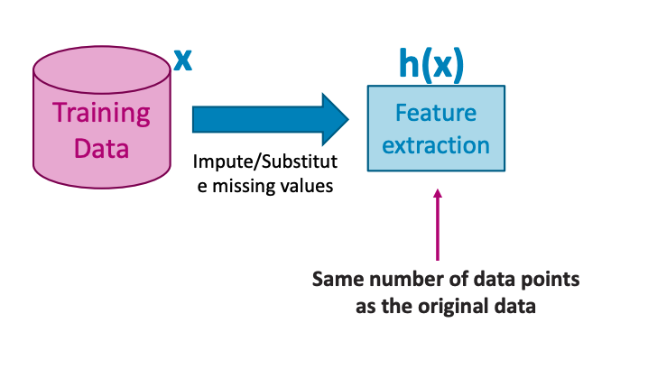
Idea: PURIFICATION BY IMPUTING
Original data with missing values
Same number of data points

Slide 34
Idea: PURIFICATION BY IMPUTING
false
Fill in each missing value with a calculated guess
true
fair

Slide 35
Example: replace with the most common value
false
Fill in each missing value with a calculated guess

Slide 36
Common (simple) rules for imputing
Impute each feature with missing values:
Categorical features: Most popular value of non-missing
Numerical features: Average or median value of non-missing

Slide 37
Missing value imputation: pros and cons
Pros
• Easy to understand and implement
• works for all machine learning models
(logistic regression, decision trees, …)
• works for missing values in the prediction part
use the same imputation rules
Cons
• May have systematic errors
Example: a feature is missing in the entire dataset in one place but is not missing in another dataset.

Slide 38
Handling missing values
Strategy 3: Adapt learning algorithm to be robust to missing values

Slide 39
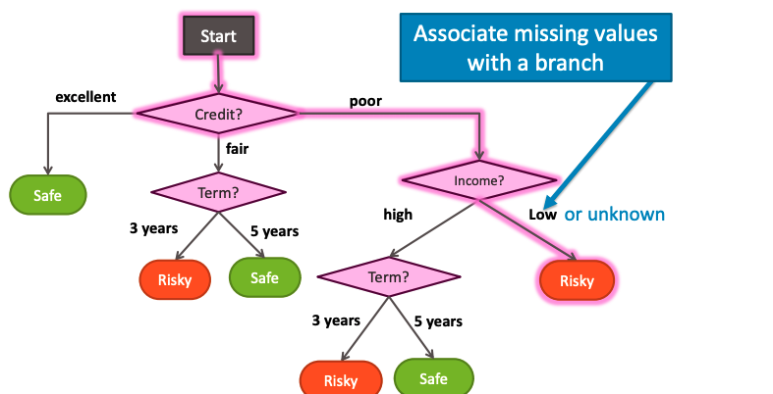
Handling missing data

Slide 40
Handling missing data
Every decision node includes choice of response to missing values

Slide 41

Feature split selection with missing data
Pros
• works in both training and prediction parts
• More accurate predictions
Cons
• modify learning algorithms
(simple for decision trees)

Slide 42
Summary of handling missing values

Slide 43
What you can do now…
Describe common ways to handling missing data:
Skip all data points (rows) with any missing values
Skip features (columns) with many missing values
Impute missing values
Modify learning algorithm (decision trees)

Slide 44
Data Preprocessing
Data Cleaning (missing values)
Data Preprocessing: An Overview
Data Quality
Major Tasks in Data Preprocessing
Data Integration
Data Reduction (PCA)

Slide 45
Data Quality: Why Preprocess the Data?
Measures for data quality: A multidimensional view
Accuracy
Completeness
Consistency
Timeliness
Believability
Interpretability

Slide 46
Major Tasks in Data Preprocessing
Data cleaning
Fill in missing values, smooth noisy data, identify or remove outliers, and resolve inconsistencies
Data integration (data engineer)
Integration of multiple databases (sql), data cubes, or files
Data reduction
Dimensionality reduction
Numerosity reduction
Data compression

Slide 47
Noisy Data
Noise: random error or variance
Incorrect attribute values may be due to
data collection instrument failures
data transmission problems
technology limitations
Other data problems which require data cleaning
Duplicate, incomplete, inconsistent
Notes:
47

Slide 48
How to Handle Noisy Data?
Binning
Regression / Classification – supervised learning
Clustering (unsupervised learning)
Combined computer and human inspection

Slide 49
How to Handle Noisy Data?
Binning (numerical – data engineer)
first sort data
partition sorted data into (equal-frequency) bins
smooth by bin means, median, or boundaries (e.g, clean jitters)

Slide 50
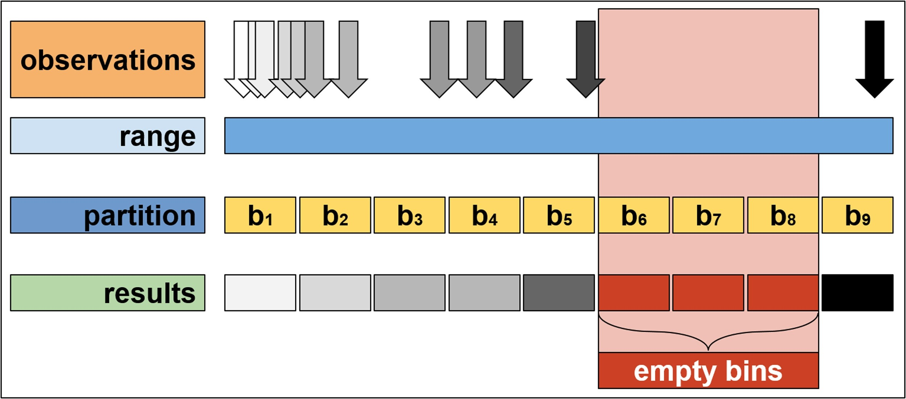
How to Handle Noisy Data?

Slide 51
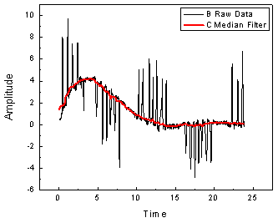
How to Handle Noisy Data?
Regression
smooth by fitting the data into regression functions

Slide 52
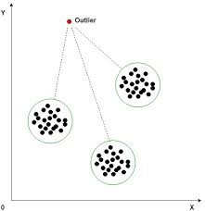
How to Handle Noisy Data?
Clustering (unsupervised learning)
detect and remove outliers

Slide 53
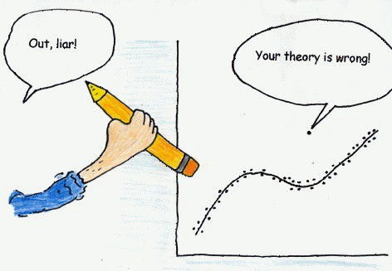
How to Handle Noisy Data?
Combined computer and human inspection
(human in the loop ⬄ combine domain experts’ perspectives)
detect suspicious values and check by human (e.g., deal with possible outliers)

