Slide 1
Computational Behavior Modeling
Multi-disciplinary research

Slide 2
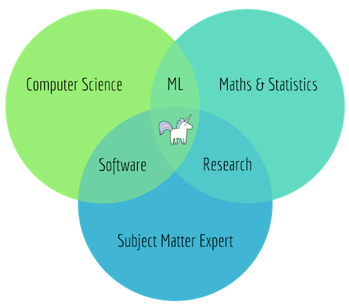
Data SCIENTIST

Slide 3
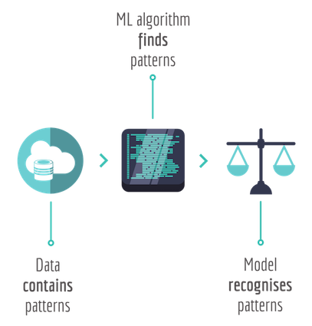
Machine learning
Purpose
Find patterns in data
Use the learned patterns to predict for future
Use the learned patterns to make decisions
Data
Data that contains patterns
ML algorithm finds the patterns and generates a model
Given new data, the model recognizes these patterns.

Slide 4
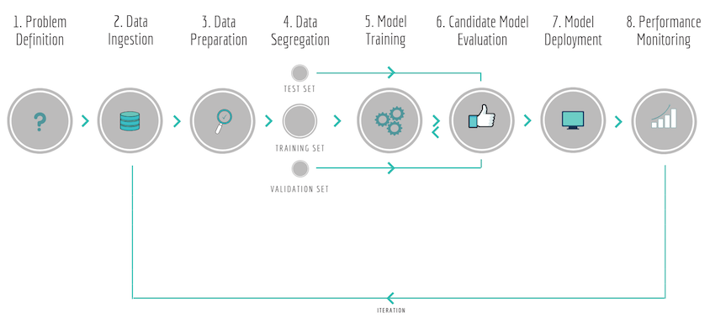
MACHINE LEARNING PIPELINE
Program
manager
Software Engineer
Data scientist / ML engineer

Slide 5
MACHINE LEARNING PIPELINE

Slide 6
Training Models
Supervised Learning
Unsupervised Learning
Reinforcement Learning

Slide 7
Models – supervised Learning
A credit card company receives thousands of applications for new cards. Each application contains information about an applicant,
age
Marital status
annual salary
outstanding debts
credit rating
etc.
Problem: to decide whether an application should be approved, or to classify applications into two categories, approved and not approved.

Slide 8
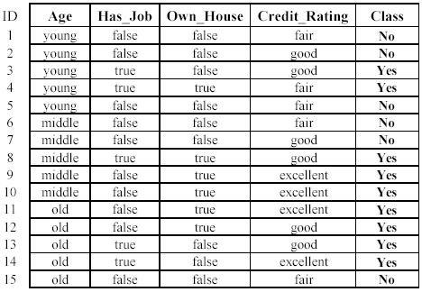
Models – supervised Learning
labels

Slide 9
Models – supervised Learning
Like human learning from past experiences or historical data.
A computer does not have “experiences”.
A computer system learns from data, which represent some “past experiences” of an application domain.
Our focus: learn a target function that can be used to predict the values of a discrete class attribute, e.g., approve or not-approved, and high-risk or low risk.
The task is commonly called: Supervised learning, classification, or inductive learning.

Slide 10
Models – supervised Learning
Learn a classification model from the data
Use the model to classify future loan applications into
Yes (approved) and
No (not approved)
What is the class for following case/instance?

Slide 11
Models – supervised Learning
Supervised learning: classification is seen as supervised learning from examples.
Supervision: The data (observations, measurements, etc.) are labeled with pre-defined classes. It is like that a “teacher” gives the classes (supervision).
Test data are classified into these classes too.
Unsupervised learning (clustering)
Class labels of the data are unknown
Given a set of data, the task is to establish the existence of classes or clusters in the data

Slide 12
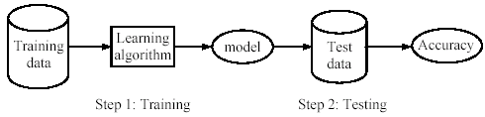
Models – supervised Learning
Learning (training): Learn a model using the training data
Testing: Test the model using unseen test data to assess the model accuracy

Slide 13
Models – supervised Learning
Data: credit card application data
Task: Predict whether a credit card application should be approved or not.
Performance measure: accuracy.
No learning: classify all future applications (test data) to the majority class (i.e., Yes):
Accuracy = 9/15 = 60%.
We can do better than 60% with learning.

Slide 14
Models – supervised Learning
Assumption: The distribution of training examples is identical to the distribution of test examples (including future unseen examples).
In practice, this assumption is often violated to certain degree.
Strong violations will clearly result in poor classification accuracy.
To achieve good accuracy on the test data, training examples must be sufficiently representative of the test data.

Slide 15
Models – supervised Learning Algorithms
Decision tree induction/classification
Random Forest (the average of the results from 100 random trees)
Naïve Bayesian classification (0 or 1 cases – binary cases)
Naïve Bayes for text classification
Support vector machines (binary cases)
K-nearest neighbor
Ensemble methods: Bagging and Boosting

Slide 16
Models
Supervised learning: discover patterns in the data that relate data attributes with a target (class) attribute.
These patterns are then utilized to predict the values of the target attribute in future data instances.
Unsupervised learning: The data have no target attribute.
We want to explore the data to find some intrinsic structures in them.

Slide 17
Models

Slide 18
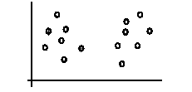
Models – unsupervised learning (clustering)

Slide 19
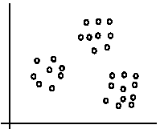
Models – unsupervised learning

Slide 20
Models – unsupervised learning MODELS
K-means algorithm
Representation of clusters
Hierarchical clustering

Slide 21
Models
Supervised learning
Classification (discrete), regression(continuous)
Unsupervised learning
clustering
Reinforcement learning
more general than supervised/unsupervised learning
learn from interaction w/ environment to achieve a goal

Slide 22
Models –rEINFORCEMENT LEARNING
Supervised learning
classification, regression
Unsupervised learning
clustering
Reinforcement learning
more general than supervised/unsupervised learning
learn from interaction w/ environment to achieve a goal
environment
reward
new state
action
agent

Slide 23
Models –rEINFORCEMENT LEARNING
 |  |  | +1
 |  |  | -1
START
actions: UP, DOWN, LEFT, RIGHT
70% move UP
10% move Down
10% move LEFT
10% move RIGHT
reward +1 at [4,3], -1 at [4,2]
reward -0.04 for each step
what’s the strategy to achieve max reward?
what if the actions were deterministic?

Slide 24
Models –rEINFORCEMENT LEARNING
pole-balancing: move car left/right to keep the pole balanced
no teacher who would say “good” or “bad”
is reward “10” good or bad?
rewards could be delayed
similar to control theory
more general, fewer constraints
explore the environment and learn from experience
not just blind search, try to be smart about it

Slide 26
Machine learning algorithms for topics
car or bicycle driving patterns (traffic management)
Resource re-allocation.
Human mobility patterns based on GPS data
Crowd flow
Crime Analysis for Chicago
Algorithm: Explainable AI (bonus: design a website / app system)
Weather prediction and its impact to human behavior
Maximize the energy efficiency to help the weather.
Mining the spread patterns of COVID-19
GPS/ sensor; combine spatio-temporal data into one model: IRL
Robotic deep inverse reinforcement learning
Smart and connected community
Supervised Learning
Unsupervised Learning
Reinforcement Learning

Slide 27
car or bicycle driving patterns (traffic management)
Resource re-allocation.
Outline
Dataset from Data.world
We want to design features that could be used to train the ML models to better allocate resources
(e.g., shared bikes).
Innovative parts: design features (date cleaning + data manipulation + data analysis ⬄ part of data science)
+ incorporate with the current ML algorithms.
Features:
over activity level in each place (defined what is a place – cells with longtitude / latitude)
Duration for a bike that has been parking in a spot.
Number of the bikes in that spot.
- Other features

