Slide 1
Sensor data

Slide 2
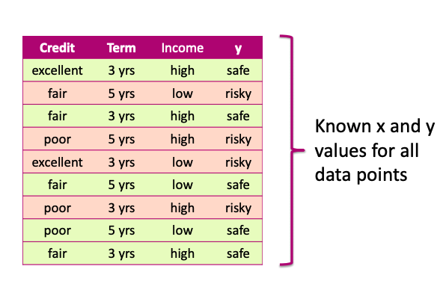
Data

Slide 3
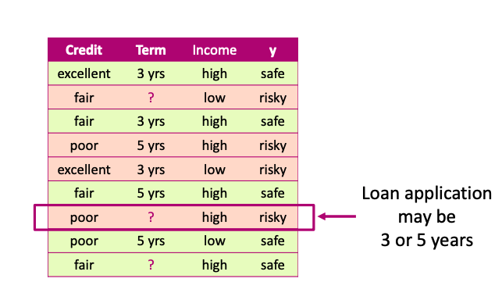
Missing values

Slide 4
Missing values Impact
Missing values impact training and prediction
Training data: “unknown” values
Prediction: input at prediction time with “unknown” values

Slide 5
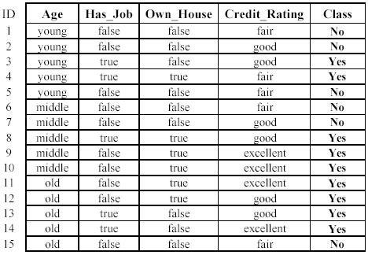
Missing values Impact
Training data: “unknown” values

Slide 6
Missing values Impact
Prediction: input at prediction time with “unknown” values

Slide 7
Handling missing values
Strategy 1: Purification by skipping

Slide 8
Purification by skipping / removing

Slide 9
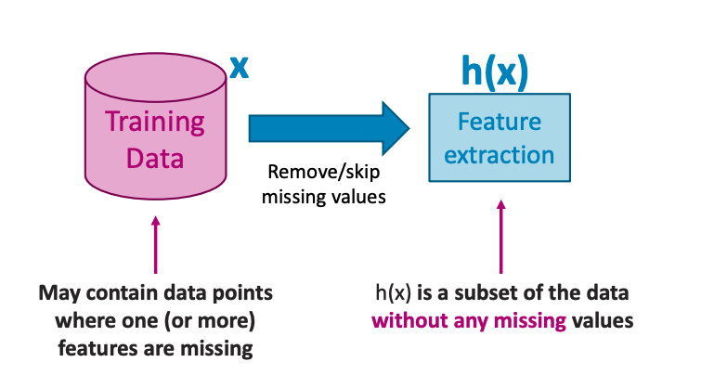
Purification by skipping / removing

Slide 10
The challenge with skipping / revoming

Slide 11
The challenge with skipping / revoming
Warning: more than 50% of the data are removed!

Slide 12
The challenge with skipping / removing
Idea 2: Skip features with many missing values

Slide 13
The challenge with skipping / removing
Idea 1: Skip data points where any feature contains a missing value
- make sure only a few points are skipped
Idea 2: Skip features with many missing values
- make sure only a few features are skipped

Slide 14
skipping / removing missing values: pros and cons
Pros:
East to understand and implement
Can be applied to any machine learning model
Cons:
Removing data points and features may remove important information
Unclear when it’s better to remove data points v.s. features
Doesn’t help if data is missing at prediction part.

Slide 15
Handling missing values
Strategy 2: Purification by imputing

Slide 16
Main drawback of skipping method
Data is precious.
Do not throw it away.

Slide 17
Can we keep all the data?
Use other data point in the column to “guess” the “missing part”.

Slide 18
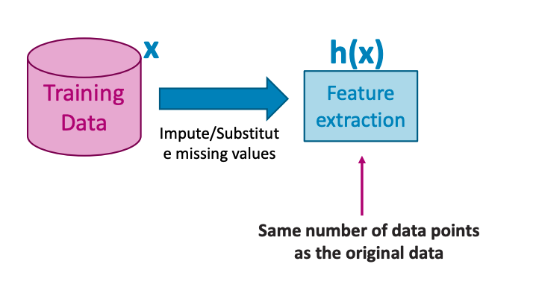
Idea: PURIFICATION BY IMPUTING

Slide 19
Idea: PURIFICATION BY IMPUTING
false
Fill in each missing value with a calculated guess
true
fair

Slide 20
Example: replace with the most common value
false
Fill in each missing value with a calculated guess

Slide 21
Common (simple) rules for imputing
Impute each feature with missing values:
Categorical features use mode: Most popular value (mode) of non-missing
Numerical features use average or median: Average or median value of non-missing

Slide 22
Missing value imputation: pros and cons
Pros
• Easy to understand and implement
• Can be applied to any model (decision trees, logistic regression, linear regression,…)
• Can be used at prediction time: use same imputation rules
Cons
• May result in systematic errors
Example: Feature “age” missing in all banks in Washington by state law

Slide 23
Handling missing values
Strategy 3: Adapt learning algorithm to be robust to missing values

Slide 24
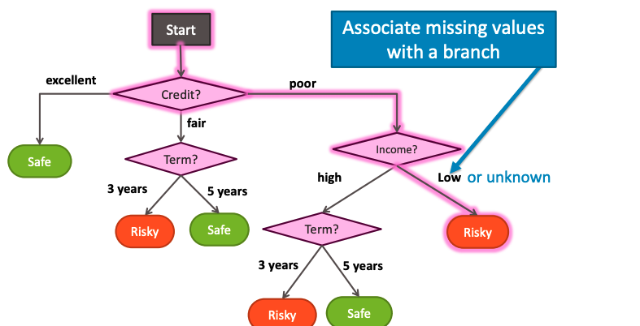
Handling missing data

Slide 25









Handling missing data
Every decision node includes choice of response to missing values

Slide 26
Feature split selection with missing data
Pros
• Addresses training and prediction time
• More accurate predictions
Cons
• Requires modification of learning algorithm
-Very simple for decision trees

Slide 27
Summary of handling missing values

Slide 28
What you can do now…
Describe common ways to handling missing data:
Skip all rows with any missing values
Skip features (columns) with many missing values
Impute missing values using other data points
Modify learning algorithm (decision trees) to handle missing data.

