Slide 1
Variables, Memory and Pointers

Slide 2

200

Slide 3
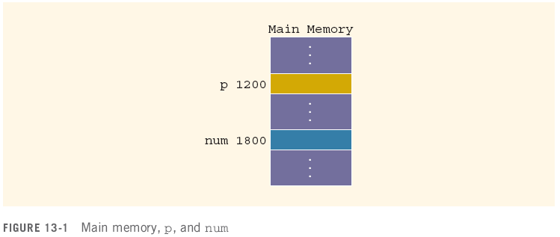
Variables, Memory and Pointers
A variable is a named piece of memory
The name stands in for the memory address
int num;//allocate memory to it first
num = 10;
10

Slide 4
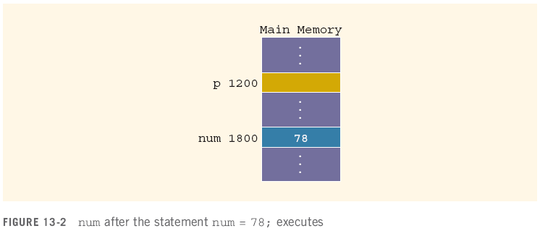
Variables, Memory and Pointers
When a value is assigned to a variable, it is stored at that address in memory
num = 78;

Slide 5
Variables, Memory and Pointers
A pointer is a variable that holds the address of another variable
It is declared in terms of the type of variable it points at:
int *p; // given a * in front of a variable, it means that this variable is a pointer.
int num; num = 78;

Slide 6
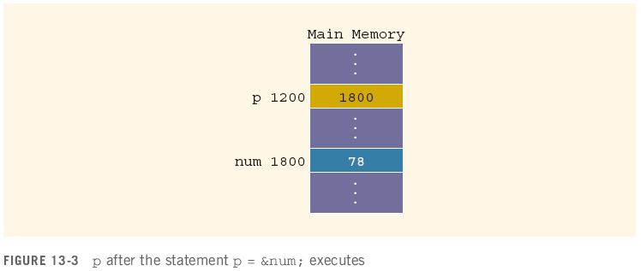
Variables, Memory and Pointers
The operator & returns the address of a variable
It can then be assigned to a pointer
p = &num;
// &num => the address of the variable num ⬄ 1800
// assign the address of num to the value of p.
&num
p

Slide 7
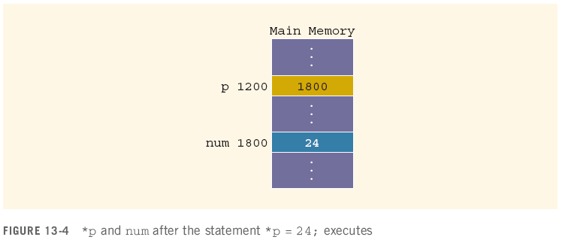
Variables, Memory and Pointers
The operator * takes an address (a pointer) and returns the location in memory being pointed to
Can only be applied to a pointer
*p = 24;
int *q; // define a pointer;
*q = 30; // assign 30 to the variable that the pointer pointed to.

Slide 8
Declaring Pointer Variables
Syntax:
Examples:
int *p; // this pointer will point to an integer variable
char *ch; // a pointer, ch, points to a character variable
These statements are equivalent:
int *p;
int* p;
int * p;

Slide 9
Declaring Pointer Variables (continued)
In the statement:
int* p, q; // p is a pointer; q is variable
int num1, num2; ⬄ int num1; int num2;
only p is the pointer variable, not q; here q is an int variable
To avoid confusion, attach the character * to the variable name:
int *p, q;
int *p, *q;
int array1[100], array2[20];

Slide 10
Address of Operator (&)
The ampersand, &, is called the address of operator
The address of operator is a unary operator that returns the address of its operand
Binary operator
LHS = RHS, cout << “hello”, cin >> a, +, -, *, /, %
Unary operator
Only need one side
&RHS; &a

Slide 11




Dereferencing Operator (*)
When used as a unary operator, * is the dereferencing operator or indirection operator
Refers to object to which its operand points
Example:
To print the value of x, using p:
To store a value in x, using p:
Variable name | address | value
x | 153 | 25
p (pointer) | 1008

Slide 12
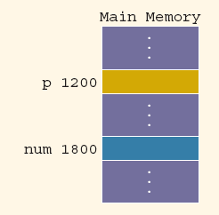

Exercise
Assuming the memory layout provided, after this code executes:
int num; // declare an integer variable
int *p; // declare a pointer named: p
num = 50; // assign 50 to variable num
p = &num;
*p = 38;
num = 38;
cout << p; // 1800
cout << *p;
// variable num; *p the value of this variable: 38
What are the values of these expressions?
&num // 1800;
num // num: value of this one ⬄ 38
&p // 1200
p // 1800
*p // 38

Slide 13




Assigning Pointers
Pointers can be assigned to pointers of the same type
int x, *p, *q; // variable x, two pointers: p, q
x = 50;
p = &x;
q = p; // q is a pointer; assign the value of p to the value of q ⬄ both pointers p and q are assigned to variable x.
The value of *q is?
*q: the value that the pointer q pointed to
So *q is 50
Variable name | address | value
x | 153 | 50
p (pointer) | 1008
q (pointer) | 17

Slide 14
Assigning Pointers
Pointers can be assigned to pointers of the same type
int x, *p, *q;
x = 50;
p = &x;
q = p;
The value of *q is 50

Slide 15
The Null Pointer
In addition to variable addresses and other pointers, a pointer can be assigned to the null pointer
Either the number 0 or the constant NULL
Used to indicate an invalid pointer (pointing to nothing)
Dereferencing a null pointer causes a hard error
int *p = 0;
p = NULL;
*p //dereferencing
int num, *q;
q = &num;

Slide 16



Comparing Pointers
Be careful of the difference between comparing two pointers and comparing their values:
int x = 50, y = 50, *p, *q;
p = &x; // assign the pointer p to the variable x
q = &y;
*q == *p evaluates to?
q == p evaluates to?

Slide 17
Comparing Pointers
Be careful of the difference between comparing two pointers and comparing their values:
int x = 50, y = 50, *p, *q;
p = &x;
q = &y;
*q == *p evaluates to true
q == p evaluates to false

Slide 18

Pointers and Arrays
int a[20] = {1,2,3,4};
int *p; // declare a pointer named p
p = a; // the reference/address of the index 0.
cout << a[0] << endl; // a[0]: the value of the 1st element: 1
cout << a[1] << endl; // a[1]: the value of the 2nd element: 2
cout << p[2] << endl; // 2 p points to element with index 0: p[2] ⬄ *(p + 2)
cout << p[3] << endl; // 4
cout << *p << endl; //
cout << *(p+2) << endl;
cout << *(p+3) << endl;
cout << p << endl;
int num = 78;
int *p;
p = &num;
// variable pass by values;
2000 | 2004 | 2008 | 2012
Array: a | value | 1 | 2 | 3 | 4
 | index | 0 | 1 | 2 | 3 | 4 | 5 | 6 | …
pointer p
Address of p: 1000 | Value of p: 2000
p
P[2] ⬄ *(p+2)
P[3] ⬄ *(p+3)

Slide 19

Pointers and Class
Class | Names
 | Public variables:
 | string | first_name
 | string | last_name | b
 | int | salary[10] | c
class Names{
public:
string first_name;
string last_name;
int salary[10];
};
value
index | 0 | 1 | .. | … | .. | 9

Slide 20
Pointers and Class
object | n1
 | first_name | mary
 | last_name | smith | b
 | int | salary[10] | c
class Names{
public:
string first_name;
string last_name;
int salary[10];
};
value | 100 | 90 | 85
index | 0 | 1 | .. | … | .. | 9

Slide 21
Pointers and Class
A x; x.a = '7';
x.b = 'b';
x.c = 'a’;
A *p; // declare a pointer named p with the type A. p = &x; (*p).a = '8’;
(*p).b = 'b';
p->b = 'a’; p->r[6] = 5;
cout << x.r[6] << endl;
int num;
num = 78;
p = &num;
A y;
y.a = ‘9’;
y.b = ‘b’;

Slide 22

Pointers and Class
A x; x.a = '7';
x.b = 'b';
x.c = 'a’;
A *p;
p = &x; (*p).a = '8’;
(*p).b = 'b';
p->b = 'a’; ⬄ (*p).b = ‘a’
cout << p << endl;
p -> a = ‘t’;
p -> c = ‘n’;
p -> r[0] = 10; p->r[6] = 5;
cout << x.r[6] << endl;
cout << p->r[6] << endl;
Object | x | With address | With address | 21
 | Public variables:
 |  |  | char | a = ‘7’
 |  |  | char | b = ‘a’
 |  |  | char | c = ‘a’
 |  |  | int | r[7]
value | 10 |  |  |  |  | 5
index | 0 | 1 | .. | … | .. | 6
Pointer p
Address | value
100000 | 21

Slide 23


Pointers and Classes
A pointer to a class object is no different than a pointer to any other type of variable
Given:
class Names{
public:
string first_name;
string last_name;
int salary[10];
};
Names n[31];
n[0].first_name = “mary”;
n[0].last_name = “smith”;
n[0].salary[0] = 100;
n | index | 0 | 1 | 2 |  | 30
 | values
string | title
first_name | mary
last_name | smith
salary[10]
string | title
index | 0 | 2 | 9
value | 100
index | 0 | …… | 9
value

Slide 24

Pointers and Classes
A pointer to a class object is no different than a pointer to any other type of variable
Given:
class album
{
public:
string title;
string artist;
int tracks;
double price;
int nums[10];
};
album stock[100];
album *pick;
album stock | index | 0 | 1 | 2 |  | 99
 | name | Obj_array[0] | stock[1] | stock[2]
string | title
string | artist
int | tracks
double | Price
int | r[7]
string | title
string | artist
int | tracks
double | Price
int | nums[10]
index | 0 | 2 | 9
value | 200
index | 0 | …… | 9
value

Slide 25
Pointers and Classes
A particular album can be selected by assignment:
pick = stock; // album a, *p; p = &a;
pick = pick + 49; // pick + 49 ⬄ stock[49]
or
pick = &(stock[49]);
The members of that album are accessed by a combination of dereference (*) and membership (.):
(*pick).title = “Listener Supported”;
There is also a syntactic shortcut:
pick->title = “Listener Supported”;
// pick is a pointer
// point to an object
// one element of the object is title

Slide 26
Pointers and Functions
Pointers, like any variable, can be used as parameters and return values
void some_function( int x, album * p );
album * some_other_function( double y );
They are passed by value by default
Involves copying the value (an address) into a local variable
Changes to a local copy do not change the pointer
But, changes to the memory the pointer points at are not limited to local variables!
void some_function( int x, album * p )
{
p->artist = “The Black Crowes”; // non-local change
p = NULL; // local change!
}

Slide 27
Dynamic Memory Allocation
All the variables we have dealt with so far have been stack variables
Allocated by the compiler before the program is run
Pre-determined size, even arrays
Pointers give us a mechanism for dynamically allocating memory on demand
Allocated as needed at run-time (during execution)
Size determined at time of allocation
De-allocated when no longer useful

Slide 28
Operator new
Declaring a pointer only allocates memory for the pointer address, not the data
album *p;
album->tracks = 4; // error, write to some random address (segmentation fault)
The new operator allocates memory for a specified type of variable and returns the address
p = new album();
p->tracks = 4; // write to newly allocated memory
This memory is not named like the parameters and variables we’ve been using
That pointer is the only way to refer to it

Slide 29
Operator new
new can also be used to dynamically allocate memory space for arrays
int *p;
int ct;
cout << “how many albums?: ”;
cin >> ct;
p = new album[ct];
Calls the default constructor on each object in the array (no way to pass in parameters)

Slide 30
Pointers and Arrays
An array is a contiguous block of memory, divided into some number of equal sized elements
An array variable is really just a constant pointer to the first element in that block
A pointer can be assigned the value of an array variable
Given:
int a[20];
int *p;
p = a;
a[0] , p[0] and *p all refer to the first element in the array, expected to be 4 bytes long (the size of an int)
a[1], p[1] both refer to the second element in the array, starting 4 bytes after the first element

Slide 31
Operator delete
Dynamic memory allocation runs the risk of running out of memory during program execution
If new cannot allocate the requested piece of memory, it fails and terminates the program
To avoid this, programs need to de-allocate dynamic memory when they are done with it
This is done with the operator delete, called on a pointer to a dynamically allocated piece of memory
int *p, *q;
q = new int;
p = new int[x];
delete q;
delete [] p;

Slide 32
Memory Leaks
If a pointer to dynamically allocated memory is moved, that memory location cannot be found again
int *p;
p = new int[1024];
p = new int[518];
p = new int[20435];
p = 0;
This means it cannot be deleted, and is lost to the program
This is referred to as a memory leak
If a leak occurs in a repeating part of the program, then no matter how small it is the program will eventually run out of memory
This matters a lot in server programs that run for months or years

