Slide 1
Sensor data

Slide 2
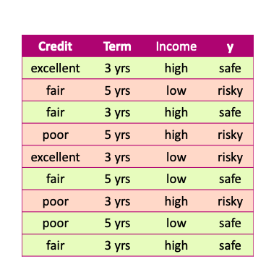
Data
x and y values are known

Slide 3
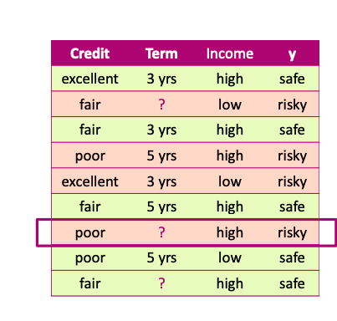
Missing values
Unknown values

Slide 4
Missing values Impact
Missing values impact both training and prediction
Training data: unknown values
Prediction: input for prediction has unknown values

Slide 5
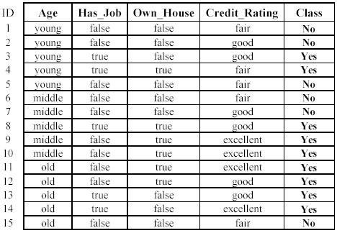
Missing values Impact
Training data: “unknown” values

Slide 6
Missing values Impact
Prediction: input at prediction time with “unknown” values

Slide 7
Handling missing values
Strategy 1: Purification by skipping

Slide 8
Purification by skipping / removing

Slide 9
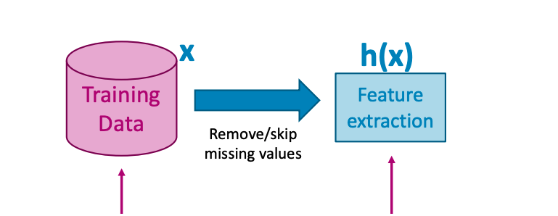
Purification by skipping / removing
Original data with missing values
Data without any missing values

Slide 10
The challenge with skipping / revoming

Slide 11
The challenge with skipping / revoming
Warning: more than 50% of the data are removed!

Slide 12
The challenge with skipping / removing
Idea 2: Skip features with many missing values

Slide 13
The challenge with skipping / removing
Strategy 1: Skip data points with a missing value
- make sure only a few points are skipped
Strategy 2: Skip features with many missing values
- make sure only a few features are skipped

Slide 14
skipping / removing missing values: pros and cons
Pros:
Easy to understand and implement
Applied to all machine learning model
Cons:
Removing data points and features may take off some important information
Unclear when it’s better to remove data points or features
Doesn’t help if data is missing at prediction part

Slide 15
Handling missing values
Strategy 2: Purification by imputing

Slide 16
Main drawback of skipping method
Data is precious.
Do not throw it away.

Slide 17
Can we keep all the data?
Use other data point in the column to “guess” the “missing part”.

Slide 18
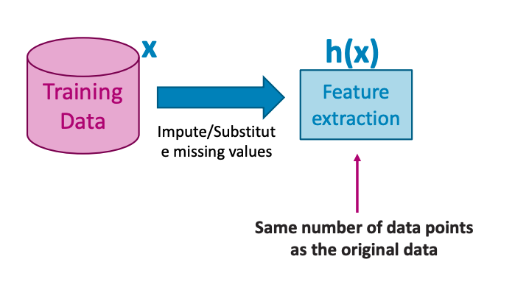
Idea: PURIFICATION BY IMPUTING
Original data with missing values
Same number of data points

Slide 19
Idea: PURIFICATION BY IMPUTING
false
Fill in each missing value with a calculated guess
true
fair

Slide 20
Example: replace with the most common value
false
Fill in each missing value with a calculated guess

Slide 21
Common (simple) rules for imputing
Impute each feature with missing values:
Categorical features: Most popular value of non-missing
Numerical features: Average or median value of non-missing

Slide 22
Missing value imputation: pros and cons
Pros
• Easy to understand and implement
• works for all machine learning models
(logistic regression, decision trees, …)
• works for missing values in the prediction part
use the same imputation rules
Cons
• May have systematic errors
Example: a feature is missing in the entire dataset in one place but is not missing in another dataset.

Slide 23
Handling missing values
Strategy 3: Adapt learning algorithm to be robust to missing values

Slide 24
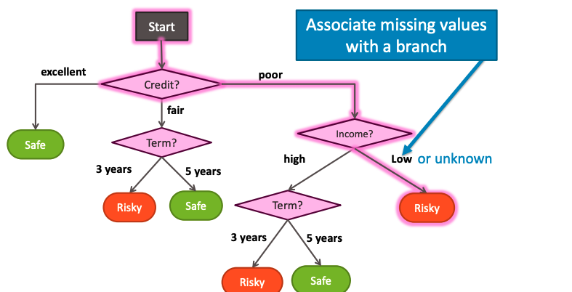
Handling missing data

Slide 25
Handling missing data
Every decision node includes choice of response to missing values

Slide 26
Feature split selection with missing data
Pros
• works in both training and prediction parts
• More accurate predictions
Cons
• modify learning algorithms
(simple for decision trees)

Slide 27
Summary of handling missing values

Slide 28
What you can do now…
Describe common ways to handling missing data:
Skip all data points (rows) with any missing values
Skip features (columns) with many missing values
Impute missing values
Modify learning algorithm (decision trees)

Slide 29
Data Preprocessing
Data Cleaning (missing values)
Data Preprocessing: An Overview
Data Quality
Major Tasks in Data Preprocessing
Data Integration
Data Reduction (PCA)

Slide 30
Data Quality: Why Preprocess the Data?
Measures for data quality: A multidimensional view
Accuracy
Completeness
Consistency
Timeliness
Believability
Interpretability

Slide 31
Major Tasks in Data Preprocessing
Data cleaning
Fill in missing values, smooth noisy data, identify or remove outliers, and resolve inconsistencies
Data integration (data engineer)
Integration of multiple databases (sql), data cubes, or files
Data reduction
Dimensionality reduction
Numerosity reduction
Data compression

Slide 32
Noisy Data
Noise: random error or variance
Incorrect attribute values may be due to
data collection instrument failures
data transmission problems
technology limitations
Other data problems which require data cleaning
Duplicate, incomplete, inconsistent
Notes:
32

Slide 33
How to Handle Noisy Data?
Binning
Regression – supervised learning
Clustering (unsupervised learning)
Combined computer and human inspection

Slide 34
How to Handle Noisy Data?
Binning (numerical – data engineer)
first sort data
partition sorted data into (equal-frequency) bins
smooth by bin means, median, or boundaries (e.g, clean jitters)

Slide 35
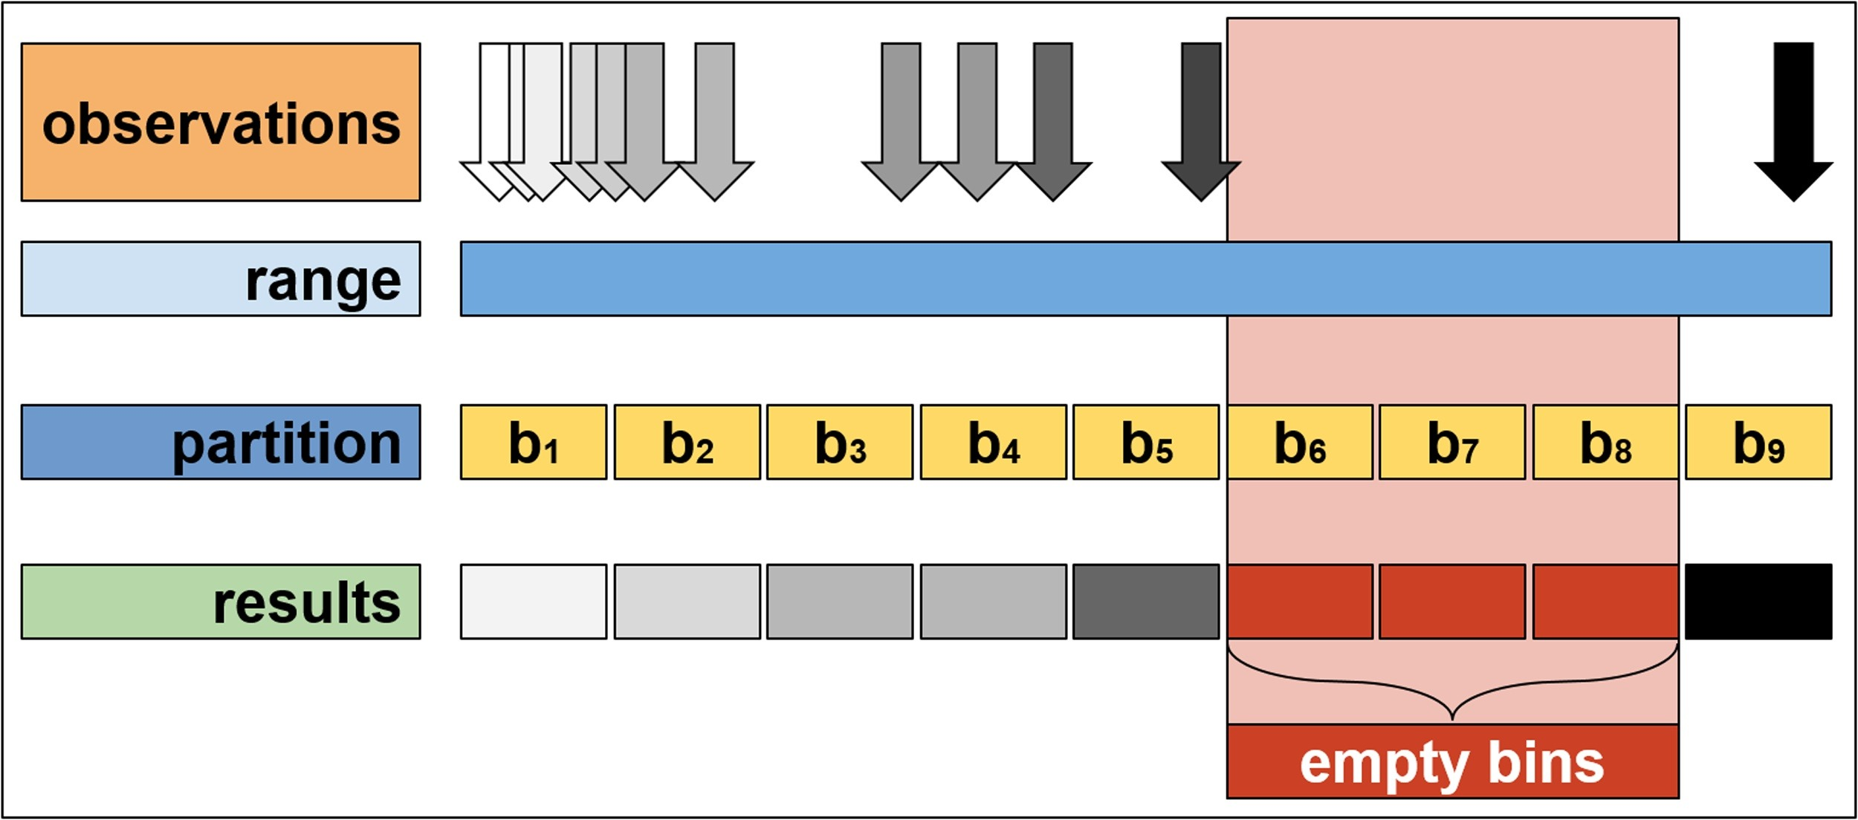
How to Handle Noisy Data?

Slide 36
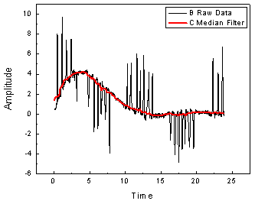
How to Handle Noisy Data?
Regression
smooth by fitting the data into regression functions

Slide 37
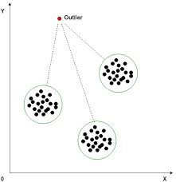
How to Handle Noisy Data?
Clustering (unsupervised learning)
detect and remove outliers

Slide 38
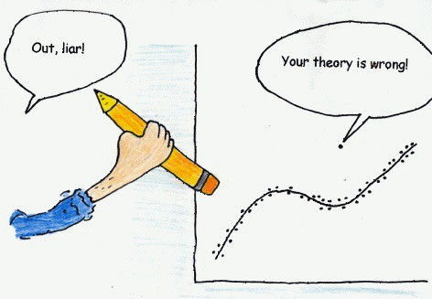
How to Handle Noisy Data?
Combined computer and human inspection
(human in the loop ⬄ combine domain experts’ perspectives)
detect suspicious values and check by human (e.g., deal with possible outliers)

