Slide 1
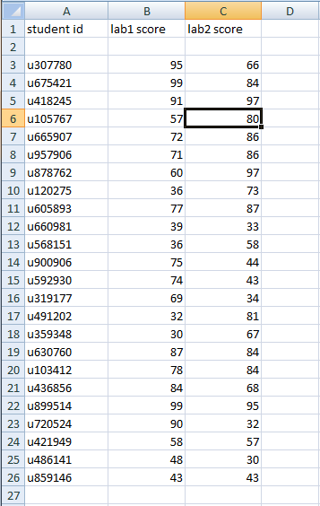
Using Arrays in Parallel
Data is often organized along more than one dimension
This is why spreadsheets are so useful
Rows represent entities
Columns represent information
How would you represent this data in a C++ program?
0 | 1 | 2 | 3 | 4
Ed | John | Peter | Mary | Pedro
99 | 100 | 100 | 100 | 98
name_array[1] ⬄ John
lab1[1] <=> the grade of lab 1 for John

Slide 2
Using Arrays in Parallel
Data is often organized along more than one dimension
This is why spreadsheets are so useful
Rows represent entities
Columns represent information
How would you represent this data in a C++ program?
A 2-dimensional array
Limited to one data type (int)
3 arrays used in parallel
Can have different column types

Slide 3
Using Arrays in Parallel
Declare three arrays of the same length
string id[24];
int lab1[24];
int lab2[24];
The values for a row are found at the same position/index in the three arrays
Row 10 ID: id[9]
Row 10 lab1 score: lab1[9]
Row 10 lab2 score: lab2[9]

Slide 4
Example: employee data
For each employee, we have:
Name
Position
Review score
For example, in our text file:
peter manager 86
michael developer 68
samir developer 75
lumbergh vp 82
Declare variables to hold/store the data
Read from the file into the variables
Print out the data

