Slide 1
Control Structures
A program can proceed:
Sequentially
Selectively (branch) - making a choice
Repetitively (iteratively) - looping

Slide 2
Conditional Execution
if is a reserved word
The most basic syntax for if:
if( condition )
statement
The statement is executed if the condition evaluates to true
The statement is bypassed if the condition evaluates to false

Slide 3
bool Data Type and Conditions
A condition can be a bool variable
The data type bool has logical (Boolean) values true and false
bool, true, and false are reserved words
The identifier true has the value 1
The identifier false has the value 0

Slide 4
int Data Type and Conditions
Earlier versions of C++ did not provide built-in data types that had Boolean values
Logical expressions evaluate to either 1 or 0
The value of a logical expression was stored in a variable of the data type int
You can use the int data type as a condition

Slide 5
Logical Expressions
General syntax for if:
if( logical-expression )
statement
A logical expression is any expression that evaluates to true or false
A literal (anything but 0 is true)
A variable (any built-in type)
A function (should return bool or int)
Any expression that evaluates to bool or int

Slide 6
Logical Expressions
Arithmetic expressions
Built with arithmetic operators
Evaluate to numbers (integer or floating-point)
3 + 5
(7 / 2) * 4.0
Logical expressions
Built with relational operators
Evaluate to true or false
3 == 3
“hello” < “goodbye”

Slide 7
Relational Operators

Slide 8
Comparing Numbers
Integer and floating-point types can be compared
8 < 15 evaluates to true
6 != 6 evaluates to false
2.5 > 5.8 evaluates to false
5.9 <= 7 evaluates to true

Slide 9
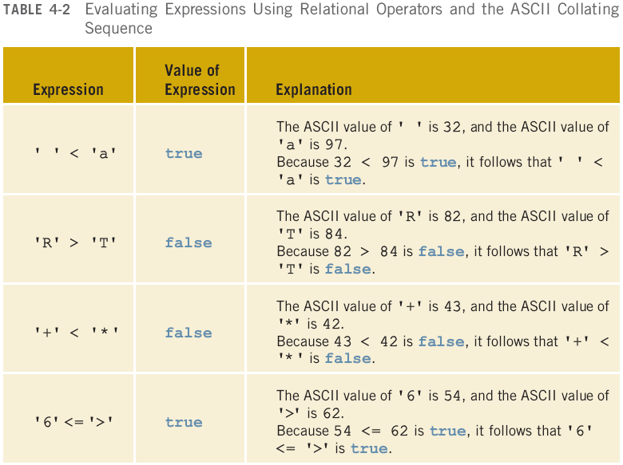
Comparing Characters

Slide 10
Comparing strings
Relational operators can be applied to strings
Strings are compared character by character, starting with the first character
Comparison continues until either a mismatch is found or all characters are found equal
If two strings of different lengths are compared and the comparison is equal to the last character of the shorter string
The shorter string is less than the larger string
Note: this does not work for comparing 2 string literals!

Slide 11
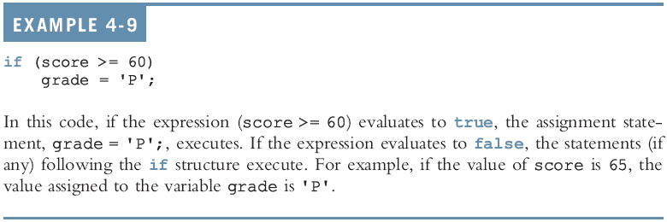
Examples

Slide 13
Common Syntax Errors

Slide 14
Two-way Conditional Execution
if can be paired with else
if( logical-expression )
statement1
else
statement2
If the condition is true, statement1 is executed
If the condition is false, statement2 is executed

Slide 15
One-Way Selection

Slide 16
Two-Way Selection

Slide 17
Example

Slide 18
Common Syntax Errors

Slide 19
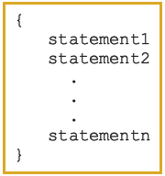
Block Statements
A block (or compound) statement looks like:
A block can be used anywhere a statement can be used

Slide 20
Conditional Block Statements
if (age > 18)
cout << "No longer a minor." << endl;
else
cout << "Still a minor." << endl;

Slide 21
Conditional Block Statements
if (age > 18)
{
cout << "No longer a minor." << endl;
}
else
{
cout << "Still a minor." << endl;
}

Slide 22
Conditional Block Statements
if (age > 18)
{
cout << "No longer a minor." << endl;
cout << "Eligible to vote." << endl;
}
else
{
cout << "Still a minor." << endl;
cout << "Not eligible to vote." << endl;
}

Slide 23
More Than 2 Choices
Series of if statements:
if( logical-expression1 )
{
statement1
}
if( logical-expression2 )
{
statement2
}
if( logical-expression3 )
{
statement3
}
Checks all three conditions
Can’t have a default else condition
Used for statements that are not mutually exclusive

Slide 24
More Than 2 Choices
For mutually exclusive conditions, use an if…else tree
Stops when a condition is true
Can have a default else condition
if( logical-expression1 )
{
statement1
}
else if( logical-expression2 )
{
statement2
}
else if( logical-expression3 )
{
statement3
}
else
{
statement4
}

Slide 25
Example: Date Conversion
Input
Date in the form yyyy-mm-dd
(e.g. 2009-09-24)
Output
Date in the form month day, year
(e.g. September 24, 2009)

Slide 26
Example: Large Joe’s
Write a simple fast food drive-through ordering program for Large Joe’s restaurant. The menu is:
Triple Burger: $4.99
Fried Chicken $6.99
French Fries $2.29
Sample run (user input in bold):
== Welcome to Large Joe's, can I take your order? ==
For a triple burger, press 1
For a heap of fried chicken, press 2
Your order: 1
Would you like fries with that? (y/n): y
Your total is $7.28, please drive through.

Slide 27
Example: Large Joe’s
Large Joe’s now has bacon!
Adding bacon to your burger costs $0.99
Modify the program so that if the customer orders a burger, the program asks them:
Would you like bacon on your burger? (y/n): y
If they answer yes, add the cost to their order
Don’t ask about bacon if they didn’t order a burger!

Slide 28
A Repetitive Task
Get six numbers from the user
Add them all together
Print the result to the screen
Requires:
Six variables to hold input (e.g. num1, num2, num3, etc.)
Six input statements
Repetitive and inefficient
Worse, what if it was 1000 numbers (perhaps from a file rather than from a user)?

Slide 29
Repetitive Execution
A better solution:
Tell the computer to iterate, to do the same thing six times
Get a number from the user
Add it to a running total
Then print the result
Requires:
Two variables (input and total)
One input statement for each iteration
Pretty much any real program involves iteration

Slide 30
Conditional Execution
if…else is used to control conditional execution
if( condition )
{
// do some stuff only if condition is true
}
Conditional execution happens 0 or 1 time
Condition is a logical expression
Evaluates to true (1) or false (0)
Can be a literal, a variable, a function or an expression

Slide 31
Iterative Execution
while used to control iterative execution (looping)
while( condition )
{
// do some stuff repeatedly as long
// as condition is true
}
Iterative execution happens 0 or more times
Condition is a logical expression
Evaluates to true (1) or false (0)
Can be a literal, a variable, a function or an expression

Slide 32
while Looping (Repetition) Structure
Infinite loop: continues to execute endlessly
Avoided by including statements in loop body that assure exit condition is eventually false

Slide 33
Elements of an Iterative Statement
There are three key parts to an iterative statement:
Initialization (before the loop)
What are the values of variables set to before the loop starts?
Condition (the while condition)
When does the loop quit?
Update (in the body of the loop)
How are those values changed in the loop?

Slide 34
Example Case: Counter Loop
Use a while loop to do something a predetermined number of times
Initialization (before the loop)
Declare a variable to use as a counter
Assign it the value to start counting at
Condition (the while condition)
Check to see if the counter value has reached the target count
If it has, quit the loop
Update (in the body of the loop)
Increment or decrement the counter value
Do the other repetitive tasks as well
Steps 2 and 3 repeat

Slide 35
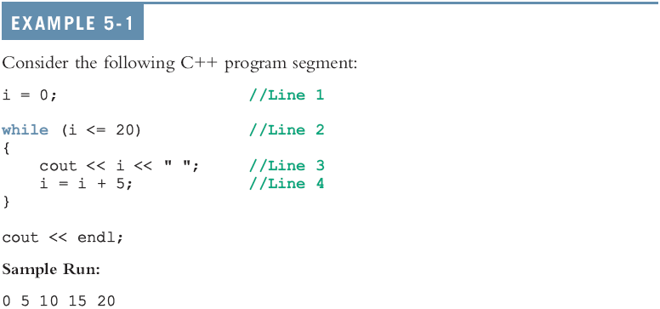
while Looping (Repetition) Structure (continued)

Slide 36
The Rest of the Loop
The body of a counter loop must update the counter
But it also does whatever repetitive tasks you are trying to accomplish
Update other variables
Get input
Print output
Etc…

Slide 37
Exercise
int i = 0, j = 0;
while( i < 5 )
{
j = j + 10;
i++;
}
Initialization:
Both i and j are set to 0 before the loop
Update:
Both i and j are assigned new values in the body of the loop
Condition:
The loop stops based on the value of i

Slide 38
Exercise
What are the values of i, j at the beginning of each iteration of this loop?
int i = 0, j = 0;
while( i < 5 )
{
j = j + 10;
i++;
}
Iteration | i | j
first
second
third
…

Slide 39
Exercise
Write the output of the following loops:
a: int i = 0;
while ( i < 5 )
{
cout << i << “ ”;
cout << endl;
i++;
}
b: int i = 0;
while ( i < 5 )
{
i++;
cout << i << “ ”;
}
cout << endl;

Slide 40
Example Case: Input Condition
Use a while loop to do something until input (user, file, etc) tells us to stop
Initialization (before the loop)
Declare a variable to hold the user input
Assign it an initial value
Condition (the while condition)
Check to see if the input variable matches the target value
If it does, quit the loop
Update (in the body of the loop)
Get new input
Steps 2 and 3 repeat

Slide 41
Exercise
Write a while loop that:
Asks the user to enter a number
If the number is -99 it quits
Otherwise, adds that number to a running total
And repeat
Initialization
Variables to hold user input and the accumulated total
Initial values?
Condition
Is the latest input equal to -99?
Update
Add the last number to the total
Get the next user input

Slide 42
Combining Conditions
A loop may depend on multiple conditions, just like with if…else
Can use a complex logical statement (using &&, ||)
Can also use an intermediate boolean flag variable

Slide 43
Example Case: Flag Variable
Use a while loop to do something until a certain boolean variable becomes false
Initialization (before the loop)
Declare a boolean flag variable
Assign it an initial value of true
Condition (the while condition)
Check to see if the flag is true
If it is not, quit the loop
Update (in the body of the loop)
Do the repetitive tasks
Something in the body must potentially set the flag to false, otherwise the loop will never end
Steps 2 and 3 repeat

Slide 44
do…while Loop
while loop executes 0 or more times
do…while loop executes 1 or more times
do
{
// do some stuff then repeat
// as long as condition is true
}
while( condition )

Slide 45
while vs. do…while Loop

