Slide 1
Classification

Slide 2
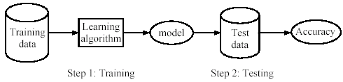
Supervised learning process: two steps
Learning (training): learn a model via the training data
Testing: test the model via test data and evaluate the model accuracy

Slide 3
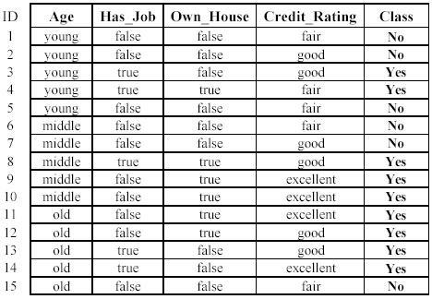

A decision tree from the loan data

Slide 4
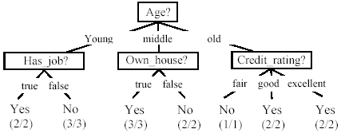
A decision tree from the loan data
Decision nodes and leaf nodes (classes)

Slide 5





Use the decision tree

Slide 6







Another example
Test Data
Home Owner
Yes
No
NO
MarSt
Single, Divorced
Married
Income
NO
< 80K
> 80K
NO
YES

Slide 7
Decision Tree Induction
Many Algorithms:
Hunt’s Algorithm (one of the earliest)
CART
ID3, C4.5
SLIQ,SPRINT

Slide 8
General Structure of Hunt’s Algorithm
Let D_{t} be the set of training records that reach a node t
General Procedure:
If D_{t} contains records that belong the same class y_{t}, then t is a leaf node labeled as y_{t}
If D_{t} contains records that belong to more than one class, use an attribute test to split the data into smaller subsets. Recursively apply the procedure to each subset.
D_{t}
?

Slide 9
Design Issues of Decision Tree Induction
How should training records be split?
Method for expressing test condition
depending on attribute types
Measure for evaluating the goodness of a test condition
How should the splitting procedure stop?
Stop splitting if all the records belong to the same class or have identical attribute values
Early termination

Slide 10
Methods for Expressing Test Conditions
Depends on attribute types
Binary
Nominal
Ordinal
Continuous

Slide 11

Test Condition for Nominal Attributes
Multi-way split:
Use as many partitions as distinct values.
Binary split:
Divides values into two subsets

Slide 12
Test Condition for Ordinal Attributes
Multi-way split:
Use as many partitions as distinct values
Binary split:
Divides values into two subsets
Preserve order property among attribute values
This grouping violates order property

Slide 13
Test Condition for Continuous Attributes

Slide 14
Splitting Based on Continuous Attributes
Different ways of handling
Discretization to form an ordinal categorical attribute
Ranges can be found by equal interval bucketing, equal frequency bucketing (percentiles), or clustering.
Static – discretize once at the beginning
Dynamic – repeat at each node
Binary Decision: (A < v) or (A ≥ v)
consider all possible splits and finds the best cut
can be more compute intensive

Slide 15
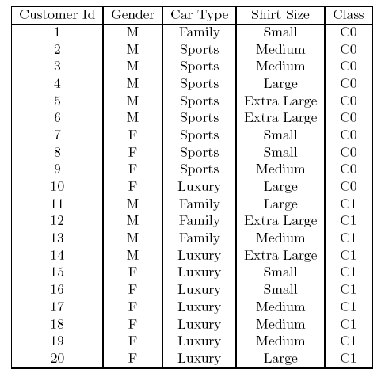

How to determine the Best Split
Before Splitting: 10 records of class 0 (c0), 10 records of class 1 (c1)
What are the values of the label for this data? How many cases / records for each label.
Learn the type of each attribute / feature, their values.
Which test condition is the best?

Slide 16


How to determine the Best Split
Greedy approach:
Nodes with purer class distribution are preferred
Need a measure of node impurity:
How to define what is purer or not
High degree of impurity
Low degree of impurity

Slide 17
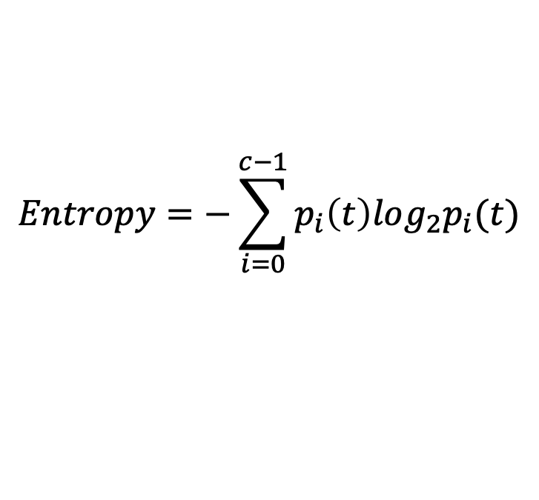
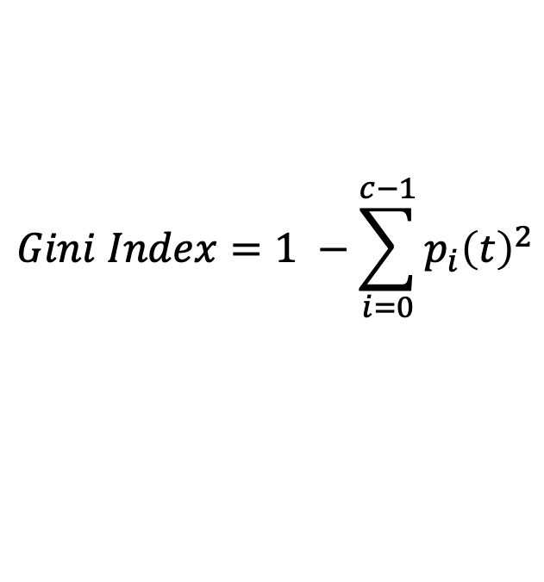
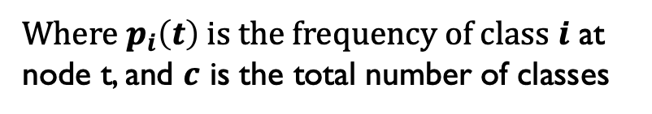
Measures of Node Impurity
Gini Index
Entropy
Misclassification error (confusing matrix for decision tree)
$$Gini Index=1 −\sum_{i=0}^{c−1}{p_{i}{\left(t\right)}^{2}}$$
Where $p_{i}\left(t\right)$ is the frequency of class $i$ at node t, and $c$ is the total number of classes
$$Entropy=−\sum_{i=0}^{c−1}{p_{i}\left(t\right)log_{2}p_{i}(t)}$$
$$Classification error={1 −max⁡[p}_{i}(t)]$$

Slide 18
Finding the Best Split
Compute impurity measure (P) before splitting
Compute impurity measure (M) after splitting
Compute impurity measure of each child node
M is the weighted impurity of child nodes
Choose the attribute test condition that produces the highest gain
Gain = P - M or equivalently, lowest impurity measure after splitting (M)

Slide 19
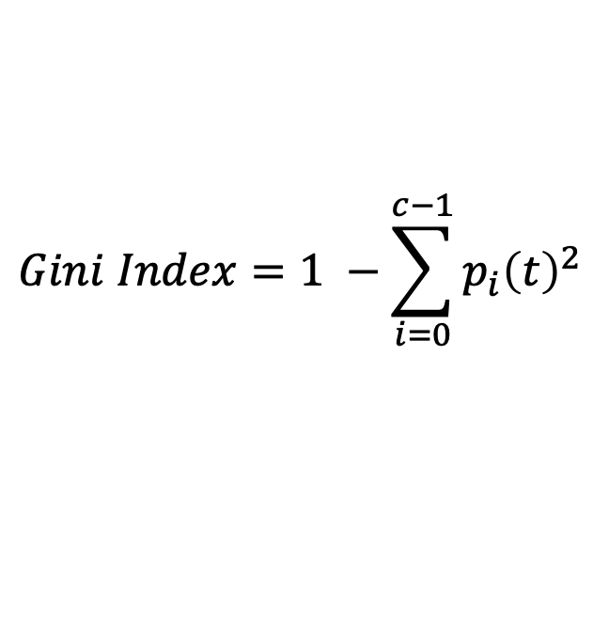

Gini Index
What is Gini Index?
Gini index or Gini impurity measures the degree or probability of a particular variable being wrongly classified when it is randomly chosen.
But what is actually meant by ‘impurity’?
If all the elements belong to a single class, then it can be called pure.
The degree of Gini index varies between 0 and 1, 0: all elements belong to a certain class or if there exists only one class, and 1: the elements are randomly distributed across various classes.
A Gini Index of 0.5 denotes equally distributed elements into some classes.
$$Gini Index=1 −\sum_{i=0}^{c−1}{p_{i}{\left(t\right)}^{2}}$$

Slide 20
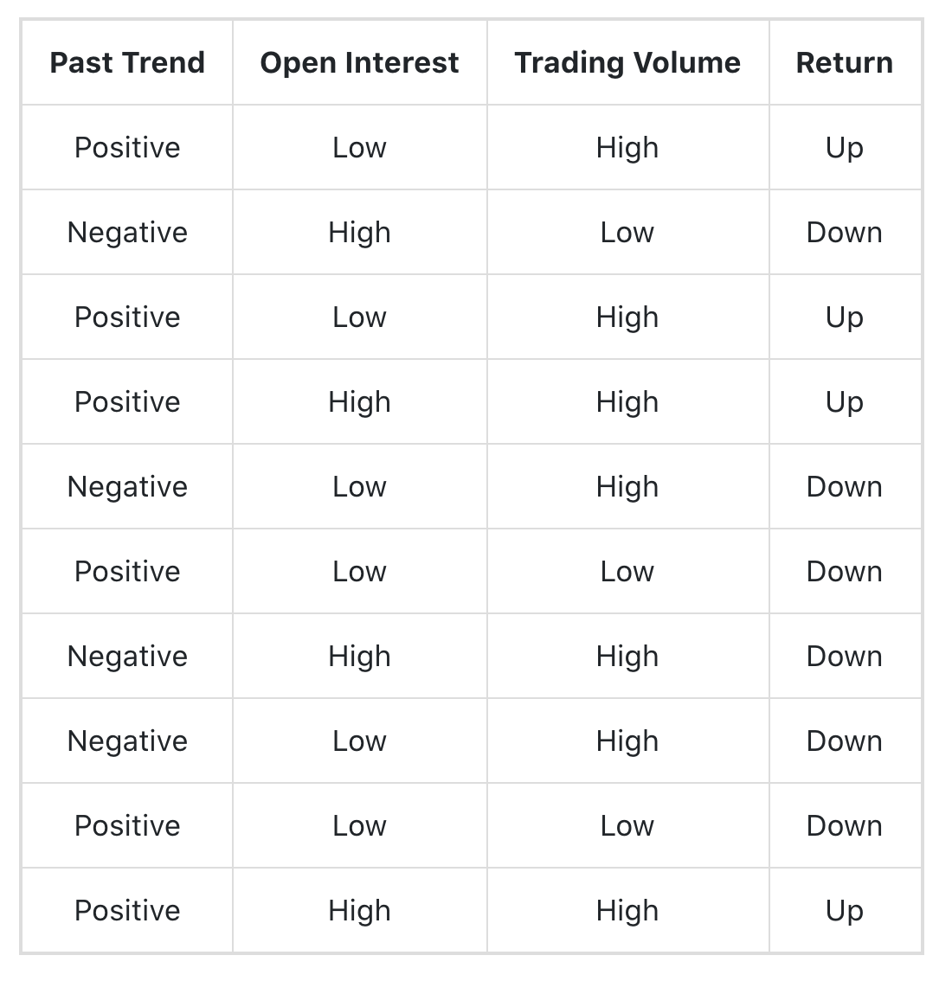
Example of Gini Index
$$\# of positive cases in attribute past trend$$
P(Past Trend=Positive): 6/10
P(Past Trend=Negative): 4/10
If (Past Trend = Positive & Return = Up), probability = 4/6
If (Past Trend = Positive & Return = Down), probability = 2/6
Gini index = 1 - ((4/6)^2 + (2/6)^2) = 0.45
If (Past Trend = Negative & Return = Up), probability = 0
If (Past Trend = Negative & Return = Down), probability = 4/4
Gini index = 1 - ((0)^2 + (4/4)^2) = 0
Weighted sum of the Gini Indices can be calculated as follows:
Gini Index for Past Trend = (6/10)0.45 + (4/10)0 = 0.27
# of cases for attribute past trend

Slide 21
Finding the Best Split
Before Splitting:
P
A?
B?
Yes
No
Yes
No
Node N1
Node N2
Node N3
Node N4
M11
M12
M21
M22
M1
Gain = P – M1 vs P – M2
M2

Slide 22
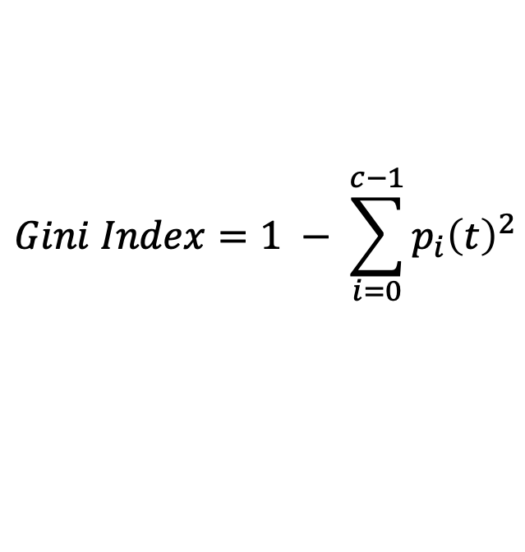
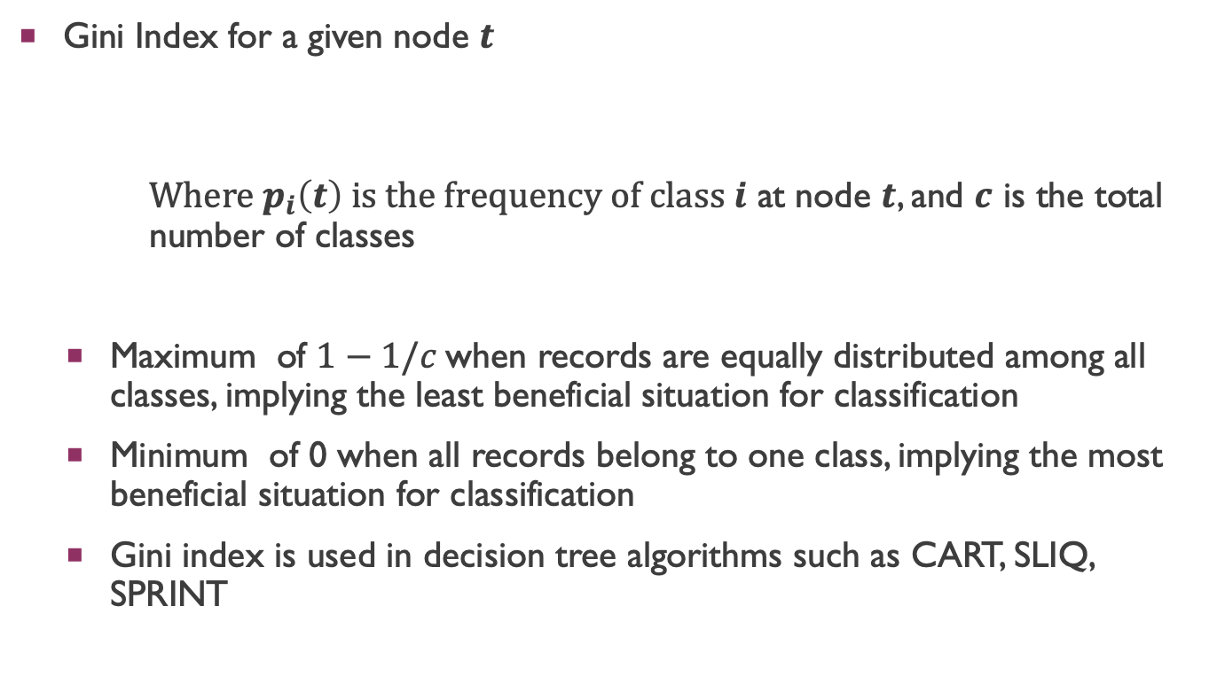
Measure of Impurity: GINI
$$Gini Index=1 − \sum_{i=0}^{c−1}{p_{i}{\left(t\right)}^{2}}$$
Gini Index for a given node $t$
Where $p_{i}\left(t\right)$ is the frequency of class $i$ at node $t$, and $c$ is the total number of classes
Maximum of $1−1/c$when records are equally distributed among all classes, implying the least beneficial situation for classification
Minimum of 0 when all records belong to one class, implying the most beneficial situation for classification
Gini index is used in decision tree algorithms such as CART, SLIQ, SPRINT

Slide 23
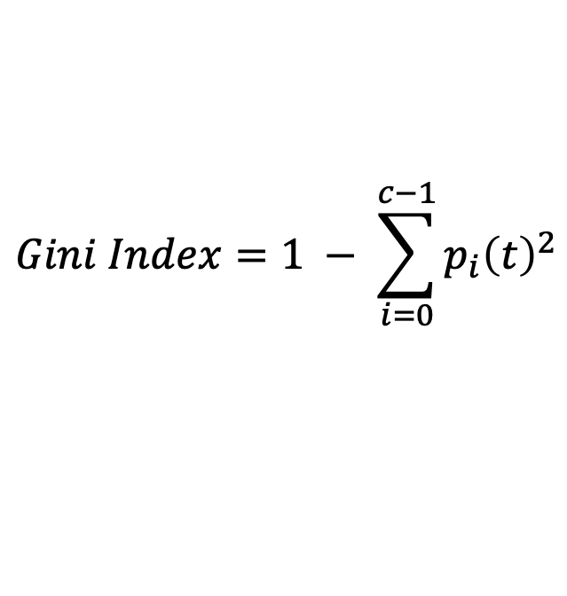
Measure of Impurity: GINI
Gini Index for a given node t :
For 2-class problem (p, 1 – p):
GINI = 1 – p² – (1 – p)² = 2p (1-p)
$$Gini Index=1 − \sum_{i=0}^{c−1}{p_{i}{\left(t\right)}^{2}}$$

Slide 24
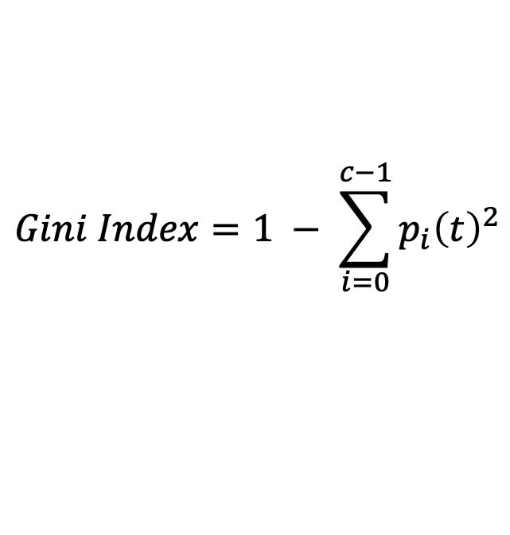
Computing Gini Index of a Single Node
$$Gini Index=1 − \sum_{i=0}^{c−1}{p_{i}{\left(t\right)}^{2}}$$
P(C1) = 0/6 = 0 P(C2) = 6/6 = 1
Gini = 1 – P(C1)² – P(C2)² = 1 – 0 – 1 = 0
P(C1) = 1/6 P(C2) = 5/6
Gini = 1 – (1/6)² – (5/6)² = 0.278
P(C1) = 2/6 P(C2) = 4/6
Gini = 1 – (2/6)² – (4/6)² = 0.444

Slide 25
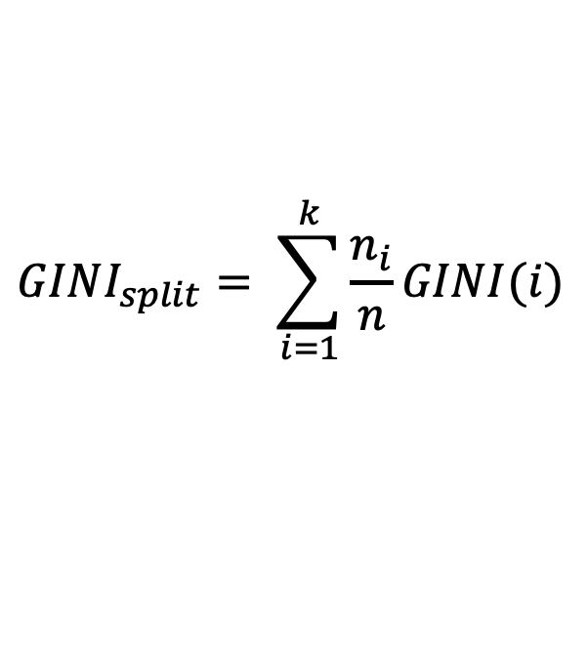

Computing Gini Index for a Collection of Nodes
When a node $p$ is split into $k$ partitions (children)
where, $n_{i}$ = number of records at child $i$,
$n$ = number of records at parent node $p$.
$$GINI_{split}= \sum_{i=1}^{k}{\frac{n_{i}}{n}GINI(i)}$$

Slide 26
Binary Attributes: Computing GINI Index
Splits into two partitions (child nodes)
Effect of Weighing partitions:
Larger and purer partitions are sought
B?
Yes
No
Node N1
Node N2
Gini(N1) = 1 – (5/6)² – (1/6)² = 0.278
Gini(N2) = 1 – (2/6)² – (4/6)² = 0.444
Weighted Gini of N1 N2 = 6/12 * 0.278 + 6/12 * 0.444 = 0.361
Gain = 0.486 – 0.361 = 0.125

Slide 27
Categorical Attributes: Computing Gini Index
For each distinct value, gather counts for each class in the dataset
Use the count matrix to make decisions
Multi-way split
Two-way split
(find best partition of values)
Which of these is the best?

Slide 28
Continuous Attributes: Computing Gini Index
Use Binary Decisions based on one value
Several Choices for the splitting value
Number of possible splitting values = Number of distinct values
Each splitting value has a count matrix associated with it
Class counts in each of the partitions, A ≤ v and A > v
Simple method to choose best v
For each v, scan the database to gather count matrix and compute its Gini index
Computationally Inefficient! Repetition of work.
Annual Income ?
 | ≤ 80 | > 80
Defaulted Yes | 0 | 3
Defaulted No | 3 | 4

Slide 29
Continuous Attributes: Computing Gini Index...
For efficient computation: for each attribute,
Sort the attribute on values
Linearly scan these values, each time updating the count matrix and computing gini index
Choose the split position that has the least gini index
Sorted Values

Slide 30
Continuous Attributes: Computing Gini Index...
For efficient computation: for each attribute,
Sort the attribute on values
Linearly scan these values, each time updating the count matrix and computing gini index
Choose the split position that has the least gini index
Sorted Values
Split Positions

Slide 31
Continuous Attributes: Computing Gini Index...
For efficient computation: for each attribute,
Sort the attribute on values
Linearly scan these values, each time updating the count matrix and computing gini index
Choose the split position that has the least gini index
Sorted Values
Split Positions

Slide 32
Continuous Attributes: Computing Gini Index...
For efficient computation: for each attribute,
Sort the attribute on values
Linearly scan these values, each time updating the count matrix and computing gini index
Choose the split position that has the least gini index
Sorted Values
Split Positions

Slide 33
Continuous Attributes: Computing Gini Index...
For efficient computation: for each attribute,
Sort the attribute on values
Linearly scan these values, each time updating the count matrix and computing gini index
Choose the split position that has the least gini index
Sorted Values
Split Positions

Slide 34
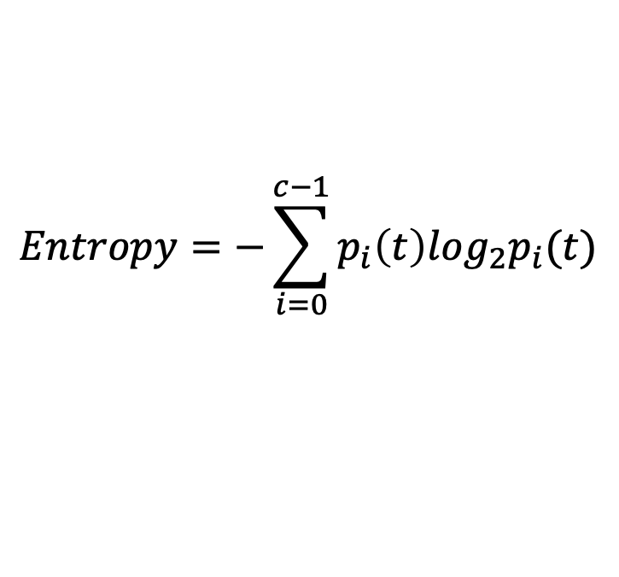
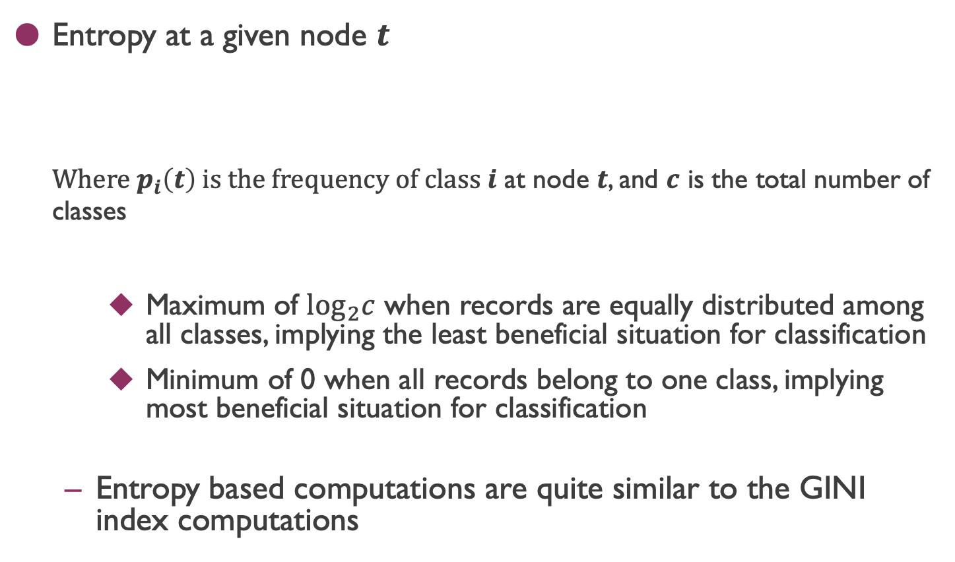
Measure of Impurity: Entropy
Entropy at a given node $t$
Where $p_{i}\left(t\right)$ is the frequency of class $i$ at node $t$, and $c$ is the total number of classes
Maximum of $\log_{2}c$ when records are equally distributed among all classes, implying the least beneficial situation for classification
Minimum of 0 when all records belong to one class, implying most beneficial situation for classification
Entropy based computations are quite similar to the GINI index computations
$$Entropy=−\sum_{i=0}^{c−1}{p_{i}\left(t\right)log_{2}p_{i}(t)}$$

Slide 35
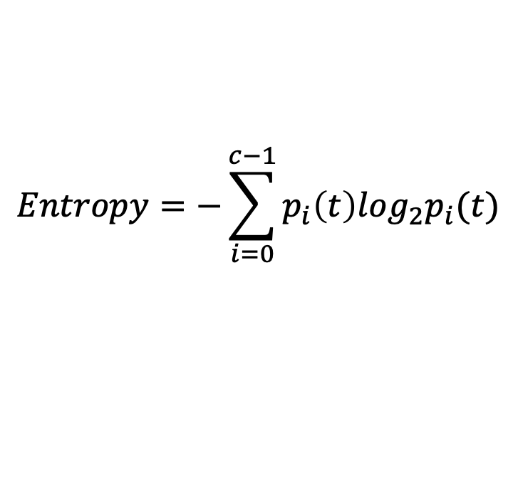
Computing Entropy of a Single Node
$$Entropy=−\sum_{i=0}^{c−1}{p_{i}\left(t\right)log_{2}p_{i}(t)}$$
P(C1) = 0/6 = 0 P(C2) = 6/6 = 1
Entropy = – 0 log 0 – 1 log 1 = – 0 – 0 = 0
P(C1) = 1/6 P(C2) = 5/6
Entropy = – (1/6) log₂ (1/6) – (5/6) log₂ (1/6) = 0.65
P(C1) = 2/6 P(C2) = 4/6
Entropy = – (2/6) log₂ (2/6) – (4/6) log₂ (4/6) = 0.92

Slide 36
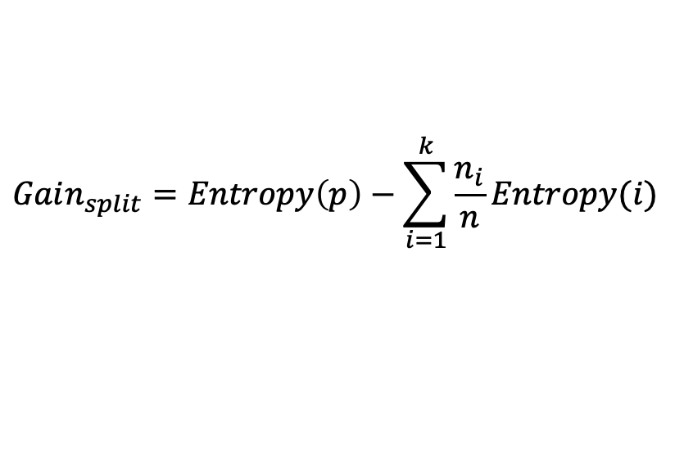
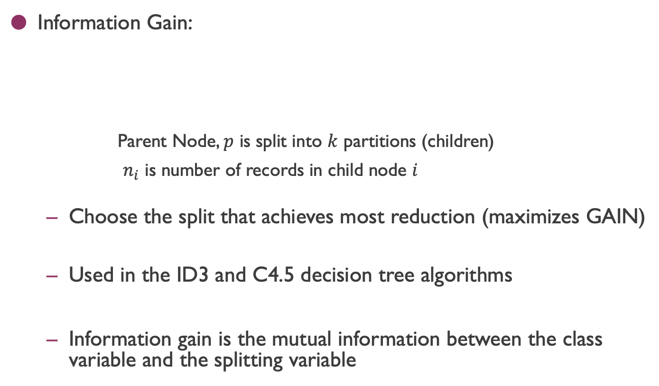
Computing Information Gain After Splitting
Information Gain:
Parent Node, $p$ is split into $k$ partitions (children)
$n_{i}$ is number of records in child node $i$
Choose the split that achieves most reduction (maximizes GAIN)
Used in the ID3 and C4.5 decision tree algorithms
Information gain is the mutual information between the class variable and the splitting variable
$$Gain_{split}=Entropy\left(p\right)−\sum_{i=1}^{k}{\frac{n_{i}}{n}Entropy(i)}$$

Slide 37
Problem with large number of partitions
Node impurity measures tend to prefer splits that result in large number of partitions, each being small but pure
Customer ID has highest information gain because entropy for all the children is zero

Slide 38
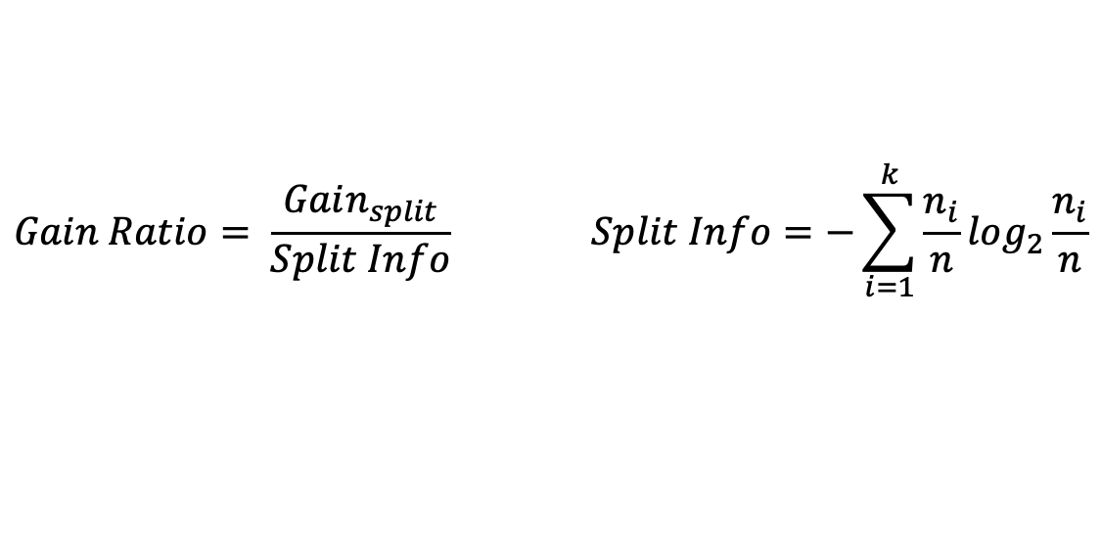
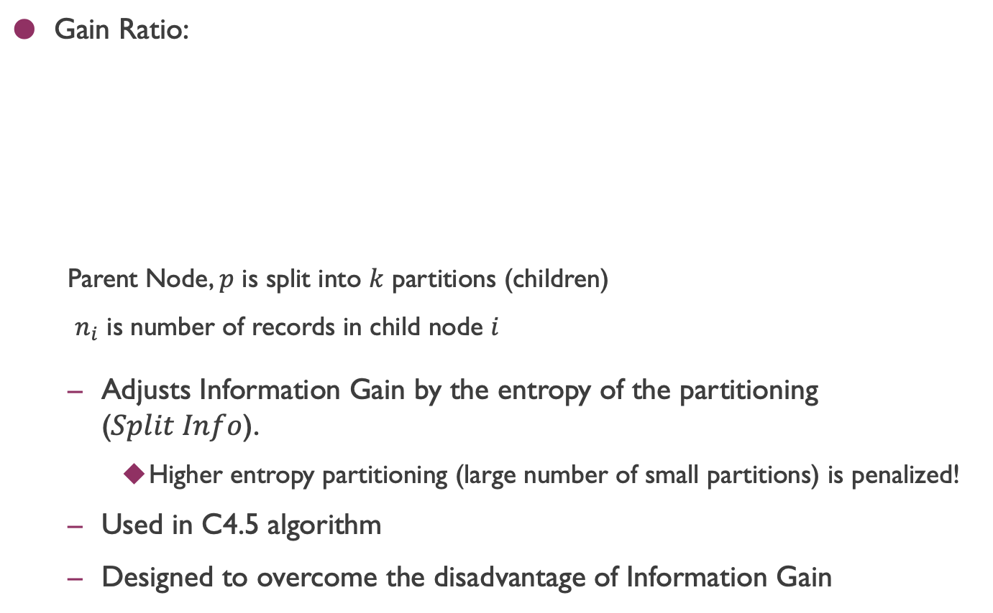
Gain Ratio
Gain Ratio:
Parent Node, $p$ is split into $k$ partitions (children)
$n_{i}$ is number of records in child node $i$
Adjusts Information Gain by the entropy of the partitioning ($Split Info$).
Higher entropy partitioning (large number of small partitions) is penalized!
Used in C4.5 algorithm
Designed to overcome the disadvantage of Information Gain
$$Gain Ratio= \frac{Gain_{split}}{Split Info} Split Info=−\sum_{i=1}^{k}{\frac{n_{i}}{n}log_{2}}\frac{n_{i}}{n}$$

Slide 39

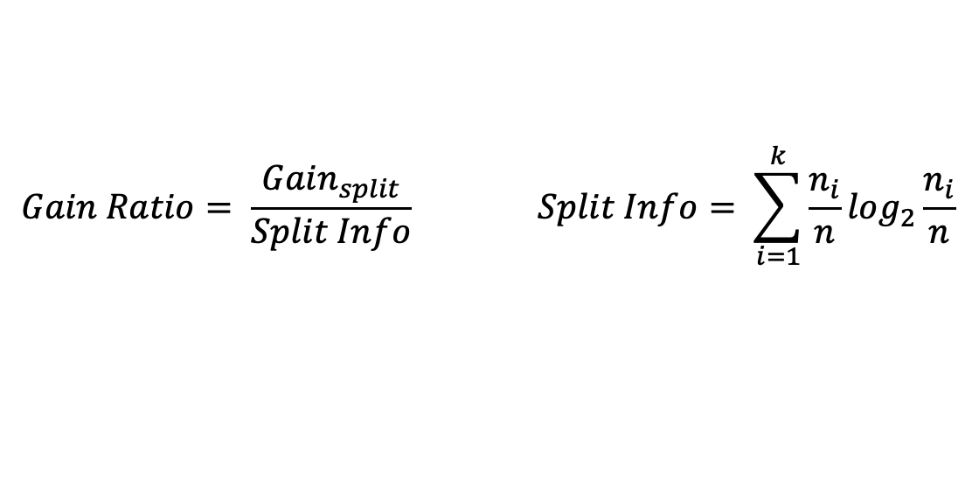
Gain Ratio
Gain Ratio:
Parent Node, $p$ is split into $k$ partitions (children)
$n_{i}$ is number of records in child node $i$
$$Gain Ratio= \frac{Gain_{split}}{Split Info} Split Info= \sum_{i=1}^{k}{\frac{n_{i}}{n}log_{2}}\frac{n_{i}}{n}$$
SplitINFO = 1.52
SplitINFO = 0.72
SplitINFO = 0.97

Slide 40
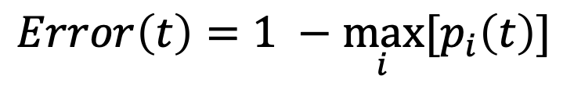
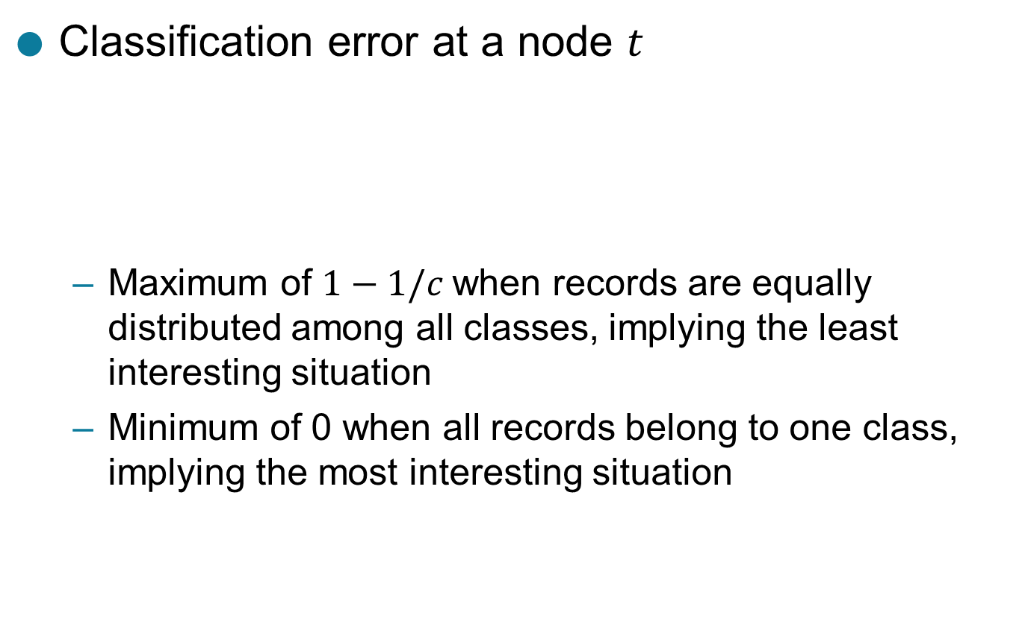
Measure of Impurity: Classification Error
$$Error\left(t\right)=\underset{ i}{1 −max}⁡[p_{i}\left(t\right)]$$
Classification error at a node $t$
Maximum of $1−1/c$when records are equally distributed among all classes, implying the least interesting situation
Minimum of 0 when all records belong to one class, implying the most interesting situation

Slide 41
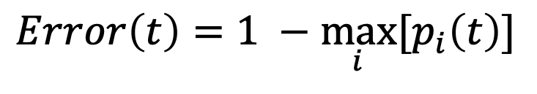
Computing Error of a Single Node
$$Error\left(t\right)=\underset{ i}{1 −max}⁡[p_{i}\left(t\right)]$$
P(C1) = 0/6 = 0 P(C2) = 6/6 = 1
Error = 1 – max (0, 1) = 1 – 1 = 0
P(C1) = 1/6 P(C2) = 5/6
Error = 1 – max (1/6, 5/6) = 1 – 5/6 = 1/6
P(C1) = 2/6 P(C2) = 4/6
Error = 1 – max (2/6, 4/6) = 1 – 4/6 = 1/3

Slide 42
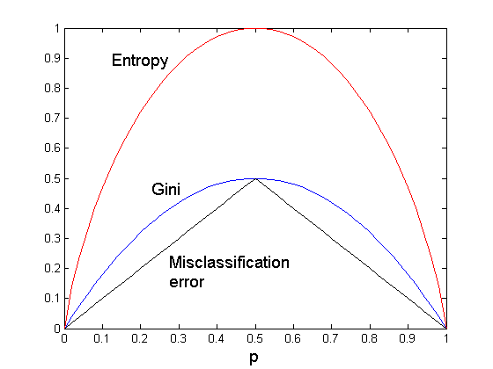
Comparison among Impurity Measures
For a 2-class problem:

Slide 43
Misclassification Error vs Gini Index
A?
Yes
No
Node N1
Node N2
Gini(N1) = 1 – (3/3)² – (0/3)² = 0
Gini(N2) = 1 – (4/7)² – (3/7)² = 0.489
Gini(Children) = 3/10 * 0 + 7/10 * 0.489 = 0.342
Gini improves but error remains the same!!

Slide 44
Misclassification Error vs Gini Index
A?
Yes
No
Node N1
Node N2
Misclassification error for all three cases = 0.3 !

Slide 45
Decision Tree Based Classification
Advantages:
Relatively inexpensive to construct
Extremely fast at classifying unknown records
Easy to interpret for small-sized trees
Robust to noise (especially when methods to avoid overfitting are employed)
Can easily handle redundant attributes
Can easily handle irrelevant attributes (unless the attributes are interacting)
Disadvantages: .
Due to the greedy nature of splitting criterion, interacting attributes (that can distinguish between classes together but not individually) may be passed over in favor of other attributed that are less discriminating.
Each decision boundary involves only a single attribute

Slide 46
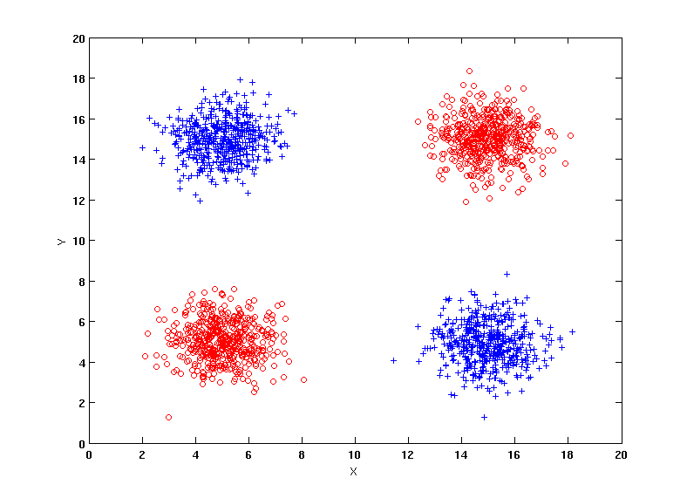
Handling interactions
+ : 1000 instances
o : 1000 instances
Entropy (X) : 0.99
Entropy (Y) : 0.99
Y
X

Slide 47
Handling interactions

Slide 48
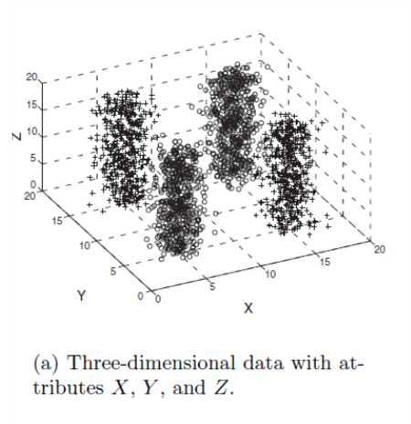
Handling interactions given irrelevant attributes
+ : 1000 instances
o : 1000 instances
Adding Z as a noisy attribute generated from a uniform distribution
Entropy (X) : 0.99
Entropy (Y) : 0.99
Entropy (Z) : 0.98
Attribute Z will be chosen for splitting!
Y
X

Slide 49
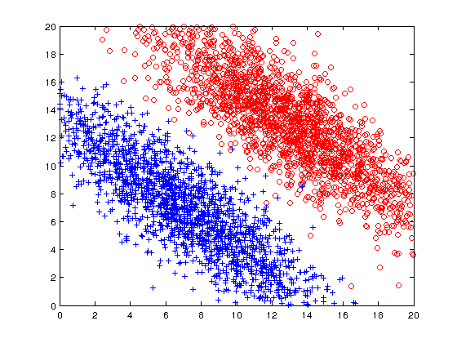
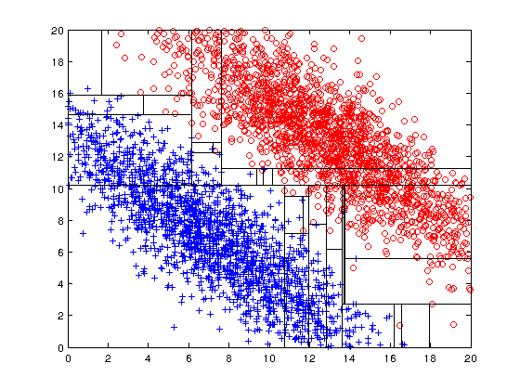
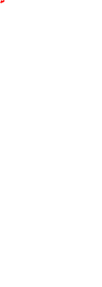
Limitations of single attribute-based decision boundaries
Both positive (+) and negative (o) classes generated from skewed Gaussians with centers at (8,8) and (12,12) respectively.

