Slide 1
Association Rule Mining
Beiyu Lin

Slide 2
Association Rule Mining
Given a set of transactions, find rules that will predict the occurrence of an item based on the occurrences of other items
Market transactions
Example of Association Rules
{Beer} → {Eggs}, {Milk, Bread} → {Diaper, Beer},

Slide 3

Association Rule Mining
Itemset (set / subset)
A collection of one or more items
Example: {Milk, Bread, Diaper}
k-itemset
An itemset that contains k items
Support count (σ)
Frequency of occurrence of an itemset
E.g. σ({Milk, Bread,Diaper}) = 2
Support
Fraction of transactions that contain an itemset
E.g. s({Milk, Bread, Diaper}) = 2/5
Frequent Itemset
An itemset whose support is greater than or equal to a minsup threshold

Slide 4


Definition: Association Rule
Association Rule
An implication expression of the form X → Y, where X and Y are itemsets
Example: {Milk, Diaper} → {Beer}
Rule Evaluation Metrics
Support (s)
Fraction of transactions that contain both X and Y
Confidence (c)
Measures how often items in Y appear in transactions that contain X
Example:
=# of itemset / total # transactions
= # of itemset of Xand Y/ # of itemset of X

Slide 5

Frequent Itemset Generation
Brute-force approach:
Each itemset in the lattice is a candidate frequent itemset
Count the support of each candidate by scanning the database
Match each transaction against every candidate
Complexity ~ O(NMw) => Expensive since M = 2^{d} !!!

Slide 6

Frequent Itemset Generation Strategies
Reduce the number of candidates (M)
Complete search: M=2^{d}
Use pruning techniques to reduce M
Reduce the number of transactions (N)
Reduce size of N as the size of itemset increases
Used by DHP and vertical-based mining algorithms
Reduce the number of comparisons (NM)
Use efficient data structures to store the candidates or transactions
No need to match every candidate against every transaction

Slide 7
Reducing Number of Candidates
Apriori principle:
If an itemset is frequent, then all of its subsets must also be frequent
Apriori principle holds due to the following property of the support measure:
Support of an itemset never exceeds the support of its subsets
This is known as the anti-monotone property of support
If the subset of an itemset is not frequent, then the itemset is not frequent
Support
s({Milk, Bread, Diaper}) = 2/5
Subset: {milk, bread}
s({milk, break}) = #{milk, bread} /5

Slide 8
Illustrating Apriori Principle
Found to be Infrequent
Pruned supersets

Slide 9
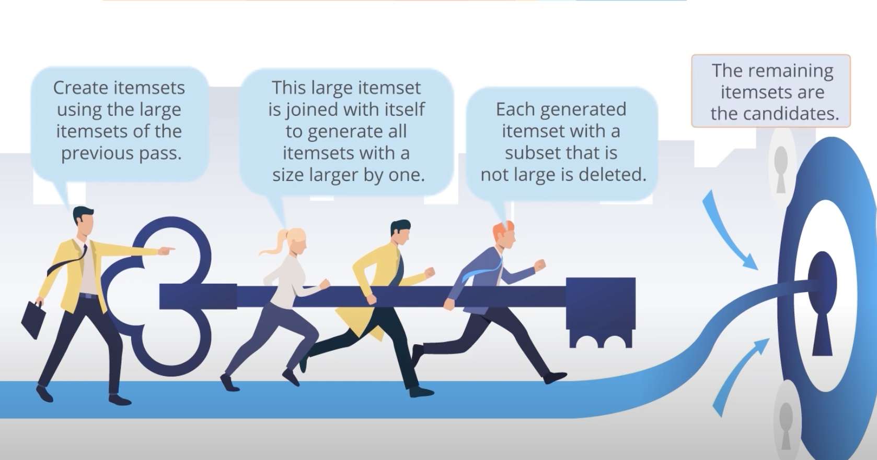
Apriori Principle

Slide 10
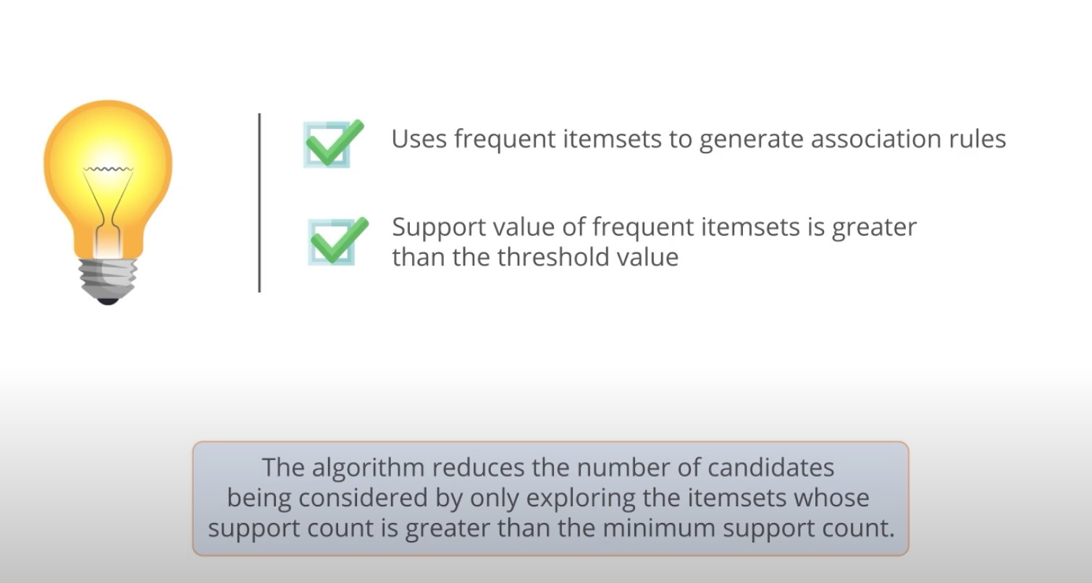
Apriori Principle

Slide 11
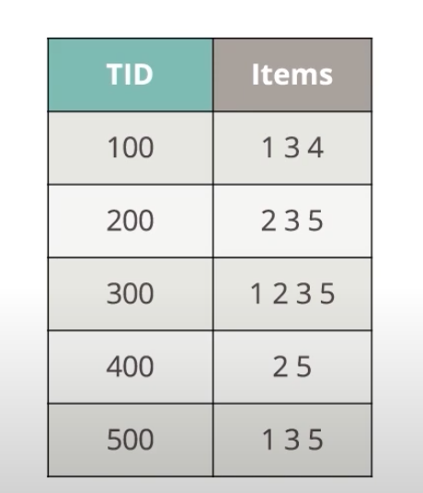
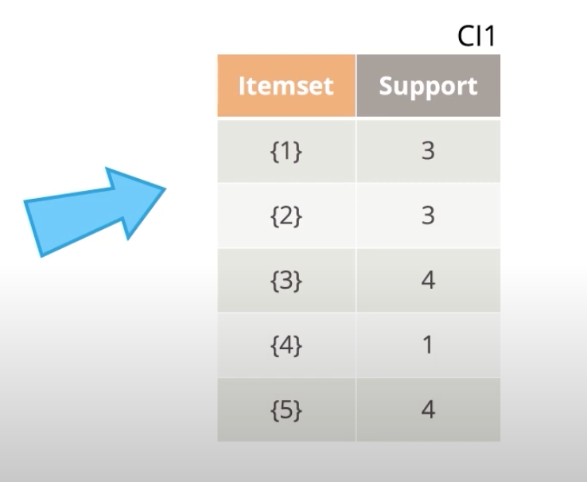
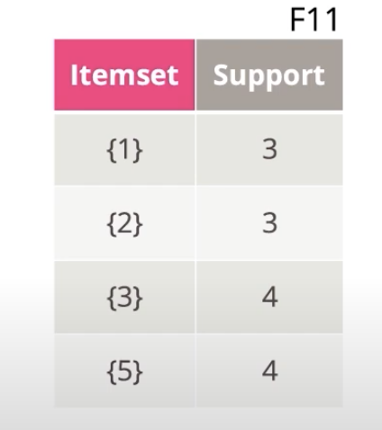
Apriori Principle Example

Slide 12
Apriori Principle Example

Slide 13
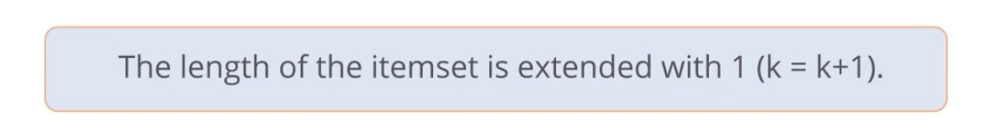
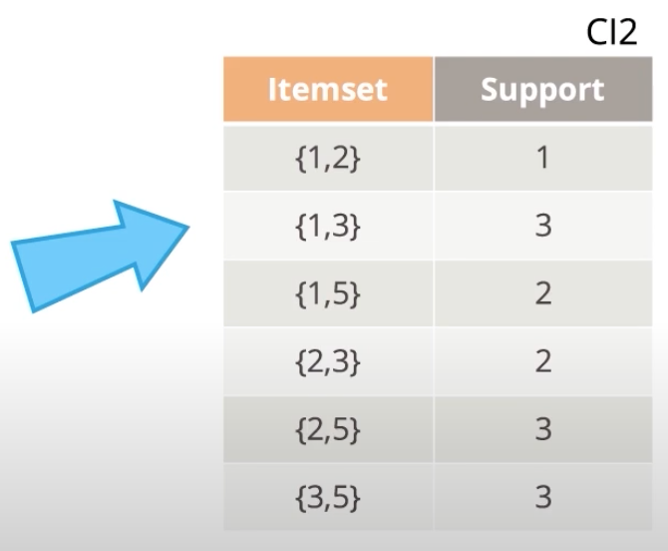
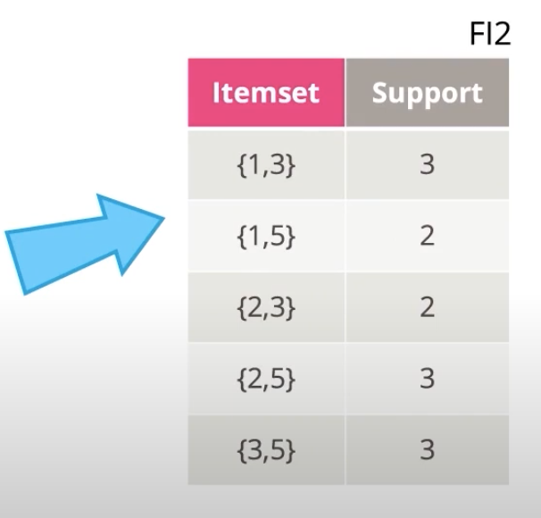
Apriori Principle Example

Slide 14
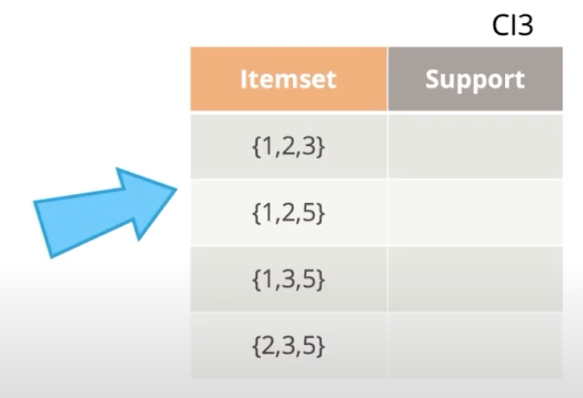
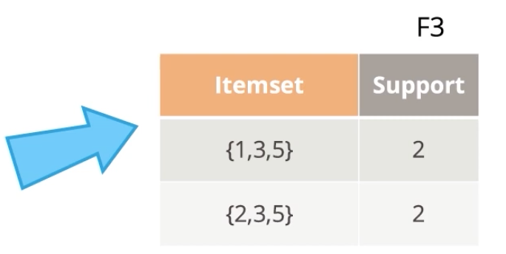





Apriori Principle Example

Slide 15
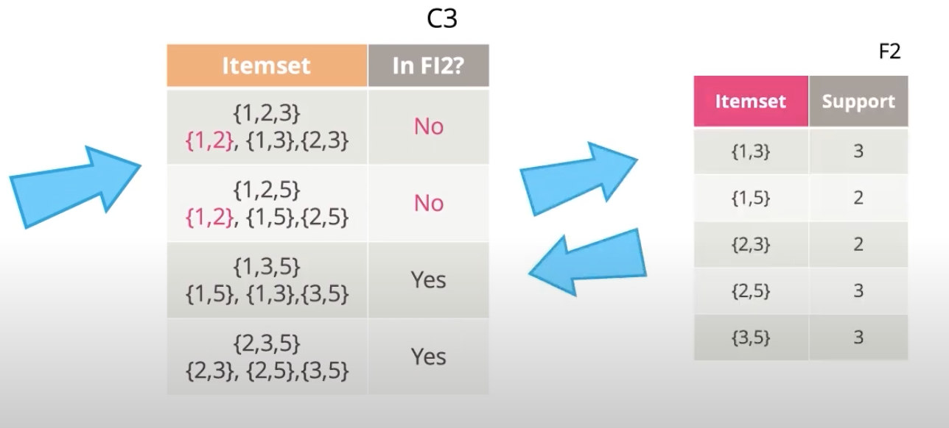
Apriori Principle Example
{1,2}, {1,3}, {2,3}, {1}, {2},{3}
{1,2},{1,5},{2,5},
{1},{2},{5}
{1,3}, {1,5},{3,5},
{1},{3},{5}}

Slide 16


Apriori Principle Example

Slide 17
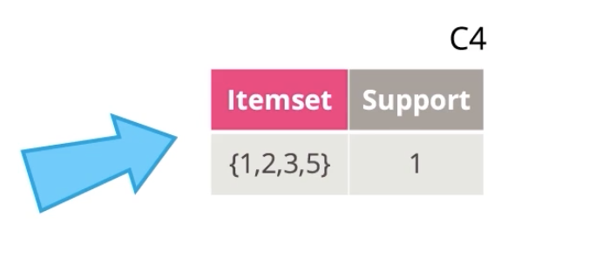
Apriori Principle Example

Slide 18
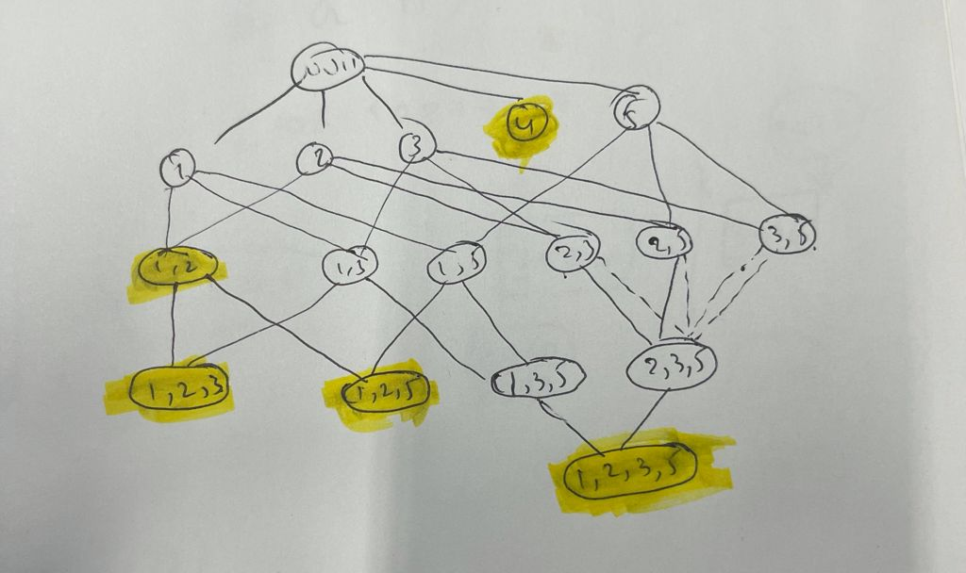

Slide 19
Apriori Algorithm
F_{k}: frequent k-itemsets
L_{k}: candidate k-itemsets
Algorithm
Let k=1
Generate F₁ = {frequent 1-itemsets}
Repeat until F_{k} is empty
Candidate Generation: Generate L_{k+1} from F_{k}
Candidate Pruning: Prune candidate itemsets in L_{k+1} containing subsets of length k that are infrequent
Support Counting: Count the support of each candidate in L_{k+1} by scanning the DB
Candidate Elimination: Eliminate candidates in L_{k+1} that are infrequent, leaving only those that are frequent => F_{k+1}

