Slide 1
Association Rule Mining
Beiyu Lin

Slide 2
Rule Generation
Given a frequent itemset L, find all non-empty subsets f ⊂ L such that f → L – f satisfies the minimum confidence requirement
If {A,B,C,D} is a frequent itemset, candidate rules:
ABC →D, ABD →C, ACD →B, BCD →A, A →BCD, B →ACD, C →ABD, D →ABC AB →CD, AC → BD, AD → BC, BC →AD, BD →AC, CD →AB,
If |L| = k, then there are 2^{k} – 2 candidate association rules (ignoring L → ∅ and ∅ → L)

Slide 3
Rule Generation
In general, confidence does not have an anti-monotone property
c(ABC →D) can be larger or smaller than c(AB →D)
But confidence of rules generated from the same itemset has an anti-monotone property
E.g., Suppose {A,B,C,D} is a frequent 4-itemset: c(ABC → D) ≥ c(AB → CD) ≥ c(A → BCD)
Confidence is anti-monotone w.r.t. number of items on the RHS of the rule

Slide 4


Rule Generation for Apriori Algorithm
Lattice of rules
Low Confidence Rule
Pruned Rules

Slide 5
Association Analysis: Basic Concepts and Algorithms
Algorithms and Complexity

Slide 6

Factors Affecting Complexity of Apriori
Choice of minimum support threshold
Dimensionality (number of items) of the data set
Size of database
Average transaction width

Slide 7
Factors Affecting Complexity of Apriori
Choice of minimum support threshold
lowering support threshold results in more frequent itemsets
this may increase number of candidates and max length of frequent itemsets
Dimensionality (number of items) of the data set
Size of database
Average transaction width

Slide 8



Impact of Support Based Pruning
Items (1-itemsets)
Minimum Support = 3
Minimum Support = 2
If every subset is considered,
⁶C₁ + ⁶C₂ + ⁶C₃
6 + 15 + 20 = 41
With support-based pruning,
6 + 6 + 4 = 16
If every subset is considered,
⁶C₁ + ⁶C₂ + ⁶C₃ + ⁶C₄
6 + 15 + 20 +15 = 56

Slide 9

Factors Affecting Complexity of Apriori
Choice of minimum support threshold
lowering support threshold results in more frequent itemsets
this may increase number of candidates and max length of frequent itemsets
Dimensionality (number of items) of the data set
More space is needed to store support count of itemsets
if number of frequent itemsets also increases, both computation and I/O (input / output)
costs may also increase
Size of database
Average transaction width
How to do sampling for stream data
While we do not know how many data are reading in.

Slide 10
Factors Affecting Complexity of Apriori
Choice of minimum support threshold
lowering support threshold results in more frequent itemsets
this may increase number of candidates and max length of frequent itemsets
Dimensionality (number of items) of the data set
More space is needed to store support count of itemsets
if number of frequent itemsets also increases, both computation and I/O costs may also increase
Size of database
run time of algorithm increases with number of transactions
Average transaction width

Slide 11
Factors Affecting Complexity of Apriori
Choice of minimum support threshold
lowering support threshold results in more frequent itemsets
this may increase number of candidates and max length of frequent itemsets
Dimensionality (number of items) of the data set
More space is needed to store support count of itemsets
if number of frequent itemsets also increases, both computation and I/O costs may also increase
Size of database
run time of algorithm increases with number of transactions
Average transaction width
transaction width increases the max length of frequent itemsets
number of subsets in a transaction increases with its width, increasing computation time for support counting

Slide 12
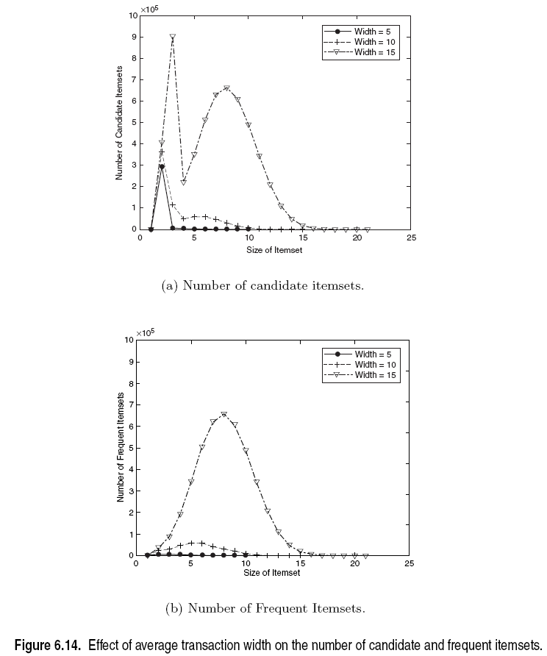
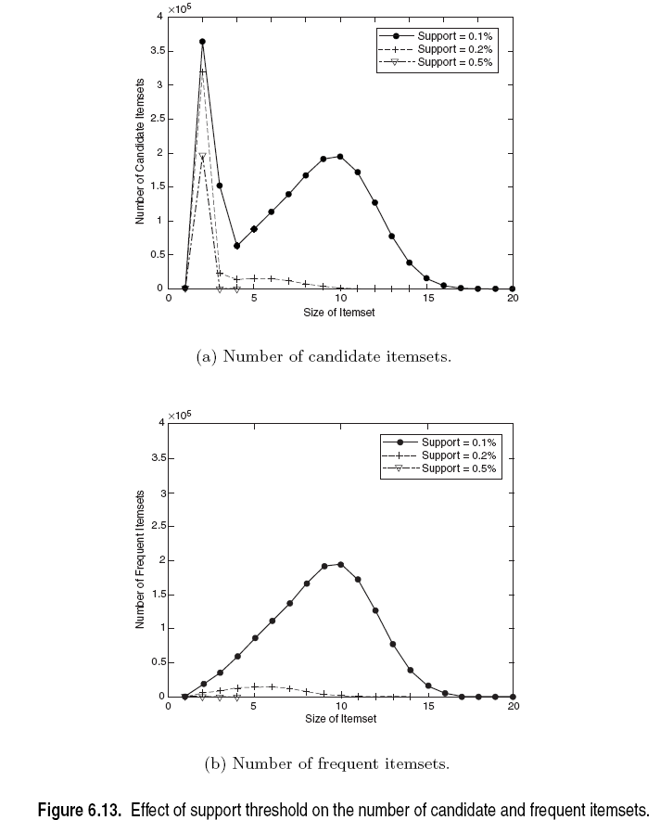
Factors Affecting Complexity of Apriori

Slide 13

Compact Representation of Frequent Itemsets
Some frequent itemsets are redundant because their supersets are also frequent
Consider the following data set. Assume support count threshold =5
Number of frequent itemsets
Need a compact representation
X is the supersets of Y;
Y is the subsets of X.
Notes:
Superset: contains more transactions then the minimum support

Slide 14
Maximal Frequent Itemset
An itemset is maximal frequent if it is frequent and none of its immediate supersets is frequent
Maximal Itemsets
Infrequent Itemsets
Border

Slide 15
What are the Maximal Frequent Itemsets in this Data?
Minimum support threshold = 5
(A1-A10)
(B1-B10)
(C1-C10)

Slide 16

An illustrative example
Items
 | A | B | C | D | E | F | G | H | I | J
1
2
3
4
5
6
7
8
9
10
Support threshold (by count) : 5
Frequent itemsets:
Maximal itemsets: ?
Given the frequent itemsets, what are the itemsets that its direct neighbors are not frequent.
Transactions

Slide 17

An illustrative example
Items
 | A | B | C | D | E | F | G | H | I | J
1
2
3
4
5
6
7
8
9
10
Support threshold (by count) : 5
Frequent itemsets: {F}
Maximal itemsets: {F}
Support threshold (by count): 4
Frequent itemsets: ?
Maximal itemsets: ?
Transactions
{E}, {F}, {E,F}, {J}

Slide 18

An illustrative example
Items
 | A | B | C | D | E | F | G | H | I | J
1
2
3
4
5
6
7
8
9
10
Support threshold (by count) : 5
Frequent itemsets: {F}
Maximal itemsets: {F}
Support threshold (by count): 4
Frequent itemsets: {E}, {F}, {E,F}, {J}
Maximal itemsets: {E,F}, {J}
Support threshold (by count): 3
Frequent itemsets: ?
Maximal itemsets: ?
Transactions
Notes:
A maximal frequent itemset is a frequent itemset for which none of its immediate supersets are frequent

Slide 19
An illustrative example
Items
 | A | B | C | D | E | F | G | H | I | J
1
2
3
4
5
6
7
8
9
10
Support threshold (by count) : 5
Frequent itemsets: {F}
Maximal itemsets: {F}
Support threshold (by count): 4
Frequent itemsets: {E}, {F}, {E,F}, {J}
Maximal itemsets: {E,F}, {J}
Support threshold (by count): 3
Frequent itemsets:
All subsets of {C,D,E,F} + {J}
Maximal itemsets:
{C,D,E,F}, {J}
Transactions
{C},{D}, {E},{F},{CD},{CE},….., {J}

Slide 20
Closed Itemset
An itemset X is closed if none of its immediate supersets has the same support as the itemset X.
X is not closed if at least one of its immediate supersets has support count as X.

