Slide 1
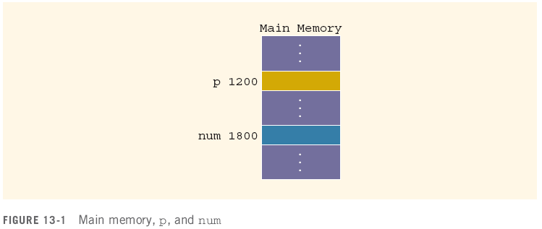
Variables, Memory and Pointers
A variable is a named piece of memory
The name stands in for the memory address
int num;//allocate memory to it first
num = 10;
10

Slide 2
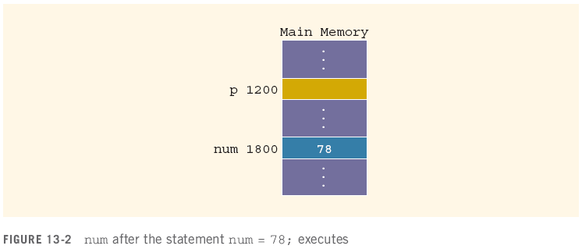
Variables, Memory and Pointers
When a value is assigned to a variable, it is stored at that address in memory
num = 78;

Slide 3
Variables, Memory and Pointers
A pointer is a variable that holds the address of another variable
It is declared in terms of the type of variable it points at:
int *p; // given a * in front of a variable, it means that this variable is a pointer.
int num; num = 78;

Slide 4
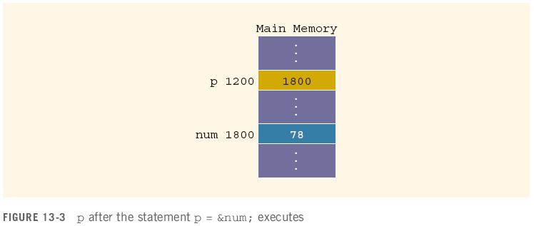
Variables, Memory and Pointers
The operator & returns the address of a variable
It can then be assigned to a pointer
p = &num;
// &num => the address of the variable num ⬄ 1800
// assign the address of num to the value of p.
&num
p

Slide 5
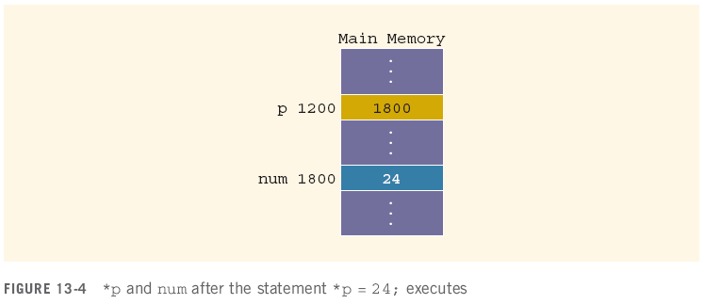
Variables, Memory and Pointers
The operator * takes an address (a pointer) and returns the location in memory being pointed to
Can only be applied to a pointer
*p = 24;
int *q; // define a pointer;
*q = 30; // assign 30 to the variable that the pointer pointed to.

Slide 6
Declaring Pointer Variables
Syntax:
Examples:
int *p;
char *ch;
These statements are equivalent:
int *p;
int* p;
int * p;

Slide 7
Declaring Pointer Variables (continued)
In the statement:
int* p, q; // p is a pointer; q is variable
int num1, num2; ⬄ int num1; int num2;
only p is the pointer variable, not q; here q is an int variable
To avoid confusion, attach the character * to the variable name:
int *p, q;
int *p, *q;
int array1[100], array2[20];

Slide 8
Address of Operator (&)
The ampersand, &, is called the address of operator
The address of operator is a unary operator that returns the address of its operand

Slide 9

Dereferencing Operator (*)
When used as a unary operator, * is the dereferencing operator or indirection operator
Refers to object to which its operand points
Example:
To print the value of x, using p:
To store a value in x, using p:
Variable name | address | value
x | 153 | 55
p (pointer) | 1008 | 153

Slide 10
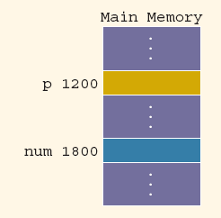
Exercise
Assuming the memory layout provided, after this code executes:
int num; // declare an integer variable
int *p; // declare a pointer named: p
num = 50; // assign 50 to variable num
p = &num;
//1. assign a pointer p to the variable num;
//2. assign the address of num (1800) to the value of the pointer p
*p = 38;
//assign 38 to *p (the value of the pointer pointed to)
// the value of num = 38
What are the values of these expressions?
&num = 1800; // &num: the address of the variable num
num = ? // value of num = 38
&p = ? // &: address of something; &p: the address of the pointer p 1200
p = ? // the value of p ⬄ the address that the pointer pointed to, 1800.
*p = ? // *p: the value of the pointer pointed to, 38.

Slide 11
Assigning Pointers
Pointers can be assigned to pointers of the same type
int x, *p, *q; //declare one variable x, and 2 pointers p, q
x = 50; // the value of x = 50
p = &x;
//1. a pointer p points to the variable x
//2. assign the address of x to the value of the pointer p
q = p; // q is a pointer; assign the value of p to the value of q ⬄ both pointers p and q are assigned to variable x.
The value of *q is?
*q: the value that the pointer q pointed to
So *q is 50
Variable name | address | value
x | 153 | 50
p (pointer) | 1008 | 153
q (pointer) | 17 | 153

Slide 12
Assigning Pointers
Pointers can be assigned to pointers of the same type
int x, *p, *q;
x = 50;
p = &x;
q = p;
The value of *q is 50

Slide 13
The Null Pointer
In addition to variable addresses and other pointers, a pointer can be assigned to the null pointer
Either the number 0 or the constant NULL
Used to indicate an invalid pointer (pointing to nothing)
Dereferencing a null pointer causes a hard error
int *p = 0;
p = NULL;
*p //dereferencing

Slide 14
Comparing Pointers
Be careful of the difference between comparing two pointers and comparing their values:
int x = 50, y = 50, *p, *q;
p = &x;
q = &y;
*q == *p evaluates to?
q == p evaluates to?

Slide 15
Comparing Pointers
Be careful of the difference between comparing two pointers and comparing their values:
int x = 50, y = 50, *p, *q;
p = &x;
q = &y;
*q == *p evaluates to true
q == p evaluates to false

