Slide 1
Supervised Learning

Slide 2
Road Map
Basic concepts
Decision tree induction
Evaluation of classifiers
Rule induction
Classification using association rules
K-nearest neighbor

Slide 3
An example application
A credit card company receives thousands of applications for new cards. Each application contains information about an applicant,
age
Marital status
annual salary
outstanding debts
credit rating
etc.
Problem: to decide whether an application should be approved, or to classify applications into two categories, approved and not approved.

Slide 4
An example application
An emergency room in a hospital measures 15 variables (e.g., blood pressure, age, heart rate, etc) of newly admitted patients.
A decision is needed: whether to send a new patient to an intensive-care unit based on the mortality risk.
Problem: to predict high-risk patients and distinguish them from low-risk patients.

Slide 5
Machine learning and our focus
A computer system learns from data
Our focus:
learn a target function
Use the learned function to predict the values of a discrete class attribute
e.g., approve or not-approved, and high-risk or low risk.
The task is commonly called: Supervised learning, classification, or inductive learning.
Classification (discrete); Regression (numeric; continuous)

Slide 6
The data and the goal
Data: A set of data examples / instances / cases described by
k attributes: A₁, A₂, … A_{k}.
a class: Each example is labelled with a pre-defined class.
e.g., approved or not approved
Goal:
learn a classification model from the data
Use the model to predict the classes of new instances.
Notes:
Induction is different from deduction and DBMS does not not support induction;
The result of induction is higher-level information or knowledge: general statements about data
There are many approaches. Refer to the lecture notes for CS3244 available at the Co-Op.
We focus on three approaches here, other examples:
Other approaches
Instance-based learning
other neural networks
Concept learning (Version space, Focus, Aq11, …)
Genetic algorithms
Reinforcement learning

Slide 7
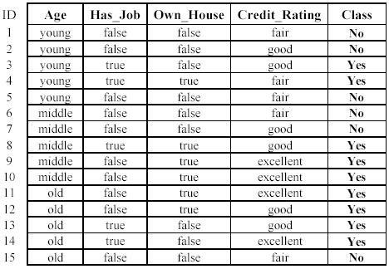
An example: data (loan application)
Approved or not

Slide 8
An example: data (loan application)
Learn a classification model from the data
Use the model to classify future loan applications into
Yes (approved) and
No (not approved)
What is the class for following case/instance?

Slide 9
Supervised vs. unsupervised Learning
Supervised learning:
Supervision: data are labeled with pre-defined classes.
Predict the test data into the classes.
Unsupervised learning (clustering)
Class labels of the data are unknown
Given a set of data, the task is to establish the existence of classes or clusters in the data

Slide 10
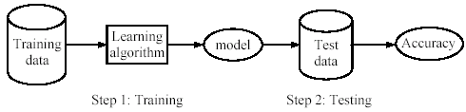
Supervised learning process: two steps
Learning (training): learn a model via the training data
Testing: test the model via test data and evaluate the model accuracy

Slide 11
An example
Data: loan application data
Task: predict whether a loan should be approved or not.
Performance measure: accuracy
No learning: put all test data to the majority class (i.e., Yes):
Accuracy = 8/15 = 53%
With the learned model, we can do better than 53%.

Slide 12
Fundamental assumption of learning
Assumption: the distribution of training data is identical to the distribution of test data.
To achieve good accuracy on the test data, training data must be sufficiently large.

Slide 13
Road Map
Basic concepts
Decision tree induction
Evaluation of classifiers
Rule induction
Classification using association rules
K-nearest neighbor

Slide 14
Introduction
Decision tree learning is one of the most widely used techniques for classification.
its accuracy is competitive with other methods
it is efficient
The classification model is a tree, called decision tree.
C4.5 is widely used decision tree.
(use python and weka to train and test machine learning models).

Slide 15
The loan data (reproduced)
Approved or not

Slide 16
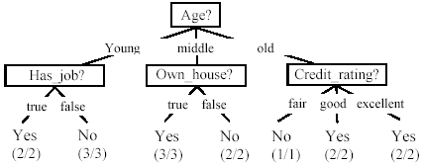
A decision tree from the loan data
Decision nodes and leaf nodes (classes)

Slide 17

Use the decision tree
No

Slide 18
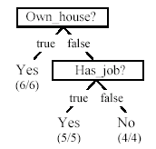
Is the decision tree unique?
No. There could be many trees.
We want smaller (easy to understand) and accurate tree (good performance).

Slide 19


From a decision tree to a set of rules
A decision tree can be converted to a set of rules
Each path from the root to a leaf is a rule.

Slide 20
Algorithm for decision tree learning
Basic algorithm (greedy divide-and-conquer)
given categorical attributes/features
tree is constructed in a top-down recursive manner
at start, all the training examples are at the root
examples are partitioned recursively based on selected attributes
attributes are selected based on information gain

Slide 21
Algorithm for decision tree learning
When to stop partitioning
All examples for a given node belong to the same class
There are no remaining attributes for further partitioning
There are no examples left

Slide 22
Choose an attribute to partition data
the key to building a decision tree - choose attribute.
the objective is to reduce impurity in data.
A subset of data is pure if all instances belong to the same class.
The heuristic in C4.5 is to choose the attribute with the maximum Information Gain.

Slide 23
The loan data (reproduced)
Approved or not

Slide 24
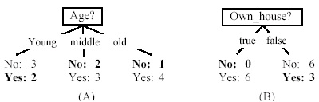
Two possible roots, which is better?
Fig. (B) seems to be better.

Slide 25
Information theory: Entropy measure
The entropy formula,
Pr(c_{j}) is the probability of class c_{j} in data set D
We use entropy as a measure of impurity or disorder of data set D. (Or, a measure of information in a tree)

Slide 26
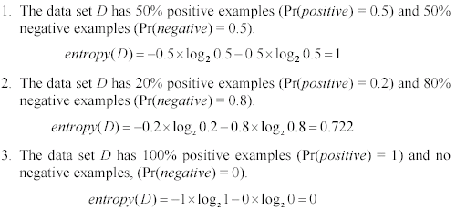
Entropy measure: let us get a feeling
As the data become purer and purer, the entropy value becomes smaller and smaller. This is useful to us!

Slide 27

Entropy measure: let us get a feeling
Given a set of examples D, we first compute its entropy:
If we make attribute A_{i}, with v values, the root of the current tree, this will partition D into v subsets D₁, D₂ …, D_{v} . The expected entropy if A_{i} is used as the current root:

Slide 28
Entropy measure: let us get a feeling
Information gained by selecting attribute A_{i} to branch or to partition the data is
We choose the attribute with the highest gain to branch/split the current tree.

Slide 29
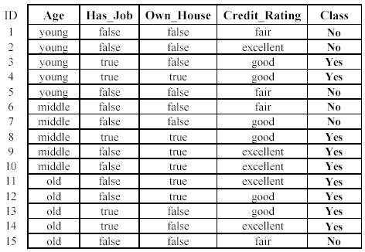

An example
Own_house is the best choice for the root.

Slide 30
An example

Slide 31
We build the final tree
We can use information gain ratio to evaluate the impurity as well (see the handout)

