Slide 1
clustering

Slide 2
Clustering Algorithms
K-means and its variants
Hierarchical clustering
Density-based clustering

Slide 3
Unsupervised Measures: Cohesion and Separation
A proximity graph-based approach can also be used for cohesion and separation.
Cluster cohesion is the sum of the weight of all links within a cluster.
Cluster separation is the sum of the weights between nodes in the cluster and nodes outside the cluster.
cohesion
separation

Slide 4

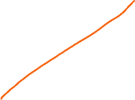
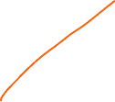

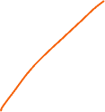

Unsupervised Measures: Silhouette Coefficient
Silhouette coefficient combines ideas of both cohesion and separation, but for individual points, as well as clusters and clusterings
For an individual point, i
Calculate a = average distance of i to the points in its cluster
Calculate b = min (average distance of i to points in another cluster)
The silhouette coefficient for a point is then given by s = (b – a) / max(a,b)
Value can vary between -1 and 1
Typically ranges between 0 and 1.
The closer to 1 the better.
Can calculate the average silhouette coefficient for a cluster or a clustering

Slide 5
Measuring Cluster Validity Via Correlation
Two matrices
Proximity Matrix
Ideal Similarity Matrix
One row and one column for each data point
An entry is 1 if the associated pair of points belong to the same cluster
An entry is 0 if the associated pair of points belongs to different clusters
Compute the correlation between the two matrices
Since the matrices are symmetric, only the correlation between n(n-1) / 2 entries needs to be calculated.
High magnitude of correlation indicates that points that belong to the same cluster are close to each other.
Correlation may be positive or negative depending on whether the similarity matrix is a similarity or dissimilarity matrix
Not a good measure for some density or contiguity based clusters.

Slide 6
Measuring Cluster Validity Via Correlation
Correlation of ideal similarity and proximity matrices for the K-means clusterings (partition cluster) of the following well-clustered data set.
Corr = 0.9235

Slide 7
Measuring Cluster Validity Via Correlation
Correlation of ideal similarity and proximity matrices for the K-means clusterings of the following random data set.
K-means
Corr = 0.5810

Slide 8
Judging a Clustering Visually by its Similarity Matrix
Order the similarity matrix with respect to cluster labels and inspect visually.

Slide 9
Judging a Clustering Visually by its Similarity Matrix
Clusters in random data are not so crisp
DBSCAN (density based clustering)
Correlation may be not a good measure for some density-based clusters.

Slide 10
Judging a Clustering Visually by its Similarity Matrix
DBSCAN

Slide 11
Determining the Correct Number of Clusters
Elbow: after that point, the values of sse
Do not change dramastically
SSE is good for comparing two clusterings or two clusters
SSE can also be used to estimate the number of clusters

Slide 12
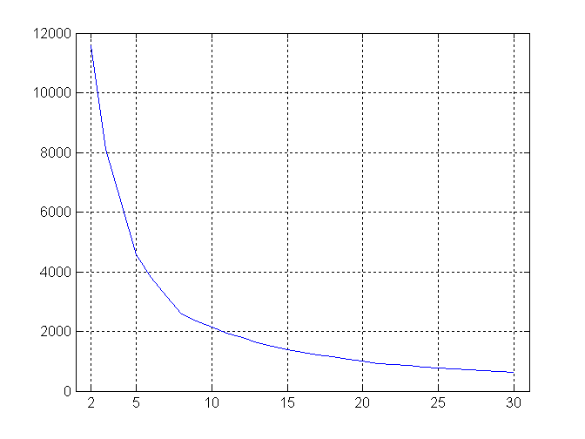


Determining the Correct Number of Clusters
SSE curve for a more complicated data set
SSE of clusters found using K-means

Slide 13
Assessing the Significance of Cluster Validity Measures
Need a framework to interpret any measure.
For example, if our measure of evaluation has the value, 10, is that good, fair, or poor?
Statistics provide a framework for cluster validity
The more “atypical” a clustering result is, the more likely it represents valid structure in the data
Compare the value of an index obtained from the given data with those resulting from random data.
If the value of the index is unlikely, then the cluster results are valid

Slide 14
Statistical Framework for SSE
Example
Compare SSE of three cohesive clusters against three clusters in random data
SSE = 0.005
Histogram shows SSE of three clusters in 500 sets of random data points of size 100 distributed over the range 0.2 – 0.8 for x and y values

Slide 15
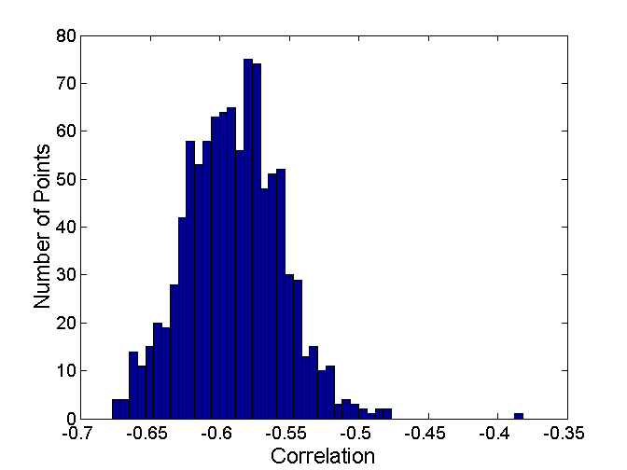
Statistical Framework for Correlation
Correlation of ideal similarity and proximity matrices for the K-means clusterings of the following two data sets.
Histogram of correlation for 500 random data sets of size 100 with x and y values of points between 0.2 and 0.8.
Corr = -0.9235
Corr = -0.5810
Correlation is negative because it is calculated between a distance matrix and the ideal similarity matrix. Higher magnitude is better.

Slide 16
Other Cluster Methods
Partitioning Methods
Hierarchical Methods
Density-Based Methods
Grid-Based Methods
Model-Based Methods
Clustering High-Dimensional Data
Constraint-Based Clustering
Outlier Analysis

Slide 17
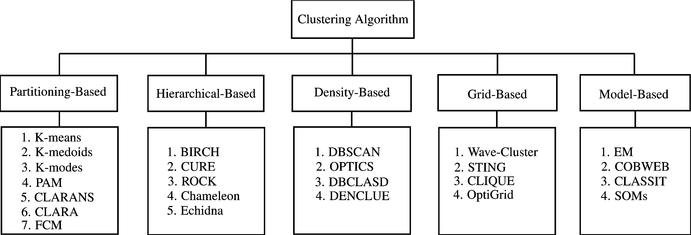
Summary

Slide 18
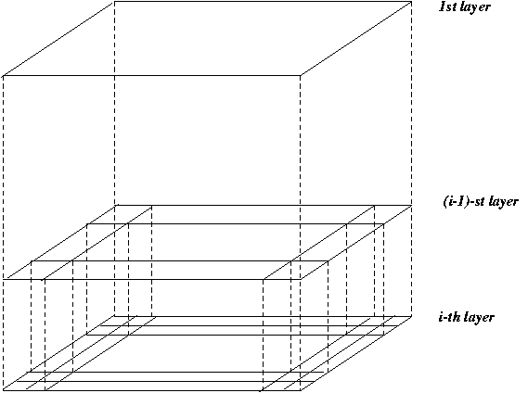





STING: A Statistical Information Grid Approach
Wang, Yang and Muntz (VLDB’97)
The spatial area aea is divided into rectangular cells
There are several levels of cells corresponding to different levels of resolution

Slide 19
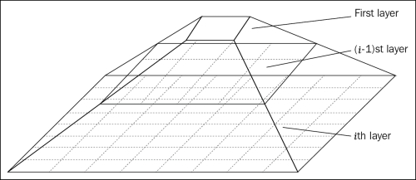



The STING Clustering Method
Each cell at a high level is partitioned into a number of smaller cells in the next lower level
Statistical info of each cell is calculated and stored beforehand and is used to answer queries
Parameters of higher level cells can be easily calculated from parameters of lower level cell
count, mean, s, min, max
type of distribution—normal, uniform, etc.
Use a top-down approach to answer spatial data queries
Start from a pre-selected layer—typically with a small number of cells
For each cell in the current level compute the confidence interval

Slide 20
Comments on STING
Remove the irrelevant cells from further consideration
When finish examining the current layer, proceed to the next lower level
Repeat this process until the bottom layer is reached
Advantages:
Query-independent, easy to parallelize, incremental update
O(K), where K is the number of grid cells at the lowest level
Disadvantages:
All the cluster boundaries are either horizontal or vertical, and no diagonal boundary is detected

Slide 21
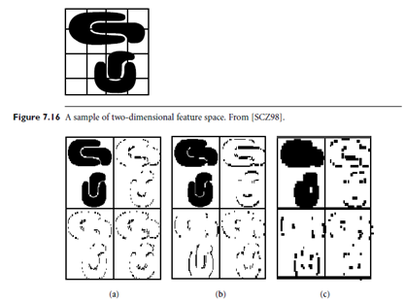
Wave Cluster: Clustering by Wavelet Analysis
Sheikholeslami, Chatterjee, and Zhang
A multi-resolution clustering approach which applies wavelet transform to the feature space
How to apply wavelet transform to find clusters
Summarizes the data by imposing a multidimensional grid structure onto data space
These multidimensional spatial data objects are represented in a n-dimensional feature space
Apply wavelet transform on feature space to find the dense regions in the feature space
Apply wavelet transform multiple times which result in clusters at different scales from fine to coarse

Slide 22
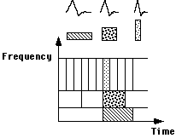
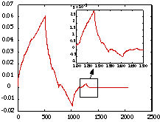
Wavelet Transform
Wavelet transform: A signal processing technique that decomposes a signal into different frequency sub-band (can be applied to n-dimensional signals)
Data are transformed to preserve relative distance between objects at different levels of resolution
Allows natural clusters to become more distinguishable

Slide 23
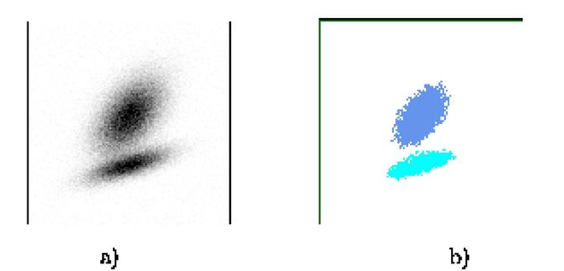
The WaveCluster Algorithm
Input parameters
# of grid cells for each dimension
the wavelet, and the # of applications of wavelet transform
Why is wavelet transformation useful for clustering?
Use hat-shape filters to emphasize region where points cluster, but simultaneously suppress weaker information in their boundary
Effective removal of outliers, multi-resolution, cost effective
Major features:
Complexity O(N)
Detect arbitrary shaped clusters at different scales
Not sensitive to noise, not sensitive to input order
Only applicable to low dimensional data
Both grid-based and density-based

Slide 24
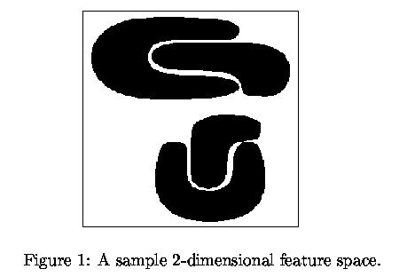
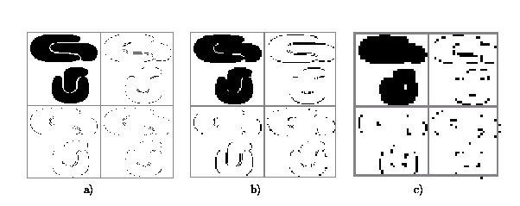
Quantization & Transformation
First, quantize data into m-D grid structure, then wavelet transform
a) scale 1: high resolution
b) scale 2: medium resolution
c) scale 3: low resolution

Slide 25
Other Cluster Methods
Partitioning Methods
Hierarchical Methods
Density-Based Methods
Grid-Based Methods
Model-Based Methods
Clustering High-Dimensional Data
Constraint-Based Clustering
Outlier Analysis

Slide 26
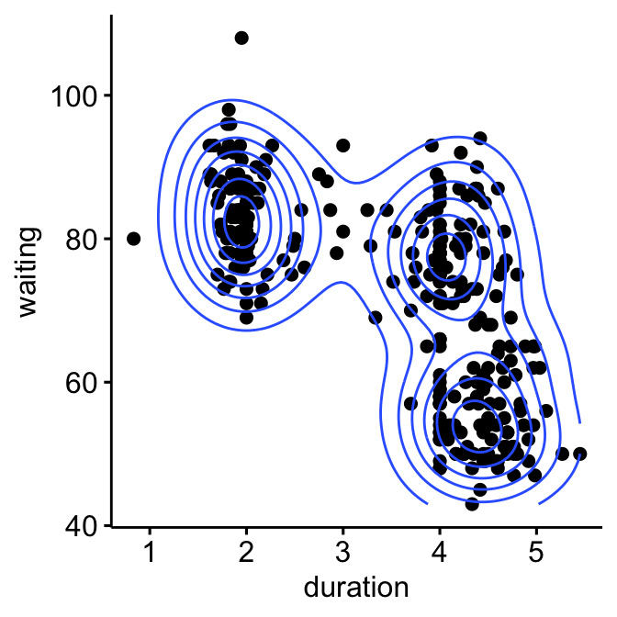
Model-Based Clustering
What is model-based clustering?
Attempt to optimize the fit between the given data and some mathematical model
Based on the assumption: Data are generated by a mixture of underlying probability distribution
Typical methods
Statistical approach
EM (Expectation maximization), AutoClass
Machine learning approach
COBWEB, CLASSIT
Neural network approach
SOM (Self-Organizing Feature Map)

Slide 27
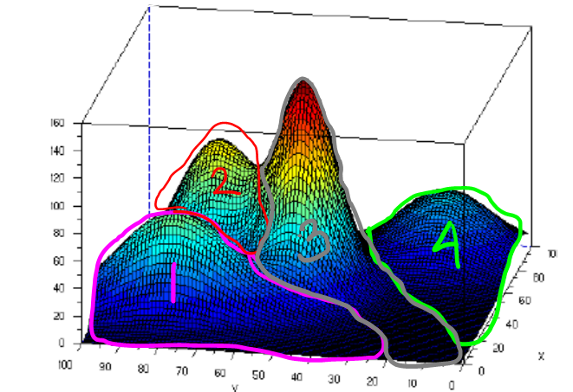
EM — Expectation Maximization
EM — A popular iterative refinement algorithm
An extension to k-means
Assign each object to a cluster according to a weight (prob. distribution)
New means are computed based on weighted measures
General idea
Starts with an initial estimate of the parameter vector
Iteratively rescores the patterns against the mixture density produced by the parameter vector
The rescored patterns are used to update the parameter updates
Patterns belonging to the same cluster, if they are placed by their scores in a particular component
Algorithm converges fast but may not be in global optima

Slide 28


The EM (Expectation Maximization) Algorithm
Initially, randomly assign k cluster centers
Iteratively refine the clusters based on two steps
Expectation step: assign each data point X_{i} to cluster C_{i} with the following probability
Maximization step:
Estimation of model parameters

Slide 29
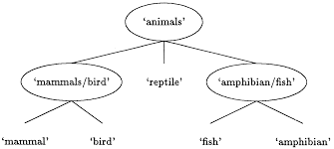
Conceptual Clustering
Conceptual clustering
A form of clustering in machine learning
Produces a classification scheme for a set of unlabeled objects
Finds characteristic description for each concept (class)
COBWEB
A popular a simple method of incremental conceptual learning
Creates a hierarchical clustering in the form of a classification tree
Each node refers to a concept and contains a probabilistic description of that concept

Slide 30
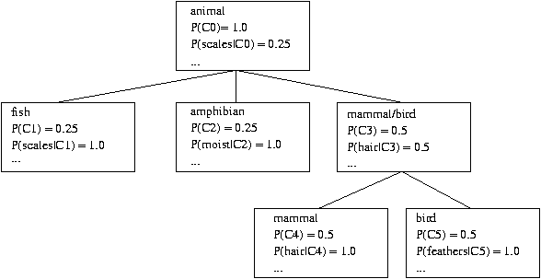
COBWEB Clustering Method
A classification tree

Slide 31
More on Conceptual Clustering
Limitations of COBWEB
The assumption that the attributes are independent of each other is often too strong because correlation may exist
Not suitable for clustering large database data – skewed tree and expensive probability distributions
CLASSIT
an extension of COBWEB for incremental clustering of continuous data
suffers similar problems as COBWEB
AutoClass (Cheeseman and Stutz, 1996)
Uses Bayesian statistical analysis to estimate the number of clusters
Popular in industry

Slide 32
Neural Network Approach
Neural network approaches
Represent each cluster as an exemplar, acting as a “prototype” of the cluster
New objects are distributed to the cluster whose exemplar is the most similar according to some distance measure
Typical methods
SOM (Soft-Organizing feature Map)
Competitive learning
Involves a hierarchical architecture of several units (neurons)
Neurons compete in a “winner-takes-all” fashion for the object currently being presented

Slide 33
Self-Organizing Feature Map (SOM)
SOMs, also called topological ordered maps, or Kohonen Self-Organizing Feature Map (KSOMs)
It maps all the points in a high-dimensional source space into a 2 to 3-d target space, s.t., the distance and proximity relationship (i.e., topology) are preserved as much as possible
Similar to k-means: cluster centers tend to lie in a low-dimensional manifold in the feature space
Clustering is performed by having several units competing for the current object
The unit whose weight vector is closest to the current object wins
The winner and its neighbors learn by having their weights adjusted
SOMs are believed to resemble processing that can occur in the brain
Useful for visualizing high-dimensional data in 2- or 3-D space

Slide 34
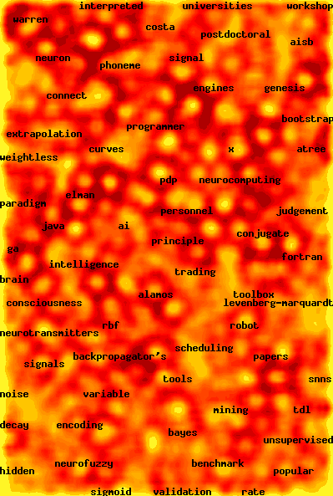
Web Document Clustering Using SOM
The result of SOM clustering of 12088 Web articles
The picture on the right: drilling down on the keyword “mining”
Based on websom.hut.fi Web page

Slide 35
Summary

Slide 36
Chapter 6. Cluster Analysis
Partitioning Methods
Hierarchical Methods
Density-Based Methods
Grid-Based Methods
Model-Based Methods
Clustering High-Dimensional Data
Constraint-Based Clustering
Outlier Analysis

Slide 37
Clustering High-Dimensional Data
Clustering high-dimensional data
Many applications: text documents, DNA micro-array data
Major challenges:
Many irrelevant dimensions may mask clusters
Distance measure becomes meaningless—due to equi-distance
Clusters may exist only in some subspaces
Methods
Feature transformation: only effective if most dimensions are relevant
PCA & SVD useful only when features are highly correlated/redundant
Feature selection: wrapper or filter approaches
useful to find a subspace where the data have nice clusters
Subspace-clustering: find clusters in all the possible subspaces
CLIQUE, ProClus, and frequent pattern-based clustering

Slide 38
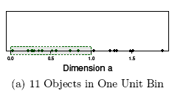
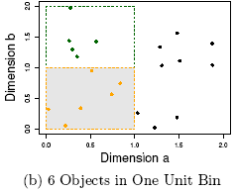
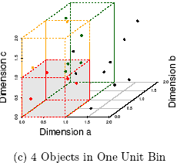
The Curse of Dimensionality (graphs adapted from Parsons et al. KDD Explorations 2004)
Data in only one dimension is relatively packed
Adding a dimension “stretch” the points across that dimension, making them further apart
Adding more dimensions will make the points further apart—high dimensional data is extremely sparse
Distance measure becomes meaningless—due to equi-distance

Slide 39
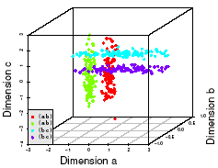
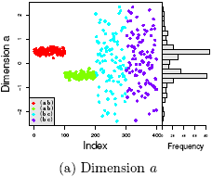
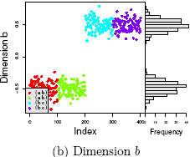
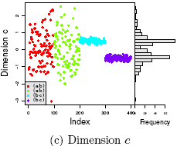
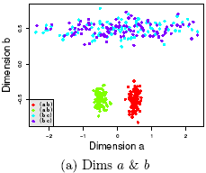
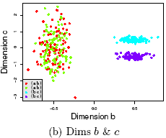
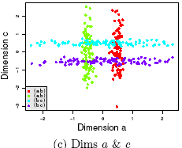
Why Subspace Clustering? (adapted from Parsons et al. SIGKDD Explorations 2004)
Clusters may exist only in some subspaces
Subspace-clustering: find clusters in all the subspaces

Slide 40
CLIQUE (Clustering In QUEst)
Agrawal, Gehrke, Gunopulos, Raghavan (SIGMOD’98)
Automatically identifying subspaces of a high dimensional data space that allow better clustering than original space
CLIQUE can be considered as both density-based and grid-based
It partitions each dimension into the same number of equal length interval
It partitions an m-dimensional data space into non-overlapping rectangular units
A unit is dense if the fraction of total data points contained in the unit exceeds the input model parameter
A cluster is a maximal set of connected dense units within a subspace

Slide 41
CLIQUE: The Major Steps
Partition the data space and find the number of points that lie inside each cell of the partition.
Identify the subspaces that contain clusters using the Apriori principle
Identify clusters
Determine dense units in all subspaces of interests
Determine connected dense units in all subspaces of interests.
Generate minimal description for the clusters
Determine maximal regions that cover a cluster of connected dense units for each cluster
Determination of minimal cover for each cluster

Slide 42
Salary (10,000)
Vacation(week)
7
7
6
6
5
5
4
4
3
3
2
2
1
1
0
age
0
age
20
30
40
50
60
20
30
40
50
60
τ = 3
Vacation
Salary
30
50
age

Slide 43
Strength and Weakness of CLIQUE
Strength
automatically finds subspaces of the highest dimensionality such that high density clusters exist in those subspaces
insensitive to the order of records in input and does not presume some canonical data distribution
scales linearly with the size of input and has good scalability as the number of dimensions in the data increases
Weakness
The accuracy of the clustering result may be degraded at the expense of simplicity of the method

Slide 44
Frequent Pattern-Based Approach
Clustering high-dimensional space (e.g., clustering text documents, microarray data)
Projected subspace-clustering: which dimensions to be projected on?
CLIQUE, ProClus
Feature extraction: costly and may not be effective?
Using frequent patterns as “features”
“Frequent” are inherent features
Mining freq. patterns may not be so expensive
Typical methods
Frequent-term-based document clustering
Clustering by pattern similarity in micro-array data (pClustering)

Slide 45
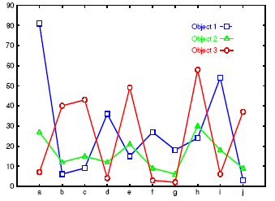
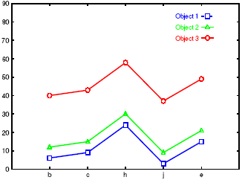
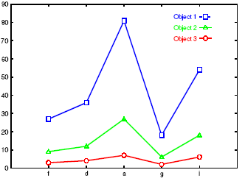
Clustering by Pattern Similarity (p-Clustering)
Right: The micro-array “raw” data shows 3 genes and their values in a multi-dimensional space
Difficult to find their patterns
Bottom: Some subsets of dimensions form nice shift and scaling patterns

Slide 46


Why p-Clustering?
Microarray data analysis may need to
Clustering on thousands of dimensions (attributes)
Discovery of both shift and scaling patterns
Clustering with Euclidean distance measure? — cannot find shift patterns
Clustering on derived attribute A_{ij} = a_{i} – a_{j}? — introduces N(N-1) dimensions
Bi-cluster using transformed mean-squared residue score matrix (I, J)
Where
A submatrix is a δ-cluster if H(I, J) ≤ δ for some δ > 0
Problems with bi-cluster
No downward closure property,
Due to averaging, it may contain outliers but still within δ-threshold

Slide 47

p-Clustering: Clustering by Pattern Similarity
Given object x, y in O and features a, b in T, pCluster is a 2 by 2 matrix
A pair (O, T) is in δ-pCluster if for any 2 by 2 matrix X in (O, T), pScore(X) ≤ δ for some δ > 0
Properties of δ-pCluster
Downward closure
Clusters are more homogeneous than bi-cluster (thus the name: pair-wise Cluster)
Pattern-growth algorithm has been developed for efficient mining
For scaling patterns, one can observe, taking logarithmic on will lead to the pScore form

Slide 48
Chapter 6. Cluster Analysis
What is Cluster Analysis?
Types of Data in Cluster Analysis
A Categorization of Major Clustering Methods
Partitioning Methods
Hierarchical Methods
Density-Based Methods
Grid-Based Methods
Model-Based Methods
Clustering High-Dimensional Data
Constraint-Based Clustering
Outlier Analysis
Summary

Slide 49
Why Constraint-Based Cluster Analysis?
Need user feedback: Users know their applications the best
Less parameters but more user-desired constraints, e.g., an ATM allocation problem: obstacle & desired clusters

Slide 50
A Classification of Constraints in Cluster Analysis
Clustering in applications: desirable to have user-guided (i.e., constrained) cluster analysis
Different constraints in cluster analysis:
Constraints on individual objects (do selection first)
Cluster on houses worth over $300K
Constraints on distance or similarity functions
Weighted functions, obstacles (e.g., rivers, lakes)
Constraints on the selection of clustering parameters
# of clusters, MinPts, etc.
User-specified constraints
Contain at least 500 valued customers and 5000 ordinary ones
Semi-supervised: giving small training sets as “constraints” or hints

Slide 51
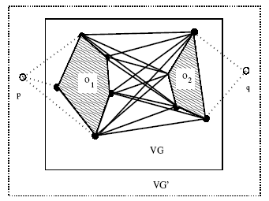
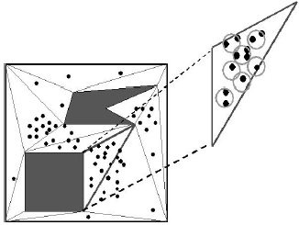
Clustering With Obstacle Objects
K-medoids is more preferable since k-means may locate the ATM center in the middle of a lake
Visibility graph and shortest path
Triangulation and micro-clustering
Two kinds of join indices (shortest-paths) worth pre-computation
VV index: indices for any pair of obstacle vertices
MV index: indices for any pair of micro-cluster and obstacle indices

Slide 52
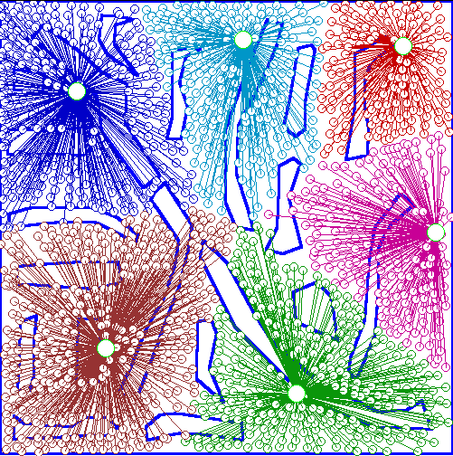
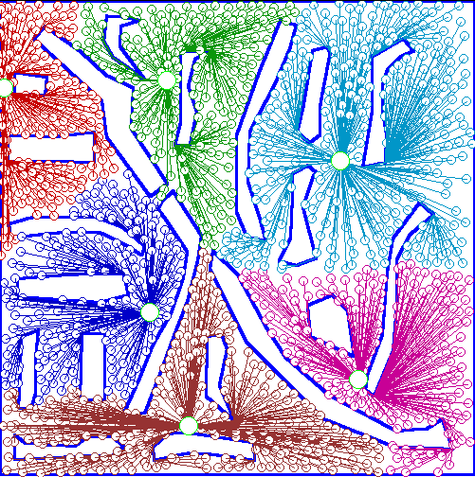
An Example: Clustering With Obstacle Objects
Not Taking obstacles into account
Taking obstacles into account

Slide 53
Clustering with User-Specified Constraints
Example: Locating k delivery centers, each serving at least m valued customers and n ordinary ones
Proposed approach
Find an initial “solution” by partitioning the data set into k groups and satisfying user-constraints
Iteratively refine the solution by micro-clustering relocation (e.g., moving δ μ-clusters from cluster C_{i} to C_{j}) and “deadlock” handling (break the microclusters when necessary)
Efficiency is improved by micro-clustering
How to handle more complicated constraints?
E.g., having approximately same number of valued customers in each cluster?! — Can you solve it?

Slide 54
Chapter 7. Cluster Analysis
What is Cluster Analysis?
Types of Data in Cluster Analysis
A Categorization of Major Clustering Methods
Partitioning Methods
Hierarchical Methods
Density-Based Methods
Grid-Based Methods
Model-Based Methods
Clustering High-Dimensional Data
Constraint-Based Clustering
Outlier Analysis
Summary

Slide 55
What Is Outlier Discovery?
What are outliers?
The set of objects are considerably dissimilar from the remainder of the data
Example: Sports: Michael Jordon, Wayne Gretzky, ...
Problem: Define and find outliers in large data sets
Applications:
Credit card fraud detection
Telecom fraud detection
Customer segmentation
Medical analysis

Slide 56
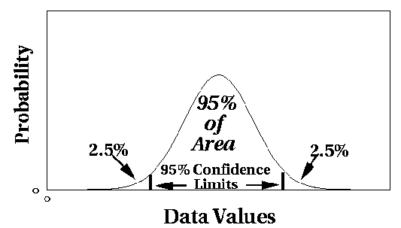
Outlier Discovery: Statistical Approaches
Assume a model underlying distribution that generates data set (e.g. normal distribution)
Use discordancy tests depending on
data distribution
distribution parameter (e.g., mean, variance)
number of expected outliers
Drawbacks
most tests are for single attribute
In many cases, data distribution may not be known

Slide 57
Outlier Discovery: Distance-Based Approach
Introduced to counter the main limitations imposed by statistical methods
We need multi-dimensional analysis without knowing data distribution
Distance-based outlier: A DB(p, D)-outlier is an object O in a dataset T such that at least a fraction p of the objects in T lies at a distance greater than D from O
Algorithms for mining distance-based outliers
Index-based algorithm
Nested-loop algorithm
Cell-based algorithm

Slide 58
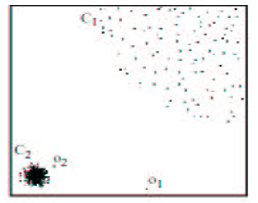
Density-Based Local Outlier Detection
Distance-based outlier detection is based on global distance distribution
It encounters difficulties to identify outliers if data is not uniformly distributed
Ex. C₁ contains 400 loosely distributed points, C₂ has 100 tightly condensed points, 2 outlier points o₁, o₂
Distance-based method cannot identify o₂ as an outlier
Need the concept of local outlier
Local outlier factor (LOF)
Assume outlier is not crisp
Each point has a LOF

Slide 59
Summary

Slide 60
Outlier Discovery: Deviation-Based Approach
Identifies outliers by examining the main characteristics of objects in a group
Objects that “deviate” from this description are considered outliers
Sequential exception technique
simulates the way in which humans can distinguish unusual objects from among a series of supposedly like objects
OLAP data cube technique
uses data cubes to identify regions of anomalies in large multidimensional data

