Slide 1
for Loop
Alternative counter loop
Could be done with a while loop
i = 0;
while( i < 5 )
{
cout << i << “ ”;
i++;
}
Provides a distinct, clear way to do counter loops
for( i = 0 ; i < 5 ; i ++ )
{
cout << i << “ ”;
}

Slide 2
for Loop
for( i = 0 ; i < 5 ; i++ )
{
cout << i << “ ”;
}
Initialization
i = 0
Sets the initial value of the counter variable
Condition
i < 5
Specifies the condition for continuing to loop
Update
i++
Updates the counter variable

Slide 3
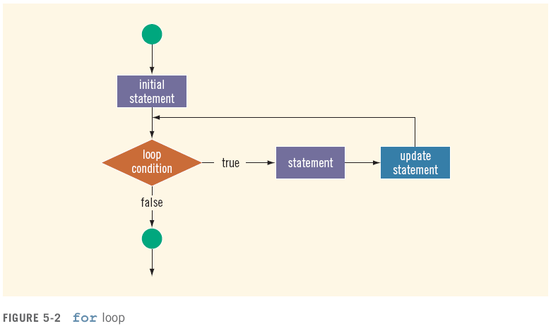
for Loop

Slide 4
for Loop Examples
for( i = 0 ; i < 5 ; i++ )
{
cout << i << “ ”;
}
Different starting points
Complex conditions
Different counter updates
Increment (i++) vs. decrement (i--)
Count by multiples (i = i + 3)

Slide 5
for Loop Examples

Slide 6
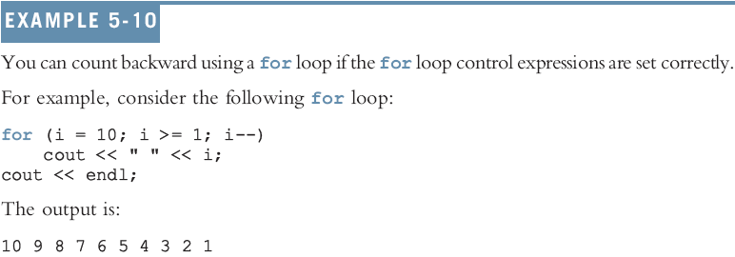
for Loop Examples

Slide 7
Choosing the Right Looping Structure
All three loops have their place in C++
If you know or can determine in advance the number of repetitions needed, the for loop is the correct choice
If you do not know and cannot determine in advance the number of repetitions needed, and it could be zero, use a while loop
If you do not know and cannot determine in advance the number of repetitions needed, and it is at least one, use a do...while loop

Slide 8
Nested Loops
i | j
for (i = 1; i <= 5; i++)
{
for (j = 1; j <= i; j++)
{
cout << "*";
}
cout << endl;
}

Slide 9
Nested Loops
i | j
1 | 1
2 | 1
 | 2
3 | 1
 | 2
 | 3
4 | 1
 | 2
 | 3
 | 4
5 | 1
 | 2
 | 3
 | 4
 | 5
for (i = 1; i <= 5; i++)
{
for (j = 1; j <= i; j++)
{
cout << "*";
}
cout << endl;
}
Outputs:
*
**
***
****
*****

Slide 10
Exercise
Draw the pattern created by this code (the top for statement has changed):
for (i = 5; i >= 1; i--)
{
for (j = 1; j <= i; j++)
{
cout << "*";
}
cout << endl;
}

