Slide 1





Slide 2
Arrays and functions
Arrays can be passed as parameters to functions
Formal array parameters must have an empty []
void myArrayFunction( int one, int many[] );
An array parameter is used just like an array local variable
But, arrays are implicitly passed by reference!
All changes to an array parameter change memory outside the function scope
You never would have a formal parameter int &many[]

Slide 3
Arrays and functions
When calling a function with an array parameter:
You must provide an array variable for that parameter
It will be passed in by reference
Syntax: just the variable name, like any other parameter
Note the difference syntax for the formal parameter vs. the actual parameter
int my_function( int param[] );
…
int x, array_var[20];
x = my_function(array_var);

Slide 4
Arrays and functions
Four different array syntaxes
Declaration
int y[50]
Subscript notation to specify the size / length of the array
Accessing an element
y[20]
Subscript notation to specify the index
Formal parameter
y[] // define / declare a function parameter
Must tell the function that the parameter is an array (not a regular variable)
Actual parameter
int y; // a variable
y; // the value of the variable y;
No additional information necessary

Slide 6
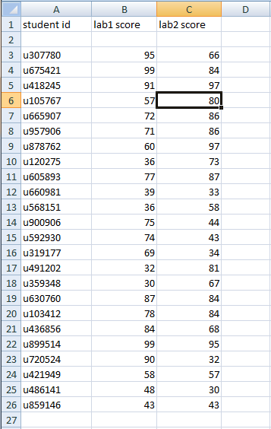
Using Arrays in Parallel
Data is often organized along more than one dimension
This is why spreadsheets are so useful
Rows represent entities
Columns represent information
How would you represent this data in a C++ program?
0 | 1 | 2 | 3 | 4
Ed | John | Peter | Mary | Pedro
99 | 100 | 100 | 100 | 98
name_array[1] ⬄ John
lab1[1] <=> the grade of lab 1 for John

Slide 7
Using Arrays in Parallel
Data is often organized along more than one dimension
This is why spreadsheets are so useful
Rows represent entities
Columns represent information
How would you represent this data in a C++ program?
A 2-dimensional array
Limited to one data type (int)
3 arrays used in parallel
Can have different column types

Slide 8
Using Arrays in Parallel
Declare three arrays of the same length
string id[24];
int lab1[24];
int lab2[24];
The values for a row are found at the same position/index in the three arrays
Row 10 ID: id[9]
Row 10 lab1 score: lab1[9]
Row 10 lab2 score: lab2[9]

Slide 9
Example: employee data
For each employee, we have:
Name
Position
Review score
For example, in our text file:
peter manager 86
michael developer 68
samir developer 75
lumbergh vp 82
Declare variables to hold the data
Read from the file into the variables
Print out the data

