Slide 1
clustering

Slide 2
What is Cluster Analysis?
Given a set of objects, place them in groups such that:
the objects in a group are similar (or related)
different from (or unrelated to) the objects in other groups
Inter-cluster distances are maximized
Intra-cluster distances are minimized

Slide 3
Clustering Algorithms
K-means and its variants
Hierarchical clustering
Density-based clustering

Slide 4
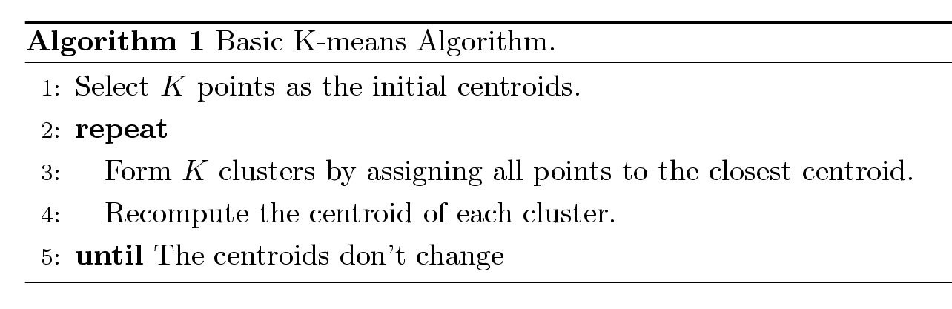
K-means Clustering
Partitional clustering approach
Number of clusters, K, must be specified
Each cluster is associated with a centroid
Each point is assigned to the cluster with the closest centroid
The basic algorithm is very simple

Slide 5


Example of K-means Clustering

Slide 6
Example of K-means Clustering

Slide 7
K-means Clustering – Details
Simple iterative algorithm.
Choose initial centroids;
repeat {assign each point to a nearest centroid; re-compute cluster centroids}
until centroids stop changing.
Initial centroids are often chosen randomly.
Clusters produced can vary from one run to another
The centroid is (typically) the mean of the points in the cluster, but other definitions are possible
K-means will converge for common proximity measures with appropriately defined centroid
Most of the convergence happens in the first few iterations.
Often the stopping condition is changed to ‘Until relatively few points change clusters’
Complexity is O( n * K * I * d )
n = number of points, K = number of clusters, I = number of iterations, d = number of attributes

Slide 8
K-means Objective Function
A common objective function (used with Euclidean distance measure) is Sum of Squared Error (SSE)
For each point, the error is the distance to the nearest cluster center
To get SSE, we square these errors and sum them.
x is a data point in cluster C_{i} and m_{i} is the centroid (mean) for cluster C_{i}
SSE improves in each iteration of K-means until it reaches a local or global minima.

Slide 9
Two different K-means Clustering
Original Points
Optimal Clustering
Sub-optimal Clustering

Slide 10
Importance of Choosing Initial Centroids …

Slide 11
Importance of Choosing Initial Centroids …

Slide 12
Solutions to Initial Centroids Problem
Multiple runs
Use some strategy to select the k initial centroids and then select among these initial centroids
Select most widely separated
K-means++ is a robust way of doing this selection
Use hierarchical clustering to determine initial centroids
Bisecting K-means
Not as susceptible to initialization issues

Slide 13
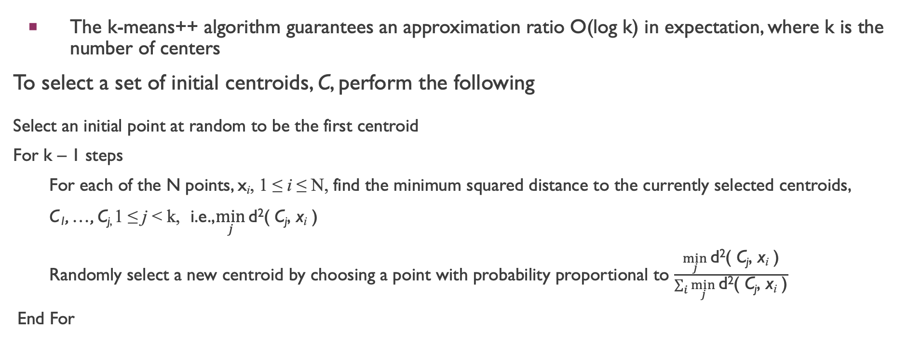

K-means++
The k-means++ algorithm guarantees an approximation ratio O(log k) in expectation, where k is the number of centers
To select a set of initial centroids, C, perform the following
Select an initial point at random to be the first centroid
For k – 1 steps
For each of the N points, x_{i}, 1 ≤ i ≤ N, find the minimum squared distance to the currently selected centroids,
C₁, …, C_{j,} 1 ≤ j < k, i.e.,$\min_{j}{\text{d}\text{2}\text{( }\text{C}\text{j}\text{, }\text{x}\text{i}\text{ )}}$
Randomly select a new centroid by choosing a point with probability proportional to $\frac{\min_{j}{\text{d}\text{2}\text{( }\text{C}\text{j}\text{, }\text{x}\text{i}\text{ )}}}{\sum_{i}{\min_{j}{\text{d}\text{2}\text{( }\text{C}\text{j}\text{, }\text{x}\text{i}\text{ )}}}}$
End For

Slide 14
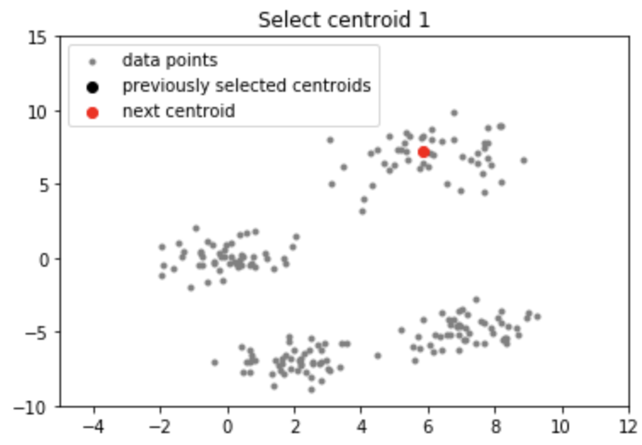
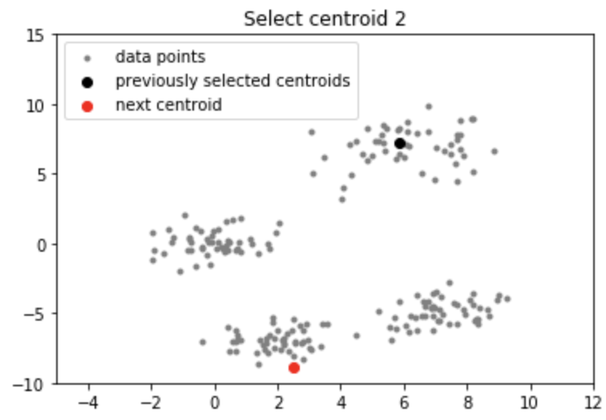
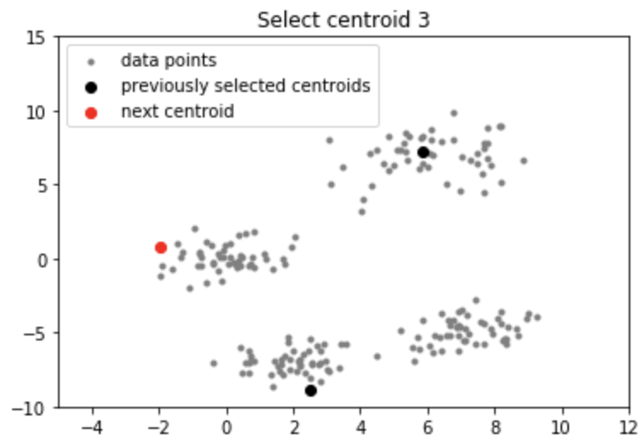
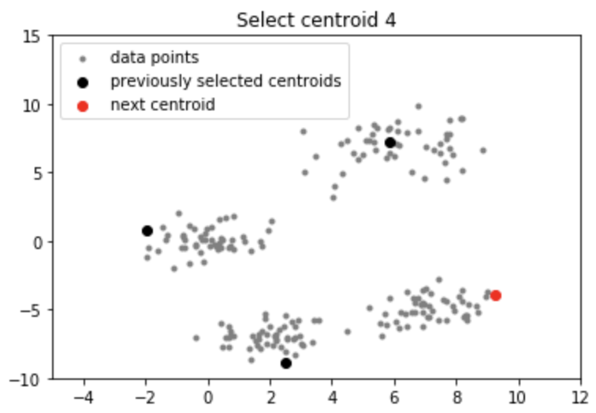
K-mean++

Slide 15
Bisecting K-means
Bisecting K-means algorithm
Variant of K-means that can produce a partitional or a hierarchical clustering

Slide 16
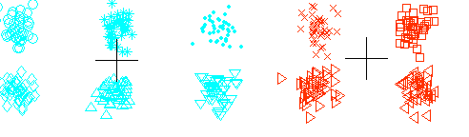
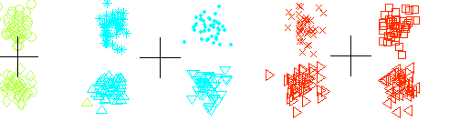
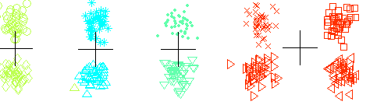
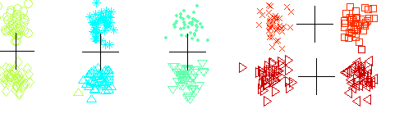
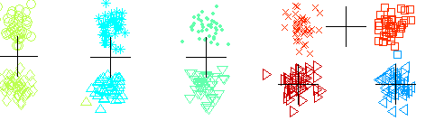
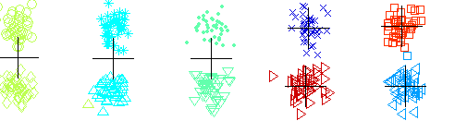
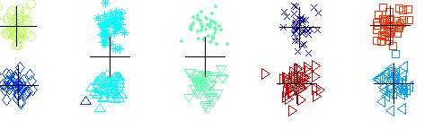
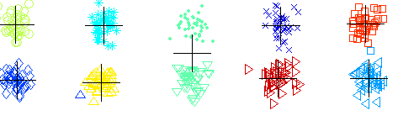
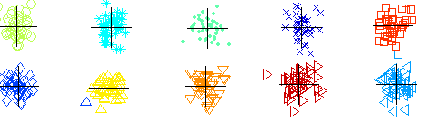
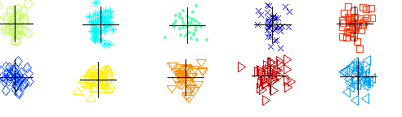
Bisecting K-means Example

Slide 17



Limitations of K-means
K-means has problems when clusters are of differing
Sizes
Densities
Non-globular shapes
K-means has problems when the data contains outliers.
One possible solution is to remove outliers before clustering

Slide 18
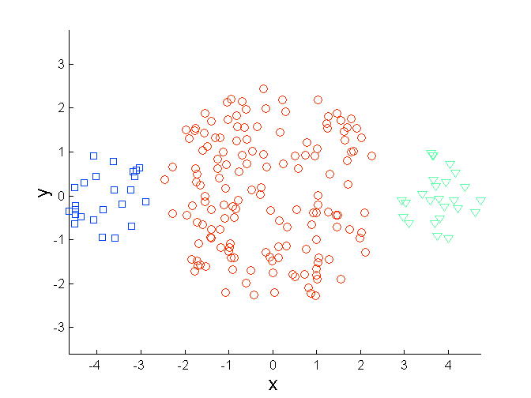
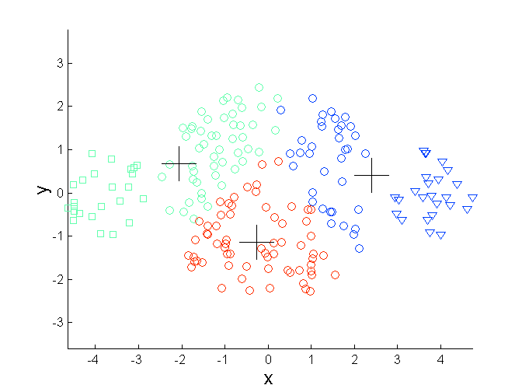
Limitations of K-means: Differing Sizes
Original Points
K-means (3 Clusters)

Slide 19
Data Mining pipeline
1. Data pre-processing for the entire dataset:
Remove outlines from the entire dataset
Remove noises from the entire dataset
Re-calculate the features (derived features)
2. split the entire data into training, validation, and testing (k-folder cross validation)
3. model selection based on different measures

Slide 20
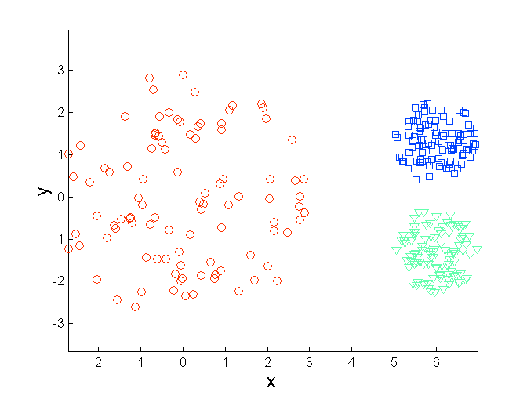
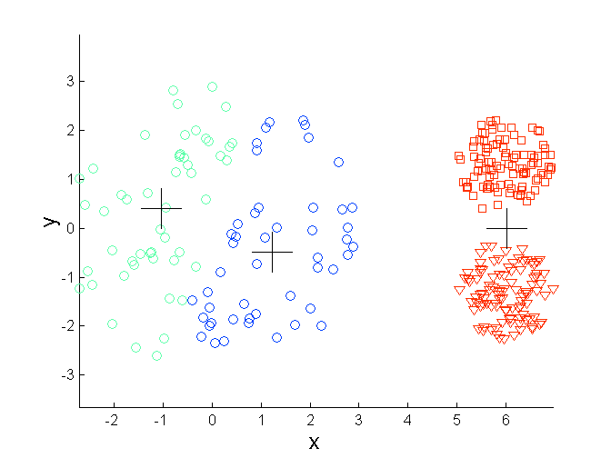
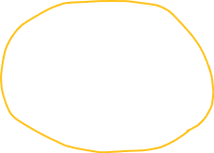

Limitations of K-means: Differing Density
Original Points
K-means (3 Clusters)

Slide 21
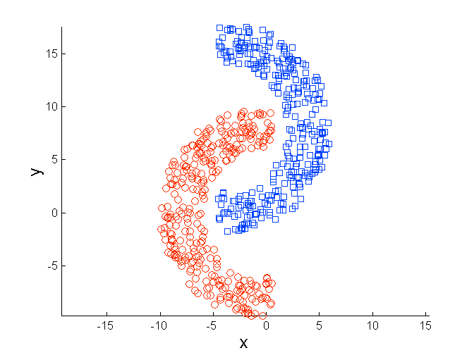
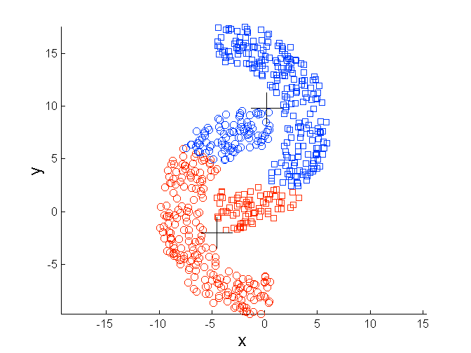
Limitations of K-means: Non-globular Shapes
Original Points
K-means (2 Clusters)

Slide 22
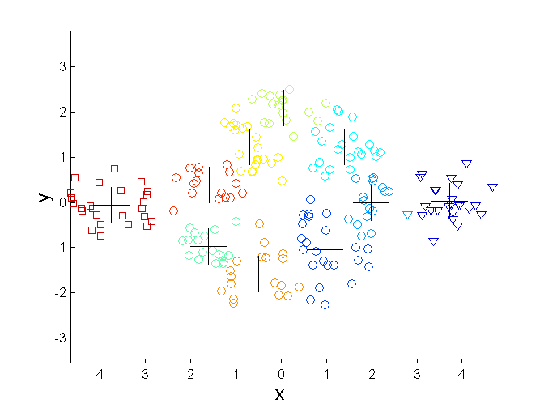
Overcoming K-means Limitations
Original Points K-means Clusters
One solution is to find a large number of clusters such that each of them represents a part of a natural cluster. But these small clusters need to be put together in a post-processing step.

Slide 23
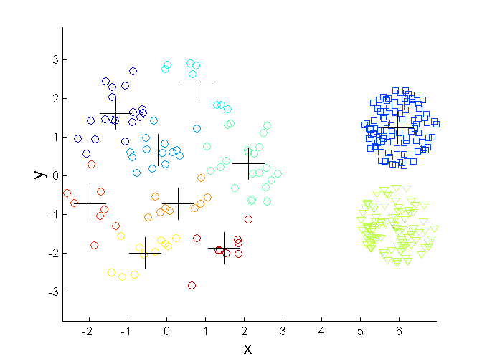
Overcoming K-means Limitations
Original Points K-means Clusters
One solution is to find a large number of clusters such that each of them represents a part of a natural cluster. But these small clusters need to be put together in a post-processing step.

Slide 24
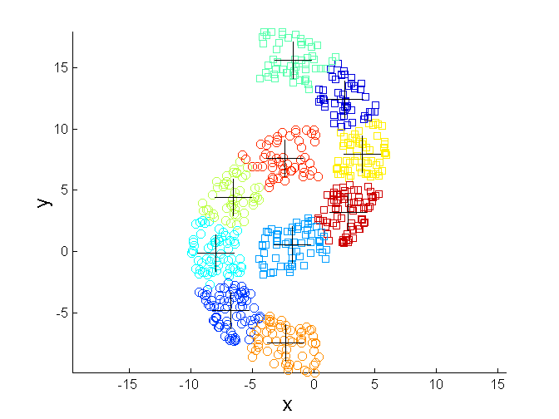
Overcoming K-means Limitations
Original Points K-means Clusters
One solution is to find a large number of clusters such that each of them represents a part of a natural cluster. But these small clusters need to be put together in a post-processing step.

