Slide 1
Class

Slide 2
Review: Array
Students in a class:
Mary | John | Eric | Katy | Tim

Slide 3
Review: Parallel Array
Students in a class:
Mary | John | Eric | Katy | Tim
1111 | 1121 | 1234 | 3214 | 1232
9 | 8 | 7 | 6 | 5

Slide 4
Class
e2
Employee:
e3
e1
Name
ID
KPI
Name
ID
KPI
Name
ID
KPI

Slide 5
Class
Employee in a class:
e[0] | e[1] | e[2] | e[3] | e[4]
Name
ID
kpi
Name
ID
kpi
Name
ID
kpi
Name
ID
kpi
Name
ID
kpi

Slide 6
Structured data
Parallel arrays aren’t a natural fit for heterogeneous rows of data
One set of names, one set of ID, one set of GPAs
What we have is structured data
Name, ID, GPA for each employee
One set of employees
For a single employee we could do:
string name;
double id;
double kpi;
Allocates memory space for 1 strings and 2 double

Slide 7
Using classes
C++ provides classes to group structured data together
class Employee
{
public:
string name;
int id;
int kpi;
};
This is a class definition
Give the class a name - Employee
Tell the compiler what the parts of the class are
Each part has a type and a name (looks just like a variable)
The parts of a class are called members

Slide 8
Using classes
C++ provides classes to group structured data together
class Employee
{
public:
string name;
int id;
int kpi;
};

Slide 9
Using classes
Defining the class creates a blueprint
No memory is allocated yet
The class is used as a data type in a variable declaration:
Variable declaration is always:
type name;
So in this example:
int num;
num = 10;
Employee e1;
e1.name = “peter”;
This variable declaration:
Allocates memory space for an instance of the class
2 strings, 1 int
Names that memory space
A class instance is also called an object

Slide 10
Using class objects
With arrays, you always have to indicate which element in the array you want to use
Using the array subscript operator []
E.g. this_array[15]
With class objects, you have to indicate which part of the class you want to use
The member access operator (.) indicates part of an object
The parts are used like any other variable:
e1.name = “peter”;
cin >> emp.id;
e1.kpi= e1.kpi + 1;

Slide 11
Linked List
Notes:
A linked list is a sequence of items arranged one after another.
• Each item in list is connected to the next item via a link
• Each item is placed together with the link to the next item, resulting in a simple component called a node.

Slide 12
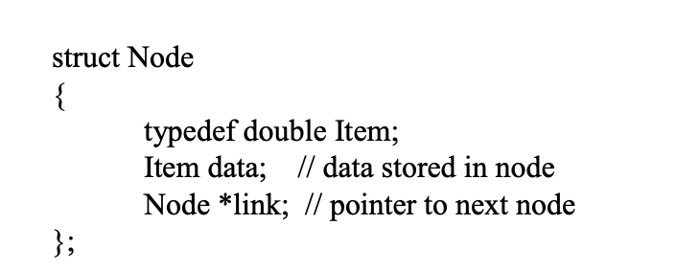
Declare a Call for Node
Notes:
A struct is a special kind of class where all members are public
e two public member variables: data, link
Whenever a program needs to refer to the item type, we can use the expression Node::Item.

Slide 13
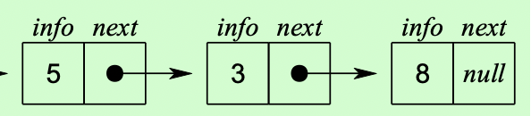
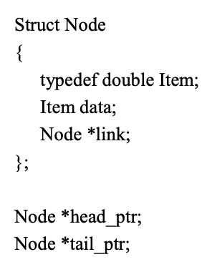
Linked List
Head_ptr
tail_ptr
Notes:
Usually, programs do not actually declare node variables. Instead, the list is accessed through one or more pointers to nodes.
Head_pointer
Tail_pointer

Slide 14
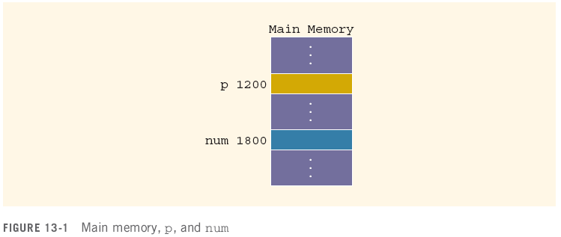
Variables, Memory and Pointers
A variable is a named piece of memory
The name stands in for the memory address
int num;//allocate memory to it first
num = 10;
10

Slide 15
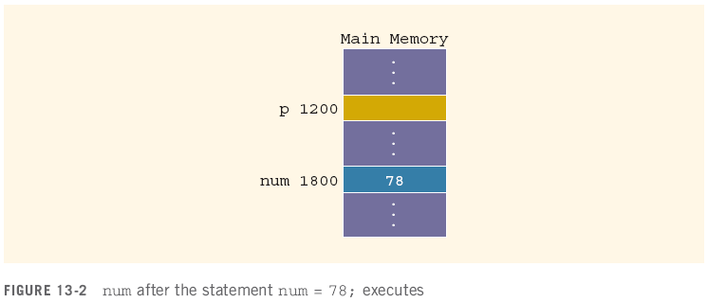
Variables, Memory and Pointers
When a value is assigned to a variable, it is stored at that address in memory
num = 78;

Slide 16
Variables, Memory and Pointers
A pointer is a variable that holds the address of another variable
It is declared in terms of the type of variable it points at:
int *p; // given a * in front of a variable, it means that this variable is a pointer.
int num; num = 78;

Slide 17
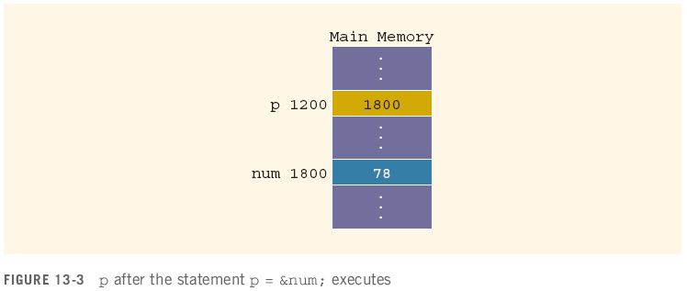
Variables, Memory and Pointers
The operator & returns the address of a variable
It can then be assigned to a pointer
p = &num;
// &num => the address of the variable num ⬄ 1800
// assign the address of num to the value of p.
&num
p

Slide 18
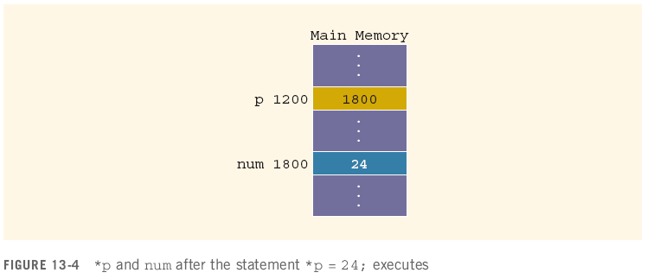
Variables, Memory and Pointers
The operator * takes an address (a pointer) and returns the location in memory being pointed to
Can only be applied to a pointer
*p = 24;
int *q; // define a pointer;
*q = 30; // assign 30 to the variable that the pointer pointed to.

Slide 19
Declaring Pointer Variables
Syntax:
Examples:
int *p;
char *ch;
These statements are equivalent:
int *p;
int* p;
int * p;

Slide 20
Declaring Pointer Variables (continued)
In the statement:
int* p, q; // p is a pointer; q is variable
int num1, num2; ⬄ int num1; int num2;
only p is the pointer variable, not q; here q is an int variable
To avoid confusion, attach the character * to the variable name:
int *p, q;
int *p, *q;
int array1[100], array2[20];

Slide 21
Address of Operator (&)
The ampersand, &, is called the address of operator
The address of operator is a unary operator that returns the address of its operand

Slide 22

Dereferencing Operator (*)
When used as a unary operator, * is the dereferencing operator or indirection operator
Refers to object to which its operand points
Example:
To print the value of x, using p:
To store a value in x, using p:
Variable name | address | value
x | 153 | 55
p (pointer) | 1008 | 153

Slide 23
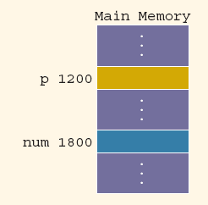
Exercise
Assuming the memory layout provided, after this code executes:
int num; // declare an integer variable
int *p; // declare a pointer named: p
num = 50; // assign 50 to variable num
p = &num;
//1. assign a pointer p to the variable num;
//2. assign the address of num (1800) to the value of the pointer p
*p = 38;
//assign 38 to *p (the value of the pointer pointed to)
// the value of num = 38
What are the values of these expressions?
&num = 1800; // &num: the address of the variable num
num = ? // value of num = 38
&p = ? // &: address of something; &p: the address of the pointer p 1200
p = ? // the value of p ⬄ the address that the pointer pointed to, 1800.
*p = ? // *p: the value of the pointer pointed to, 38.

Slide 24
Assigning Pointers
Pointers can be assigned to pointers of the same type
int x, *p, *q; //declare one variable x, and 2 pointers p, q
x = 50; // the value of x = 50
p = &x;
//1. a pointer p points to the variable x
//2. assign the address of x to the value of the pointer p
q = p; // q is a pointer; assign the value of p to the value of q ⬄ both pointers p and q are assigned to variable x.
The value of *q is?
*q: the value that the pointer q pointed to
So *q is 50
Variable name | address | value
x | 153 | 50
p (pointer) | 1008 | 153
q (pointer) | 17 | 153

Slide 25
Assigning Pointers
Pointers can be assigned to pointers of the same type
int x, *p, *q;
x = 50;
p = &x;
q = p;
The value of *q is 50

Slide 26
The Null Pointer
In addition to variable addresses and other pointers, a pointer can be assigned to the null pointer
Either the number 0 or the constant NULL
Used to indicate an invalid pointer (pointing to nothing)
Dereferencing a null pointer causes a hard error
int *p = 0;
p = NULL;
*p //dereferencing

Slide 27
Comparing Pointers
Be careful of the difference between comparing two pointers and comparing their values:
int x = 50, y = 50, *p, *q;
p = &x;
q = &y;
*q == *p evaluates to?
q == p evaluates to?

Slide 28
Comparing Pointers
Be careful of the difference between comparing two pointers and comparing their values:
int x = 50, y = 50, *p, *q;
p = &x;
q = &y;
*q == *p evaluates to true
q == p evaluates to false

Slide 29
Pointers and Class
class A
{
public:
char a, b, c;
int r[7];
};
Class | A
 | Public variables:
 |  | char | a = ‘7’
 |  | char | b = ‘a’
 |  | char | c = ‘a’
 |  | int | r[7]
value |  |  |  |  |  | 5
index | 0 | 1 | .. | … | .. | 6

Slide 30
Pointers and Class
A x; // declare an object named x with the type of the class A.
x.a = '7';
x.b = 'b';
x.c = 'a’;
A *p; // declare a pointer named p with the type A. p = &x;
(*p).a = '8';
(*p).b = 'b';
p->b = 'a’; // 1. p is a pointer;
// 2. p points to an object;
// 3. one element of this object is b;
// 4. we are updated the value of the element b for this object ( the object that the pointer p points to).
p->r[6] = 5;
cout << x.r[6] << endl;
int num;
num = 78;
p = &num;
y.a = ‘9’;
y.b = ‘b’;

Slide 31
Pointers and Classes
A pointer to a class object is no different than a pointer to any other type of variable
Given:
class album
{
public:
string title;
string artist;
int tracks;
double price;
};
album stock[100];
album *pick;

Slide 32
Pointers and Classes
A particular album can be selected by assignment:
pick = album;
pick = pick + 49;
or
pick = &(album[49]);
The members of that album are accessed by a combination of dereference (*) and membership (.):
(*pick).title = “Listener Supported”;
There is also a syntactic shortcut:
pick->title = “Listener Supported”;

