Slide 1
Class

Slide 2
Review: Array
Students in a class:
Mary | John | Eric | Katy | Tim

Slide 3
Review: Parallel Array
Students in a class:
Mary | John | Eric | Katy | Tim
1111 | 1121 | 1234 | 3214 | 1232
9 | 8 | 7 | 6 | 5

Slide 4
Class
e2
Employee:
e3
e1
Name
ID
KPI
Name
ID
KPI
Name
ID
KPI

Slide 5
Class
Employee in a class:
e[0] | e[1] | e[2] | e[3] | e[4]
Name
ID
kpi
Name
ID
kpi
Name
ID
kpi
Name
ID
kpi
Name
ID
kpi

Slide 6
Structured data
Parallel arrays aren’t a natural fit for heterogeneous rows of data
One set of names, one set of ID, one set of GPAs
What we have is structured data
Name, ID, GPA for each employee
One set of employees
For a single employee we could do:
string name;
double id;
double kpi;
Allocates memory space for 1 strings and 2 double

Slide 7
Using classes
C++ provides classes to group structured data together
class Employee
{
public:
string name;
int id;
int kpi;
};
This is a class definition
Give the class a name - Employee
Tell the compiler what the parts of the class are
Each part has a type and a name (looks just like a variable)
The parts of a class are called members

Slide 8
Using classes
C++ provides classes to group structured data together
class Employee
{
public:
string name;
int id;
int kpi;
};

Slide 9
Using classes
Defining the class creates a blueprint
No memory is allocated yet
The class is used as a data type in a variable declaration:
Variable declaration is always:
type name;
So in this example:
int num;
num = 10;
Employee e1;
e1.name = “peter”;
This variable declaration:
Allocates memory space for an instance of the class
2 strings, 1 int
Names that memory space
A class instance is also called an object

Slide 10
Using class objects
With arrays, you always have to indicate which element in the array you want to use
Using the array subscript operator []
E.g. this_array[15]
With class objects, you have to indicate which part of the class you want to use
The member access operator (.) indicates part of an object
The parts are used like any other variable:
e1.name = “peter”;
cin >> emp.id;
e1.kpi= e1.kpi + 1;

Slide 11
Linked List
Notes:
A linked list is a sequence of items arranged one after another.
• Each item in list is connected to the next item via a link
• Each item is placed together with the link to the next item, resulting in a simple component called a node.

Slide 12
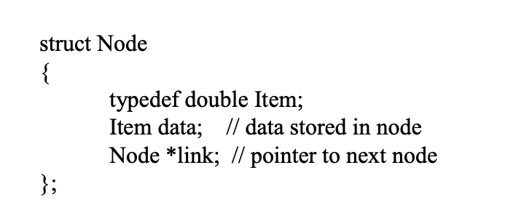
Declare a Call for Node
Notes:
A struct is a special kind of class where all members are public
e two public member variables: data, link
Whenever a program needs to refer to the item type, we can use the expression Node::Item.

Slide 13
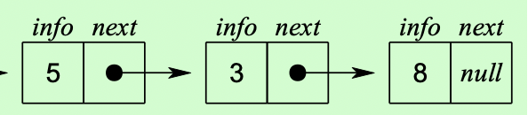
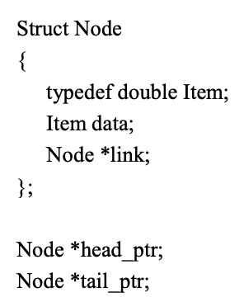
Linked List
Head_ptr
tail_ptr
https://www.cs.bu.edu/fac/gkollios/cs113/Slides/linkedlist.pdf
Notes:
Usually, programs do not actually declare node variables. Instead, the list is accessed through one or more pointers to nodes.
Head_pointer
Tail_pointer

Slide 18
Linked List
Notes:
A linked list is a sequence of items arranged one after another.
• Each item in list is connected to the next item via a link
• Each item is placed together with the link to the next item, resulting in a simple component called a node.

