Slide 1


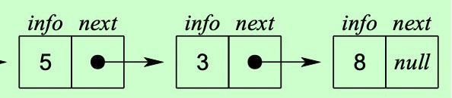
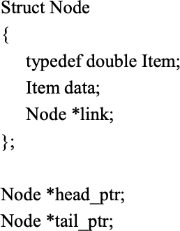
Linked List
Head_ptr
tail_ptr

Slide 2

Doubly Linked List

Slide 3

Node data
info: the user's data
next, back pointer: the address of the next and previous node in the list

Slide 4

Node data (cont.)
struct Node { string name;
Node *prev, *next;
};
Node* NodePtr;

Slide 5
Node data (cont.)
struct Node { int item;
Node *prev, *next;
};
typedef Node* NodePtr;
10
 | 20
 | 40
 | 55
70

Slide 6

Doubly Linked List Operations
insertNode(NodePtr Head, int item)
//add new node to ordered doubly linked list
deleteNode(NodePtr Head, int item)
//remove a node from doubly linked list
searchNode(NodePtr Head, int item)
print(NodePtr Head, int item)

Slide 7

Deleting a Node
Delete a node Cur (not at front or rear)
(Cur->prev)->next | = | Cur->next;
(Cur->next)->prev delete Cur; | = | Cur->prev;
10
 | 20
 | 40
 | 55
70
Head
Cur

Slide 8

Inserting a Node
Insert a node New before Cur (not at front or rear)
New->next | = | Cur;
New->prev | = | Cur->prev;
Cur->prev | = | New;
(New->prev)->next = New;
10
 | 20
55
70
 | 40
Head
Cur
New

Slide 9


Doubly Linked Lists with Dummy Head Node
To simplify insertion and deletion by avoiding
special cases of
deletion and insertion at front and
rear, a dummy head node is added at the head of the list
The last node also points to the dummy head node as its successor

Slide 10

Doubly Linked Lists with Dummy Head
– Non-Empty List
Dummy Head Node
10 20 40 55
70
Head
– Empty List
Dummy Head Node
Head

Slide 11
void createHead(NodePtr& Head){ Head = new Node;
Head->next = Head; Head->prev = Head;
}

Slide 12
Deleting a Node
Delete a node Cur at front
(Cur->prev)->next = Cur->next; (Cur->next)->prev = Cur->prev; delete Cur;
Dummy Head Node
10
20
40
55
70
Head
Cur

Slide 13
Delete a node Cur in the middle
(Cur->prev)->next = Cur->next; (Cur->next)->prev = Cur->prev;
delete Cur; // same as delete front!
Dummy Head Node
10
20
40
55
70
Cur
Head

Slide 14
Delete a node Cur at rear
(Cur->prev)->next = Cur->next; (Cur->next)->prev = Cur->prev;
delete Cur; // same as delete front and middle!
Dummy Head Node
10
20
40
55
70
Head
Cur

Slide 15
void deleteNode(NodePtr Head, int item){ NodePtr Cur;
Cur = searchNode(Head, item); if(Cur != NULL){
Cur->prev->next = Cur->next;
Cur->next->prev = Cur->prev; delete Cur;
}
}

Slide 16
Inserting a Node
Insert a Node New after dummy node and before
Cur
New->next | = | Cur;
New->prev | = | Cur->prev;
Cur->prev | = | New;
(New->prev)->next = New;
Dummy Head Node
20
10
Head
New
Cur

Slide 17
Insert a Node New in the middle and before Cur
New->next | = | Cur;
New->prev | = | Cur->prev;
Cur->prev | = | New;
(New->prev)->next = New; // same as insert front!
Dummy Head Node
10
20
55
40
New
Cur
Head

Slide 18
Insert a Node New at Rear (with Cur pointing to dummy head)
New->next = Cur;
New->prev = Cur->prev; Cur->prev = New;
(New->prev)->next = New; // same as insert front!
Dummy Head Node
10
20
40
55
70
Cur
Head
New

Slide 19
Insert a Node New to Empty List (with Cur
pointing to dummy head node)
New->next | = | Cur;
New->prev | = | Cur->prev;
Cur->prev | = | New;
(New->prev)->next = New;
Dummy Head Node
20
Head Cur
New

Slide 20
void insertNode(NodePtr Head, int item){ NodePtr New, Cur;
New = new Node; New->data = item;
Cur = Head->next;
while(Cur != Head){ //position Cur for insertion if(Cur->data < item)
Cur = Cur->next;
else
break;
}
New->next | = | Cur;
New->prev | = | Cur->prev;
Cur->prev | = | New;
(New->prev)->next = New;
}

Slide 21
Searching a node:
NodePtr searchNode(NodePtr Head, int item){ NodePtr Cur = Head->next;
while(Cur != Head){ if(Cur->data == item)
return Cur;
if(Cur->data < item) Cur = Cur->next;
else
break;
}
return NULL;
}

Slide 22
Print the whole list:
void print(NodePtr Head){ NodePtr Cur=Head->next; while(Cur != Head){
cout << Cur->data << " "; Cur = Cur->next;
}
cout << endl;
}

