Slide 1
Opportunities
Mining dataset for evictions in LV ($20 per hour X 15 hours per week) for this semester.
Working with me and social science.

Slide 2
Up-to-date information
Google CEO Sundar: Google an AI first company
Microsoft is aggressively investing in healthcare AI

Slide 3
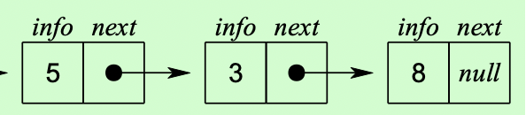
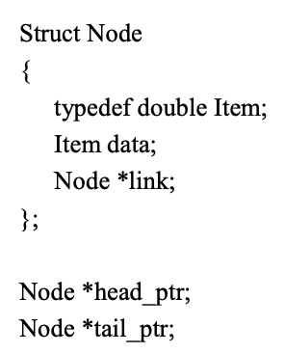
Linked List
Head_ptr
tail_ptr
Notes:
Usually, programs do not actually declare node variables. Instead, the list is accessed through one or more pointers to nodes.
Head_pointer
Tail_pointer

Slide 4

Doubly Linked List

Slide 5
Node data
info: the user's data
next, back pointer: the address of the next and previous node in the list

Slide 6
Doubly Linked Lists with Dummy Head
– Non-Empty List
Dummy Head Node
10 20 40 55
70
Head
– Empty List
Dummy Head Node
Head

Slide 7
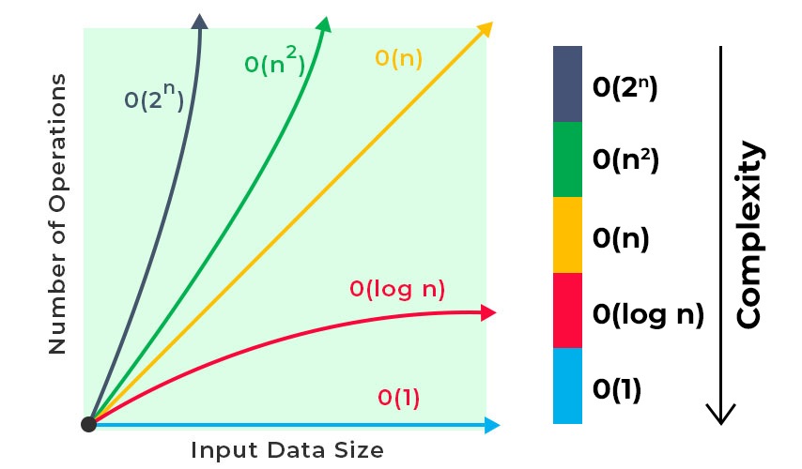
Computational Complexity

Slide 8
Constant Time Operations
Assigning the value to a variable: x = y
Mathematical operations: x = y + 2 * z
Comparisons: if (x > max) max = x
Accessing a value in an array: x = y[3]

Slide 9
Linear Operations
for (let i = 0; i < n; i ++){
cout << i;
}
The number of additions depends on the length of the array. Hence the run time is O(n)

Slide 10
Quadratic Operations
for (let i = 0; i < n; i ++){
for (let j = 0; j < m; j++){
cout << i << “ ” << j;
}
}
O(n²)

Slide 11
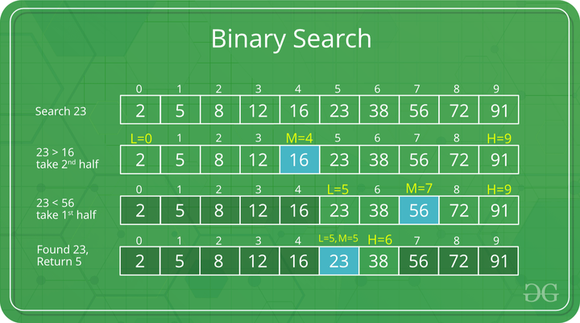
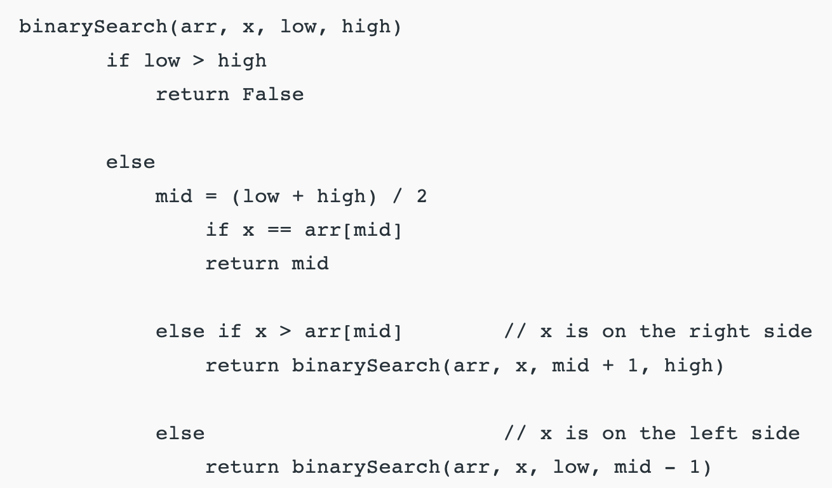
Computational Complexity
O(logN)
Binary search:
Notes:
Computational complexities:
Function:
Recursive method
Iteration method

Slide 12
Asymptotic Complexity
Running time of an algorithm as a function of input size n for large n.
Expressed using only the highest-order term in the expression for the exact running time.
Instead of exact running time, say Θ(n²).
Describes behavior of function in the limit.
Written using Asymptotic Notation.
Notes:
Assohole => ass - sym totic
Theta

Slide 13
Asymptotic Notation
Θ, O, Ω, o, ω
Defined for functions over the natural numbers.
Ex: f(n) = Θ(n²).
Describes how f(n) grows in comparison to n².
Define a set of functions; in practice used to compare two function sizes.
The notations describe different rate-of-growth relations between the defining function and the defined set of functions.

Slide 14
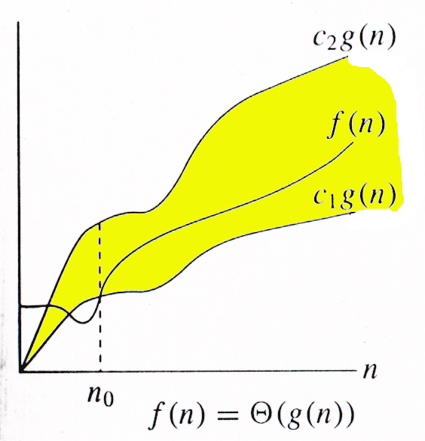
Θ-notation
For function g(n), we define Θ(g(n)), big-Theta of n, as the set:
Θ(g(n)) = {f(n) : ∃ positive constants c₁, c₂, and n_{0,} such that ∀n ≥ n₀,
we have 0 ≤ c₁g(n) ≤ f(n) ≤ c₂g(n)
}
Intuitively: Set of all functions that
have the same rate of growth as g(n).
g(n) is an asymptotically tight bound for f(n).

Slide 15
Θ-notation
For function g(n), we define Θ(g(n)), big-Theta of n, as the set:
Θ(g(n)) = {f(n) : ∃ positive constants c₁, c₂, and n_{0,} such that ∀n ≥ n₀,
we have 0 ≤ c₁g(n) ≤ f(n) ≤ c₂g(n)
}
Technically, f(n) ∈ Θ(g(n)).
Older usage, f(n) = Θ(g(n)).
f(n) and g(n) are nonnegative, for large n.

Slide 16
Example
Θ(g(n)) = {f(n) : ∃ positive constants c₁, c₂, and n₀, such that ∀n ≥ n₀, 0 ≤ c₁g(n) ≤ f(n) ≤ c₂g(n)}
10n² - 3n = Θ(n²)
What constants for n₀, c₁, and c₂ will work?
Make c₁ a little smaller than the leading coefficient, and c₂ a little bigger.
To compare orders of growth, look at the leading term.
Exercise: Prove that n²/2-3n= Θ(n²)

Slide 17
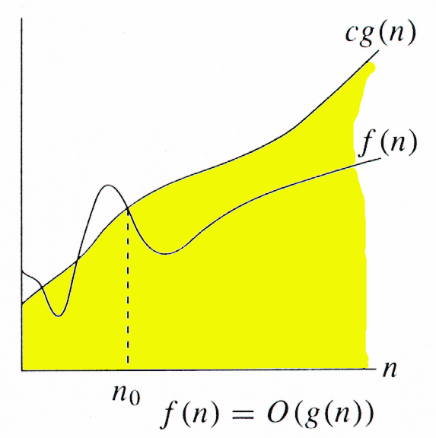
O-notation
For function g(n), we define O(g(n)), big-O of n, as the set:
O(g(n)) = {f(n) : ∃ positive constants c and n_{0,} such that ∀n ≥ n₀,
we have 0 ≤ f(n) ≤ cg(n) }
Intuitively: Set of all functions whose rate of growth is the same as or lower than that of g(n).
g(n) is an asymptotic upper bound for f(n).
f(n) = Θ(g(n)) ⇒ f(n) = O(g(n)).
Θ(g(n)) ⊂ O(g(n)).

Slide 18
Examples
O(g(n)) = {f(n) : ∃ positive constants c and n₀, such that ∀n ≥ n₀, we have 0 ≤ f(n) ≤ cg(n) }
Any linear function an + b is in O(n²).

Slide 19
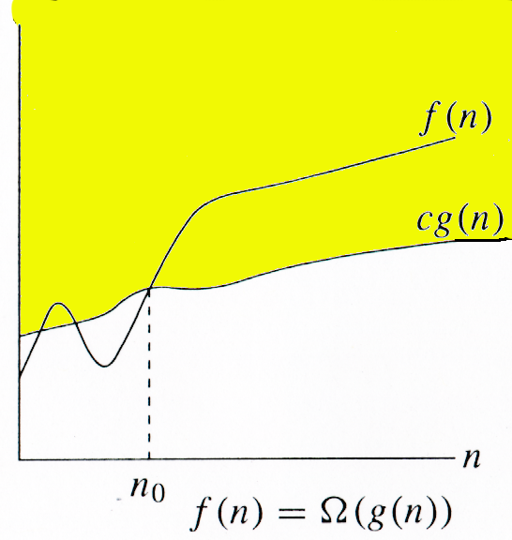
Ω -notation
For function g(n), we define Ω(g(n)), big-Omega of n, as the set:
Ω(g(n)) = {f(n) : ∃ positive constants c and n_{0,} such that ∀n ≥ n₀,
we have 0 ≤ cg(n) ≤ f(n)}
Intuitively: Set of all functions whose rate of growth is the same as or higher than that of g(n).
g(n) is an asymptotic lower bound for f(n).
f(n) = Θ(g(n)) ⇒ f(n) = Ω(g(n)).
Θ(g(n)) ⊂ Ω(g(n)).

Slide 20
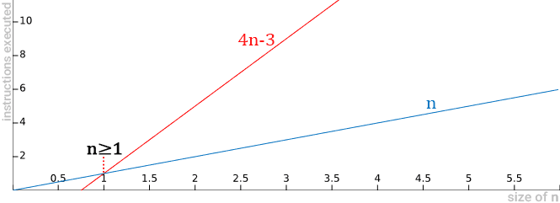
Example
Ω(g(n)) = {f(n) : ∃ positive constants c and n₀, such that ∀n ≥ n₀, we have 0 ≤ cg(n) ≤ f(n)}
When we say that the function 4n-3 is Ω(n),
Notes:
When we say that the function 4n-3 is Ω(n),
This means that the 4n-3 function will never have a lower growth behavior than a function with the linear behavior.
Thus, Ω(n) is presented as a lower limit, and we know that the function will never exhibit growth behavior that is exceeded by this lower limit.
Example: for function 4n-3, there is another function of linear behavior that limits it inferiorly. Note in the graph below that, for values of n≥1, function 4n-3 outperforms function n.

Slide 21
Relations Between Θ, O, Ω

Slide 22
Relations Between Θ, Ω, O
Theorem : For any two functions g(n) and f(n), f(n) = Θ(g(n)) iff
f(n) = O(g(n)) and f(n) = Ω(g(n)).
I.e., Θ(g(n)) = O(g(n)) ∩ Ω(g(n))
In practice, asymptotically tight bounds are obtained from asymptotic upper and lower bounds.

Slide 23
Running Times
“Running time is O(f(n))” ⇒ Worst case is O(f(n))
O(f(n)) bound on the worst-case running time ⇒ O(f(n)) bound on the running time of every input.
Θ(f(n)) bound on the worst-case running time ⇒ Θ(f(n)) bound on the running time of every input.
“Running time is Ω(f(n))” ⇒ Best case is Ω(f(n))
Can still say “Worst-case running time is Ω(f(n))”
Means worst-case running time is given by some unspecified function g(n) ∈ Ω(f(n)).

Slide 24
Asymptotic Notation in Equations
Can use asymptotic notation in equations to replace expressions containing lower-order terms.
For example,
4n³ + 3n² + 2n + 1 = 4n³ + 3n² + Θ(n)
= 4n³ + Θ(n²) = Θ(n³). How to interpret?
In equations, Θ(g(n)) always stands for an anonymous function f(n) ∈ Θ(g(n))
In the example above, Θ(n²) stands for 3n² + 2n + 1.
Θ(g(n)) ⊂ O(g(n))
Θ(g(n)) = O(g(n)) ∩ W(g(n))

Slide 25
Common Functions

Slide 26
Monotonicity
f(n) is
monotonically increasing if m ≤ n ⇒ f(m) ≤ f(n).
monotonically decreasing if m ≥ n ⇒ f(m) ≥ f(n).
strictly increasing if m < n ⇒ f(m) < f(n).
strictly decreasing if m > n ⇒ f(m) > f(n).

Slide 27
Exponentials
Useful Identities:
Exponentials and polynomials

Slide 28
Logarithms
x = log_{b}a is the exponent for a = b^{x}.
Natural log: ln a = log_{e}a
Binary log: lg a = log₂a
lg²a = (lg a)²
lg lg a = lg (lg a)

Slide 29
Logarithms and exponentials – Bases
If the base of a logarithm is changed from one constant to another, the value is altered by a constant factor.
Ex: log₁₀ n * log₂10 = log₂ n.
Base of logarithm is not an issue in asymptotic notation.
Exponentials with different bases differ by a exponential factor (not a constant factor).
Ex: 2^{n} = (2/3)^{n}*3^{n}.

Slide 30
Polylogarithms
For a ≥ 0, b > 0, lim _{n→∞} ( lgª n / n^{b} ) = 0, so lgª n = o(n^{b}), and n^{b} = ω(lgª n )
Prove using L’Hopital’s rule repeatedly
lg(n!) = Θ(n lg n)
Prove using Stirling’s approximation (in the text) for lg(n!).

Slide 31
Exercise
for (int i = 0; i < n; i++){
for (int j = 0; j< I; j++){
cout << “hello”;
}
}
O(n²)

Slide 32
Exercise
for (int i = 0; i < n; i=i*2){
cout << “hello”;
}
O(log n)

Slide 33
Exercise
for (int i = 0; i < n; i++){
for (int j = 0; j< n; j=j*2){
cout << “hello”;
}
}
O(nlogn)

Slide 34
Exercise
for (int i = 0; i < n; i++){
for (int j = 0; j< i; j=j*2){
cout << “hello”;
}
}
O(nlogn)

Slide 35
Exercise
for (int i = n; i > 0; i=i/2){
for (int j = 0; j< n; j++){
cout << “hello”;
}
}
O(nlogn)

Slide 36
Exercise
for (int i = n; i > 0; i=i/2){
for (int j = 0; j< i; j++){
cout << “hello”;
}
}
O(n)

