Slide 1
mining Internet of Things Data -healthcare
Beiyu Lin

Slide 2
Learning Objectives
Give a basic overview of data analytics in healthcare
Give a basic overview of data elements and their attributes
Describe the nine steps of the data analytics process

Slide 3
Introduction
“Information is the oil of the 21st century, and analytics is the combustion engine.”
Peter Sondegaard, Senior Vice President and Global Head of Research for Gartner

Slide 4
Benefits of healthcare data mining
Care providers can use data mining to identify effective treatments and best practices as well as to develop guidelines and standards of care;
Patients, especially those having chronic or high-risk diseases, can receive better, more affordable healthcare services with appropriate identification, tracking and use of appropriate interventions and treatment protocols;
Healthcare organizations can use data mining to improve patient satisfaction, to provide more patient-centered care, and to decrease costs and increase operating efficiency while maintaining high-quality care;
Insurance organization can detect medical insurance fraud and abuse through data mining and reduce their losses

Slide 5
What is data mining in healthcare
Data mining provides the methodology and technology for healthcare organizations to:
evaluate treatment effectiveness,
save lives of patients using predictive medicine,
manage healthcare at different levels,
manage customer relationship,
detect waste, fraud and abuse.

Slide 6
How does data mining work in healthcare
The whole process includes the following main steps
Data selection: create a target data set from the original data
Data preprocessing: clean data to define strategies for handling missing data fields
Data transformation: reduce and project the data using transformation techniques or methods
Data mining: extract interesting patterns
Data interpretation or evaluation: interpret and extract knowledge from the mined patterns

Slide 7
Data Mining techniques in healthcare
healthcare data mining parameters include:
sequence or path analysis
(i.e. finding patterns where one event leads to another later event),
classification
(i.e. looking for new patterns and predicting variables based on the factors the database contains),
clustering
(i.e. grouping a set of objects and aggregating them based on their similarity to each other)
forecasting

Slide 8
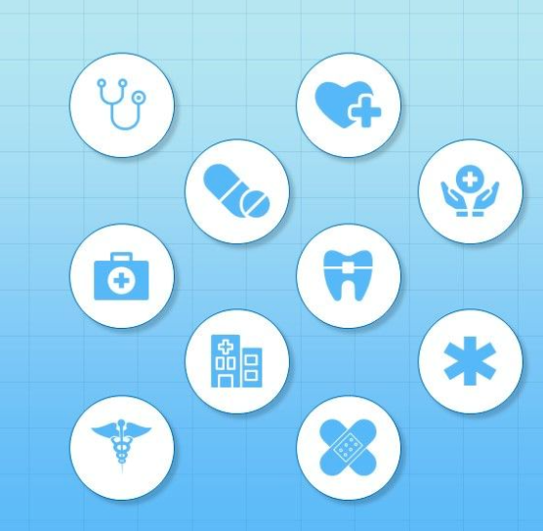
Data mining techniques
web mining,
network approaches,
text mining,
natural language processing (NLP),
machine learning,
predictive modeling,
relationship and link analysis,
statistical analysis, etc

Slide 9
Purposes of data mining in healthcare
the healthcare industry can be very effective in such fields as:
medical research,
pharmaceuticals,
medical devices,
genetics,
hospital management,
and health care insurance, etc.

Slide 10


Examples of healthcare data mining applications
The FTC reports that $20.9 million in fraud occurred
during the first round of stimulus checks

Slide 11
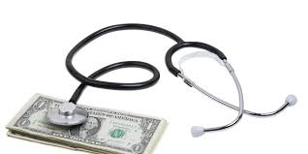
Examples of healthcare data mining applications
Detection and prevention of fraud and abuse
establishing normal patterns
identifying unusual patterns of medical claims by healthcare providers (clinics, doctors, labs, etc).

Slide 12
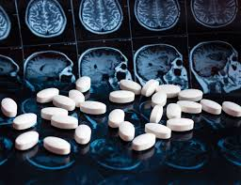
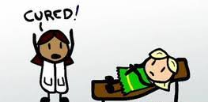
Example: measuring treatment effectiveness
comparing and contrasting symptoms
causes and courses of treatment
identify the side effects of a particular treatment
analyze which decision would be most effective.

Slide 13
The big picture of patient data
Multiple systems in a health information system
These systems are designed for clinical use and reporting purposes
None has a complete set of data for
Individual patients
Groups of patients
All aspects of a health information system

Slide 14
Clinical Data Warehouse
Aggregates data for a patient from multiple sources
Used for analysis and reporting, not clinical care
Requires an extraction-transform-load process

Slide 15
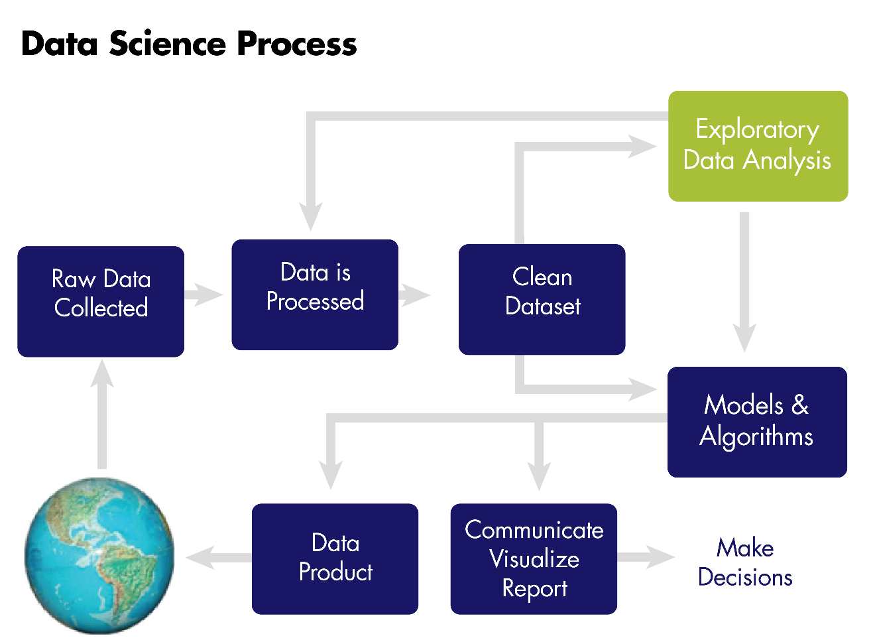
What is analytics?
Entire process of
data collection,
extraction,
transformation,
analysis,
interpretation,
reporting

Slide 16
Clinical case: Objectives
In ‘Machine Learning’, machine is made to learn the various parameters including,
symptoms,
behavior,
biochemical variables
Pathologic parameters
ML helps with diagnostic sensitivity, specificity and treatment
e.g., AI in Medicine

Slide 17
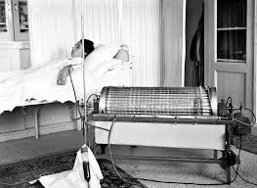
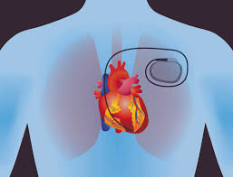
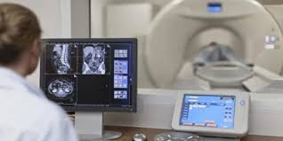
Innovations in Medical and Biological Engineering
1950s and earlier
Artificial Kidney
X ray
Cardiac Pacemaker
Antibiotic Production technology
1970s
Computer assisted tomography
Artificial hip and knee replacements
Balloon catheter

Slide 18
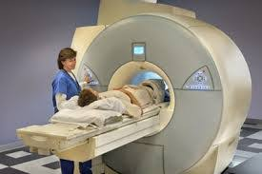
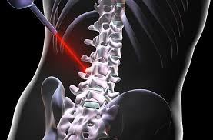
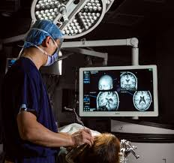
Innovations in Medical and Biological Engineering
1960s
Heart valve replacement
Intraocular lens
Ultrasound
Vascular grafts
Blood analysis and processing
1980s
Magnetic resonance imaging
Laser surgery
Vascular grafts
Recombinant therapeutics
Present day
Genomic sequencing and microarrays
Positron Emission tomography
Image guided surgery

Slide 19
New generations of medical technology

Slide 20
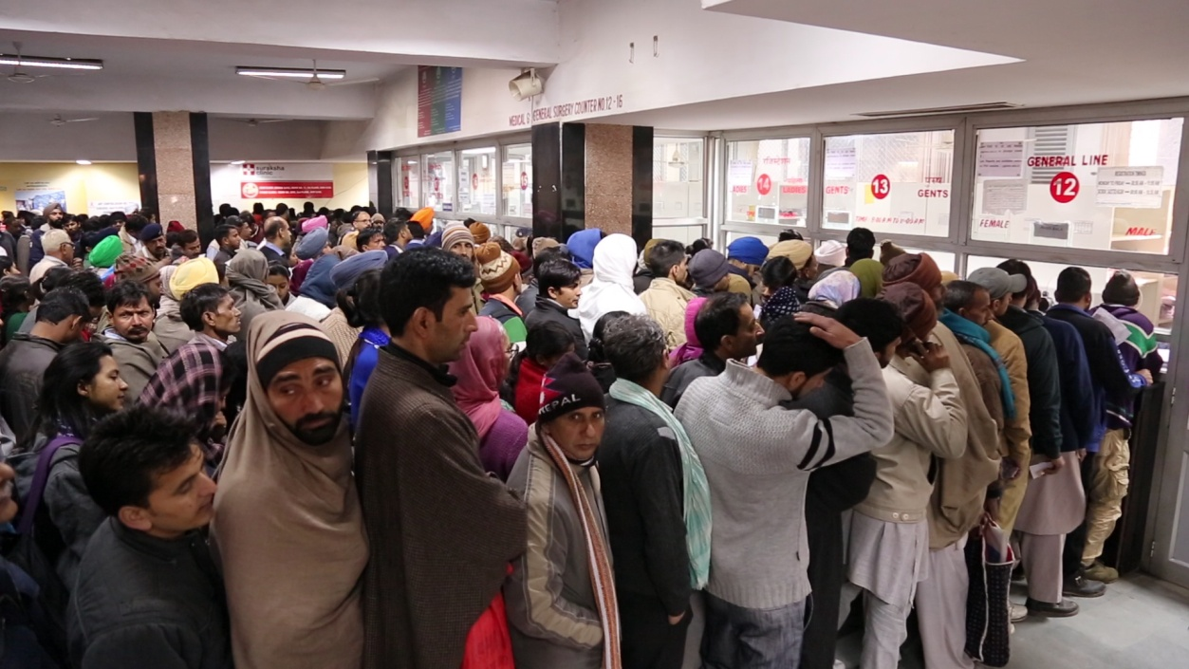
The application of AI in medicine has two main branches:
A) Virtual branch
B) Physical branch.
Highly repetitive work
Empower doctors
help them deliver faster and more accurate
Augment the professionals, offering them expertise and assistance.
Replace personnel and staffing in medical facilities, particularly in administrative functions,
Managing wait times & automating scheduling
“Deep-learning devices will not replace clinicians

Slide 21

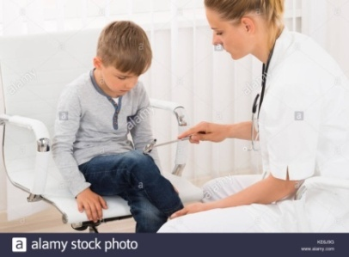
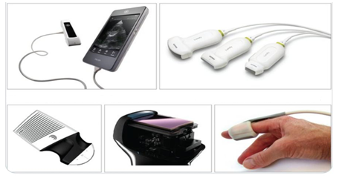
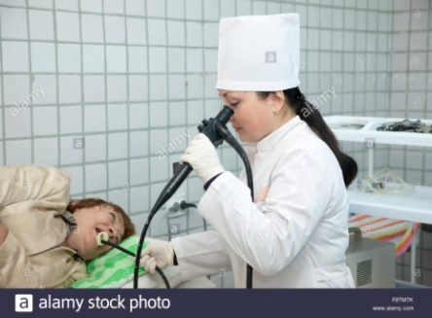
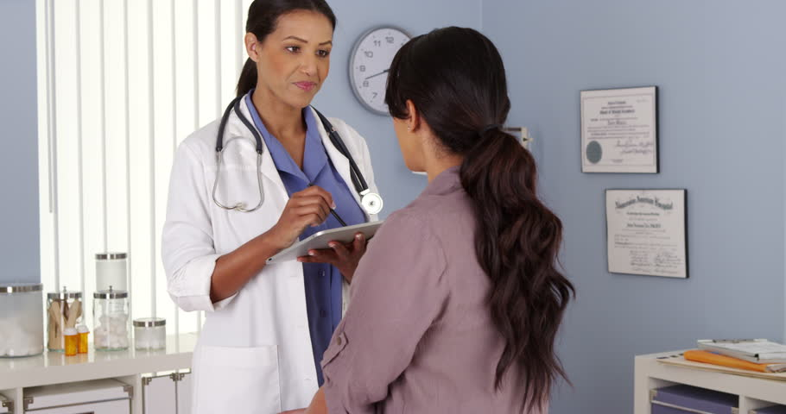
Artificial intelligence in medicine : The virtual branch
The virtual component is represented by Machine Learning, (also called Deep Learning)-mathematical algorithms that improve learning through experience.
Three types of machine learning algorithms:
Unsupervised (ability to find patterns)
Supervised (classification and prediction algorithms based on previous examples)
Reinforcement learning (use of sequences of rewards and punishments to form a strategy for operation in a specific problem space)

Slide 22
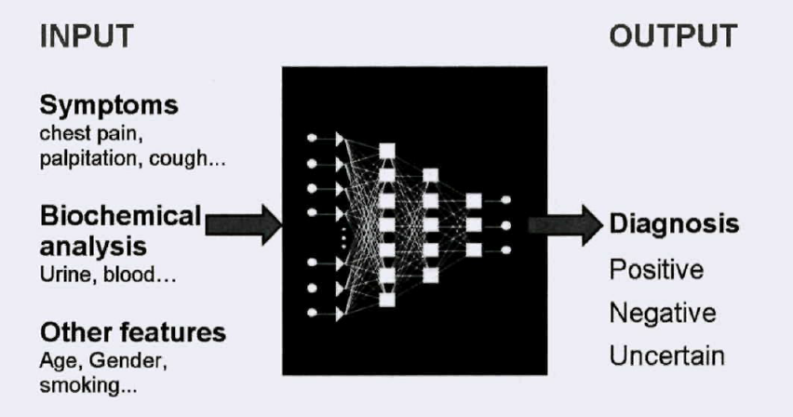
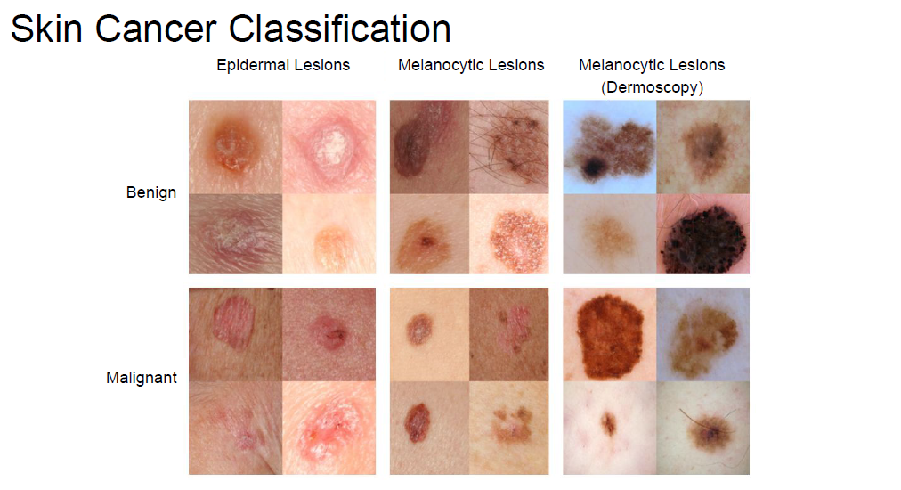
Benefits of Artificial intelligence
AI can definitely assist physicians
Clinical decision making - better clinical decisions
Replace human judgement in certain functional areas of healthcare (eg, radiology).
up-to-date medical information from journals, textbooks and clinical practices
Experienced vs (fresh Clinician + AI algorithms)
Early diagnosis
Prediction of outcome of the disease as well as treatment
Feedback on treatment
Reinforce non pharmacological management
Reduce diagnostic and therapeutic errors
Increased patient safety and Huge cost savings associated with use of AI
AI system extracts useful information from a large patient population
Assist making real-time inferences for health risk alert and health outcome prediction

Slide 23
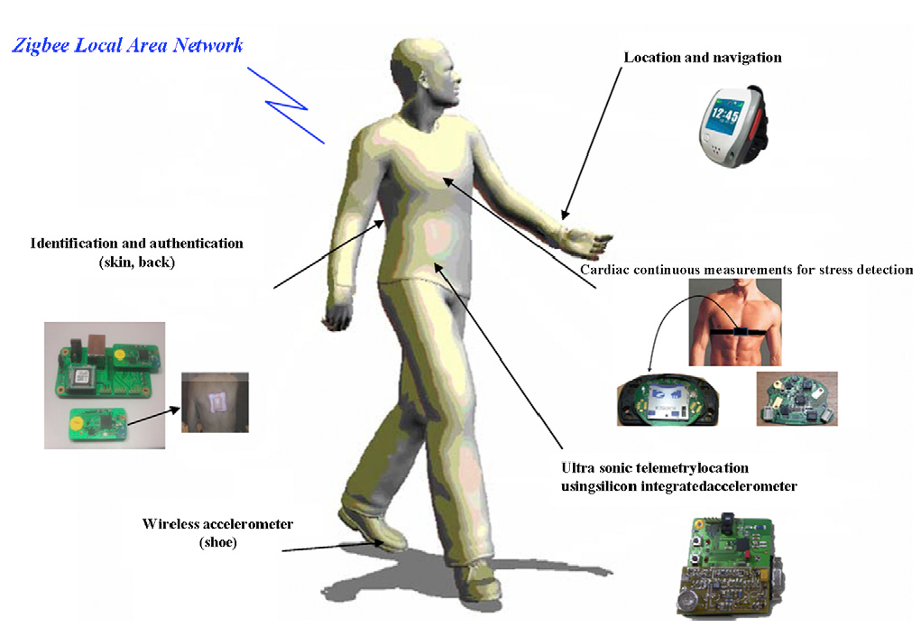
Artificial intelligence in medicine: The physical branch
It includes:
Physical objects,
Medical devices
Sophisticated robots for delivery of care (carebots)/ robots for surgery.

Slide 24
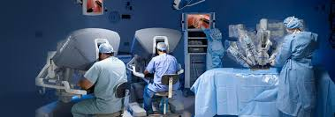
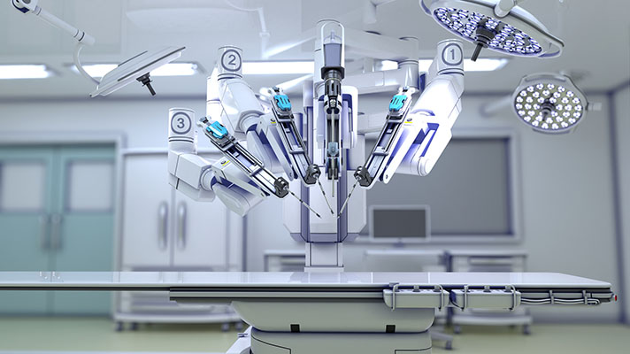
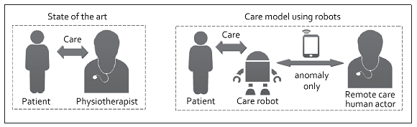
Use of robots to deliver treatment..robotic surgery
Use of robots to deliver treatment - Robotic surgery
Use of robots to monitor effectiveness of treatment

Slide 25
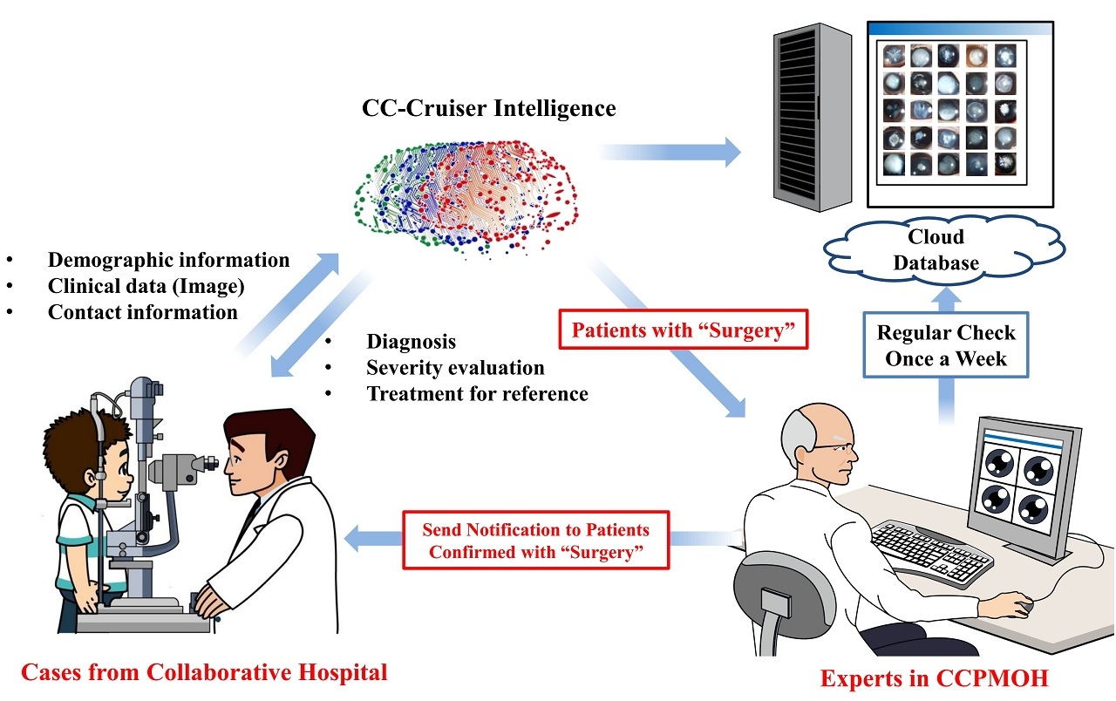
Growth drivers of AI in healthcare
Increasing individual healthcare expenses
Larger Geriatric population
Imbalance between health workforce and patients
Increasing Global Health care expenditure
Continuous shortage of nursing and technician staff. The number of vacancies for nurses will be 1.2 million by 2020
AI is and will help medical practitioners efficiently achieve their tasks with minimal human intervention, a critical factor in meeting increasing patient demand.

Slide 26
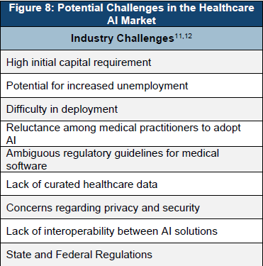
Potential challenges
Development costs
Integration issues
Ethical issues / Fear of replacing humans
Reluctance among medical practitioners to adopt AI
Explainable AI
Data Privacy and security – adversarial attacks
Mobile health applications and devices that use AI
Lack of interoperability between AI solutions
Data exchange
Need for continuous training by data from clinical studies
Incentives for sharing data on the system for further development and improvement of the system. Nevertheless,
All the parties in the healthcare system, the physicians, the pharmaceutical companies and the patients, have greater incentives to compile and exchange information

Slide 27
Future Indian Scenario
Collaboration between medical and technical institutions
Government funding – more intelligent and result oriented rather than you pat – i pat
Scientific mafia or scientist Mafia
Current status of medical records
incommunicable silos of wasted information for the health system and for knowledge acquisition. Laboratories and clinics need to collaborate to accelerate the implementation of electronic health records
Data need to be captured in real-time, and institutions should promote their transformation into intelligible processes
Integration and interoperability including ethical, legal and logistical concerns are enormous
Simplification, readability and clinical utility of data sets
Each result must be questioned for its clinical applicability.
Aim of increasing their clinical value and decreasing health costs
Electronic medical or health records
are essential tools for personalized medicine
Early detection and targeted prevention, again

