Slide 1
Classification

Slide 2
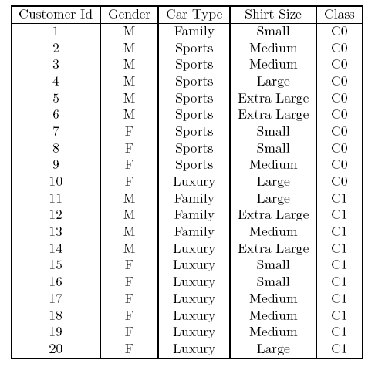
How to determine the Best Split
Before Splitting: 10 records of class 0 (c0), 10 records of class 1 (c1)
What are the values of the label for this data? How many cases / records for each label.
Learn the type of each attribute / feature, their values.
Which test condition is the best?

Slide 3
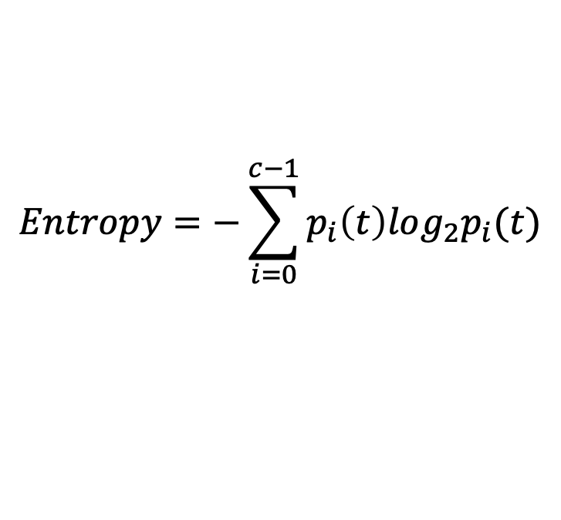
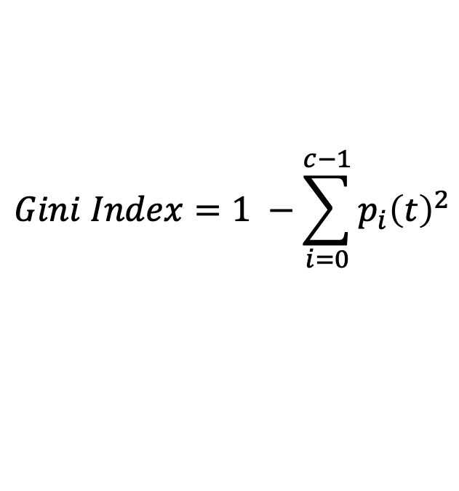
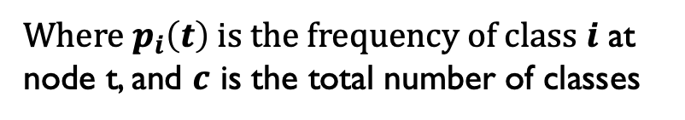
Measures of Node Impurity
Gini Index
Entropy
Misclassification error (confusing matrix for decision tree)
$$Gini Index=1 −\sum_{i=0}^{c−1}{p_{i}{\left(t\right)}^{2}}$$
Where $p_{i}\left(t\right)$ is the frequency of class $i$ at node t, and $c$ is the total number of classes
$$Entropy=−\sum_{i=0}^{c−1}{p_{i}\left(t\right)log_{2}p_{i}(t)}$$
$$Classification error={1 −max⁡[p}_{i}(t)]$$

Slide 4
Finding the Best Split
Compute impurity measure (P) before splitting
Compute impurity measure (M) after splitting
Compute impurity measure of each child node
M is the weighted impurity of child nodes
Choose the attribute test condition that produces the highest gain
Gain = P - M or equivalently, lowest impurity measure after splitting (M)

Slide 5

Model Selection
Performed during model building
Select a model that is not overly complex
(potential concerns for overly complex model: overfitting)
Estimate generalization error
validation set
model complexity

Slide 6
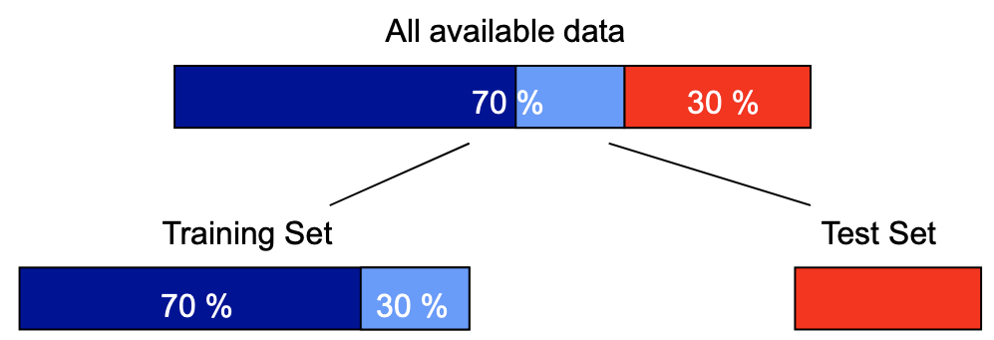




Model Selection: Using Validation Set
Divide training data into two parts:
Training set:
Validation set:
use for estimating generalization error
Drawback:
less data available for training

Slide 7
Model Selection: Incorporating Model Complexity
Rationale: Occam’s Razor
Given two models of similar generalization errors, one should prefer the simpler model
A complex model has a greater chance of overfitting
Include model complexity when evaluating a model
Generalization Error(Model) = Train. Error(Model, Train. Data) + x Complexity(Model)

Slide 8




Estimating the Complexity of Decision Trees
Pessimistic Error Estimate of decision tree T with k leaf nodes:
err(T): error rate on all training records
Ω: trade-off hyper-parameter (similar to )
Relative cost of adding a leaf node
k: number of leaf nodes
N_{train}: total number of training records

Slide 9
Estimating the Complexity of Decision Trees: Example
e(T_{L}) = 4/24
e(T_{R}) = 6/24
Ω = 1
Pessimistic errors for both trees
e_{gen}(T_{L}) = 4/24 + 1*7/24 = 11/24 = 0.458
e_{gen}(T_{R}) = 6/24 + 1*4/24 = 10/24 = 0.417
E_p_L = err.train + 1*k/N
= 4/24 + 1* 7/ 24
E_p_R = error of train + 1*k/N
= 6/24 + 1* 4/24

Slide 10
Estimating the Complexity of Decision Trees
Resubstitution Estimate:
optimistic error estimate: using training error as an estimate of generalization error
e(T_{L}) = 4/24
e(T_{R}) = 6/24

Slide 11
Minimum Description Length (MDL)
Cost(Model,Data) = Cost(Data|Model) + x Cost(Model)
Cost is the number of bits needed for encoding.
Search for the least costly model.
Cost(Data|Model) encodes the misclassification errors.
Cost(Model) uses node encoding (number of children) plus splitting condition encoding.

Slide 12
Model Selection for Decision Trees
Pre-Pruning (Early Stopping Rule)
Stop the algorithm before it becomes a fully-grown tree
Typical stopping conditions for a node:
Stop if all instances belong to the same class
or Stop if all the attribute values are the same
More restrictive conditions:
Stop if the number of instances is < some user-specified threshold
or Stop if class distribution of instances are independent of the available features (e.g., using χ ² test)
or Stop if expanding the current node does not improve impurity measures
(e.g., Gini or information gain).
or Stop if estimated generalization error falls below certain threshold

Slide 13

Model Selection for Decision Trees
Post-pruning
Grow decision tree to its entirety
Subtree replacement
Trim the nodes of the decision tree in a bottom-up fashion
If generalization error improves after trimming, replace sub-tree by a leaf node
Class label of leaf node is determined from majority class of instances in the sub-tree

Slide 14

Example of Post-Pruning
Class = Yes | 20
Class = No | 10
Error = 10/30
Training Error (Before splitting) = 10/30
Pessimistic error = (10 + 0.5)/30 = 10.5/30
Training Error (After splitting) = 9/30
Pessimistic error (After splitting)
= (9 + 4 × 0.5)/30 = 11/30
PRUNE!
P_e = 10/30 + 1/8 * 4/30
Class = Yes | 8
Class = No | 4
Class = Yes | 3
Class = No | 4
Class = Yes | 4
Class = No | 1
Class = Yes | 5
Class = No | 1
Notes:
Pessimistic pruning builds a sequence of DC from the initial one and at each step, one rule is removed such that its removal brings the lowest error among all possible removals. This pruning returns the smallest tree with lowest error.

Slide 15
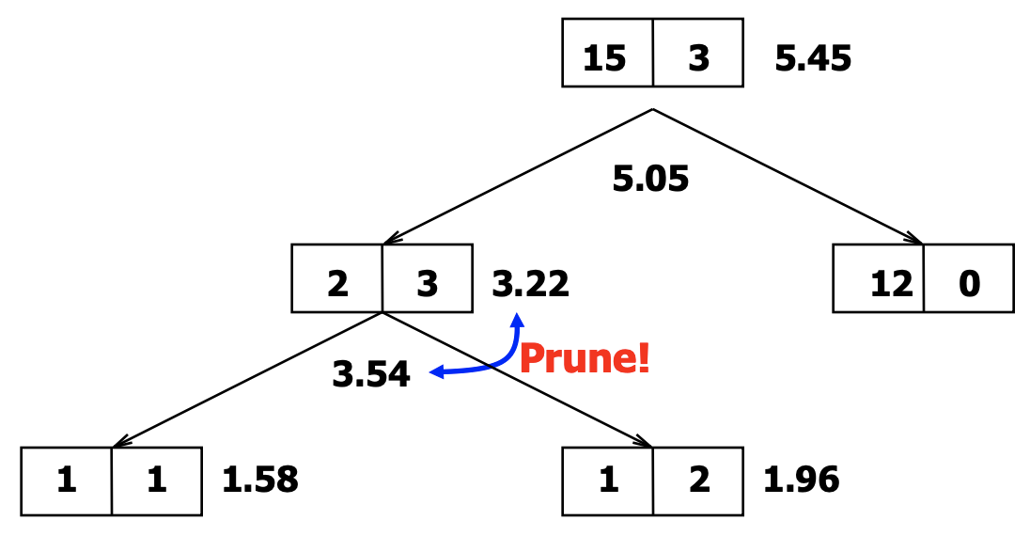
Example of Post-Pruning
Notes:
Pessimistic pruning builds a sequence of DC from the initial one and at each step, one rule is removed such that its removal brings the lowest error among all possible removals. This pruning returns the smallest tree with lowest error.

Slide 16
Examples of Post-pruning

Slide 17
Model Evaluation
Purpose:
Estimate performance of classifier on test set
Holdout
Reserve k% for training and (100-k)% for testing
Random subsampling: repeated holdout
Cross validation
Partition data into k disjoint subsets
k-fold: train on k-1 partitions, test on the remaining one
id | data
1 | +
2 | +
 | +
10 | -

Slide 18
Cross-validation Example
3-fold cross-validation

Slide 19
Variations on Cross-validation
Repeated cross-validation
Perform cross-validation for multiple times
Give an estimate of the variance of the generalization error
Stratified cross-validation
Guarantee the same percentage of class labels in training and test
Good for imbalanced datasets and small samples
Use nested cross-validation approach for model selection and evaluation

