Slide 1
Association Rule Mining
Beiyu Lin

Slide 2

Rule Generation
Given a frequent itemset L, find all non-empty subsets f ⊂ L such that f → L – f satisfies the minimum confidence requirement
If {A,B,C,D} is a frequent itemset, candidate rules:
ABC →D, ABD →C, ACD →B, BCD →A, A →BCD, B →ACD, C →ABD, D →ABC AB →CD, AC → BD, AD → BC, BC →AD, BD →AC, CD →AB,
If |L| = k, then there are 2^{k} – 2 candidate association rules (ignoring L → ∅ and ∅ → L)

Slide 3




Rule Generation
In general, confidence does not have an anti-monotone property
c(ABC →D) can be larger or smaller than c(AB →D)
But confidence of rules generated from the same itemset has an anti-monotone property
E.g., Suppose {A,B,C,D} is a frequent 4-itemset: c(ABC → D) ≥ c(AB → CD) ≥ c(A → BCD)
Confidence is anti-monotone w.r.t. number of items on the RHS of the rule

Slide 4
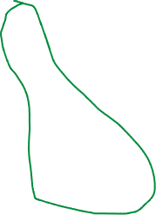
Rule Generation for Apriori Algorithm
Lattice of rules
Low Confidence Rule
Pruned Rules

Slide 5
Association Analysis: Basic Concepts and Algorithms
Algorithms and Complexity

Slide 6
Factors Affecting Complexity of Apriori
Choice of minimum support threshold
Dimensionality (number of items) of the data set
Size of database
Average transaction width

Slide 7
Factors Affecting Complexity of Apriori
Choice of minimum support threshold
lowering support threshold results in more frequent itemsets
this may increase number of candidates and max length of frequent itemsets
Dimensionality (number of items) of the data set
Size of database
Average transaction width

Slide 8




Impact of Support Based Pruning
Items (1-itemsets)
Minimum Support = 3
Minimum Support = 2
If every subset is considered,
⁶C₁ + ⁶C₂ + ⁶C₃
6 + 15 + 20 = 41
With support-based pruning,
6 + 6 + 4 = 16
If every subset is considered,
⁶C₁ + ⁶C₂ + ⁶C₃ + ⁶C₄
6 + 15 + 20 +15 = 56

Slide 9
Factors Affecting Complexity of Apriori
Choice of minimum support threshold
lowering support threshold results in more frequent itemsets
this may increase number of candidates and max length of frequent itemsets
Dimensionality (number of items) of the data set
More space is needed to store support count of itemsets
if number of frequent itemsets also increases, both computation and I/O costs may also increase
Size of database
Average transaction width

Slide 10
Factors Affecting Complexity of Apriori
Choice of minimum support threshold
lowering support threshold results in more frequent itemsets
this may increase number of candidates and max length of frequent itemsets
Dimensionality (number of items) of the data set
More space is needed to store support count of itemsets
if number of frequent itemsets also increases, both computation and I/O costs may also increase
Size of database
run time of algorithm increases with number of transactions
Average transaction width

Slide 11
Factors Affecting Complexity of Apriori
Choice of minimum support threshold
lowering support threshold results in more frequent itemsets
this may increase number of candidates and max length of frequent itemsets
Dimensionality (number of items) of the data set
More space is needed to store support count of itemsets
if number of frequent itemsets also increases, both computation and I/O costs may also increase
Size of database
run time of algorithm increases with number of transactions
Average transaction width
transaction width increases the max length of frequent itemsets
number of subsets in a transaction increases with its width, increasing computation time for support counting

Slide 12
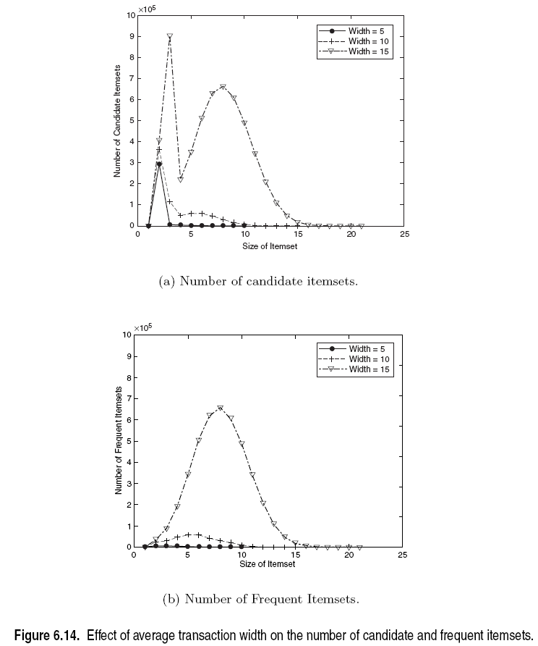
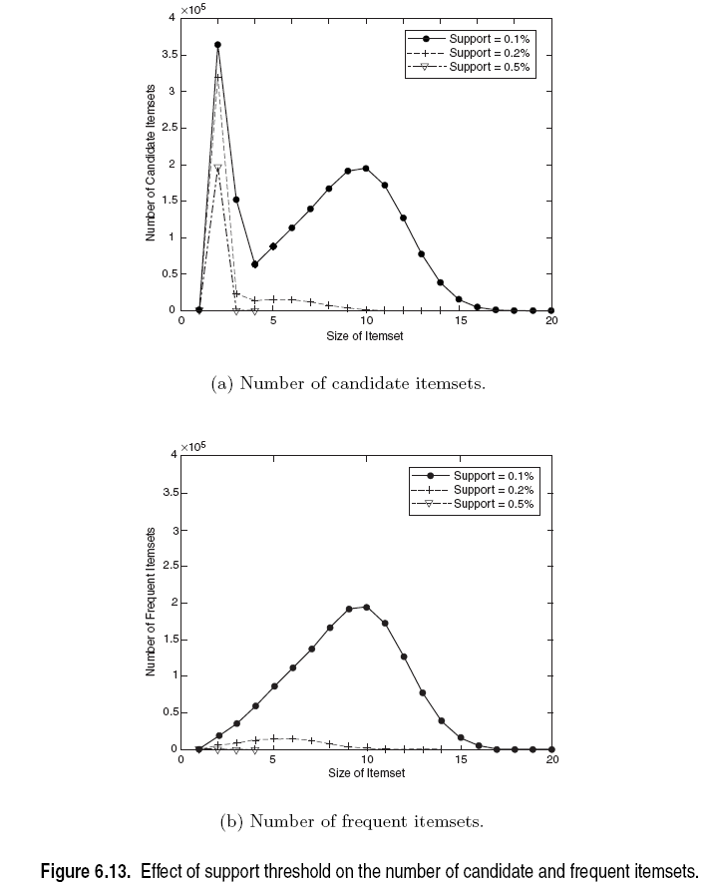
Factors Affecting Complexity of Apriori

Slide 13
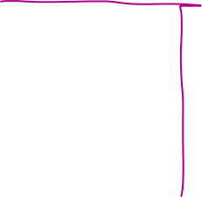
Compact Representation of Frequent Itemsets
Some frequent itemsets are redundant because their supersets are also frequent
Consider the following data set. Assume support threshold =5
Number of frequent itemsets
Need a compact representation
Notes:
Superset: contains more transactions then the minimum support

Slide 14

Illustrating Apriori Principle
Found to be Infrequent
Pruned supersets

Slide 15
Maximal Frequent Itemset
An itemset is maximal frequent if it is frequent and none of its immediate supersets is frequent
Maximal Itemsets
Infrequent Itemsets
Border

Slide 16
What are the Maximal Frequent Itemsets in this Data?
Minimum support threshold = 5
(A1-A10)
(B1-B10)
(C1-C10)

Slide 17

An illustrative example
Items
 | A | B | C | D | E | F | G | H | I | J
1
2
3
4
5
6
7
8
9
10
Support threshold (by count) : 5
Frequent itemsets: ?
Maximal itemsets: ?
Transactions

Slide 18




An illustrative example
Items
 | A | B | C | D | E | F | G | H | I | J
1
2
3
4
5
6
7
8
9
10
Support threshold (by count) : 5
Frequent itemsets: {F}
Maximal itemsets: {F}
Support threshold (by count): 4
Frequent itemsets: ?
Maximal itemsets: ?
Transactions

Slide 19
An illustrative example
Items
 | A | B | C | D | E | F | G | H | I | J
1
2
3
4
5
6
7
8
9
10
Support threshold (by count) : 5
Frequent itemsets: {F}
Maximal itemsets: {F}
Support threshold (by count): 4
Frequent itemsets: {E}, {F}, {E,F}, {J}
Maximal itemsets: {E,F}, {J}
Support threshold (by count): 3
Frequent itemsets: ?
Maximal itemsets: ?
Transactions
Notes:
A maximal frequent itemset is a frequent itemset for which none of its immediate supersets are frequent

Slide 20
An illustrative example
Items
 | A | B | C | D | E | F | G | H | I | J
1
2
3
4
5
6
7
8
9
10
Support threshold (by count) : 5
Frequent itemsets: {F}
Maximal itemsets: {F}
Support threshold (by count): 4
Frequent itemsets: {E}, {F}, {E,F}, {J}
Maximal itemsets: {E,F}, {J}
Support threshold (by count): 3
Frequent itemsets:
All subsets of {C,D,E,F} + {J}
Maximal itemsets:
{C,D,E,F}, {J}
Transactions

Slide 21
Closed Itemset
An itemset X is closed if none of its immediate supersets has the same support as the itemset X.
X is not closed if at least one of its immediate supersets has support count as X.

Slide 22
Weka – associate rule

Slide 23



Closed Itemset
An itemset X is closed if none of its immediate supersets has the same support as the itemset X.
X is not closed if at least one of its immediate supersets has support count as X.

Slide 24



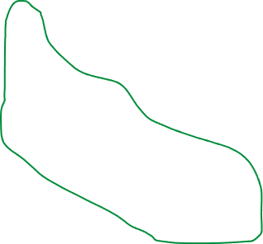
Maximal vs Closed Itemsets
Transaction Ids
Not supported by any transactions

Slide 25
Maximal Frequent vs Closed Frequent Itemsets
Minimum support = 2
Closed but not maximal
Closed and maximal
# Closed frequent = 9
# Maximal freaquent = 4

Slide 26
What are the Closed Itemsets in this Data?
(A1-A10)
(B1-B10)
(C1-C10)

Slide 27

Example 1
Items
 | A | B | C | D | E | F | G | H | I | J
1
2
3
4
5
6
7
8
9
10
Itemsets | Support (counts) | Closed itemsets
{C} | 3
{D} | 2
{C,D} | 2
Transactions

Slide 28
Example 1
Items
 | A | B | C | D | E | F | G | H | I | J
1
2
3
4
5
6
7
8
9
10
Itemsets | Support (counts) | Closed itemsets
{C} | 3 | ✓
{D} | 2
{C,D} | 2 | ✓
Transactions

Slide 29
Example 2
Items
 | A | B | C | D | E | F | G | H | I | J
1
2
3
4
5
6
7
8
9
10
Itemsets | Support (counts) | Closed itemsets
{C} | 3
{D} | 2
{E} | 2
{C,D} | 2
{C,E} | 2
{D,E} | 2
{C,D,E} | 2
Transactions

Slide 30
Example 2
Items
 | A | B | C | D | E | F | G | H | I | J
1
2
3
4
5
6
7
8
9
10
Itemsets | Support (counts) | Closed itemsets
{C} | 3 | ✓
{D} | 2
{E} | 2
{C,D} | 2
{C,E} | 2
{D,E} | 2
{C,D,E} | 2 | ✓
Transactions

Slide 31
Example 3
Items
 | A | B | C | D | E | F | G | H | I | J
1
2
3
4
5
6
7
8
9
10
Closed itemsets: {C,D,E,F}, {C,F}
Transactions

Slide 32
Example 4
Items
 | A | B | C | D | E | F | G | H | I | J
1
2
3
4
5
6
7
8
9
10
Closed itemsets: {C,D,E,F}, {C}, {F}
Transactions

Slide 33
Maximal vs Closed Itemsets

Slide 34
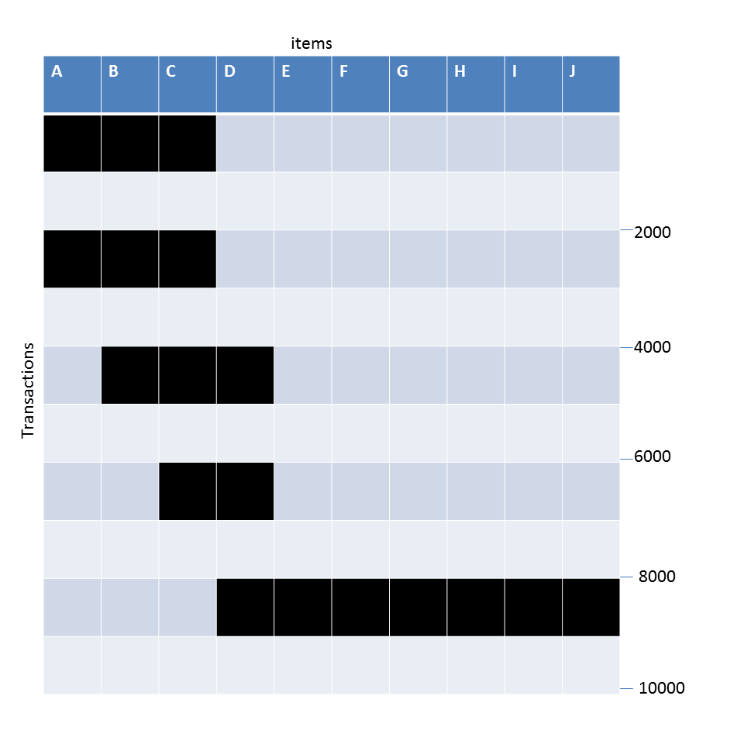
Example question
Given the following transaction data sets (dark cells indicate presence of an item in a transaction) and a support threshold of 20%, answer the following questions
Data Set: C
What is the number of frequent itemsets for each dataset? Which dataset will produce the most number of frequent itemsets?
Which dataset will produce the longest frequent itemset?
Which dataset will produce frequent itemsets with highest maximum support?
Which dataset will produce frequent itemsets containing items with widely varying support levels (i.e., itemsets containing items with mixed support, ranging from 20% to more than 70%)?
What is the number of maximal frequent itemsets for each dataset? Which dataset will produce the most number of maximal frequent itemsets?
What is the number of closed frequent itemsets for each dataset? Which dataset will produce the most number of closed frequent itemsets?

Slide 35
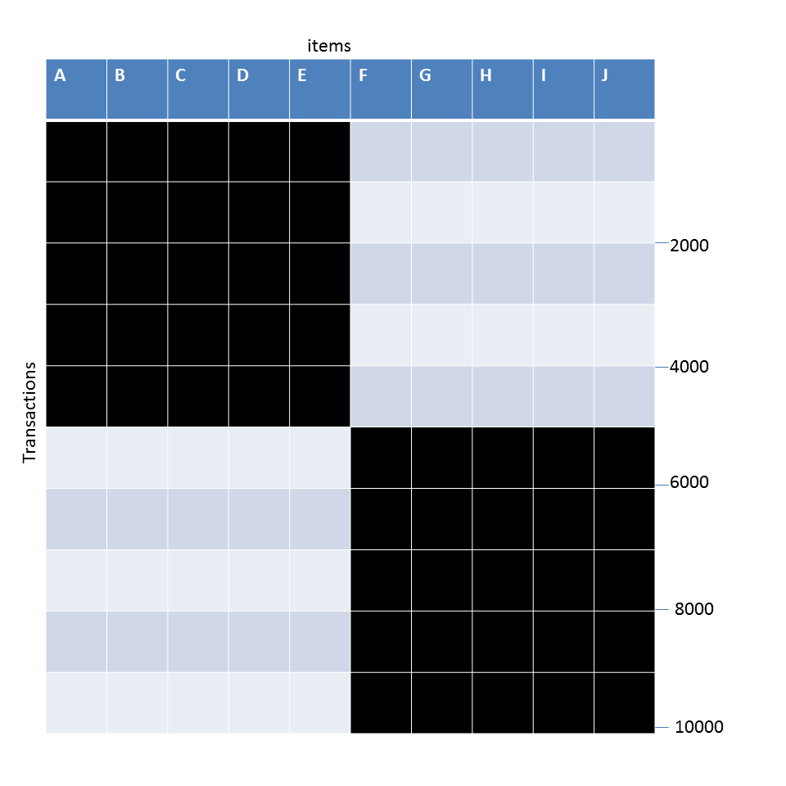
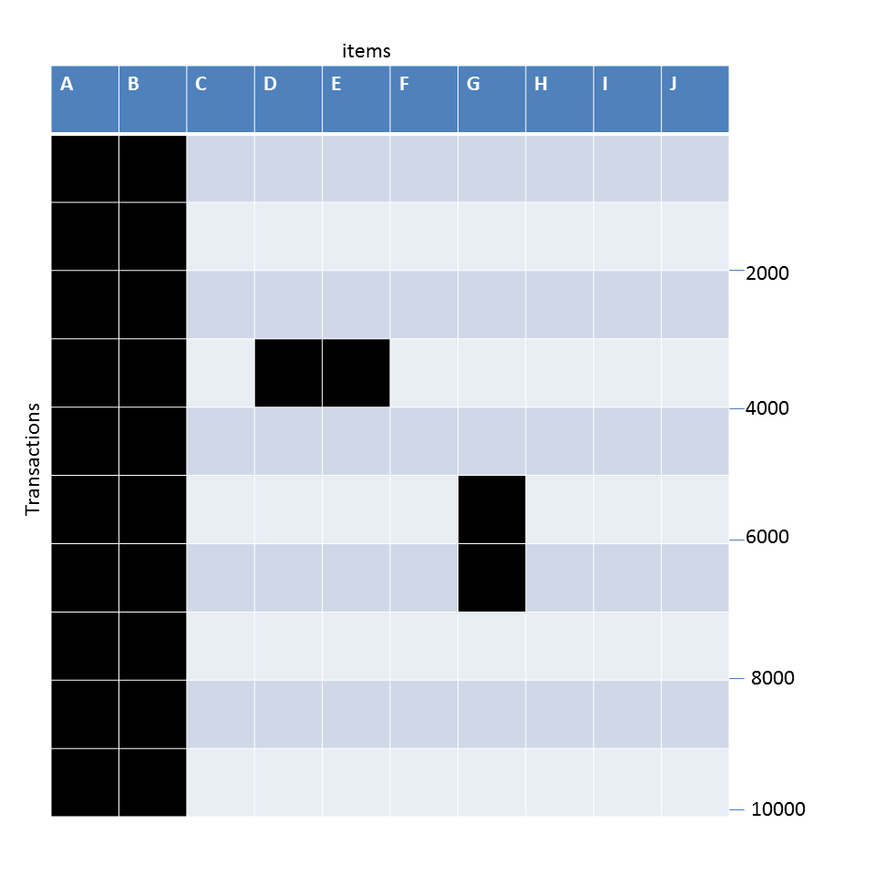
Example question
Given the following transaction data sets (dark cells indicate presence of an item in a transaction) and a support threshold of 20%, answer the following questions
DataSet: A
Data Set: B
Data Set: C
What is the number of frequent itemsets for each dataset? Which dataset will produce the most number of frequent itemsets?
Which dataset will produce the longest frequent itemset?
Which dataset will produce frequent itemsets with highest maximum support?
Which dataset will produce frequent itemsets containing items with widely varying support levels (i.e., itemsets containing items with mixed support, ranging from 20% to more than 70%)?
What is the number of maximal frequent itemsets for each dataset? Which dataset will produce the most number of maximal frequent itemsets?
What is the number of closed frequent itemsets for each dataset? Which dataset will produce the most number of closed frequent itemsets?

Slide 36
Pattern Evaluation
Association rule algorithms can produce large number of rules
Interestingness measures can be used to prune/rank the patterns
In the original formulation, support & confidence are the only measures used

Slide 37
Computing Interestingness Measure
Given X → Y or {X,Y}, information needed to compute interestingness can be obtained from a contingency table
Contingency table
 | Y | Y
X | f₁₁ | f₁₀ | f₁₊
X | f₀₁ | f₀₀ | f_{o+}
 | f₊₁ | f₊₀ | N
f₁₁: support of X and Y f₁₀: support of X and Y f₀₁: support of X and Y f₀₀: support of X and Y
Used to define various measures
support, confidence, Gini, entropy, etc.

Slide 38
Drawback of Confidence
Customers | Tea | Coffee | …
C1 | 0 | 1 | …
C2 | 1 | 0 | …
C3 | 1 | 1 | …
C4 | 1 | 0 | …
…
Association Rule: Tea → Coffee
Confidence ≅ P(Coffee|Tea) = 150/200 = 0.75
Confidence > 50%, meaning people who drink tea are more likely to drink coffee than not drink coffee
So rule seems reasonable

Slide 39
Drawback of Confidence
 | Coffee | Coffee
Tea | 150 | 50 | 200
Tea | 650 | 150 | 800
 | 800 | 200 | 1000
Association Rule: Tea → Coffee
Confidence= P(Coffee|Tea) = 150/200 = 0.75
but P(Coffee) = 0.8, which means knowing that a person drinks tea reduces the probability that the person drinks coffee!
Note that P(Coffee|Tea) = 650/800 = 0.8125

Slide 40
Drawback of Confidence
Customers | Tea | Honey | …
C1 | 0 | 1 | …
C2 | 1 | 0 | …
C3 | 1 | 1 | …
C4 | 1 | 0 | …
…
Association Rule: Tea → Honey Confidence ≅ P(Honey|Tea) = 100/200 = 0.50
Confidence = 50%, which may mean that drinking tea has little influence whether honey is used or not
So rule seems uninteresting
But P(Honey) = 120/1000 = .12 (hence tea drinkers are far more likely to have honey

Slide 41
Measure for Association Rules
So, what kind of rules do we really want?
Confidence(X → Y) should be sufficiently high
To ensure that people who buy X will more likely buy Y than not buy Y
Confidence(X → Y) > support(Y)
Otherwise, rule will be misleading because having item X actually reduces the chance of having item Y in the same transaction
Is there any measure that capture this constraint?
Answer: Yes. There are many of them.

Slide 42
Statistical Relationship between X and Y
The criterion confidence(X → Y) = support(Y)
is equivalent to:
P(Y|X) = P(Y)
P(X,Y) = P(X) × P(Y) (X and Y are independent)
If P(X,Y) > P(X) × P(Y) : X & Y are positively correlated
If P(X,Y) < P(X) × P(Y) : X & Y are negatively correlated

Slide 43
Measures that take into account statistical dependence
lift is used for rules while interest is used for itemsets

Slide 44
Example: Lift/Interest
 | Coffee | Coffee
Tea | 150 | 50 | 200
Tea | 650 | 150 | 800
 | 800 | 200 | 1000
Association Rule: Tea → Coffee
Confidence= P(Coffee|Tea) = 0.75
but P(Coffee) = 0.8
Interest = 0.15 / (0.2×0.8) = 0.9375 (< 1, therefore is negatively associated)
So, is it enough to use confidence/Interest for pruning?

Slide 45
There are lots of measures proposed in the literature

Slide 46
Comparing Different Measures
10 examples of contingency tables:
Rankings of contingency tables using various measures:

Slide 47
Property under Inversion Operation
Transaction 1
.
.
.
.
.
Transaction N

Slide 48
Property under Inversion Operation
Transaction 1
.
.
.
.
.
Transaction N
Correlation: -0.1667 -0.1667
IS/cosine 0.0 0.825

Slide 49
Property under Null Addition
Invariant measures:
cosine, Jaccard, All-confidence, confidence
Non-invariant measures:
correlation, Interest/Lift, odds ratio, etc

Slide 50
Property under Row/Column Scaling
Grade-Gender Example (Mosteller, 1968):
 | Male | Female
High | 30 | 20 | 50
Low | 40 | 10 | 50
 | 70 | 30 | 100
 | Male | Female
High | 60 | 60 | 120
Low | 80 | 30 | 110
 | 140 | 90 | 230
2x
3x
Mosteller: Underlying association should be independent of the relative number of male and female students in the samples
Odds-Ratio ((f₁₁₊f₀₀ )/(f₁₀₊f₁₀)) has this property
has this property

Slide 51
Property under Row/Column Scaling
Relationship between Mask use and susceptibility to Covid:
 | Covid-Positive | Covid-Free
Mask | 20 | 30 | 50
No-Mask | 40 | 10 | 50
 | 60 | 40 | 100
 | Covid-Positive | Covid-Free
Mask | 40 | 300 | 340
No-Mask | 80 | 100 | 180
 | 120 | 400 | 520
2x
10x
Mosteller: Underlying association should be independent of the relative number of Covid-positive and Covid-free subjects
Odds-Ratio ((f₁₁₊f₀₀ )/(f₁₀₊f₁₀)) has this property

Slide 52
Different Measures have Different Properties

Slide 53
Simpson’s Paradox
Observed relationship in data may be influenced by the presence of other confounding factors (hidden variables)
Hidden variables may cause the observed relationship to disappear or reverse its direction!
Proper stratification is needed to avoid generating spurious patterns

Slide 54
Simpson’s Paradox
Recovery rate from Covid
Hospital A: 80%
Hospital B: 90%
Which hospital is better?

Slide 55
Simpson’s Paradox
Recovery rate from Covid
Hospital A: 80%
Hospital B: 90%
Which hospital is better?
Covid recovery rate on older population
Hospital A: 50%
Hospital B: 30%
Covid recovery rate on younger population
Hospital A: 99%
Hospital B: 98%

Slide 56
Simpson’s Paradox
Covid-19 death: (per 100,000 of population)
County A: 15
County B: 10
Which state is managing the pandemic better?

Slide 57
Simpson’s Paradox
Covid-19 death: (per 100,000 of population)
County A: 15
County B: 10
Which state is managing the pandemic better?
Covid death rate on older population
County A: 20
County B: 40
Covid death rate on younger population
County A: 2
County B: 5

Slide 58
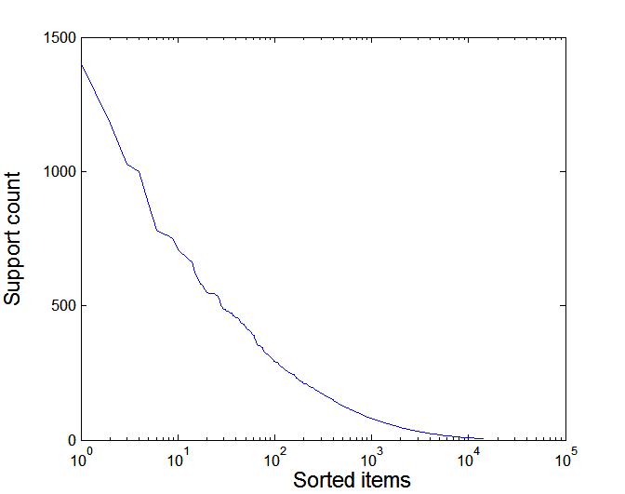
Effect of Support Distribution on Association Mining
Few items with high support
Many items with low support
Support distribution of a retail data set
Rank of item (in log scale)
Many real data sets have skewed support distribution

Slide 59
Effect of Support Distribution
Difficult to set the appropriate minsup threshold
If minsup is too high, we could miss itemsets involving interesting rare items (e.g., {caviar, vodka})
If minsup is too low, it is computationally expensive and the number of itemsets is very large

Slide 60
Cross-Support Patterns
A cross-support pattern involves items with varying degree of support
Example: {caviar,milk}
How to avoid such patterns?
caviar
milk

Slide 61
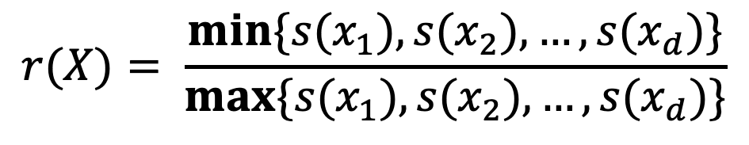
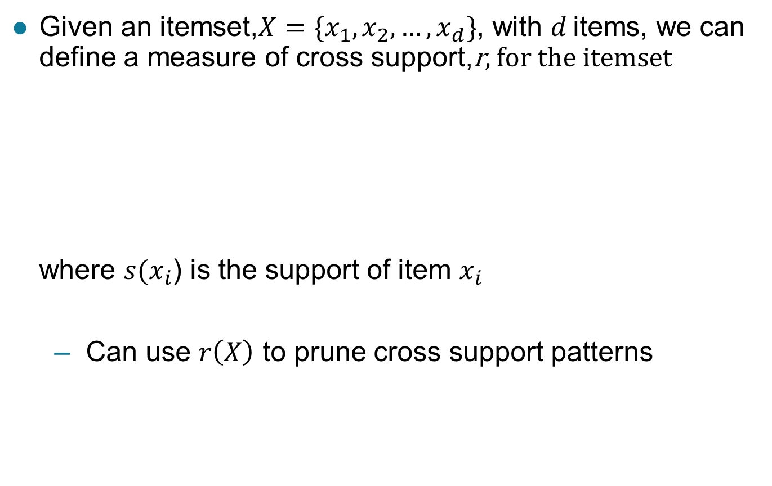
A Measure of Cross Support
$$r(X)= \frac{min\{s(x_{1}),s(x_{2}), …,s(x_{d})\}}{max\{s(x_{1}),s(x_{2}), …,s(x_{d})\}}$$
Given an itemset,$X=\{x_{1},x_{2},…,x_{d}\}$, with $d$ items, we can define a measure of cross support,r, for the itemset where $s(x_{i}$) is the support of item $x_{i}$
Can use $r\left(X\right)$ to prune cross support patterns

Slide 62
Confidence and Cross-Support Patterns
Observation:
conf(caviar→milk) is very high
but
conf(milk→caviar) is very low
Therefore,
min( conf(caviar→milk), conf(milk→caviar) ) is also very low
caviar
milk

Slide 63
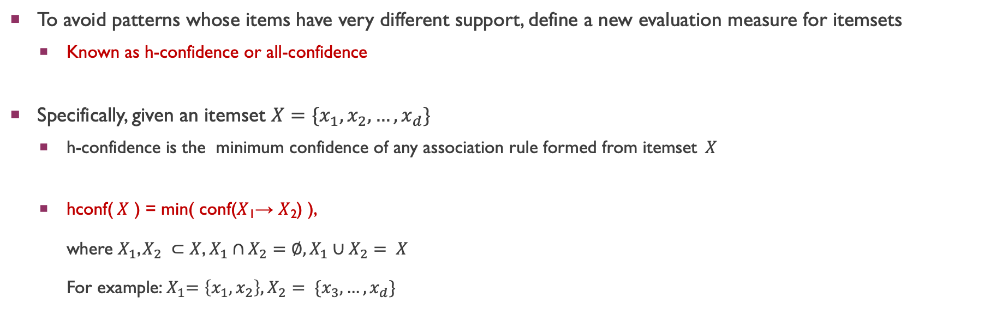
H-Confidence
To avoid patterns whose items have very different support, define a new evaluation measure for itemsets
Known as h-confidence or all-confidence
Specifically, given an itemset $X=\{x_{1},x_{2},…,x_{d}\}$
h-confidence is the minimum confidence of any association rule formed from itemset$X$
hconf($X$ ) = min( conf($X$₁→ $X$₂) ), where $X_{1}$, $X_{2} ⊂$ $X$, $X_{1}∩$ $X_{2}=∅,X_{1}∪X_{2}$ $= X$ For example:${ X}_{1}=\left\{x_{1},x_{2}\right\}, X_{2}$ $= \{x_{3},…,x_{d}\}$

Slide 64
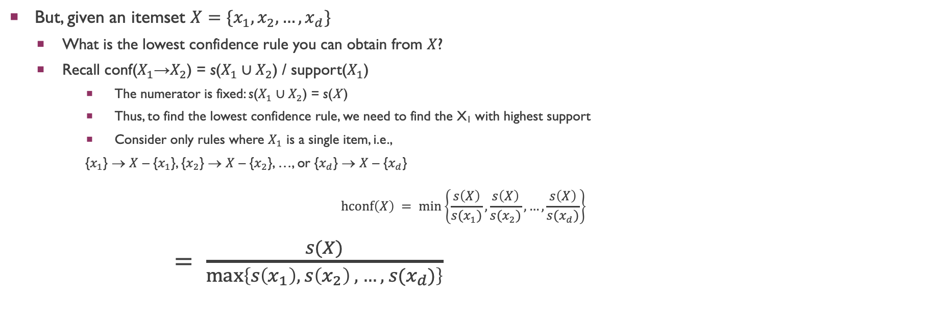
H-Confidence …
But, given an itemset $X=\{x_{1},x_{2},…,x_{d}\}$
What is the lowest confidence rule you can obtain from $X$?
Recall conf($X_{1}$→$X_{2}$) = s($X_{1}∪X_{2}$) / support($X_{1}$)
The numerator is fixed: s($X_{1}∪X_{2}$) = s(X )
Thus, to find the lowest confidence rule, we need to find the X₁ with highest support
Consider only rules where $X_{1}$ is a single item, i.e.,
{$x_{1}$} → $X$ – {$x_{1}$}, {$x_{2}$} → $X$ – {$x_{2}$}, …, or {$x_{d}$} → $X$ – {$x_{d}$}
$$hconf\left(X\right) = min\left\{\frac{s\left(X\right)}{s(x_{1})},\frac{s\left(X\right)}{s(x_{2})},…,\frac{s\left(X\right)}{s(x_{d})}\right\}$$ $= \frac{s(X)}{max⁡\left\{s\left(x_{1}\right), s\left(x_{2}\right) , …, s(x_{d})\right\}}$

Slide 65
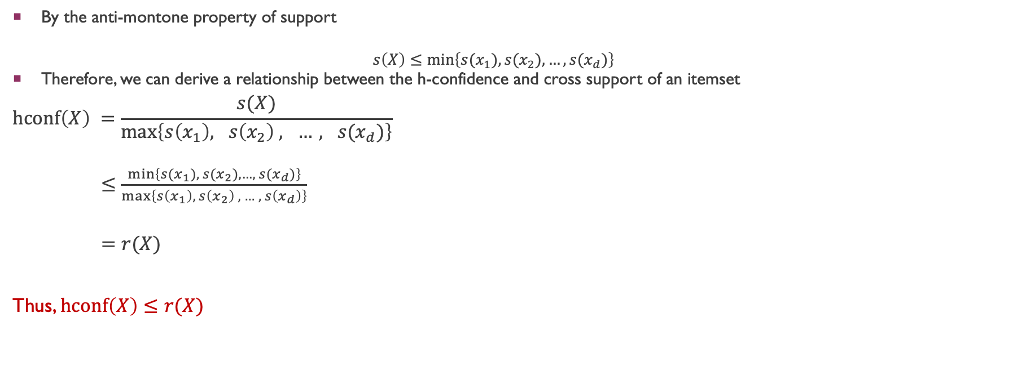
Cross Support and H-confidence
By the anti-montone property of support
$$s\left(X\right)≤min\left\{s(x_{1}),{s(x}_{2}), …,{s(x}_{d})\right\}$$
Therefore, we can derive a relationship between the h-confidence and cross support of an itemset
$$hconf\left(X\right) =\frac{s(X)}{max⁡\left\{s\left(x_{1}\right), s\left(x_{2}\right) , …, s(x_{d})\right\}}$$ $≤\frac{min\left\{s(x_{1}),{ s(x}_{2}), …,{ s(x}_{d})\right\}}{\max\left\{s\left(x_{1}\right), s\left(x_{2}\right) , …, s\left(x_{d}\right)\right\}}$
$=r(X)$
Thus, $hconf\left(X\right)≤r(X)$

Slide 66
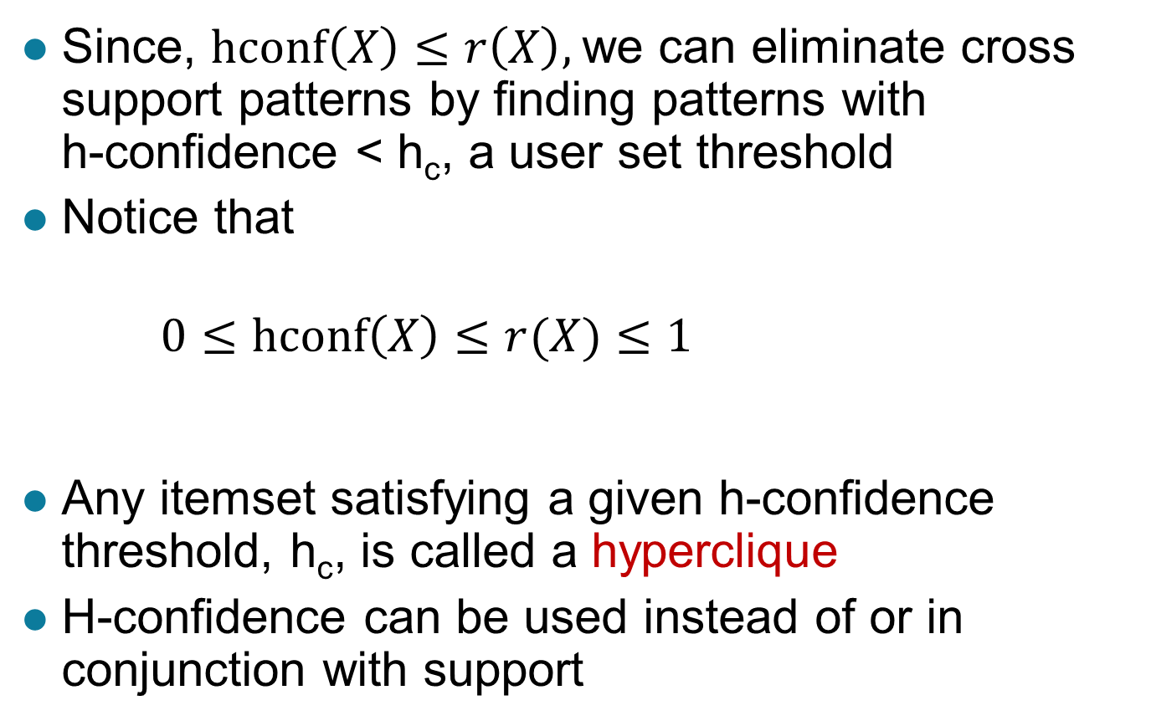
Cross Support and H-confidence …
Since, $hconf\left(X\right)≤r\left(X\right),$we can eliminate cross support patterns by finding patterns with h-confidence < h_{c}, a user set threshold
Notice that
$0≤hconf\left(X\right)≤r(X)≤1$
Any itemset satisfying a given h-confidence threshold, h_{c}, is called a hyperclique
H-confidence can be used instead of or in conjunction with support

Slide 67
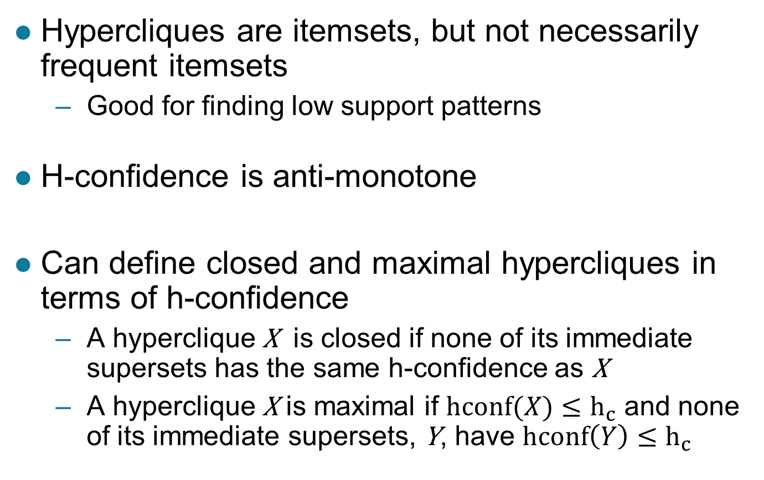
Properties of Hypercliques
Hypercliques are itemsets, but not necessarily frequent itemsets
Good for finding low support patterns
H-confidence is anti-monotone
Can define closed and maximal hypercliques in terms of h-confidence
A hyperclique X is closed if none of its immediate supersets has the same h-confidence as X
A hyperclique X is maximal if $hconf(X)≤h_{c}$ and none of its immediate supersets, Y, have $hconf\left(Y\right)≤h_{c}$

Slide 68
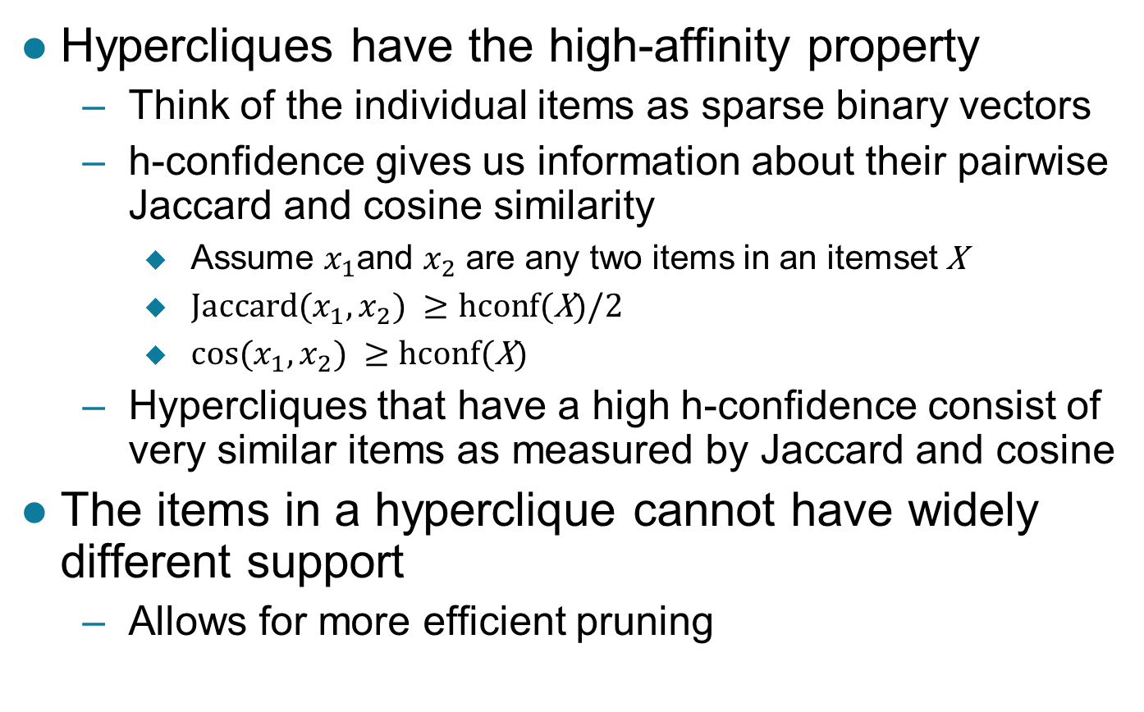
Properties of Hypercliques …
Hypercliques have the high-affinity property
Think of the individual items as sparse binary vectors
h-confidence gives us information about their pairwise Jaccard and cosine similarity
Assume $x_{1}$and $x_{2}$ are any two items in an itemset X
${Jaccard⁡(x}_{1},x_{2}) ≥hcon$f(X)/2
${cos⁡(x}_{1},x_{2}) ≥hcon$f(X)
Hypercliques that have a high h-confidence consist of very similar items as measured by Jaccard and cosine
The items in a hyperclique cannot have widely different support
Allows for more efficient pruning

Slide 69
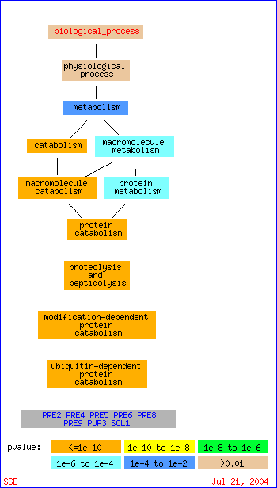
Example Applications of Hypercliques
Hypercliques are used to find strongly coherent groups of items
Words that occur together in documents
Proteins in a protein interaction network
In the figure at the right, a gene ontology hierarchy for biological process shows that the identified proteins in the hyperclique (PRE2, …, SCL1) perform the same function and are involved in the same biological process

