Slide 1
Association Rule Mining
Beiyu Lin

Slide 2

Rule Generation
Given a frequent itemset L, find all non-empty subsets f ⊂ L such that f → L – f satisfies the minimum confidence requirement
If {A,B,C,D} is a frequent itemset, candidate rules:
ABC →D, ABD →C, ACD →B, BCD →A, A →BCD, B →ACD, C →ABD, D →ABC AB →CD, AC → BD, AD → BC, BC →AD, BD →AC, CD →AB,
If |L| = k, then there are 2^{k} – 2 candidate association rules (ignoring L → ∅ and ∅ → L)

Slide 3




Rule Generation
In general, confidence does not have an anti-monotone property
c(ABC →D) can be larger or smaller than c(AB →D)
But confidence of rules generated from the same itemset has an anti-monotone property
E.g., Suppose {A,B,C,D} is a frequent 4-itemset: c(ABC → D) ≥ c(AB → CD) ≥ c(A → BCD)
Confidence is anti-monotone w.r.t. number of items on the RHS of the rule

Slide 4
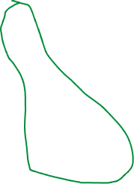
Rule Generation for Apriori Algorithm
Lattice of rules
Low Confidence Rule
Pruned Rules

Slide 5
Association Analysis: Basic Concepts and Algorithms
Algorithms and Complexity

Slide 6
Factors Affecting Complexity of Apriori
Choice of minimum support threshold
Dimensionality (number of items) of the data set
Size of database
Average transaction width

Slide 7
Factors Affecting Complexity of Apriori
Choice of minimum support threshold
lowering support threshold results in more frequent itemsets
this may increase number of candidates and max length of frequent itemsets
Dimensionality (number of items) of the data set
Size of database
Average transaction width

Slide 8




Impact of Support Based Pruning
Items (1-itemsets)
Minimum Support = 3
Minimum Support = 2
If every subset is considered,
⁶C₁ + ⁶C₂ + ⁶C₃
6 + 15 + 20 = 41
With support-based pruning,
6 + 6 + 4 = 16
If every subset is considered,
⁶C₁ + ⁶C₂ + ⁶C₃ + ⁶C₄
6 + 15 + 20 +15 = 56

Slide 9
Factors Affecting Complexity of Apriori
Choice of minimum support threshold
lowering support threshold results in more frequent itemsets
this may increase number of candidates and max length of frequent itemsets
Dimensionality (number of items) of the data set
More space is needed to store support count of itemsets
if number of frequent itemsets also increases, both computation and I/O costs may also increase
Size of database
Average transaction width

Slide 10
Factors Affecting Complexity of Apriori
Choice of minimum support threshold
lowering support threshold results in more frequent itemsets
this may increase number of candidates and max length of frequent itemsets
Dimensionality (number of items) of the data set
More space is needed to store support count of itemsets
if number of frequent itemsets also increases, both computation and I/O costs may also increase
Size of database
run time of algorithm increases with number of transactions
Average transaction width

Slide 11
Factors Affecting Complexity of Apriori
Choice of minimum support threshold
lowering support threshold results in more frequent itemsets
this may increase number of candidates and max length of frequent itemsets
Dimensionality (number of items) of the data set
More space is needed to store support count of itemsets
if number of frequent itemsets also increases, both computation and I/O costs may also increase
Size of database
run time of algorithm increases with number of transactions
Average transaction width
transaction width increases the max length of frequent itemsets
number of subsets in a transaction increases with its width, increasing computation time for support counting

Slide 12
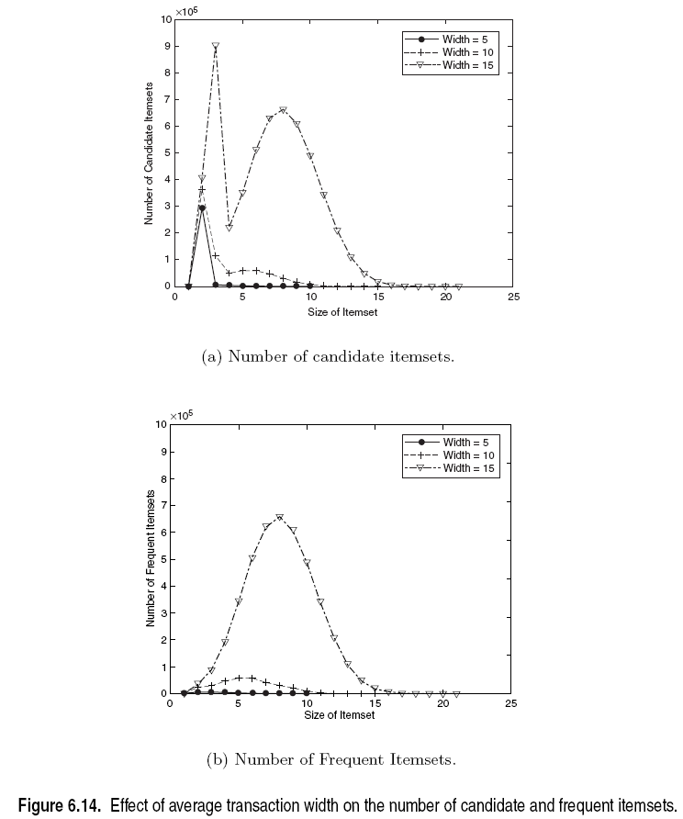
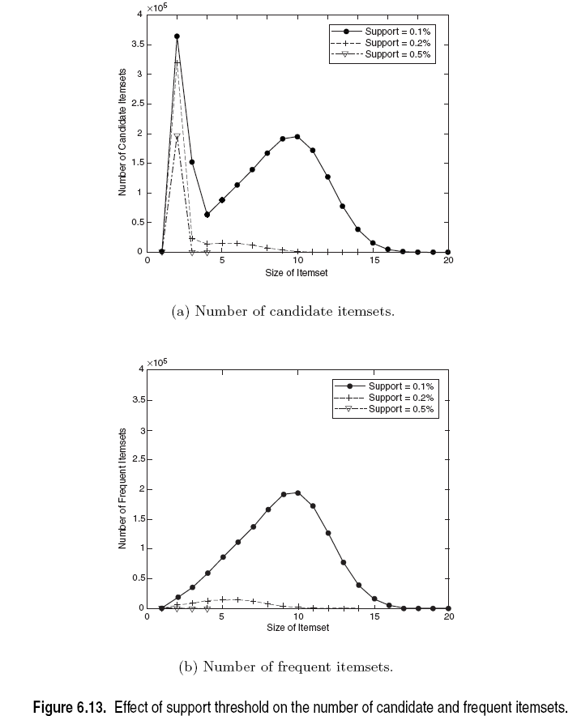
Factors Affecting Complexity of Apriori

Slide 13

Compact Representation of Frequent Itemsets
Some frequent itemsets are redundant because their supersets are also frequent
Consider the following data set. Assume support threshold =5
Number of frequent itemsets
Need a compact representation
Notes:
Superset: contains more transactions then the minimum support

Slide 14

Illustrating Apriori Principle
Found to be Infrequent
Pruned supersets

Slide 15
Maximal Frequent Itemset
An itemset is maximal frequent if it is frequent and none of its immediate supersets is frequent
Maximal Itemsets
Infrequent Itemsets
Border

Slide 16
What are the Maximal Frequent Itemsets in this Data?
Minimum support threshold = 5
(A1-A10)
(B1-B10)
(C1-C10)

Slide 17

An illustrative example
Items
 | A | B | C | D | E | F | G | H | I | J
1
2
3
4
5
6
7
8
9
10
Support threshold (by count) : 5
Frequent itemsets: ?
Maximal itemsets: ?
Transactions

Slide 18




An illustrative example
Items
 | A | B | C | D | E | F | G | H | I | J
1
2
3
4
5
6
7
8
9
10
Support threshold (by count) : 5
Frequent itemsets: {F}
Maximal itemsets: {F}
Support threshold (by count): 4
Frequent itemsets: ?
Maximal itemsets: ?
Transactions

Slide 19
An illustrative example
Items
 | A | B | C | D | E | F | G | H | I | J
1
2
3
4
5
6
7
8
9
10
Support threshold (by count) : 5
Frequent itemsets: {F}
Maximal itemsets: {F}
Support threshold (by count): 4
Frequent itemsets: {E}, {F}, {E,F}, {J}
Maximal itemsets: {E,F}, {J}
Support threshold (by count): 3
Frequent itemsets: ?
Maximal itemsets: ?
Transactions
Notes:
A maximal frequent itemset is a frequent itemset for which none of its immediate supersets are frequent

Slide 20
An illustrative example
Items
 | A | B | C | D | E | F | G | H | I | J
1
2
3
4
5
6
7
8
9
10
Support threshold (by count) : 5
Frequent itemsets: {F}
Maximal itemsets: {F}
Support threshold (by count): 4
Frequent itemsets: {E}, {F}, {E,F}, {J}
Maximal itemsets: {E,F}, {J}
Support threshold (by count): 3
Frequent itemsets:
All subsets of {C,D,E,F} + {J}
Maximal itemsets:
{C,D,E,F}, {J}
Transactions

Slide 21
Closed Itemset
An itemset X is closed if none of its immediate supersets has the same support as the itemset X.
X is not closed if at least one of its immediate supersets has support count as X.

Slide 22
Weka – associate rule

Slide 23



Closed Itemset
An itemset X is closed if none of its immediate supersets has the same support as the itemset X.
X is not closed if at least one of its immediate supersets has support count as X.

Slide 24



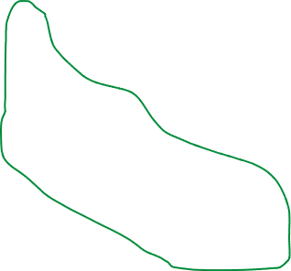
Maximal vs Closed Itemsets
Transaction Ids
Not supported by any transactions

Slide 25
Maximal Frequent vs Closed Frequent Itemsets
Minimum support = 2
Closed but not maximal
Closed and maximal
# Closed frequent = 9
# Maximal freaquent = 4

Slide 26
What are the Closed Itemsets in this Data?
(A1-A10)
(B1-B10)
(C1-C10)

Slide 27

Example 1
Items
 | A | B | C | D | E | F | G | H | I | J
1
2
3
4
5
6
7
8
9
10
Itemsets | Support (counts) | Closed itemsets
{C} | 3
{D} | 2
{C,D} | 2
Transactions

Slide 28
Example 1
Items
 | A | B | C | D | E | F | G | H | I | J
1
2
3
4
5
6
7
8
9
10
Itemsets | Support (counts) | Closed itemsets
{C} | 3 | ✓
{D} | 2
{C,D} | 2 | ✓
Transactions

Slide 29
Example 2
Items
 | A | B | C | D | E | F | G | H | I | J
1
2
3
4
5
6
7
8
9
10
Itemsets | Support (counts) | Closed itemsets
{C} | 3
{D} | 2
{E} | 2
{C,D} | 2
{C,E} | 2
{D,E} | 2
{C,D,E} | 2
Transactions

Slide 30
Example 2
Items
 | A | B | C | D | E | F | G | H | I | J
1
2
3
4
5
6
7
8
9
10
Itemsets | Support (counts) | Closed itemsets
{C} | 3 | ✓
{D} | 2
{E} | 2
{C,D} | 2
{C,E} | 2
{D,E} | 2
{C,D,E} | 2 | ✓
Transactions

Slide 31
Example 3
Items
 | A | B | C | D | E | F | G | H | I | J
1
2
3
4
5
6
7
8
9
10
Closed itemsets: {C,D,E,F}, {C,F}
Transactions

Slide 32
Example 4
Items
 | A | B | C | D | E | F | G | H | I | J
1
2
3
4
5
6
7
8
9
10
Closed itemsets: {C,D,E,F}, {C}, {F}
Transactions

Slide 33
Maximal vs Closed Itemsets

Slide 34
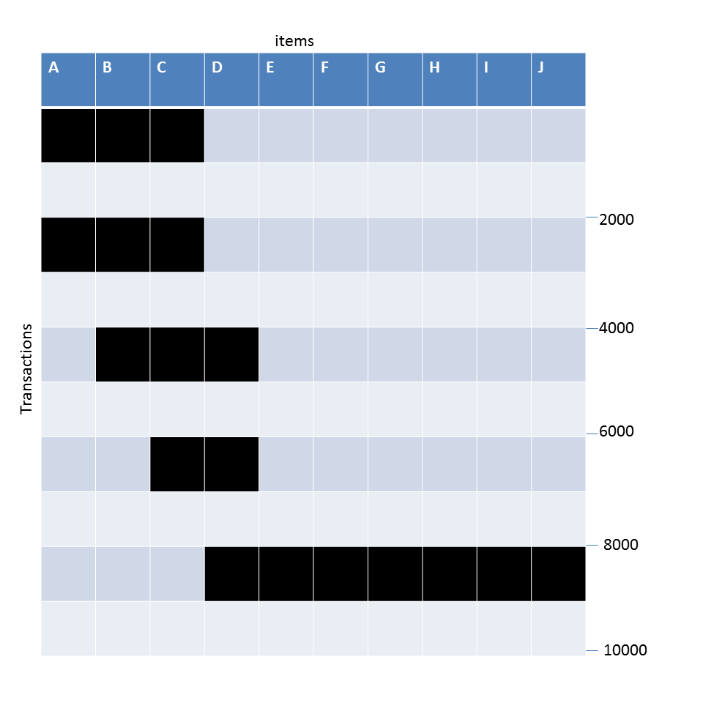
Example question
Data Set: C
What is the number of frequent itemsets for each dataset? Which dataset will produce the most number of frequent itemsets?
Which dataset will produce the longest frequent itemset?
Which dataset will produce frequent itemsets with highest maximum support?
Which dataset will produce frequent itemsets containing items with widely varying support levels (i.e., itemsets containing items with mixed support, ranging from 20% to more than 70%)?
What is the number of maximal frequent itemsets for each dataset? Which dataset will produce the most number of maximal frequent itemsets?
What is the number of closed frequent itemsets for each dataset? Which dataset will produce the most number of closed frequent itemsets?

Slide 35
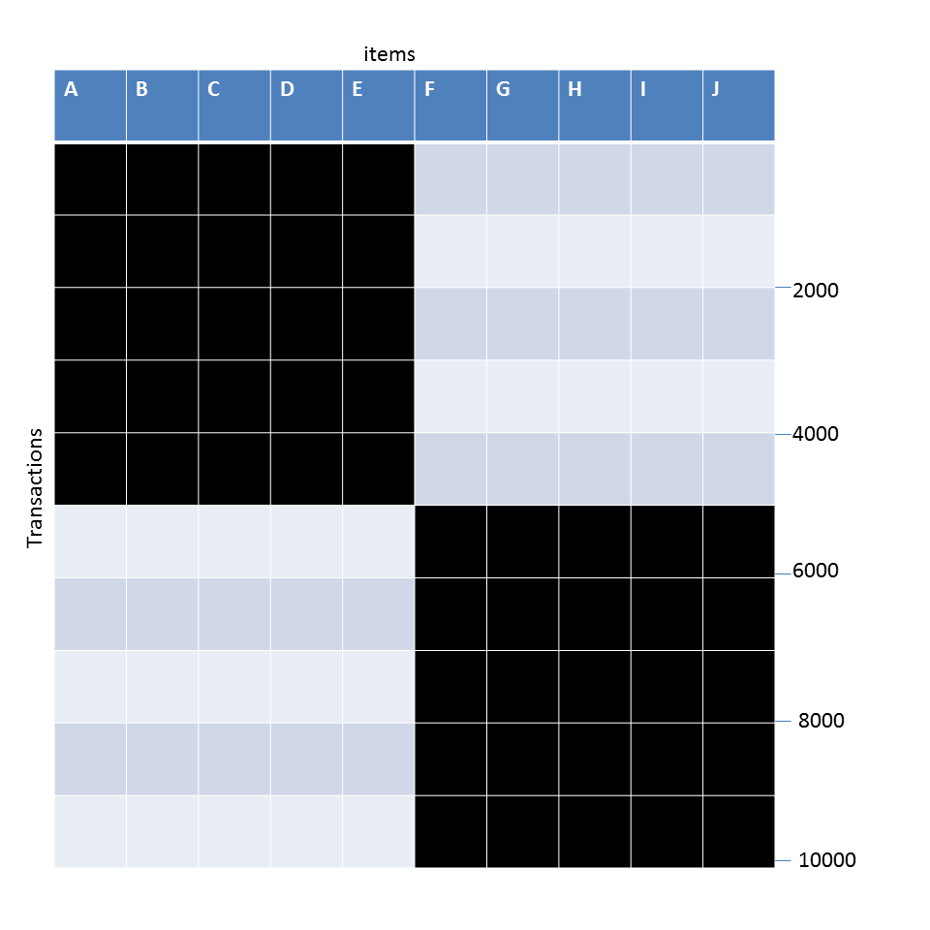
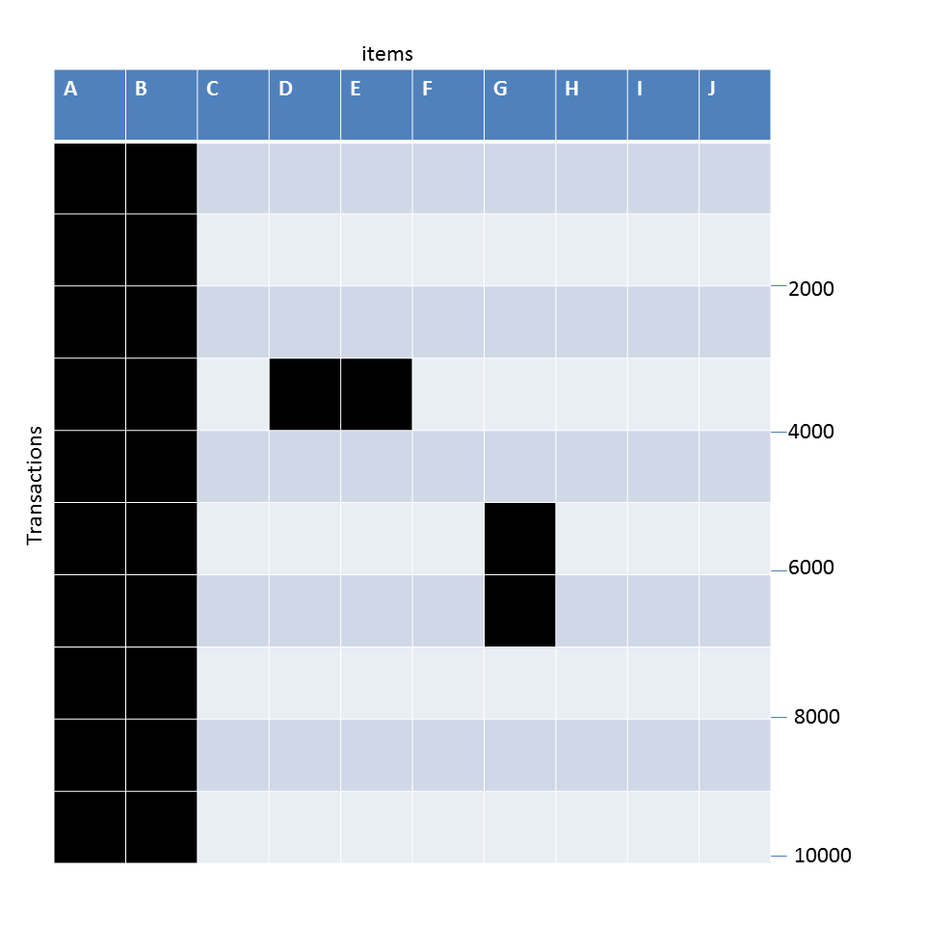
Example question
DataSet: A
Data Set: B
Data Set: C
Given the following transaction data sets (dark cells indicate presence of an item in a transaction) and a support threshold of 20%, answer the following questions
What is the number of frequent itemsets for each dataset? Which dataset will produce the most number of frequent itemsets?
Which dataset will produce the longest frequent itemset?
Which dataset will produce frequent itemsets with highest maximum support?
Which dataset will produce frequent itemsets containing items with widely varying support levels (i.e., itemsets containing items with mixed support, ranging from 20% to more than 70%)?
What is the number of maximal frequent itemsets for each dataset? Which dataset will produce the most number of maximal frequent itemsets?
What is the number of closed frequent itemsets for each dataset? Which dataset will produce the most number of closed frequent itemsets?

