Slide 1
Control Structures
A program can proceed:
Sequentially
Selectively (branch) - making a choice
Repetitively (iteratively) - looping

Slide 2
Conditional Execution
if is a reserved word
The most basic syntax for if:
if( condition )
{statement;}
The statement is executed if the condition evaluates to true
The statement is bypassed if the condition evaluates to false

Slide 3
bool Data Type and Conditions
A condition can be a bool variable
The data type bool has logical (Boolean) values true and false
bool, true, and false are reserved words
The identifier true has the value 1
The identifier false has the value 0

Slide 4
int Data Type and Conditions
Earlier versions of C++ did not provide built-in data types that had Boolean values
Logical expressions evaluate to either 1 or 0
The value of a logical expression was stored in a variable of the data type int
You can use the int data type as a condition

Slide 5
Logical Expressions
General syntax for if:
if( logical-expression )
statement
A logical expression is any expression that evaluates to true or false
A literal (anything but 0 is true)
A variable (any built-in type)
A function (should return bool or int)
Any expression that evaluates to bool or int

Slide 6
Logical Expressions
Arithmetic expressions
Built with arithmetic operators
Evaluate to numbers (integer or floating-point)
3 + 5
(7 / 2) * 4.0
Logical expressions
Built with relational operators
Evaluate to true or false
3 == 3
“hello” < “goodbye”

Slide 7
Relational Operators

Slide 8
Comparing Numbers
Integer and floating-point types can be compared
8 < 15 evaluates to true
6 != 6 evaluates to false
2.5 > 5.8 evaluates to false
5.9 <= 7 evaluates to true

Slide 9
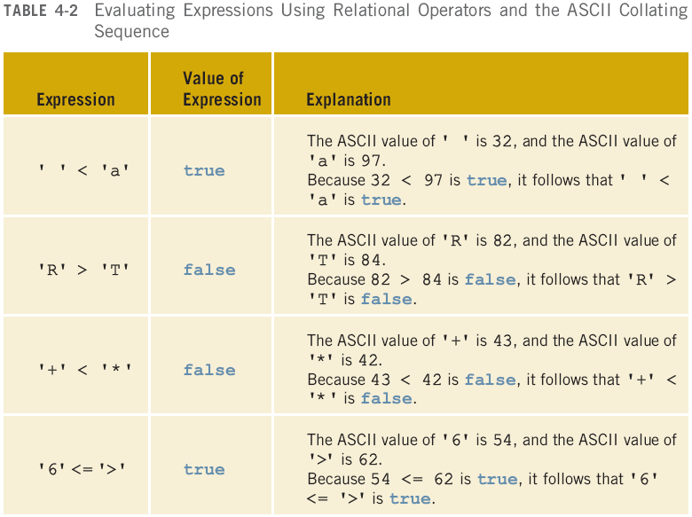
Comparing Characters

Slide 10
Comparing strings
Relational operators can be applied to strings
Strings are compared character by character, starting with the first character
Comparison continues until either a mismatch is found or all characters are found equal
If two strings of different lengths are compared and the comparison is equal to the last character of the shorter string
The shorter string is less than the larger string
Note: this does not work for comparing 2 string literals!

Slide 11
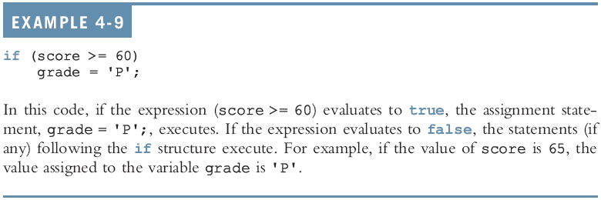
Examples

Slide 13
Common Syntax Errors

Slide 14
Two-way Conditional Execution
if can be paired with else
if( logical-expression )
statement1
else
statement2
If the condition is true, statement1 is executed
If the condition is false, statement2 is executed

Slide 15
One-Way Selection

Slide 16
Two-Way Selection

Slide 17
Example

Slide 18
Common Syntax Errors

Slide 19
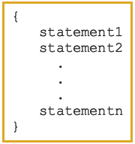
Block Statements
A block (or compound) statement looks like:
A block can be used anywhere a statement can be used

Slide 20
Conditional Block Statements
if (age > 18)
cout << "No longer a minor." << endl;
else
cout << "Still a minor." << endl;

Slide 21
Conditional Block Statements
if (age > 18)
{
cout << "No longer a minor." << endl;
}
else
{
cout << "Still a minor." << endl;
}

Slide 22
Conditional Block Statements
if (age > 18)
{
cout << "No longer a minor." << endl;
cout << "Eligible to vote." << endl;
}
else
{
cout << "Still a minor." << endl;
cout << "Not eligible to vote." << endl;
}

Slide 23
More Than 2 Choices
Series of if statements:
if( logical-expression1 )
{
statement1
}
if( logical-expression2 )
{
statement2
}
if( logical-expression3 )
{
statement3
}
Checks all three conditions
Can’t have a default else condition
Used for statements that are not mutually exclusive

Slide 24
More Than 2 Choices
For mutually exclusive conditions, use an if…else tree
Stops when a condition is true
Can have a default else condition
if( logical-expression1 )
{
statement1
}
else if( logical-expression2 )
{
statement2
}
else if( logical-expression3 )
{
statement3
}
else
{
statement4
}

Slide 25
Example: Date Conversion
Input
Date in the form yyyy-mm-dd
(e.g. 2009-09-24)
Output
Date in the form month day, year
(e.g. September 24, 2009)

Slide 26
Example: Large Joe’s
Write a simple fast food drive-through ordering program for Large Joe’s restaurant. The menu is:
Triple Burger: $4.99
Fried Chicken $6.99
French Fries $2.29
Sample run (user input in bold):
== Welcome to Large Joe's, can I take your order? ==
For a triple burger, press 1
For a heap of fried chicken, press 2
Your order: 1
Would you like fries with that? (y/n): y
Your total is $7.28, please drive through.

Slide 27
Example: Large Joe’s
Large Joe’s now has bacon!
Adding bacon to your burger costs $0.99
Modify the program so that if the customer orders a burger, the program asks them:
Would you like bacon on your burger? (y/n): y
If they answer yes, add the cost to their order
Don’t ask about bacon if they didn’t order a burger!

