Slide 1
CSCI/CMPE 1370 Engineering Computer Science I (for CSCI/CMPE majors, minors)
Beiyu Lin
Zoom Meeting ID: 758 217 1203
Email: beiyu.lin@utrgv.edu

Slide 2
Computer Science I
Goal #1:
Introduce you to the ideas behind computer science
Goal #2: Learn two practical skills:
How to design solutions to different problems
How to implement those solutions writing computer programs in C++
Expect to spend at least as much time outside of class as you spend in class (ideally at least 3 hours per each hour spent in the classroom)

Slide 3
Computer Science I
Course concepts and skills are broken up into 5 modules (they are highly cumulative!)
For each module…
I will introduce concepts and show examples
You will have to read the book, review the material discussed in class, and practice with the examples provided
You will test yourself: are you prepared?
I will assess your knowledge (assignments, exercises, and exams)

Slide 4
Computer Science I
Learning requires a little knowledge and a lot of practice:
Read the textbook and do the activities to get the knowledge
download the examples discussed in class and analyze them thoroughly until you understand them
Make small changes, try to predict the new results, and then test them to see if you get what you expected
Discuss with your teammate what you did for practice
If you do receive some help from classmates, please identify their names in the comment block at the top of your main source file and above the block of code that was shared. If you do not identify the students that helped you with your program, then you are at risk of being identified as copying or plagiarizing.

Slide 5
Course Information
All course materials and announcements will be available on Blackboard
Syllabus
Instructor and TA contact information
Lecture materials
Assignments, labs, review questions
Due dates, exam schedule, announcements
Course announcements and other updates will be handled through Announcements and Calendar
You are expected to check your Blackboard course every weekday and at least once on weekends

Slide 6
Lab Section
You must be registered for the co-requisite lab course CSCI/CMPE 1170
In lab you will:
Have to individually analyze code and then discuss the solution(s)
Have hands-on time to write code
Practice with the concepts presented in lecture
Ask questions, the TAs are there to help
Ask questions, you are encouraged to discuss amongst yourselves
(just make sure you’re getting real practice, that is, you do write the programs not just watch somebody else doing it)

Slide 7
Textbook
Zyante Programming in C++ online interactive text
Contains interactive activities and practice
Allows me to follow your progress
$58, online access good through end of semester
Can be downloaded and saved
Limited internet access? Online payment issues? See me!
Information for subscribing is on zybook_subscription.pdf in Miscellaneous https://zybooks.zyante.com/#/zybooks
Want a physical C++ textbook?
Go for it, any one will be fine
I’d recommend one with lots of examples

Slide 8
Tools
The textbook has it’s own web-based programming environment
Very convenient for exercises
We will also be using Microsoft Visual C++
Integrated Development Environment (IDE)
Available for free download
You may also use online C++ compilers (like cpp.sh and www.onlinegdb.com)

Slide 9

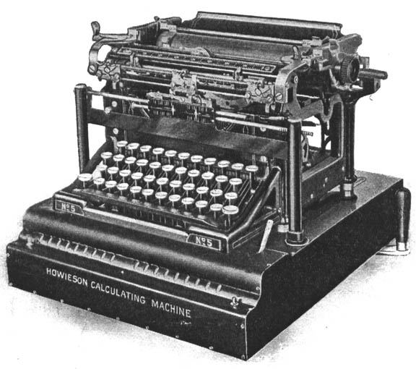
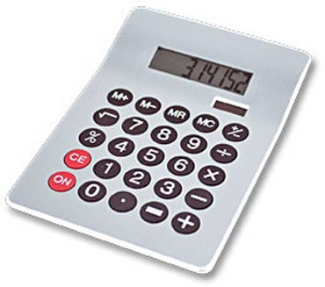



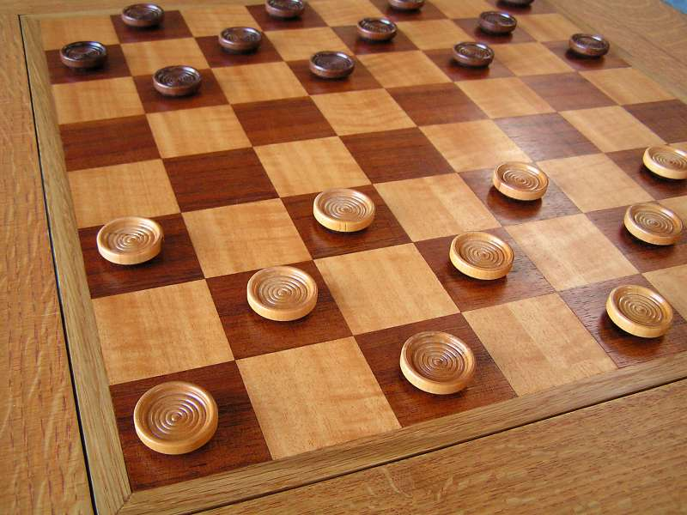
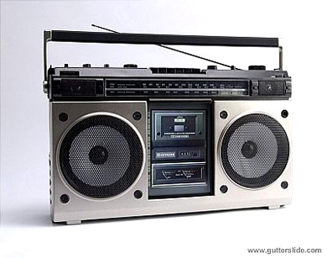
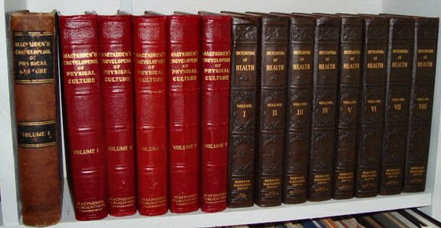

Slide 10
Programs
Writing a computer program is simply giving instructions that a computer can follow
In this course, we’ll be giving instructions in the C++ language
A program is a sequence of statements
Each statement tells the computer to do one (or more) operations

Slide 11
Language, Syntax and Semantics
C++ is an artificial language
Similar to a natural language, only the rules are a lot more strict
To use a language, you have to know the syntax (what goes where) and the semantics (what does it mean)
In natural language, you can bend things quite a bit
i are teach u good!!!1!!11!
In a programming language, you have to follow the rules
Unlike in natural language, statements in C++ have only one meaning: they tell the computer to do a specific thing

Slide 12
Language, Syntax and Semantics
Every statement in C++ is like a sentence in English
Both are made up of words and symbols separated by spaces
English syntax rule: sentences end with punctuation
C++ syntax rule: statements end with a semi-colon (;)
By convention, each statement gets its own line
Based on this rule, here is the simplest C++ statement:
;
It is a valid statement (follows the rules)
It tells the computer to do nothing

Slide 13
Operators
To tell the computer to do something, a statement can use an operator
Each operator specifies a particular operation
Insertion operator (<<): print something, somewhere
Addition operator (+): add two things
Subtraction operator (-): subtract one thing from another
Assignment operator (=): store something, somewhere
Each of these operators is binary
They take two arguments
Math: y = x + 2, x = 5, y = 7;
Computer: assume we defined a variable called y;
I want to assign value 7 to the variable y.
y = 7;
Print out the value of y:
cout << y; ⬄ English: print out the value of y.

Slide 14
Operators
Syntax rule: a binary operator needs a left-hand side (LHS) argument and a right-hand side (RHS) argument
Insertion operator: cout << “Hello world!”;
English: print out the “hello world!”.
LHS: where to print
RHS: what to print
Addition operator: 5 + 6;
LHS/RHS: the two numbers to add
Subtraction operator: 19 – 3;
LHS: the number to subtract from
RHS: the number to subtract
In general, a statement with a binary operator looks like:
LHS operator RHS;

Slide 15
The Print Statement
How does the computer understand this statement?
The insertion operator (<<) instructs the computer to print something: e.g., cout << “Hello World!”;
To do so, it has to be told what to print and where
To the right of the operator is the value that we want it to print
4 is the literal number 4
“Hello there” is a literal string of characters
To the left of the operator is the place we want to print to
cout specifies that black box on the screen
All statements in C++ end with a semi-colon (;)

Slide 16
Data
What are valid arguments?
Depends on the operator
Most of the time, a piece of data
Four primitive data types
An integer (whole number) ⬄ integer
12
A real number ⬄ data type is called double
3.14
A character (surrounded by single quotes)
'A'
A string (surrounded by double quotes)
"Hello world.” “today is Thursday.”

Slide 17
Data
Addition and subtraction only work with numbers (integers or real numbers s)
Printing (insertion) works with numbers, characters or strings on the RHS
LHS is the place to print, we’ll get back to that

Slide 18
Arithmetic Operators
C++ arithmetic operators:
+, -, *, and / can be used with integral and floating-point data types
These are binary operators
They operate on 2 operands
+ | Addition
- | Subtraction
* | Multiplication
/ | Division | 5/2 = 2 (programming: integer/integer = integer) 5/2.0 = 2.5 (integer / double = double) 5+2+4+5/2.0 => the result is in double type 5 + 2 + 4.0 + 5/2 => the result is in double type
% | Modulus | 5%2 = 1

Slide 19
Arithmetic Expressions
Combinations of arithmetic operators and numbers
23 + 4 = 27
5 – 6 * 20 = -115
56.882 – (34 / 23) = 55.882
Order:() has the highest priority
/, *, % has the second highest priority
-, +

Slide 20
Order of Precedence
All operations inside of () are evaluated first
*, /, and % are at the same level of precedence and are evaluated next
+ and – have the same level of precedence and are evaluated last
When operators are on the same level
Performed from left to right (associativity)
(3 * 7) - 6 + (2 * 5 / 4) + 6 means
(21 – 6) + 2 + 6
(15 + 2) + 6 = 23
(((3 * 7) – 6) + ((2 * 5) / 4 )) + 6

Slide 21
Integer vs. Floating Point (double)
For all arithmetic operators
If both operands are integers, returns an integer
If either operand is floating-point (double), returns floating-point (double).
For integer division, this means truncating the result
7.0 / 2.0 = 3.5
7.0 / 2 = 3.5
7 / 2 = 3

Slide 22
Exercise 1
Evaluate the following expressions:
13 / 4 = 3
3 – 7 % 5 = 1
8 + 5 * 2.0 = 18.0
17.0 / 4 = 4.25

Slide 23
Exercise 2
After these statements are executed, what are the values of variables a, b, c and d?
a = 3;
b = 4;
c = (a % b) * 6;
// (3%4) *6 = 3*6 = 18
d = c / b;
// 18/4 = 4;

Slide 24
Exercise 3
Write a function to compute an average and print the result
void avg()
{
// statements go here
}
Write C++ statements that declare the following variables of type int: num1, num2, num3 and average
Write C++ statements that assign 125 to num1, 28 to num2 and -25 to num3
Write a C++ statement that assign the average of num1, num2 and num3 into average
Write C++ statements that print the values of num1, num2, num3 and average

Slide 25



modulus
7 % 4 = the remainder of 7 / 4.
Think as 7 is divided by 4:

Slide 26







9 % 4 = 1

