Slide 2
Variables, Memory and Pointers

Slide 3

200

Slide 4
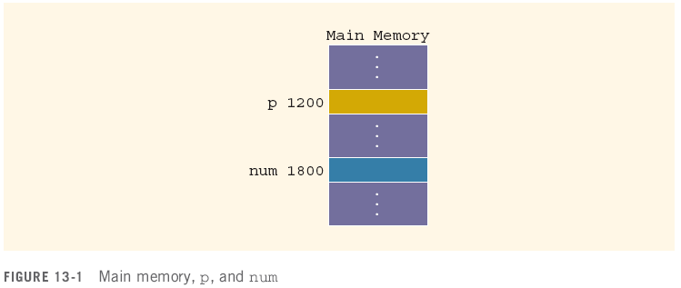
Variables, Memory and Pointers
A variable is a named piece of memory
The name stands in for the memory address
int num;//allocate memory to it first
num = 10;
10

Slide 5
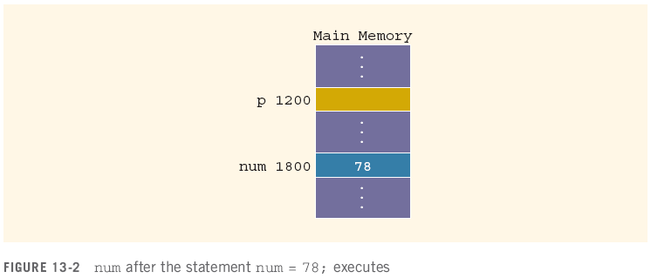
Variables, Memory and Pointers
When a value is assigned to a variable, it is stored at that address in memory
num = 78;

Slide 6
Variables, Memory and Pointers
A pointer is a variable that holds the address of another variable
It is declared in terms of the type of variable it points at:
int *p; // given a * in front of a variable, it means that this variable is a pointer.
int num; num = 78;

Slide 7
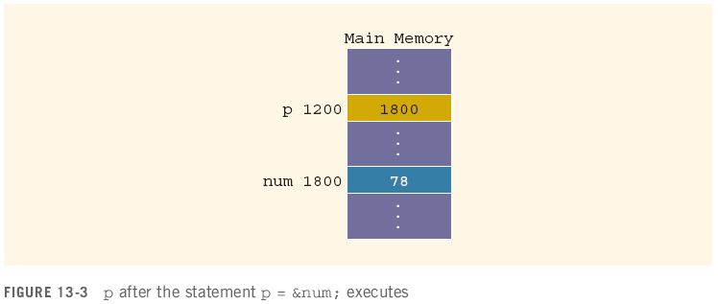
Variables, Memory and Pointers
The operator & returns the address of a variable
It can then be assigned to a pointer
p = &num;
// &num => the address of the variable num ⬄ 1800
// assign the address of num to the value of p.
&num
p

Slide 8
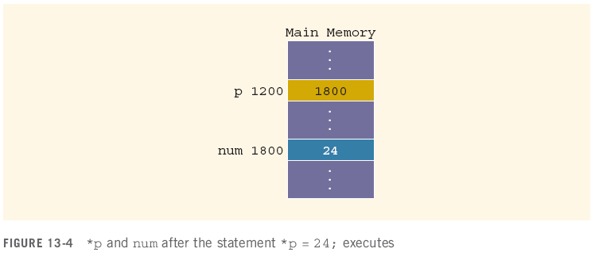
Variables, Memory and Pointers
The operator * takes an address (a pointer) and returns the location in memory being pointed to
Can only be applied to a pointer
*p = 24;
int *q; // define a pointer;
*q = 30; // assign 30 to the variable that the pointer pointed to.

Slide 9
Declaring Pointer Variables
Syntax:
Examples:
int *p; // this pointer will point to an integer variable
char *ch; // a pointer, ch, points to a character variable
These statements are equivalent:
int *p;
int* p;
int * p;

Slide 10
Declaring Pointer Variables (continued)
In the statement:
int* p, q; // p is a pointer; q is variable
int num1, num2; ⬄ int num1; int num2;
only p is the pointer variable, not q; here q is an int variable
To avoid confusion, attach the character * to the variable name:
int *p, q;
int *p, *q;
int array1[100], array2[20];

Slide 11
Address of Operator (&)
The ampersand, &, is called the address of operator
The address of operator is a unary operator that returns the address of its operand
Binary operator
LHS = RHS, cout << “hello”, cin >> a, +, -, *, /, %
Unary operator
Only need one side
&RHS; &a

