Slide 1
Introduction to data mining
Beiyu Lin

Slide 2
Course Information
Outline: https://beiyulincs.github.io/teach/fall_22/dm.html
Syllabus: https://beiyulincs.github.io/teach/fall_22/syllabus_cs_458.pdf
Notes:
Data science is the application of computational and statistical techniques to address or gain insight into some problem in the real world.
Computational
Statisticals
Real world problems

Slide 3
Outline
What is Data Mining?
Why data mining is important?
Why IoT is important?
Topics and outline of this course

Slide 4
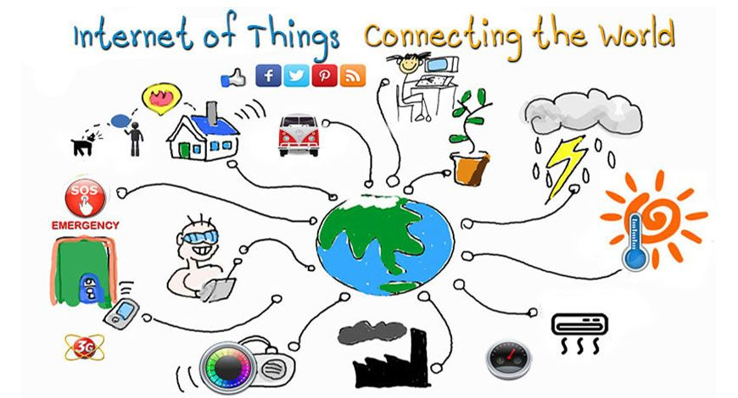
What is IOT?
Notes:
Data science is the application of computational and statistical techniques to address or gain insight into some problem in the real world.
Computational
Statisticals
Real world problems

Slide 5
What is IOT?
The Internet of Things (IoT):
-- the billions of physical devices around the world that are now connected to the internet,
all collecting and sharing data
-- merging the digital and physical universes
-- e.g., from a pill to aeroplane
Notes:
Data science is the application of computational and statistical techniques to address or gain insight into some problem in the real world.
Computational
Statisticals
Real world problems

Slide 6

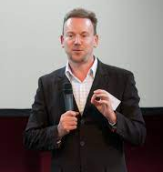
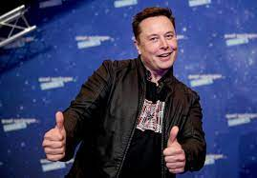
Why IOT is IMPORTANT
“If you invent a breakthrough in artificial intelligence,
so machines can learn, that is worth 10 Microsofts.” — Bill Gates
“As the Internet of things advances, the very notion of a clear dividing line
between reality and virtual reality becomes blurred, sometimes in creative ways..” – Geoff Mulgan
“I think we should be very careful about artificial intelligence.
If I had to guess at what our biggest existential threat is, I’d probably say that. So we need to be very careful.”– Elon Musk

Slide 7
Topics in this course
Data Mining Algorithms: association rules
Data Mining Algorithms: categorization
Data Mining Algorithms: clustering
IoT data

Slide 8
Topics in this course
Each topic will cover:
Motivation and terminology
Algorithms
Experiments with Weka
Guest lectures

