Slide 1
clustering

Slide 2
What is Cluster Analysis?
Given a set of objects, place them in groups such that:
the objects in a group are similar (or related)
different from (or unrelated to) the objects in other groups
Inter-cluster distances are maximized
Intra-cluster distances are minimized

Slide 3
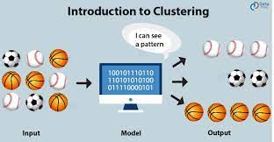
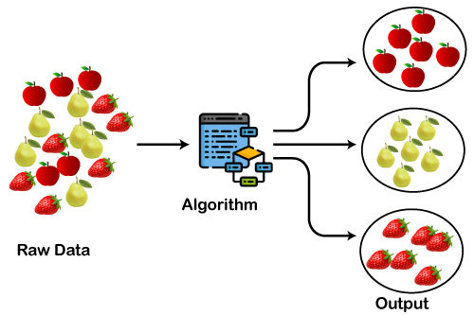
Applications of Cluster Analysis
Understanding
Group related documents for browsing, group genes and proteins that have similar functionality, or group stocks with similar price fluctuations
Summarization
Reduce the size of large data sets

Slide 4
Notion of a Cluster can be Ambiguous
How many clusters?
Six Clusters
Two Clusters
Four Clusters

Slide 5
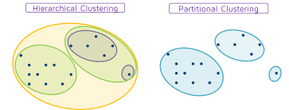
Types of Clusterings
A clustering is a set of clusters
Important distinction between hierarchical and partitional sets of clusters
Partitional Clustering
A division of data objects into non-overlapping subsets (clusters)
Hierarchical clustering
A set of nested clusters organized as a hierarchical tree

Slide 6
Partitional Clustering
Original Points
A Partitional Clustering

Slide 7
Hierarchical Clustering
Traditional Hierarchical Clustering
Traditional Dendrogram
Non-traditional Hierarchical Clustering
Non-traditional Dendrogram

Slide 8
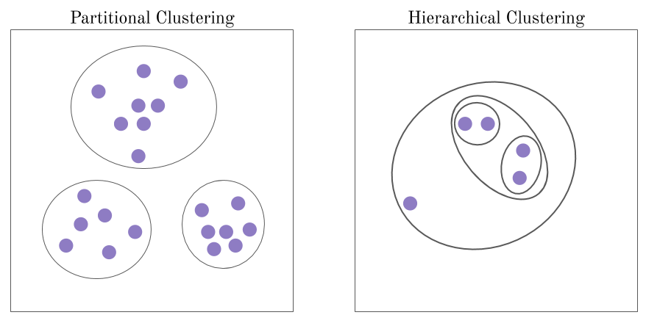
Types of Clustering

Slide 9
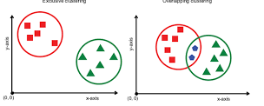
Other Distinctions Between Sets of Clusters
Exclusive versus non-exclusive
non-exclusive clustering:
points may belong to multiple clusters.
an belong to multiple classes or could be ‘border’ points
fuzzy clustering : a point belongs to every cluster with some weight between 0 and 1
weights sum to 1
probabilistic clustering has similar characteristics
Partial versus complete
Partial: only cluster some of the data

Slide 10
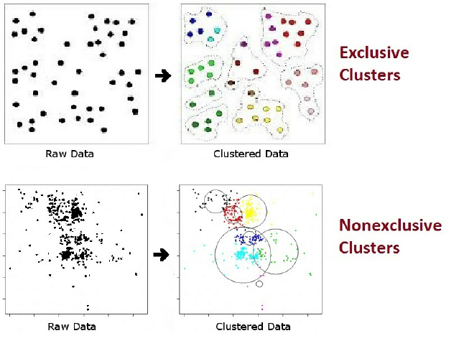


Other Distinctions Between Sets of Clusters

Slide 11
Types of Clusters
Well-separated clusters
Prototype-based clusters
Contiguity-based clusters
Density-based clusters
Described by an Objective Function

Slide 12
Types of Clusters: Well-Separated
Well-Separated Clusters:
A cluster is a set of points such that any point in a cluster is closer to every other point in the cluster than to any point not in the cluster.
3 well-separated clusters

Slide 13
Types of Clusters: Prototype-Based
Prototype-based
A cluster is a set of objects such that an object in a cluster is closer (more similar) to the prototype or “center” of a cluster, than to the center of any other cluster
centroid, the average of all the points in the cluster,
medoid, the most “representative” point of a cluster
4 center-based clusters

Slide 14
Types of Clusters: Contiguity-Based
Contiguous Cluster (Nearest neighbor or Transitive)
A cluster is a set of points such that a point in a cluster is closer to one or more other points in the cluster than to any point not in the cluster.
8 contiguous clusters

Slide 15
Types of Clusters: Density-Based
Density-based
A cluster is a dense region of points, which is separated by low-density regions, from other regions of high density.
Used when the clusters are irregular or intertwined, and when noise and outliers are present.
6 density-based clusters

Slide 16

Types of Clusters: Objective Function
Clusters Defined by an Objective Function
Finds clusters that minimize or maximize an objective function.
Enumerate all possible ways of dividing the points into clusters
Evaluate the goodness of each potential set of clusters.
Objectives can be global or local
Hierarchical clustering algorithms typically have local objectives
Partitional algorithms typically have global objectives

Slide 17





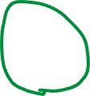
Characteristics of the Input Data Are Important
Type of proximity or density measure
Central to clustering
Depends on data and application
Data characteristics that affect proximity and/or density are
Dimensionality
Sparseness
Attribute type
Special relationships in the data
For example, autocorrelation
Distribution of the data
Noise and Outliers
Often interfere with the operation of the clustering algorithm
Clusters of differing sizes, densities, and shapes

Slide 18
Clustering Algorithms
K-means and its variants
Hierarchical clustering
Density-based clustering

Slide 19
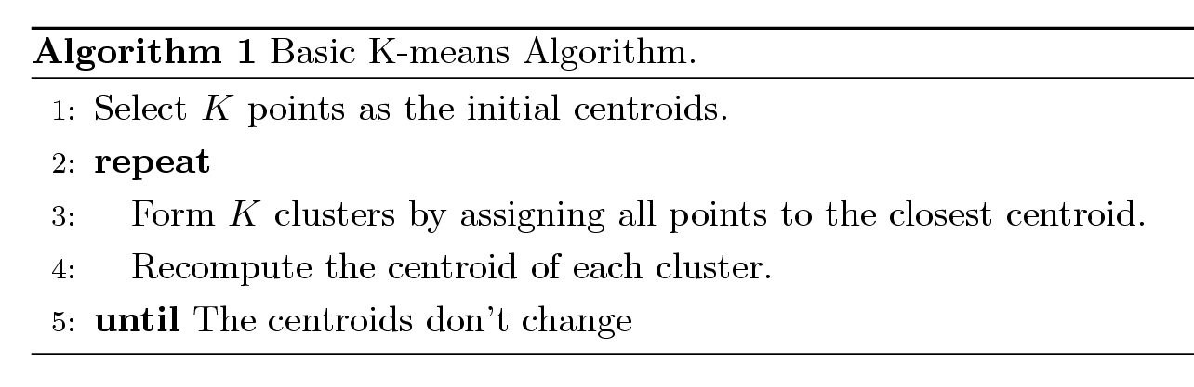
K-means Clustering
Partitional clustering approach
Number of clusters, K, must be specified
Each cluster is associated with a centroid
Each point is assigned to the cluster with the closest centroid
The basic algorithm is very simple

Slide 20

Example of K-means Clustering

Slide 21
Example of K-means Clustering

