Slide 1
Measures
Beiyu Lin

Slide 2
Data Quality
Data quality problems:
Noise and outliers (example in yellow box)
Missing values (in red box) – Impute missing value
Duplicate data (in green box)

Slide 3
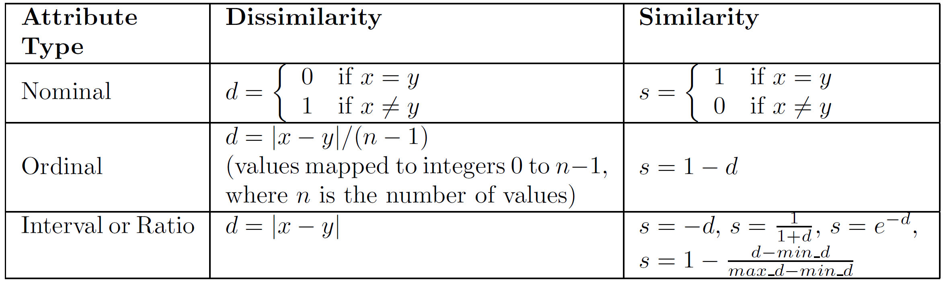
Similarity and Dissimilarity Measures
Similarity measure
how alike two data objects are.
Is higher when objects are more alike.
Often falls in the range [0,1]
Dissimilarity measure
how different two data objects are
Lower when objects are more alike
Minimum dissimilarity is often 0
Notes:
The following table shows the similarity and dissimilarity between two objects, x and y, with respect to a single, simple attribute.

Slide 4
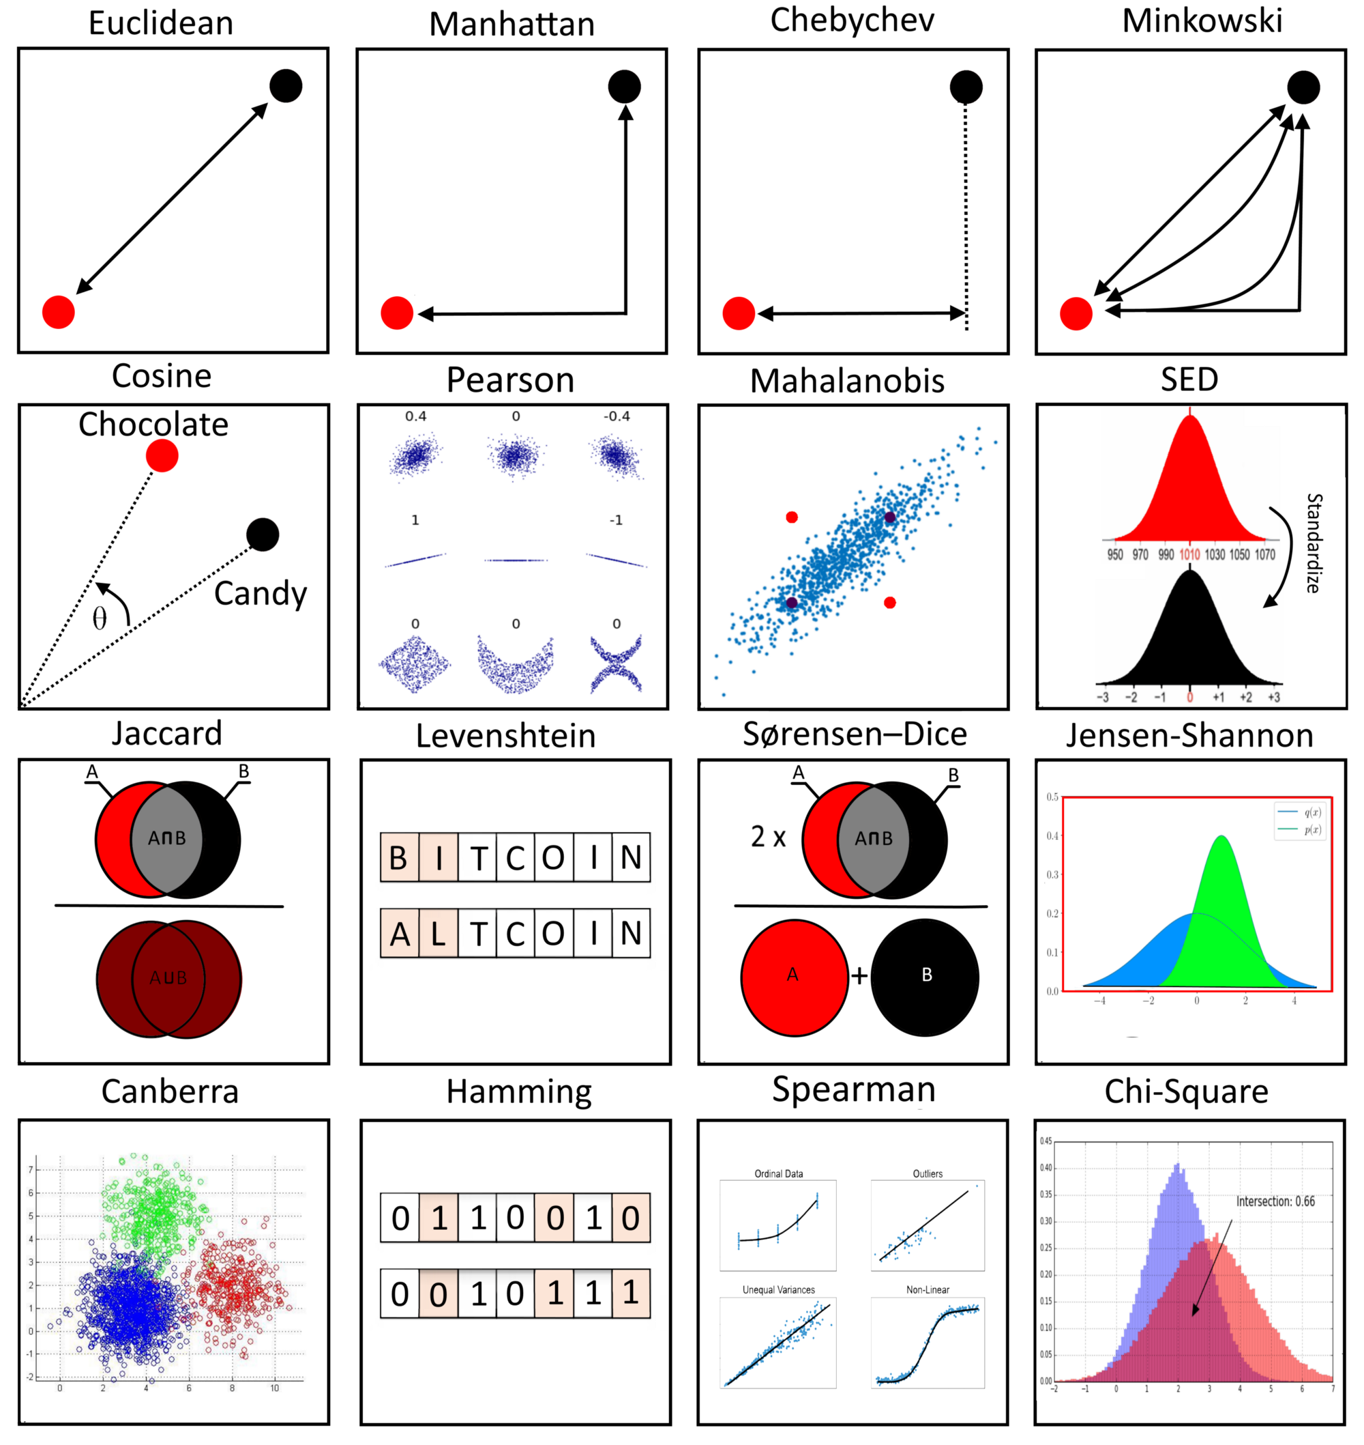
Similarity and Dissimilarity Measures
Notes:
The following table shows the similarity and dissimilarity between two objects, x and y, with respect to a single, simple attribute.

Slide 5
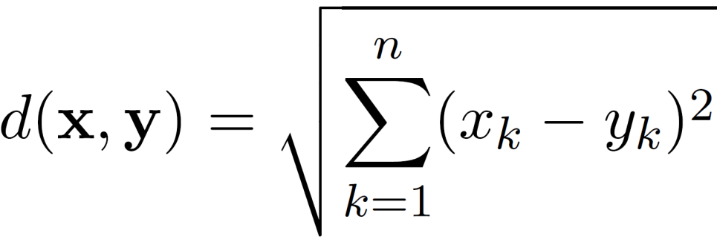



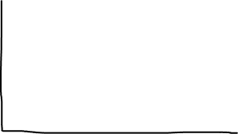
Euclidean Distance
Euclidean Distance
where n is the number of dimensions (attributes) and x_{k} and y_{k} are, respectively, the k^{th} attributes (components) or data objects x and y.
Standardization is necessary, if scales differ.

Slide 6



Euclidean Distance
Euclidean Distance Matrix

Slide 7
Euclidean Distance
Euclidean Distance

Slide 8
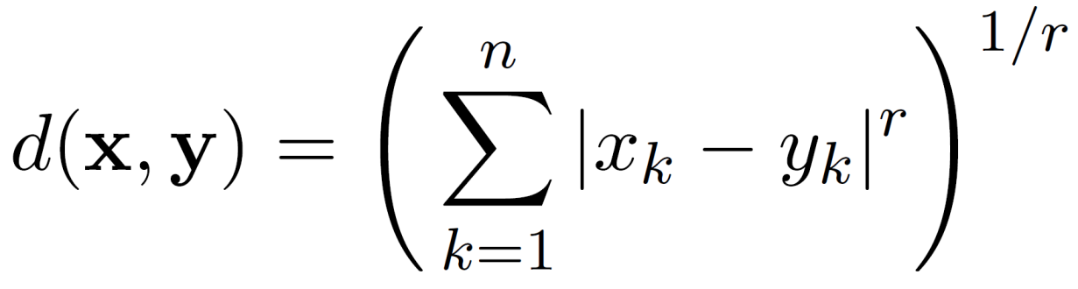

Minkowski Distance
Minkowski Distance is a generalization of Euclidean Distance
Notes:
Min+ costco+ ski

Slide 9
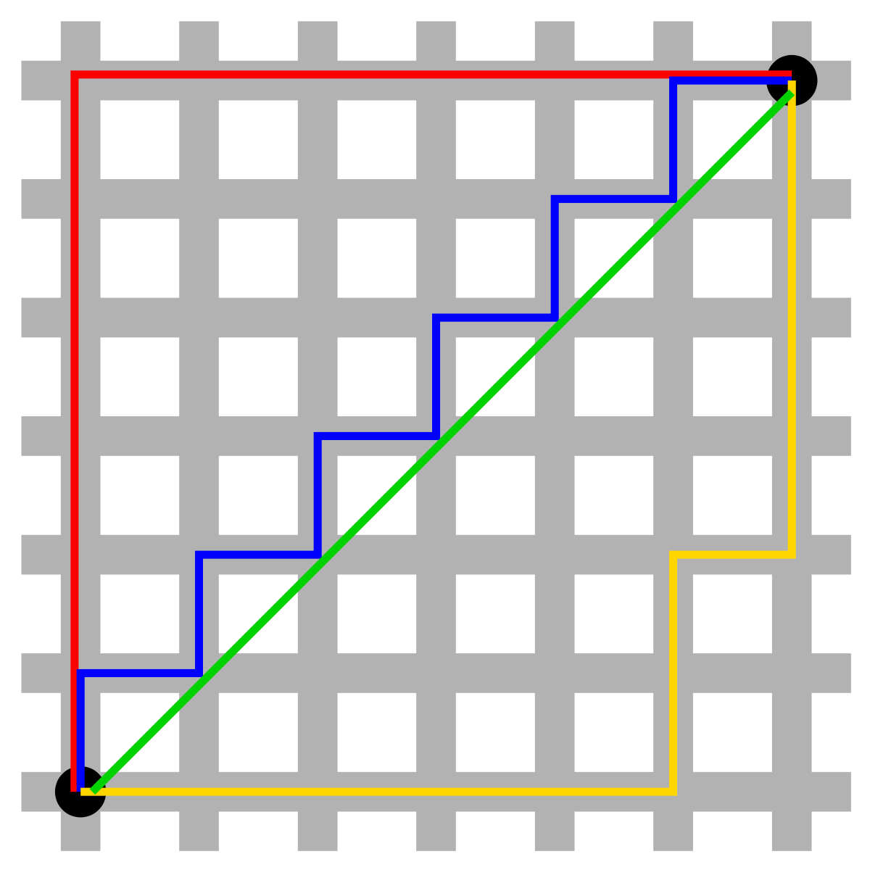
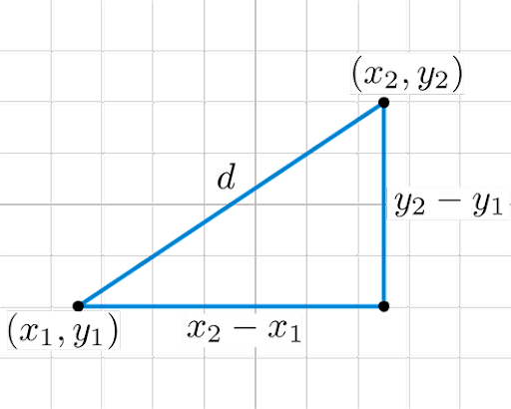
Minkowski Distance: Examples
r = 1. City block (Manhattan, taxicab, L₁ norm) distance.
r = 2. Euclidean distance
r → ∞. “supremum” (L_{max} norm, L∞ norm) distance.

Slide 10
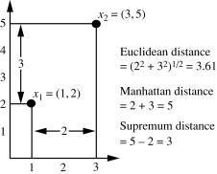






Example for Different Distances

Slide 11

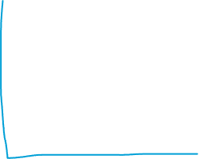







Minkowski Distance
Distance Matrix

Slide 12


Common Properties of a Distance
Properties of distances / dissimilarity, d(x, y), between points x and y.
d(x, y) ≥ 0 for all x and y and d(x, y) = 0 if and only if x = y.
d(x, y) = d(y, x) for all x and y. (Symmetry)
d(x, z) ≤ d(x, y) + d(y, z) for all points x, y, and z. (Triangle Inequality)

Slide 13


Common Properties of a Similarity
Properties of Similarities
s(x, y) = 1 (or maximum similarity) only if x = y.
s(x, y) = s(y, x) for all x and y. (Symmetry)
where s(x, y) is the similarity between points (data objects), x and y.

Slide 14


Similarity Between Binary Vectors
If objects / data points, x and y, have only binary attributes
Compute similarities using the following quantities
f₀₁ = the number of attributes where x was 0 and y was 1
f₁₀ = the number of attributes where x was 1 and y was 0
f₀₀ = the number of attributes where x was 0 and y was 0
f₁₁ = the number of attributes where x was 1 and y was 1
Simple Matching and Jaccard Coefficients
SMC = number of matches / number of attributes
= (f₁₁ + f₀₀) / (f₀₁ + f₁₀ + f₁₁ + f₀₀)
J = number of 11 matches / number of non-zero attributes
= (f₁₁) / (f₀₁ + f₁₀ + f₁₁)
mutual presences + mutual absence
mutual presences

Slide 15


SMC versus Jaccard: Example
x = 1 0 0 0 0 0 0 0 0 0
y = 0 0 0 0 0 0 1 0 0 1
f₀₁ = 2 (the number of attributes where x was 0 and y was 1)
f₁₀ = 1 (the number of attributes where x was 1 and y was 0)
f₀₀ = 7 (the number of attributes where x was 0 and y was 0)
f₁₁ = 0 (the number of attributes where x was 1 and y was 1)
SMC = (f₁₁ + f₀₀) / (f₀₁ + f₁₀ + f₁₁ + f₀₀)
= (0+7) / (2+1+0+7) = 0.7
J = (f₁₁) / (f₀₁ + f₁₀ + f₁₁) = 0 / (2 + 1 + 0) = 0

