Slide 1
Data mining in healthcare

Slide 2
Learning Objectives
Give a basic overview of data analytics in healthcare
Give a basic overview of data elements and their attributes
Describe the nine steps of the data analytics process

Slide 3
Introduction
“Information is the oil of the 21st century, and analytics is the combustion engine.”
Peter Sondegaard, Senior Vice President and Global Head of Research for Gartner

Slide 4
Benefits of healthcare data mining
Care providers can use data mining to identify effective treatments and best practices as well as to develop guidelines and standards of care;
Patients, especially those having chronic or high-risk diseases, can receive better, more affordable healthcare services with appropriate identification, tracking and use of appropriate interventions and treatment protocols;
Healthcare organizations can use data mining to improve patient satisfaction, to provide more patient-centered care, and to decrease costs and increase operating efficiency while maintaining high-quality care;
Insurance organization can detect medical insurance fraud and abuse through data mining and reduce their losses

Slide 5
What is data mining in healthcare
Data mining provides the methodology and technology for healthcare organizations to:
evaluate treatment effectiveness,
save lives of patients using predictive medicine,
manage healthcare at different levels,
manage customer relationship,
detect waste, fraud and abuse.

Slide 6
How does data mining work in healthcare
The whole process includes the following main steps
Data selection: create a target data set from the original data
Data preprocessing: clean data to define strategies for handling missing data fields
Data transformation: reduce and project the data using transformation techniques or methods
Data mining: extract interesting patterns
Data interpretation or evaluation: interpret and extract knowledge from the mined patterns

Slide 7
Data Mining techniques in healthcare
healthcare data mining parameters include:
sequence or path analysis
(i.e. finding patterns where one event leads to another later event),
classification
(i.e. looking for new patterns and predicting variables based on the factors the database contains),
clustering
(i.e. grouping a set of objects and aggregating them based on their similarity to each other)
forecasting

Slide 8
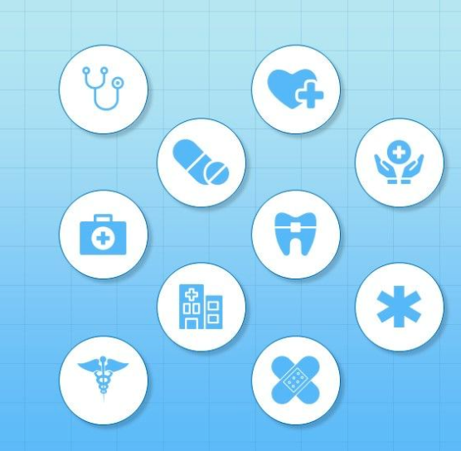
Data mining techniques
web mining,
network approaches,
text mining,
natural language processing (NLP),
machine learning,
predictive modeling,
relationship and link analysis,
statistical analysis, etc

Slide 9
Purposes of data mining in healthcare
the healthcare industry can be very effective in such fields as:
medical research,
pharmaceuticals,
medical devices,
genetics,
hospital management,
and health care insurance, etc.

Slide 10
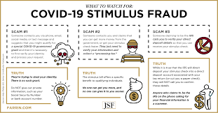

Examples of healthcare data mining applications
The FTC reports that $20.9 million in fraud occurred
during the first round of stimulus checks

Slide 11
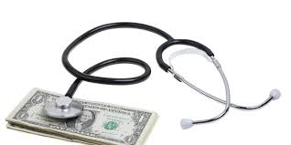
Examples of healthcare data mining applications
Detection and prevention of fraud and abuse
establishing normal patterns
identifying unusual patterns of medical claims by healthcare providers (clinics, doctors, labs, etc).

Slide 12
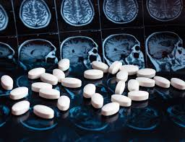

Example: measuring treatment effectiveness
comparing and contrasting symptoms
causes and courses of treatment
identify the side effects of a particular treatment
analyze which decision would be most effective.

Slide 13
The big picture of patient data
Multiple systems in a health information system
These systems are designed for clinical use and reporting purposes
None has a complete set of data for
Individual patients
Groups of patients
All aspects of a health information system

Slide 14
Clinical Data Warehouse
Aggregates data for a patient from multiple sources
Used for analysis and reporting, not clinical care
Requires an extraction-transform-load process

Slide 15
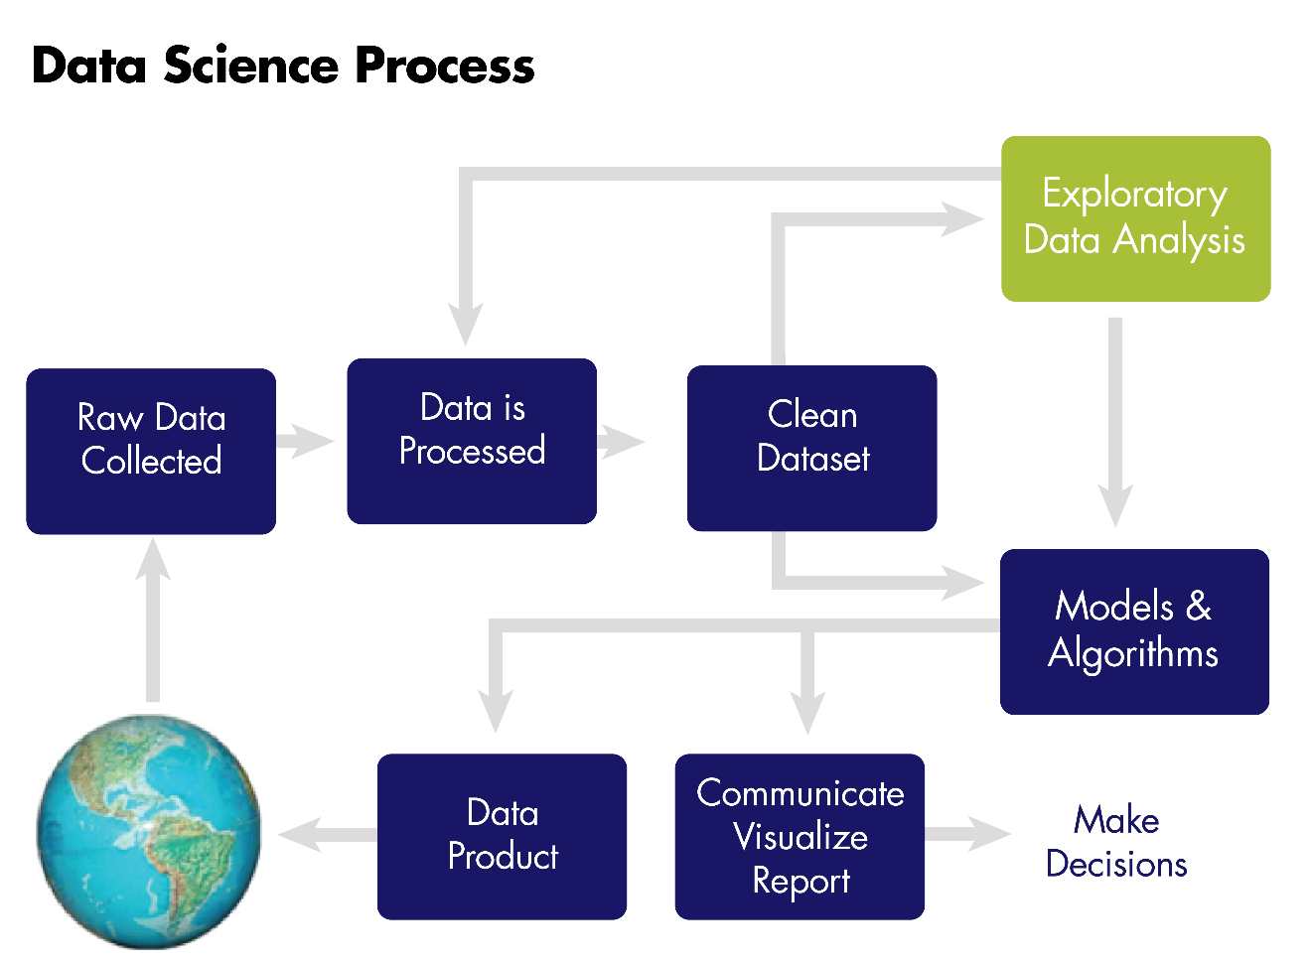
What is analytics?
Entire process of
data collection,
extraction,
transformation,
analysis,
interpretation,
reporting

