Slide 1
Introduction to agriculture and climate
Beiyu Lin

Slide 2
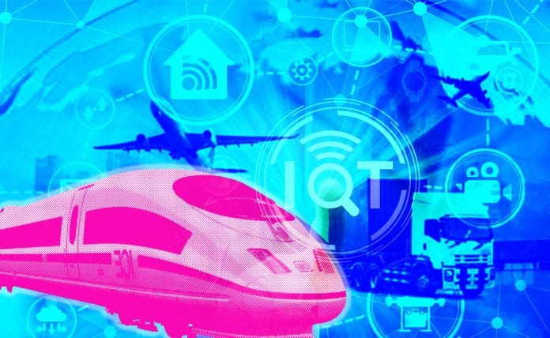
How iOT improves transportation
Assisted Driving
Dynamic Navigation
Optimized Maintenance
Expanded Ridesharing
Fleet Management

Slide 3
Why iot in transportation
The connected car market grew by 45% between 2018 and 2019 alone, with global shipments expected to pass 76 million units by 2023
It won’t be too long before connected cars are the norm. When this shift does happen, roads will be a safer and more convenient place for everyone.

Slide 4
iOT in transportation
Assisted Driving
Dynamic Navigation
Optimized Maintenance
Expanded Ridesharing
Fleet Management

Slide 5
Assisted Driving
Definition:
Driver assistance, also known as advanced driver-assistance systems (ADAS), are technologies used to make motor vehicle travel safer by automating, improving or adapting some or all of the tasks involved in operating a vehicle (link 1:04-2:10).

Slide 6
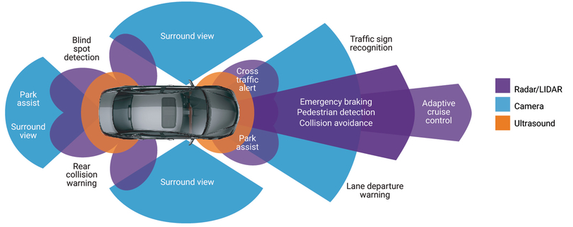
Assisted Driving

Slide 7
ASSISTED DRIVING
Challenges:
Technical: can be improved with new technologies, such as AI and machine learning
Ethical: hard to resolve
Example: difficult situations like occupant vs. pedestrian safety – moral questions
Current work:
Google partnership with General Motors and Ford
MIT’s Moral Machine

Slide 8
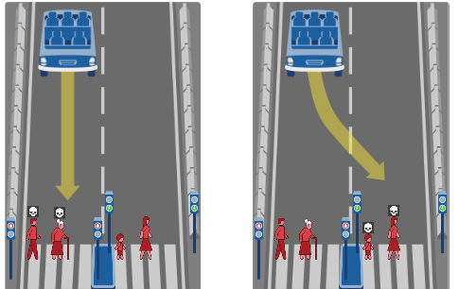
ASSISTED DRIVING
Ethical Dilemma:
What self driving car should do?
Ethical Dilemma in other fields?

Slide 9
ASSISTED DRIVING
Current methods:
Deep reinforcement learning (link)
Imitation learning (link 0:37-)

Slide 10
iOT in transportation
Assisted Driving
Dynamic Navigation
Optimized Maintenance
Expanded Ridesharing
Fleet Management

Slide 11
Dynamic Navigation
The improved navigation offered by IoT is useful to human drivers, too. Many people rely on GPS navigation, and IoT devices in vehicles could make these systems more helpful. Cross-car communication would allow navigation systems to account for real-time changes, like blockages or traffic jams.
Why not GPS?
Slow to adapt to traffic changes
IoT navigation offers real-time feedback.
Dynamic navigation (link 3:06 – 3:29 )

Slide 12
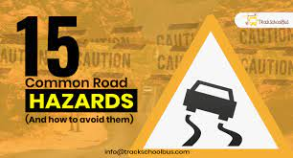
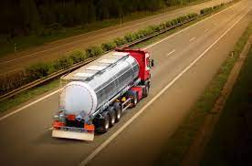
Why Dynamic Navigation
Examples
Hazards along a route can change in an instant
=> need dynamic navigation to avoid them
Examples
Environmental waste transport
=> need dynamic navigation to avoid them

Slide 13
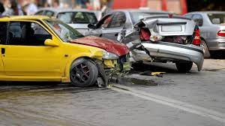
Dynamic Navigation
Examples
Traffic accidents
=> avoid risky traffic situations
IoT navigation can help them steer clear of congested areas or spots with high accident rates.

Slide 14
Dynamic Navigation
Current methods:
Deep Reinforcement Learning Dynamic Routing for Navigation (link 7:13 – 7:52 )
DRL: single targe and multi-target agent (link 4:51- 5:23)
LiDAR data (link 0:42 – 2:58)

Slide 15
iOT in transportation
Assisted Driving
Dynamic Navigation
Optimized Maintenance
Expanded Ridesharing
Fleet Management

Slide 16
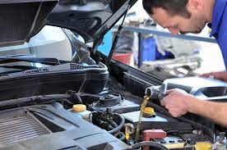
Optimized Maintenance
When should we change the oil?
How could we know when to do frequent vehicle maintenance?
IoT can help
Example (link: 0:04-1:08)

Slide 17
Optimized Maintenance
Current methods
Neural Network Classification (link 0.06- 0:13)
Sensor based (link: 0.54- 1:43)

Slide 18
iOT in transportation
Assisted Driving
Dynamic Navigation
Optimized Maintenance
Expanded Ridesharing
Fleet Management

Slide 19
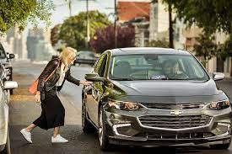
Expanded Ridesharing
Why Ridesharing is good?
able to transport people to and from anywhere
reducing traffic congestion and parking demand
eliminate vehicle emissions and creates less stressful commutes
How IoT helps?

Slide 20
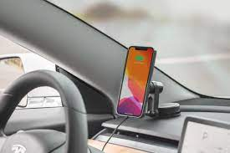
Expanded Ridesharing
What are the problems of ridesharing?
Safety of rider and driver
Possible solutions: phone vibration study

Slide 21
Expanded Ridesharing
What are the problems of ridesharing?
Fairness (rural area has no cars to pick up customers)
Reward based reinforcement learning method

Slide 22
iOT in transportation
Assisted Driving
Dynamic Navigation
Optimized Maintenance
Expanded Ridesharing
Fleet Management

Slide 23
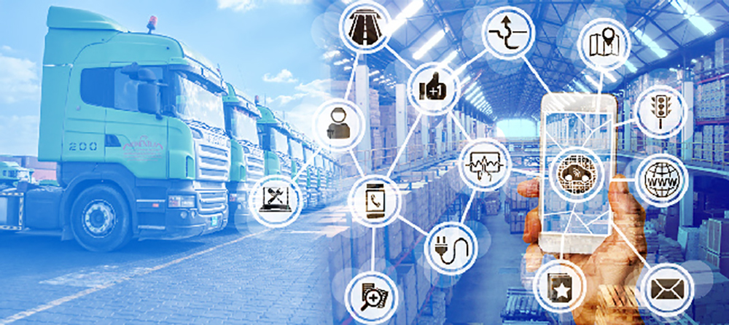
Fleet Management
An IoT-enabled fleet management solution helps businesses gain competitive advantages by automating processes in a cloud-based platform and providing real-time visibility into everything that goes on in the field.

Slide 24
Fleet Management
Possible topics:
Supply chain shortage
Security and Privacy

