Slide 1
Measures
Beiyu Lin

Slide 2
Data Quality
Data quality problems:
Noise and outliers (example in yellow box)
Missing values (in red box)
Duplicate data (in green box)

Slide 3
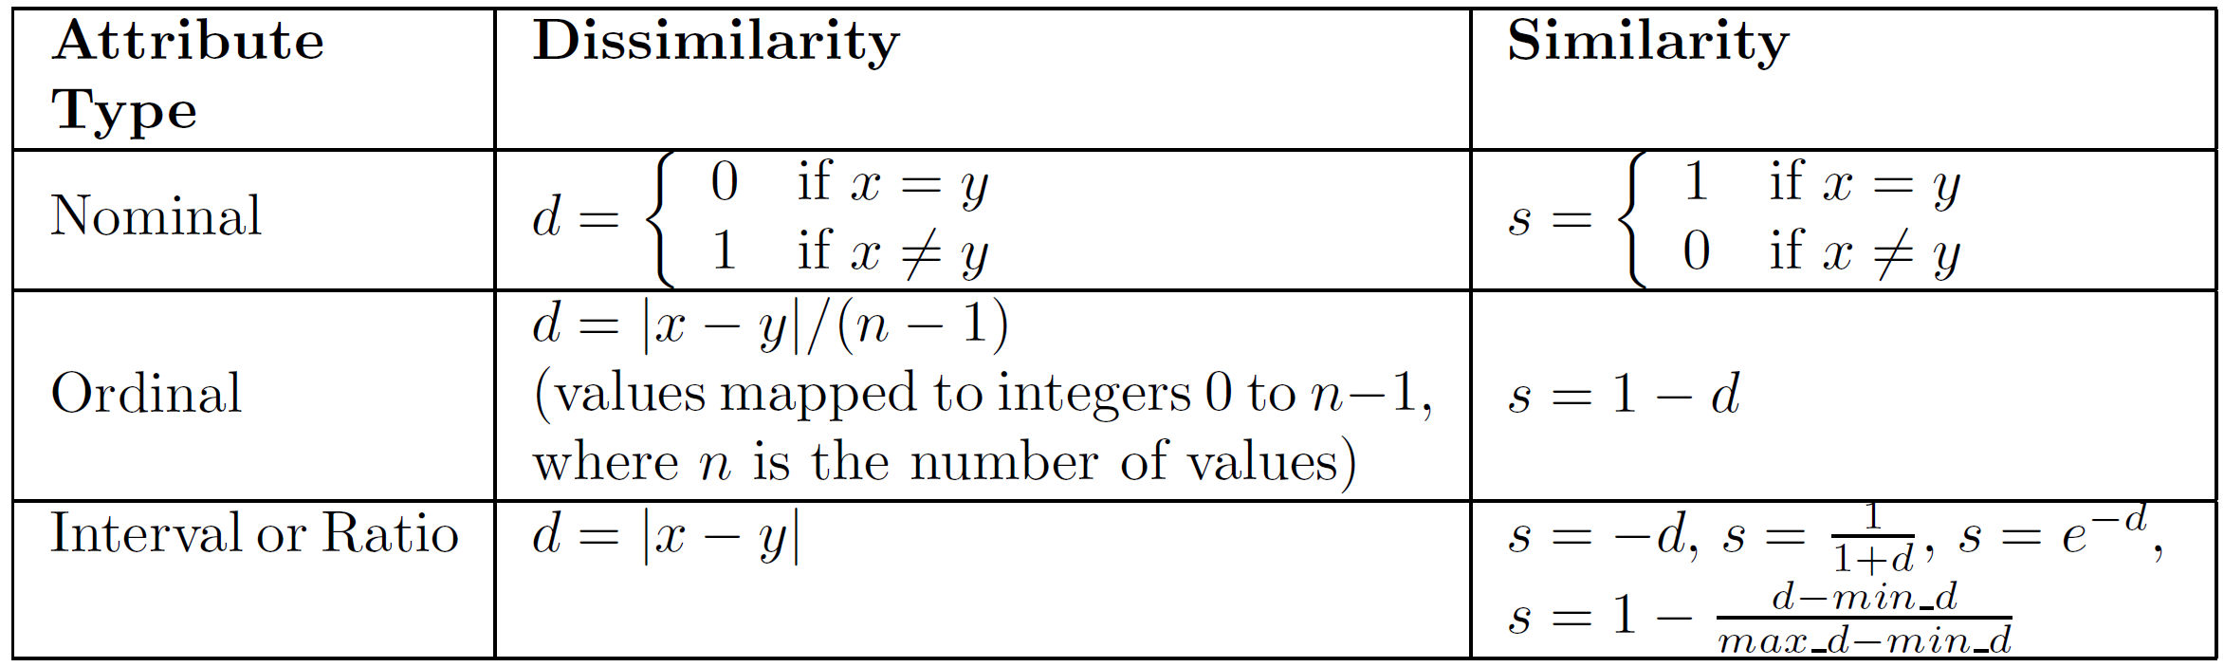
Similarity and Dissimilarity Measures
Similarity measure
Numerical measure of how alike two data objects are.
Is higher when objects are more alike.
Often falls in the range [0,1]
Dissimilarity measure
Numerical measure of how different two data objects are
Lower when objects are more alike
Minimum dissimilarity is often 0
Upper limit varies
Proximity refers to a similarity or dissimilarity
Notes:
The following table shows the similarity and dissimilarity between two objects, x and y, with respect to a single, simple attribute.

Slide 4
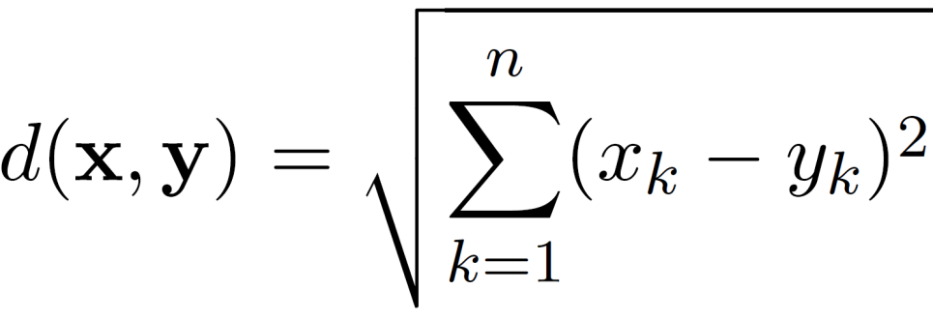

Euclidean Distance
Euclidean Distance
where n is the number of dimensions (attributes) and x_{k} and y_{k} are, respectively, the k^{th} attributes (components) or data objects x and y.
Standardization is necessary, if scales differ.

Slide 5
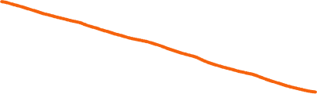

Euclidean Distance
Euclidean Distance Matrix

Slide 6
Euclidean Distance
Euclidean Distance

Slide 7
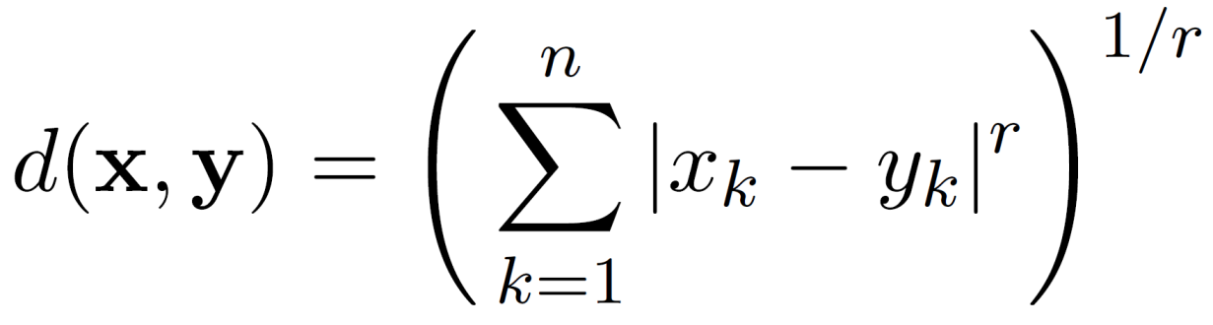
Minkowski Distance
Minkowski Distance is a generalization of Euclidean Distance
Where r is a parameter, n is the number of dimensions (attributes) and x_{k} and y_{k} are, respectively, the k^{th} attributes (components) or data objects x and y.
Notes:
Min+ costco+ ski

Slide 8
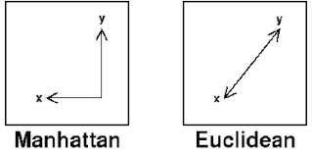
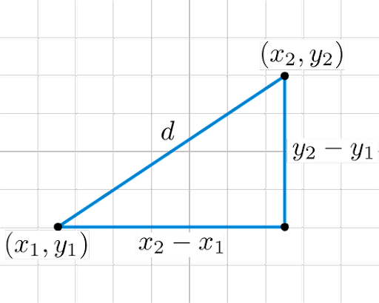
Minkowski Distance: Examples
r = 1. City block (Manhattan, taxicab, L₁ norm) distance.
A common example of this for binary vectors is the Hamming distance, which is just the number of bits that are different between two binary vectors
r = 2. Euclidean distance
r → ∞. “supremum” (L_{max} norm, L∞ norm) distance.
This is the maximum difference between any component of the vectors

Slide 9
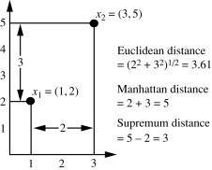

Example for Different Distances

Slide 10



Minkowski Distance
Distance Matrix

Slide 11

Common Properties of a Distance
Distances, such as the Euclidean distance, have some well known properties.
d(x, y) ≥ 0 for all x and y and d(x, y) = 0 if and only if x = y.
d(x, y) = d(y, x) for all x and y. (Symmetry)
d(x, z) ≤ d(x, y) + d(y, z) for all points x, y, and z. (Triangle Inequality)
where d(x, y) is the distance (dissimilarity) between points (data objects), x and y.
A distance that satisfies these properties is a metric

Slide 12
Common Properties of a Similarity
Similarities, also have some well known properties.
s(x, y) = 1 (or maximum similarity) only if x = y. (does not always hold, e.g., cosine)
s(x, y) = s(y, x) for all x and y. (Symmetry)
where s(x, y) is the similarity between points (data objects), x and y.

Slide 13


Similarity Between Binary Vectors
Common situation is that objects, x and y, have only binary attributes
Compute similarities using the following quantities
f₀₁ = the number of attributes where x was 0 and y was 1
f₁₀ = the number of attributes where x was 1 and y was 0
f₀₀ = the number of attributes where x was 0 and y was 0
f₁₁ = the number of attributes where x was 1 and y was 1
Simple Matching and Jaccard Coefficients
SMC = number of matches / number of attributes
= (f₁₁ + f₀₀) / (f₀₁ + f₁₀ + f₁₁ + f₀₀)
J = number of 11 matches / number of non-zero attributes
= (f₁₁) / (f₀₁ + f₁₀ + f₁₁)
mutual presences + mutual absence
mutual presences

Slide 14


SMC versus Jaccard: Example
x = 1 0 0 0 0 0 0 0 0 0
y = 0 0 0 0 0 0 1 0 0 1
f₀₁ = 2 (the number of attributes where x was 0 and y was 1)
f₁₀ = 1 (the number of attributes where x was 1 and y was 0)
f₀₀ = 7 (the number of attributes where x was 0 and y was 0)
f₁₁ = 0 (the number of attributes where x was 1 and y was 1)
SMC = (f₁₁ + f₀₀) / (f₀₁ + f₁₀ + f₁₁ + f₀₀)
= (0+7) / (2+1+0+7) = 0.7
J = (f₁₁) / (f₀₁ + f₁₀ + f₁₁) = 0 / (2 + 1 + 0) = 0

Slide 15


Cosine Similarity
If d₁ and d₂ are two document vectors, then
cos( d₁, d₂ ) = <d₁,d₂> / ||d₁|| ||d₂|| ,
where <d₁,d₂> indicates inner product or vector dot product of vectors, d₁ and d_{2,} and || d || is the length of vector d.
Example:
d₁ = 3 2 0 5 0 0 0 2 0 0
d₂ = 1 0 0 0 0 0 0 1 0 2
<d₁, d2> = 3*1 + 2*0 + 0*0 + 5*0 + 0*0 + 0*0 + 0*0 + 2*1 + 0*0 + 0*2 = 5
| d₁ || = (3*3+2*2+0*0+5*5+0*0+0*0+0*0+2*2+0*0+0*0)^{0.5} = (42) ^{0.5} = 6.481
|| d₂ || = (1*1+0*0+0*0+0*0+0*0+0*0+0*0+1*1+0*0+2*2) ^{0.5} = (6) ^{0.5} = 2.449
cos(d₁, d₂ ) = 0.3150

Slide 16
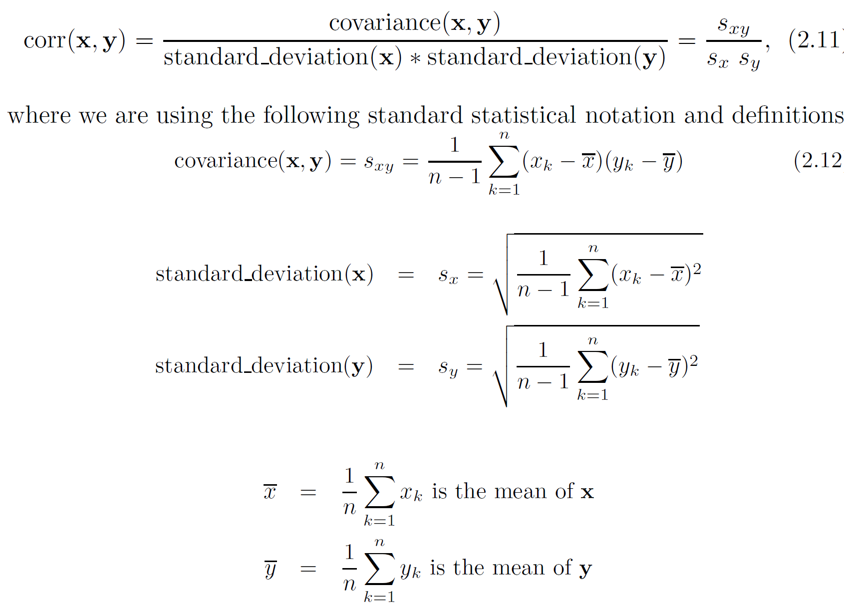
Correlation measures the linear relationship between objects

Slide 17
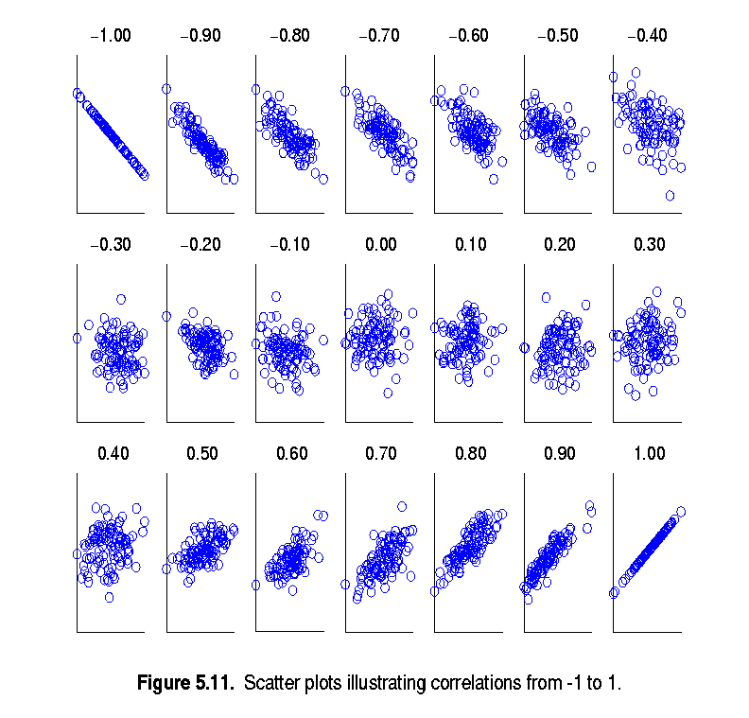
Visually Evaluating Correlation
Scatter plots showing the similarity from –1 to 1.

Slide 19
Correlation vs Cosine vs Euclidean Distance
Compare the three proximity measures according to their behavior under variable transformation
scaling: multiplication by a value
translation: adding a constant
Consider the example
x = (1, 2, 4, 3, 0, 0, 0), y = (1, 2, 3, 4, 0, 0, 0)
y_{s} = y * 2 (scaled version of y), y_{t} = y + 5 (translated version)
Property | Cosine | Correlation | Euclidean Distance
Invariant to scaling (multiplication) | Yes | Yes | No
Invariant to translation (addition) | No | Yes | No
Measure | (x , y) | (x , y_{s}) | (x , y_{t})
Cosine | 0.9667 | 0.9667 | 0.7940
Correlation | 0.9429 | 0.9429 | 0.9429
Euclidean Distance | 1.4142 | 5.8310 | 14.2127

Slide 20
Correlation vs cosine vs Euclidean distance
Choice of the right proximity measure depends on the domain
What is the correct choice of proximity measure for the following situations?
Comparing documents using the frequencies of words
Documents are considered similar if the word frequencies are similar
Comparing the temperature in Celsius of two locations
Two locations are considered similar if the temperatures are similar in magnitude
Comparing two time series of temperature measured in Celsius
Two time series are considered similar if their “shape” is similar, i.e., they vary in the same way over time, achieving minimums and maximums at similar times, etc.

Slide 21
Comparison of Proximity Measures
Domain of application
Similarity measures tend to be specific to the type of attribute and data
Record data, images, graphs, sequences, 3D-protein structure, etc. tend to have different measures
However, one can talk about various properties that you would like a proximity measure to have
Symmetry is a common one
Tolerance to noise and outliers is another
Ability to find more types of patterns?
Many others possible
The measure must be applicable to the data and produce results that agree with domain knowledge

Slide 22
Information Based Measures
Information theory is a well-developed and fundamental disciple with broad applications
Some similarity measures are based on information theory
Mutual information in various versions
Maximal Information Coefficient (MIC) and related measures
General and can handle non-linear relationships
Can be complicated and time intensive to compute

Slide 23
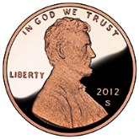

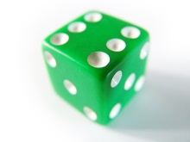
Information and Probability
Information relates to possible outcomes of an event
transmission of a message, flip of a coin, or measurement of a piece of data
The more certain an outcome, the less information that it contains and vice-versa
For example, if a coin has two heads, then an outcome of heads provides no information
More quantitatively, the information is related the probability of an outcome
The smaller the probability of an outcome, the more information it provides and vice-versa
Entropy is the commonly used measure

Slide 24
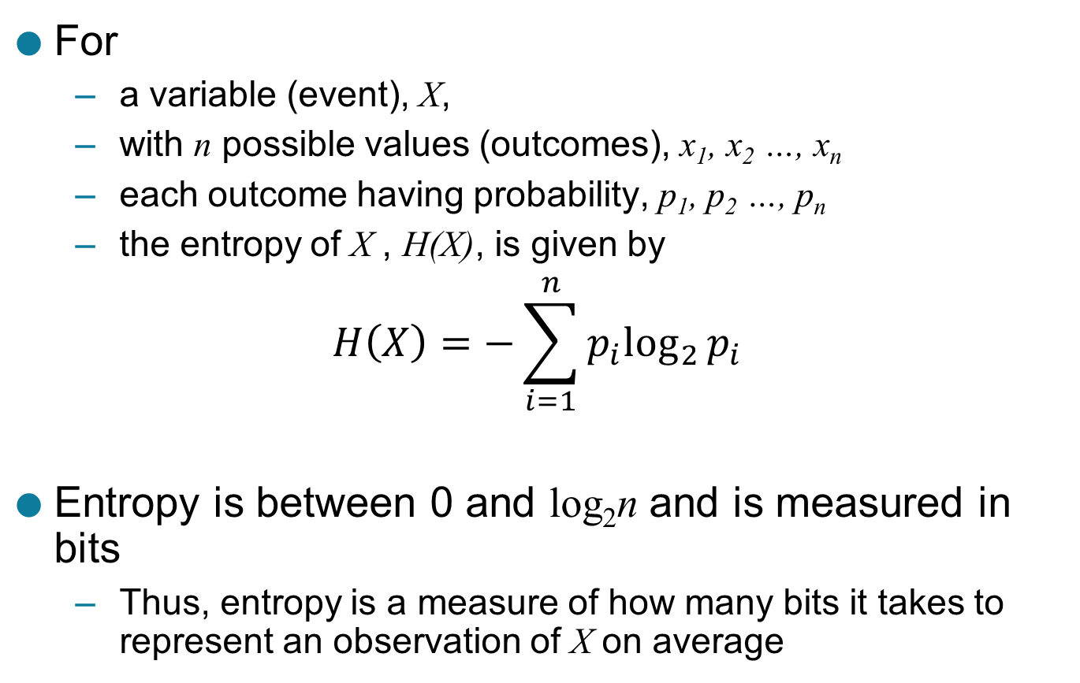
Entropy
For
a variable (event), X,
with n possible values (outcomes), x₁, x₂ …, x_{n}
each outcome having probability, p₁, p₂ …, p_{n}
the entropy of X , H(X), is given by
$$H\left(X\right)=−\sum_{i=1}^{n}{{p_{i}log}_{2}{p_{i}}}$$
Entropy is between 0 and log₂n and is measured in bits
Thus, entropy is a measure of how many bits it takes to represent an observation of X on average

Slide 25
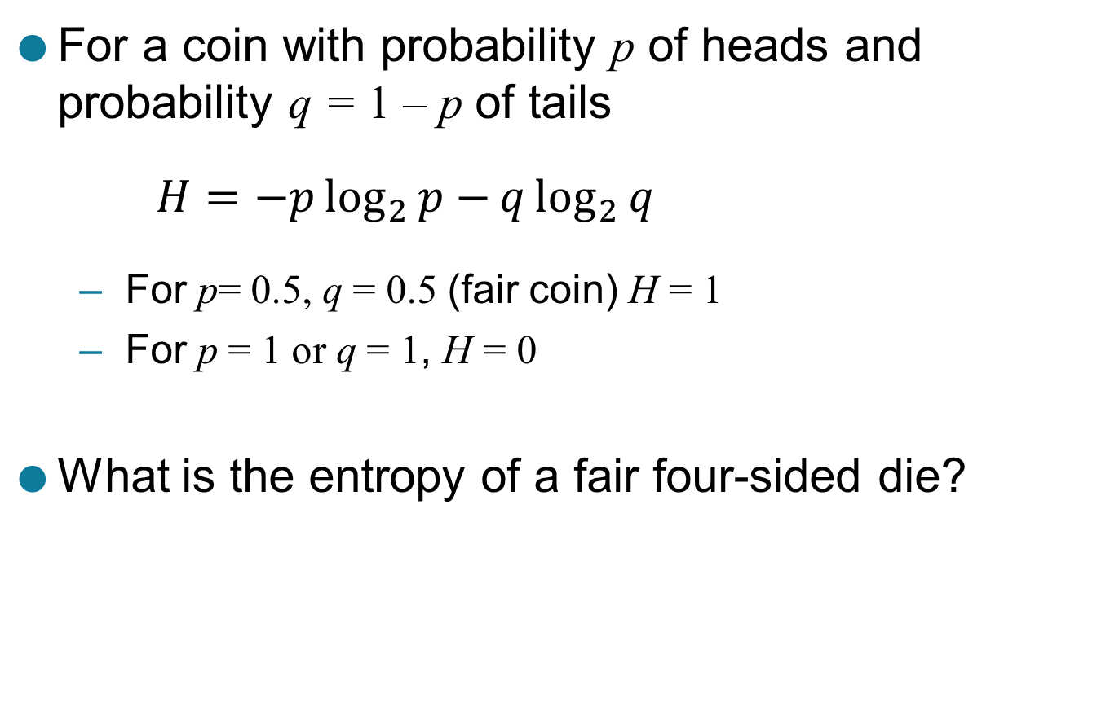
Entropy Examples
For a coin with probability p of heads and probability q = 1 – p of tails
$$H=−p\log_{2}{p−}q\log_{2}{q}$$
For p= 0.5, q = 0.5 (fair coin) H = 1
For p = 1 or q = 1, H = 0
What is the entropy of a fair four-sided die?

Slide 26
Entropy for Sample Data: Example
Hair Color | Count | p | -plog₂p
Black | 75 | 0.75 | 0.3113
Brown | 15 | 0.15 | 0.4105
Blond | 5 | 0.05 | 0.2161
Red | 0 | 0.00 | 0
Other | 5 | 0.05 | 0.2161
Total | 100 | 1.0 | 1.1540
Maximum entropy is log₂5 = 2.3219

Slide 27
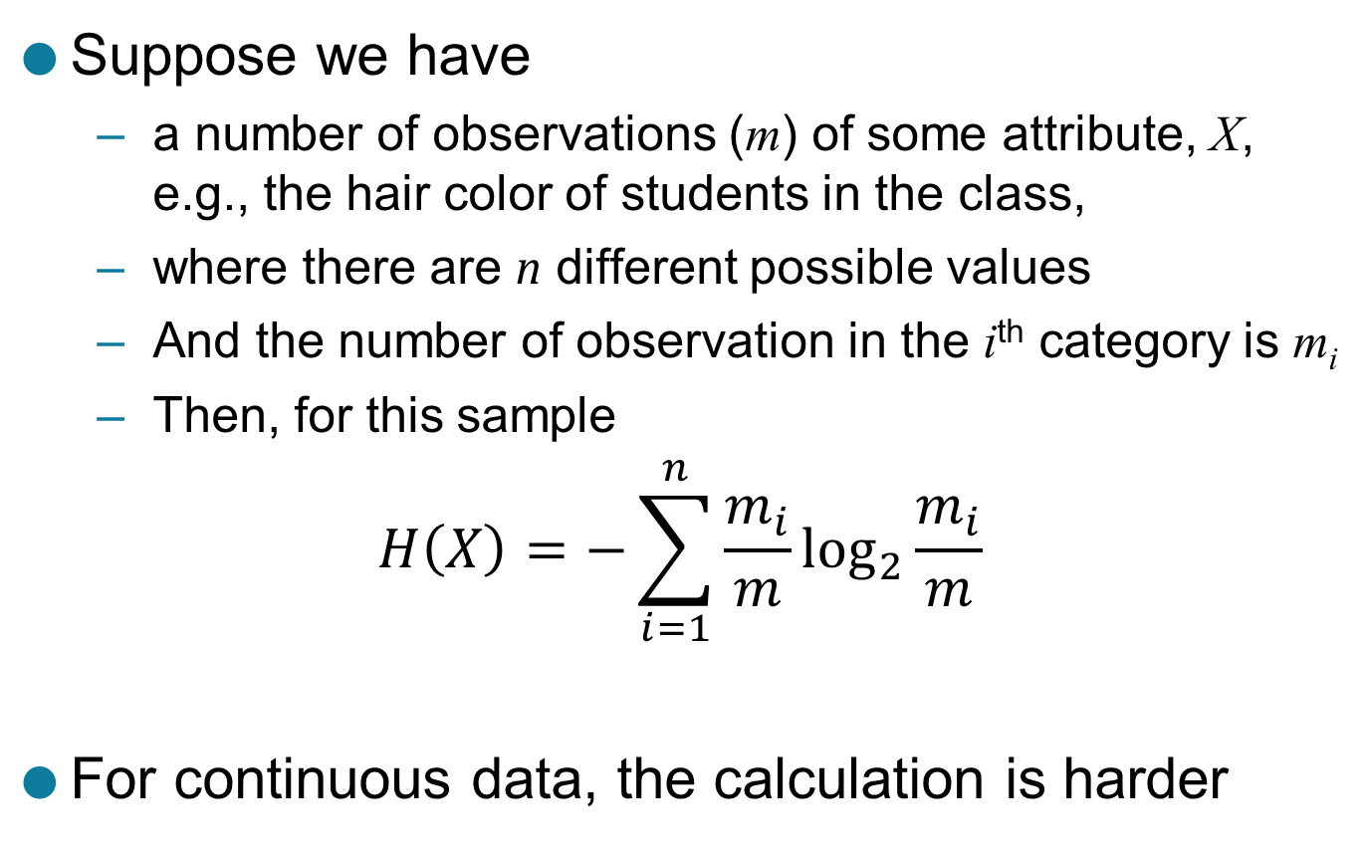
Entropy for Sample Data
Suppose we have
a number of observations (m) of some attribute, X, e.g., the hair color of students in the class,
where there are n different possible values
And the number of observation in the i^{th} category is m_{i}
Then, for this sample
$$H\left(X\right)=−\sum_{i=1}^{n}{{\frac{m_{i}}{m}log}_{2}{\frac{m_{i}}{m}}}$$
For continuous data, the calculation is harder

Slide 28
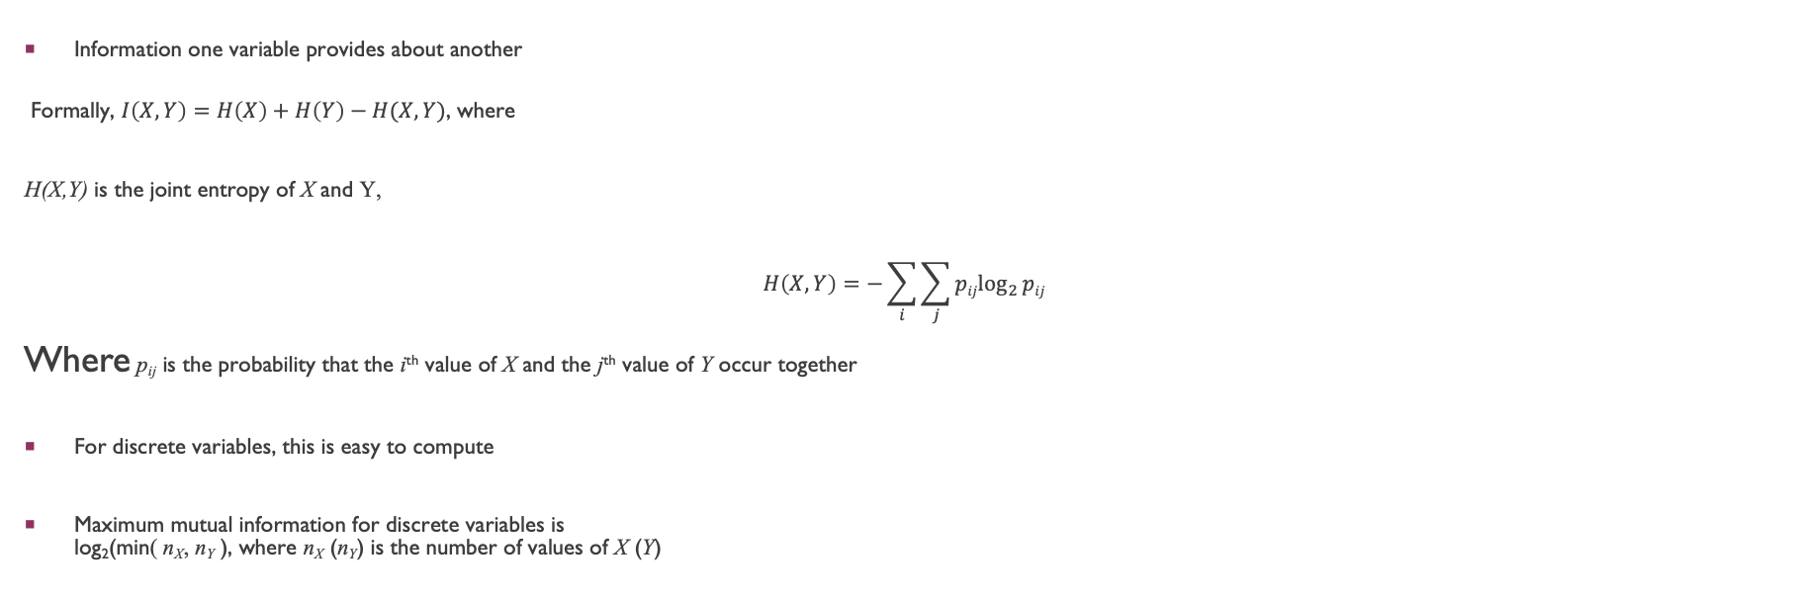
Mutual Information
Information one variable provides about another
Formally, $I\left(X,Y\right)=H\left(X\right)+H\left(Y\right)−H(X,Y)$, where
H(X,Y) is the joint entropy of X and Y,
$$H\left(X,Y\right)=−\sum_{i}{\sum_{j}{{pijlog}_{2}{pij}}}$$
Where p_{ij} is the probability that the i^{th} value of X and the j^{th} value of Y occur together
For discrete variables, this is easy to compute
Maximum mutual information for discrete variables is log₂(min( n_{X}, n_{Y} ), where n_{X} (n_{Y}) is the number of values of X (Y)

Slide 29
Mutual Information Example
Student Status | Count | p | -plog₂p
Undergrad | 45 | 0.45 | 0.5184
Grad | 55 | 0.55 | 0.4744
Total | 100 | 1.00 | 0.9928
Student Status | Grade | Count | p | -plog₂p
Undergrad | A | 5 | 0.05 | 0.2161
Undergrad | B | 30 | 0.30 | 0.5211
Undergrad | C | 10 | 0.10 | 0.3322
Grad | A | 30 | 0.30 | 0.5211
Grad | B | 20 | 0.20 | 0.4644
Grad | C | 5 | 0.05 | 0.2161
Total |  | 100 | 1.00 | 2.2710
Grade | Count | p | -plog₂p
A | 35 | 0.35 | 0.5301
B | 50 | 0.50 | 0.5000
C | 15 | 0.15 | 0.4105
Total | 100 | 1.00 | 1.4406
Mutual information of Student Status and Grade = 0.9928 + 1.4406 - 2.2710 = 0.1624

Slide 30
Maximal Information Coefficient
Reshef, David N., Yakir A. Reshef, Hilary K. Finucane, Sharon R. Grossman, Gilean McVean, Peter J. Turnbaugh, Eric S. Lander, Michael Mitzenmacher, and Pardis C. Sabeti. "Detecting novel associations in large data sets." science 334, no. 6062 (2011): 1518-1524.
Applies mutual information to two continuous variables
Consider the possible binnings of the variables into discrete categories
n_{X} × n_{Y} ≤ N^{0.6} where
n_{X} is the number of values of X
n_{Y} is the number of values of Y
N is the number of samples (observations, data objects)
Compute the mutual information
Normalized by log₂(min( n_{X}, n_{Y} )
Take the highest value

Slide 31
General Approach for Combining Similarities
Sometimes attributes are of many different types, but an overall similarity is needed.
1: For the k^{th} attribute, compute a similarity, s_{k}(x, y), in the range [0, 1].
2: Define an indicator variable, δ_{k}, for the k^{th} attribute as follows:
δ_{k} = 0 if the k^{th} attribute is an asymmetric attribute and
both objects have a value of 0, or if one of the objects has a missing value for the kth attribute
δ_{k} = 1 otherwise
3. Compute

Slide 32
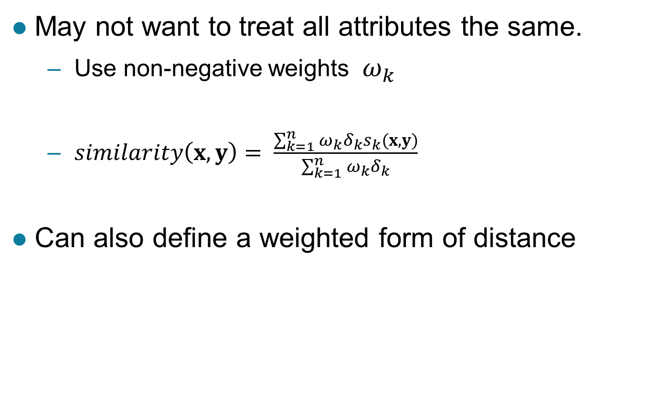
Using Weights to Combine Similarities
May not want to treat all attributes the same.
Use non-negative weights $ω_{k}$
$similarity\left(x,y\right)= \frac{\sum_{k=1}^{n}{ω_{k}δ_{k}s_{k}(x,y)}}{\sum_{k=1}^{n}{ω_{k}δ_{k}}}$
Can also define a weighted form of distance

