Slide 1
A Repetitive Task
Get six numbers from the user
Add them all together
Print the result to the screen
Requires:
Six variables to hold input (e.g. num1, num2, num3, etc.)
Six input statements
Repetitive and inefficient
Worse, what if it was 1000 numbers (perhaps from a file rather than from a user)?

Slide 2
Repetitive Execution
A better solution:
Tell the computer to iterate, to do the same thing six times
Get a number from the user
Add it to a running total
Then print the result
Requires:
Two variables (input and total)
One input statement for each iteration
Pretty much any real program involves iteration

Slide 3
Conditional Execution
if…else is used to control conditional execution
if( condition )
{
// do some stuff only if condition is true
}
Conditional execution happens 0 or 1 time
Condition is a logical expression
Evaluates to true (1) or false (0)
Can be a literal, a variable, a function or an expression

Slide 4
Iterative Execution
while used to control iterative execution (looping)
while( condition )
{
// do some stuff repeatedly as long
// as condition is true
}
Iterative execution happens 0 or more times
Condition is a logical expression
Evaluates to true (1) or false (0)
Can be a literal, a variable, a function or an expression

Slide 5
while Looping (Repetition) Structure
Infinite loop: continues to execute endlessly
Avoided by including statements in loop body that assure exit condition is eventually false

Slide 6
Elements of an Iterative Statement
There are three key parts to an iterative statement:
Initialization (before the loop)
What are the values of variables set to before the loop starts?
Condition (the while condition)
When does the loop quit?
Update (in the body of the loop)
How are those values changed in the loop?

Slide 7
Example Case: Counter Loop
Use a while loop to do something a predetermined number of times
Initialization (before the loop)
Declare a variable to use as a counter
Assign it the value to start counting at
Condition (the while condition)
Check to see if the counter value has reached the target count
If it has, quit the loop
Update (in the body of the loop)
Increment or decrement the counter value
Do the other repetitive tasks as well
Steps 2 and 3 repeat

Slide 8
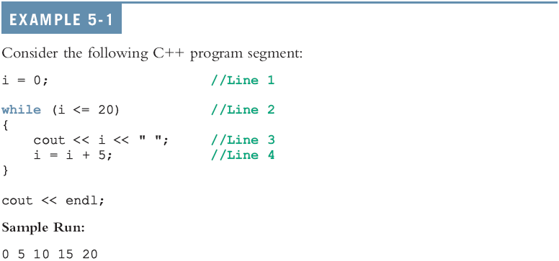
while Looping (Repetition) Structure (continued)

Slide 9
The Rest of the Loop
The body of a counter loop must update the counter
But it also does whatever repetitive tasks you are trying to accomplish
Update other variables
Get input
Print output
Etc…

Slide 10
Exercise
int i = 0, j = 0, sum= 0;
while( i < 5 )
{
j = j + 10;
sum = sum + j;
i++;
}
Initialization:
Both i and j are set to 0 before the loop
Update:
Both i and j are assigned new values in the body of the loop
Condition:
The loop stops based on the value of i
i = 0, condition T, j = 0 + 10 => j = 10; updated i = 1;
i = 1, condition T, j = 10 + 10 => j = 20; updated i = 2;
i = 2, condition T, j = 20 + 10 => j = 30; updated i = 3;
i = 3, condition T, j = 30 + 10 => j = 40; updated i = 4;
i = 4, condition T, j = 40 + 10 => j = 50; updated i = 5;
i = 5, condition F, stop the while loop and do not run any statements in side of the while loop.
Adds 10 to the value of j for 5 times (using a counter variable i)

Slide 11
Exercise
What are the values of i, j at the beginning of each iteration of this loop?
int i = 0, j = 0;
while( i < 5 )
{
j = j + 10;
i++;
}
Iteration | i | j
first
second
third
…

Slide 12
Exercise
Write the output of the following loops:
Show the difference to update the counter variable at the beginning or at the end.
a: int i = 0;
while ( i < 5 )
{
cout << i << “ ”;
cout << endl;
i++;
}
b: int i = 0;
while ( i < 5 )
{
i++;
cout << i << “,”;
}
cout << endl;
i = 0, condition T, print out “0 “, updated i = 1;
i = 1, ….. updated i = 5;
Check the condition F, stop.
The print out:
0
1
2
3
4
b.
i = 0, 0<5 T, updated i = 1, print out “1 ”
i = 1, ………….. Combined print out “1 2 ”
..
i = 4, 4< 5, T, updated i = 5, print out “1 2 .. 5 ”
Print out:
1,2,3,4,5,

Slide 13
Example Case: Input Condition
Use a while loop to do something until input (user, file, etc) tells us to stop
Initialization the counter variable (before the loop)
Declare a variable to hold the user input
Assign it an initial value
Condition related with counter variable (the while condition)
Check to see if the input variable matches the target value
If it does, quit the loop
Update the value of counter variable (in the body of the loop)
Get new input
Steps 2 and 3 repeat

Slide 14
Exercise
Write a while loop that:
Asks the user to enter a number
If the number is -99 it quits
Otherwise, adds that number to a running total
And repeat
Initialization
Variables to hold user input and the accumulated total
Initial values?
Condition
Is the latest input equal to -99?
Update
Add the last number to the total
Get the next user input

