Slide 1
Variables, Memory and Pointers

Slide 2

200
500
111234

Slide 3
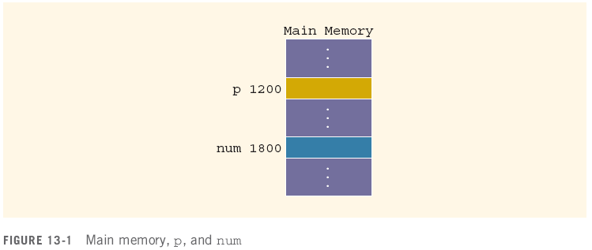
Variables, Memory and Pointers
A variable is a named piece of memory
The name stands in for the memory address
int num;//allocate memory to it first
num = 10;
10

Slide 4
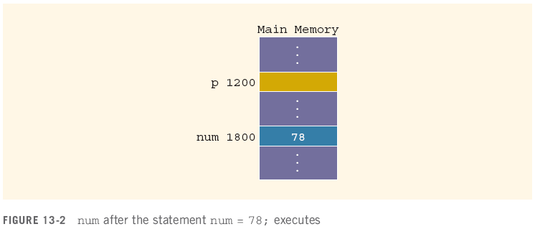
Variables, Memory and Pointers
When a value is assigned to a variable, it is stored at that address in memory
num = 78;

Slide 5
Variables, Memory and Pointers
A pointer is a variable that holds the address of another variable
It is declared in terms of the type of variable it points at:
int *p; // given a * in front of a variable, it means that this variable is a pointer.
int num; num = 78;

Slide 6
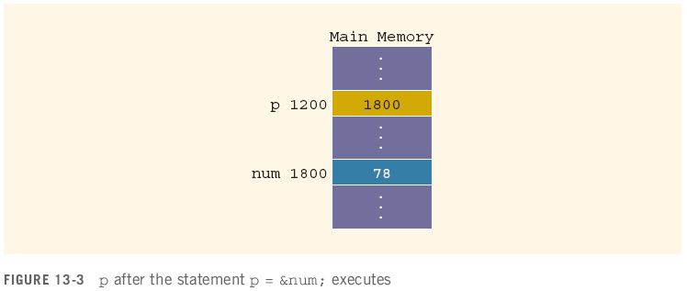
Variables, Memory and Pointers
The operator & returns the address of a variable
It can then be assigned to a pointer
p = &num;
// &num => the address of the variable num ⬄ 1800
// assign the address of num to the value of p.
&num
p

Slide 7
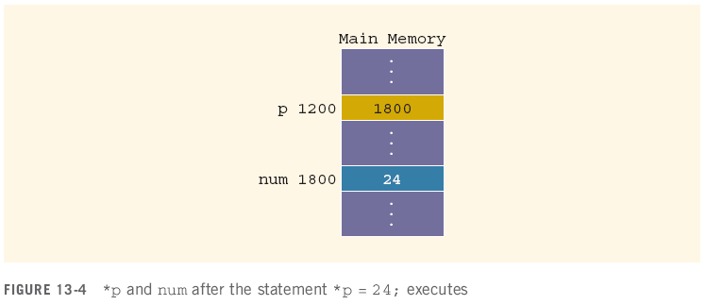
Variables, Memory and Pointers
The operator * takes an address (a pointer) and returns the location in memory being pointed to
Can only be applied to a pointer
*p = 24;
int *q; // define a pointer;
*q = 30; // assign 30 to the variable that the pointer pointed to.

Slide 8
Declaring Pointer Variables
Syntax:
Examples:
int *p;
char *ch;
These statements are equivalent:
int *p;
int* p;
int * p;

Slide 9
Declaring Pointer Variables (continued)
In the statement:
int* p, q; // p is a pointer; q is variable
int num1, num2; ⬄ int num1; int num2;
only p is the pointer variable, not q; here q is an int variable
To avoid confusion, attach the character * to the variable name:
int *p, q;
int *p, *q;
int array1[100], array2[20];

Slide 10
Address of Operator (&)
The ampersand, &, is called the address of operator
The address of operator is a unary operator that returns the address of its operand

Slide 11

Dereferencing Operator (*)
When used as a unary operator, * is the dereferencing operator or indirection operator
Refers to object to which its operand points
Example:
To print the value of x, using p:
To store a value in x, using p:
Variable name | address | value
x | 153 | 55
p (pointer) | 1008 | 153

Slide 12
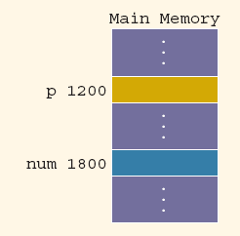
Exercise
Assuming the memory layout provided, after this code executes:
int num; // declare an integer variable
int *p; // declare a pointer named: p
num = 50; // assign 50 to variable num
p = &num;
//1. assign a pointer p to the variable num;
//2. assign the address of num (1800) to the value of the pointer p
*p = 38;
//assign 38 to *p (the value of the pointer pointed to)
// the value of num = 38
What are the values of these expressions?
&num = 1800; // &num: the address of the variable num
num = ? // value of num = 38
&p = ? // &: address of something; &p: the address of the pointer p 1200
p = ? // the value of p ⬄ the address that the pointer pointed to, 1800.
*p = ? // *p: the value of the pointer pointed to, 38.

Slide 13
Assigning Pointers
Pointers can be assigned to pointers of the same type
int x, *p, *q; //declare one variable x, and 2 pointers p, q
x = 50; // the value of x = 50
p = &x;
//1. a pointer p points to the variable x
//2. assign the address of x to the value of the pointer p
q = p; // q is a pointer; assign the value of p to the value of q ⬄ both pointers p and q are assigned to variable x.
The value of *q is?
*q: the value that the pointer q pointed to
So *q is 50
Variable name | address | value
x | 153 | 50
p (pointer) | 1008 | 153
q (pointer) | 17 | 153

Slide 14
Assigning Pointers
Pointers can be assigned to pointers of the same type
int x, *p, *q;
x = 50;
p = &x;
q = p;
The value of *q is 50

Slide 15
The Null Pointer
In addition to variable addresses and other pointers, a pointer can be assigned to the null pointer
Either the number 0 or the constant NULL
Used to indicate an invalid pointer (pointing to nothing)
Dereferencing a null pointer causes a hard error
int *p = 0;
p = NULL;
*p //dereferencing

Slide 16
Comparing Pointers
Be careful of the difference between comparing two pointers and comparing their values:
int x = 50, y = 50, *p, *q;
p = &x;
q = &y;
*q == *p evaluates to?
q == p evaluates to?

Slide 17
Comparing Pointers
Be careful of the difference between comparing two pointers and comparing their values:
int x = 50, y = 50, *p, *q;
p = &x;
q = &y;
*q == *p evaluates to true
q == p evaluates to false

Slide 18
Pointers and Arrays
int a[20] = {1, 7, 8, 3};
int *p; // declare a pointer named p
p = a; // the reference/address of the index 0.
// the default is that array pass by address / memory.
cout << a[0] << endl; // 1
cout << a[1] << endl; // 7
cout << p[2] << endl; // 8; p[2] ⬄ a[2]
cout << p[3] << endl; // 3; p[3] ⬄ a[3]
cout << *p << endl; // 1
cout << *(p+2) << endl; //8; *(p+2) ⬄ a[2]
cout << *(p+3) << endl; // 3
int num = 78;
int *p;
p = &num;
// variable pass
by values;
2000 | 2004 | 2008 | 2012
Array: a | value | 1 | 7 | 8 | 3
 | index | 0 | 1 | 2 | 3 | 4 | 5 | 6 | …
pointer p
Address of p: 1000 | Value of p: 2000
p
P[2] ⬄ *(p+2)
P[3] ⬄ *(p+3)

Slide 19
Pointers and Class
class A
{
public:
char a, b, c;
int r[7];
};
Class | A
 | Public variables:
 |  | char | a
 |  | char | b
 |  | char | c
 |  | int | r[7]
value
index | 0 | 1 | .. | … | .. | 6

Slide 20
Pointers and Class
A x; // declare an object named x with the type of the class A.
x.a = '7';
x.b = 'b';
x.c = 'a’;
A *p; // declare a pointer named p with the type A. p = &x; // assign the address of an object to a pointer.
(*p).a = '8’;
(*p).b = 'b';
p->b = 'a’; // 1. p is a pointer;
// 2. p points to an object;
// 3. one element of this object is b;
// 4. we are updated the value of the element b for this object ( the object that the pointer p points to).
p->r[6] = 5;
cout << x.r[6] << endl;
int num;
num = 78;
p = &num;
A y;
y.a = ‘9’;
y.b = ‘b’;

Slide 21


Pointers and Class
A x; // declare an object named x with the type of the class A.
x.a = '7';
x.b = 'b';
x.c = 'a’;
A *p;
p = &x; (*p).a = '8’;
(*p).b = 'b';
p->b = 'a’; ⬄ (*p).b = ‘a’
cout << p << endl;
p -> a = ‘t’;
p -> c = ‘n’;
p -> r[0] = 10; p->r[6] = 5;
cout << x.r[6] << endl;
cout << p->r[6] << endl;
Object | x | With address | With address | 21
 | Public variables:
 |  |  | char | a = ‘7’
 |  |  | char | b = ‘a’
 |  |  | char | c = ‘a’
 |  |  | int | r[7]
value | 10 |  |  |  |  | 5
index | 0 | 1 | .. | … | .. | 6
Pointer p
Address | value
100000 | 21

Slide 22


Pointers and Classes
A pointer to a class object is no different than a pointer to any other type of variable
Given:
class album
{
public:
string title;
string artist;
int tracks;
double price;
int nums[10];
};
album stock[100]; // album stock;
album *pick; // stock.title = “today is Wed”
album stock [100] | index | 0 | 1 | 2 |  | 99
 | name | Obj_array[0] | stock[1] | stock[2]
string | title
string | artist
int | tracks
double | Price
int | r[7]
string | title
string | artist
int | tracks
double | Price
int | nums[10]
index | 0 | 2 | 9
value | 200
index | 0 | …… | 9
value

Slide 23
Pointers and Classes
A particular album can be selected by assignment:
pick = stock; // album a, *p; p = &a;
pick = pick + 49; // pick + 49 ⬄ stock[49]
or
pick = &(stock[49]);
The members of that album are accessed by a combination of dereference (*) and membership (.):
(*pick).title = “Listener Supported”;
There is also a syntactic shortcut:
pick->title = “Listener Supported”;
// pick is a pointer
// point to an object
// one element of the object is title

Slide 24
Pointers and Functions
Pointers, like any variable, can be used as parameters and return values
void some_function( int x, album * p );
album * some_other_function( double y );
They are passed by value by default
Involves copying the value (an address) into a local variable
Changes to a local copy do not change the pointer
But, changes to the memory the pointer points at are not limited to local variables!
void some_function( int x, album * p )
{
p->artist = “The Black Crowes”; // non-local change
p = NULL; // local change!
}

Slide 25
Dynamic Memory Allocation
All the variables we have dealt with so far have been stack variables
Allocated by the compiler before the program is run
Pre-determined size, even arrays
Pointers give us a mechanism for dynamically allocating memory on demand
Allocated as needed at run-time (during execution)
Size determined at time of allocation
De-allocated when no longer useful

Slide 26
Operator new
Declaring a pointer only allocates memory for the pointer address, not the data
album *p;
album->tracks = 4; // error, write to some random address (segmentation fault)
The new operator allocates memory for a specified type of variable and returns the address
p = new album();
p->tracks = 4; // write to newly allocated memory
This memory is not named like the parameters and variables we’ve been using
That pointer is the only way to refer to it

Slide 27
Operator new
new can also be used to dynamically allocate memory space for arrays
int *p;
int ct;
cout << “how many albums?: ”;
cin >> ct;
p = new album[ct];
Calls the default constructor on each object in the array (no way to pass in parameters)

Slide 28
Pointers and Arrays
An array is a contiguous block of memory, divided into some number of equal sized elements
An array variable is really just a constant pointer to the first element in that block
A pointer can be assigned the value of an array variable
Given:
int a[20];
int *p;
p = a;
a[0] , p[0] and *p all refer to the first element in the array, expected to be 4 bytes long (the size of an int)
a[1], p[1] both refer to the second element in the array, starting 4 bytes after the first element

Slide 29
Operator delete
Dynamic memory allocation runs the risk of running out of memory during program execution
If new cannot allocate the requested piece of memory, it fails and terminates the program
To avoid this, programs need to de-allocate dynamic memory when they are done with it
This is done with the operator delete, called on a pointer to a dynamically allocated piece of memory
int *p, *q;
q = new int;
p = new int[x];
delete q;
delete [] p;

Slide 30
Memory Leaks
If a pointer to dynamically allocated memory is moved, that memory location cannot be found again
int *p;
p = new int[1024];
p = new int[518];
p = new int[20435];
p = 0;
This means it cannot be deleted, and is lost to the program
This is referred to as a memory leak
If a leak occurs in a repeating part of the program, then no matter how small it is the program will eventually run out of memory
This matters a lot in server programs that run for months or years

