Slide 1
Unsupervised Learning

Slide 2
Road map
Basic concepts
K-means algorithm
Representation of clusters
Hierarchical clustering
Distance functions
Data standardization
Handling mixed attributes

Slide 3
Supervised learning vs. unsupervised learning
Supervised learning: discover patterns in the data that relate data attributes with (class / label ) a target attribute.
((x1, y1)), x1: feature vector (8, 8, 8.5)
These patterns are then utilized to predict the values of the target attribute in future data instances.
Unsupervised learning: The data have no target attribute (no label/ class).
We want to explore the data to find some intrinsic structures in them.

Slide 4
Clustering
Clustering is a technique for finding similarity groups in data, called clusters. I.e.,
it groups data instances that are similar to (near) each other in one cluster and data instances that are very different (far away) from each other into different clusters.
Clustering is often called an unsupervised learning task as no class values denoting an a priori grouping of the data instances are given, which is the case in supervised learning.
Due to historical reasons, clustering is often considered synonymous with unsupervised learning.
In fact, association rule mining is also unsupervised
This chapter focuses on clustering.

Slide 5
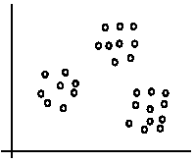
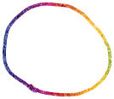

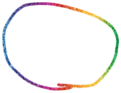
An illustration
The data set has three natural groups of data points, i.e., 3 natural clusters.

Slide 6
What is clustering for?
Let us see some real-life examples
Example 1: groups people of similar sizes together to make “small”, “medium” and “large” T-Shirts.
Tailor-made for each person: too expensive
One-size-fits-all: does not fit all.
Example 2: In marketing, segment customers according to their similarities
To do targeted marketing.

Slide 7
What is clustering for? (cont…)
Example 3: Given a collection of text documents, we want to organize them according to their content similarities,
To produce a topic hierarchy
In fact, clustering is one of the most utilized data mining techniques.
It has a long history, and used in almost every field, e.g., medicine, psychology, botany, sociology, biology, archeology, marketing, insurance, libraries, etc.
In recent years, due to the rapid increase of online documents, text clustering becomes important.

Slide 8
Aspects of clustering
A clustering algorithm
Partitional clustering
Hierarchical clustering
…
A distance (similarity, or dissimilarity) function
Clustering quality
Inter-clusters distance ⇒ maximized
Intra-clusters distance ⇒ minimized
The quality of a clustering result depends on the algorithm, the distance function, and the application.

Slide 9
Road map
Basic concepts
K-means algorithm
Representation of clusters
Hierarchical clustering
Distance functions
Data standardization
Handling mixed attributes

Slide 10
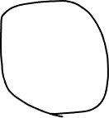





Slide 11
K-means clustering
K-means is a partitional clustering algorithm
Let the set of data points (or instances) D be
{x₁, x₂, …, x_{n}},
where x_{i} = (x_{i1}, x_{i2}, …, x_{ir}) is a vector in a real-valued space X ⊆ R^{r}, and r is the number of attributes (dimensions) in the data.
The k-means algorithm partitions the given data into k clusters.
Each cluster has a cluster center, called centroid.
k is specified by the user

Slide 12
K-means algorithm
Given k, the k-means algorithm works as follows:
Randomly choose k data points (seeds) to be the initial centroids, cluster centers
Assign each data point to the closest centroid
Re-compute the centroids using the current cluster memberships.
If a convergence criterion is not met, go to 2).

Slide 13
Stopping/convergence criterion
no (or minimum) re-assignments of data points to different clusters,
no (or minimum) change of centroids, or
minimum decrease in the sum of squared error (SSE),
C_{i} is the jth cluster, m_{j} is the centroid of cluster C_{j} (the mean vector of all the data points in C_{j}), and dist(x, m_{j}) is the distance between data point x and centroid m_{j}.
(1)

Slide 14
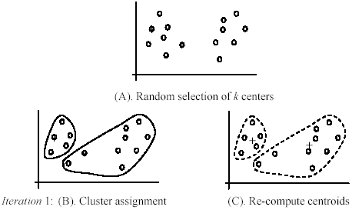


An example
+
+

Slide 15
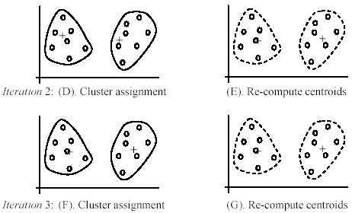
An example (cont …)

Slide 16
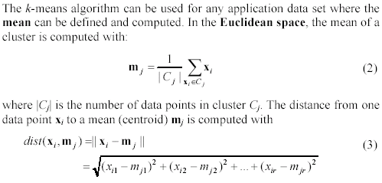
An example distance function

Slide 17
A disk version of k-means
K-means can be implemented with data on disk
In each iteration, it scans the data once.
as the centroids can be computed incrementally
It can be used to cluster large datasets that do not fit in main memory
We need to control the number of iterations
In practice, a limited is set (< 50).
Not the best method. There are other scale-up algorithms, e.g., BIRCH.

Slide 18
Strengths of k-means
Strengths:
Simple: easy to understand and to implement
Efficient: Time complexity: O(tkn),
where n is the number of data points,
k is the number of clusters, and
t is the number of iterations.
Since both k and t are small. k-means is considered a linear algorithm.
K-means is the most popular clustering algorithm.
Note that: it terminates at a local optimum if SSE is used. The global optimum is hard to find due to complexity.

Slide 19

Weaknesses of k-means
The algorithm is only applicable if the mean is defined.
For categorical data, k-mode - the centroid is represented by most frequent values.
The user needs to specify k.
The algorithm is sensitive to outliers
Outliers are data points that are very far away from other data points.
Outliers could be errors in the data recording or some special data points with very different values.

Slide 20
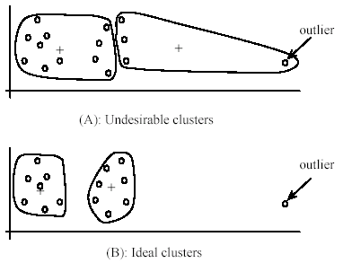
Weaknesses of k-means: Problems with outliers

Slide 21
Weaknesses of k-means: To deal with outliers
One method is to remove some data points in the clustering process that are much further away from the centroids than other data points.
To be safe, we may want to monitor these possible outliers over a few iterations and then decide to remove them.
Another method is to perform random sampling. Since in sampling we only choose a small subset of the data points, the chance of selecting an outlier is very small.
Assign the rest of the data points to the clusters by distance or similarity comparison, or classification

Slide 22
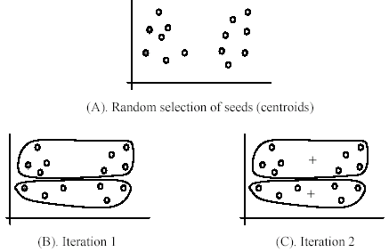
Weaknesses of k-means (cont …)
The algorithm is sensitive to initial seeds.

Slide 23
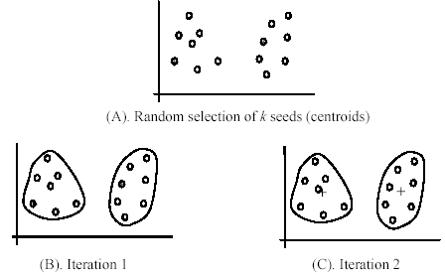
Weaknesses of k-means (cont …)
If we use different seeds: good results
There are some methods to help choose good seeds

Slide 24
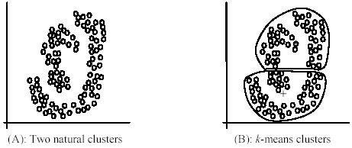
Weaknesses of k-means (cont …)
The k-means algorithm is not suitable for discovering clusters that are not hyper-ellipsoids (or hyper-spheres).
+

Slide 25
K-means summary
Despite weaknesses, k-means is still the most popular algorithm due to its simplicity, efficiency and
other clustering algorithms have their own lists of weaknesses.
No clear evidence that any other clustering algorithm performs better in general
although they may be more suitable for some specific types of data or applications.
Comparing different clustering algorithms is a difficult task. No one knows the correct clusters!

Slide 26



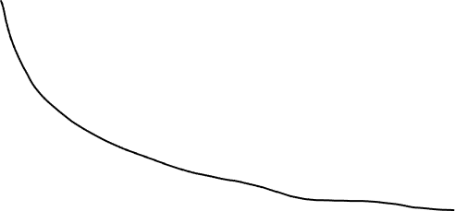
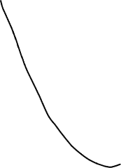
Select the k / number of centers

