Slide 1
Computational Behavior Modeling
Research method

Slide 2
What is good research?
How do I know this article is methodological sound?
Are the findings practically meaningful
Statistical versus practical significance
Design of research is a compromise
Use best possible methods
Avoid as many confound or other interpretations of you data
Look for convergence among research methods

Slide 3
Research Method
What approaches do scientists use to measure behavior modeling?
What specific designs are unique to behavior modeling research?
What are general designs for doing research?

Slide 4
Conducting Research Ethically
Collaborative Research Training Initiative
Institutional Review Board (IRB)
Informed Consent

Slide 5
Reliability & Validity of Measures
Choice of outcome measures is important.
Reliability of a measure: extent to which is provides a consistent index of the behavior of interest (measurement error).
Validity of a measure: extent to which it measures what researchers think it measures.

Slide 6
Reliability & Validity of Measures
Choice of outcome measures is important.
Reliability of a measure: extent to which is provides a consistent index of the behavior of interest (measurement error).
Validity of a measure: extent to which it measures what researchers think it measures.

Slide 7
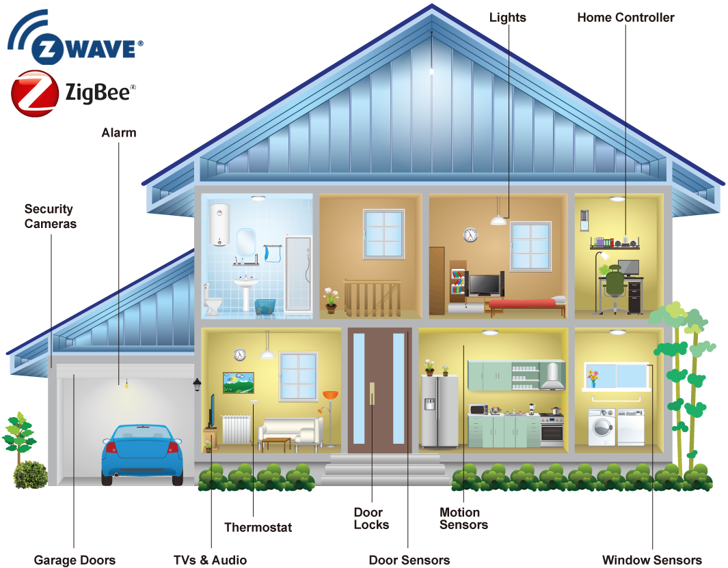
Example
Data from smart watch
2016-04-01 12:39:44.825323 MainEntryway OFF Other_Activity
2016-04-01 12:40:20.932096 BathroomASink ON Take_Medicine
2016-04-01 12:40:21.219997 BedroomABed ON Relax
2016-04-01 12:40:22.435275 MainEntryway ON Other_Activity
2016-04-01 12:40:23.53145 MainEntryway OFF Other_Activity
2016-04-01 12:40:23.62437 BedroomABed OFF Relax
2016-04-01 12:40:25.521123 BedroomABed ON Relax
2016-04-01 12:40:26.099618 BathroomASink OFF Bed_Toilet_Transition
2016-04-01 12:40:26.532888 MainEntryway OFF Other_Activity
2016-04-01 12:40:29.812875 BedroomABed OFF Relax
2016-04-01 12:40:30.058532 BathroomAArea OFF Bed_Toilet_Transition
2016-04-01 12:40:31.500912 BedroomABed ON Relax
2016-04-01 12:40:31.820019 BedroomDArea OFF Relax
2016-04-01 12:40:35.434451 BedroomABed OFF Relax
2016-04-01 12:40:38.343873 EntrywayB OFF Other_Activity

Slide 8
Example
Data from smart watch
2016-04-01 12:39:44.825323 MainEntryway OFF Other_Activity
2016-04-01 12:40:20.932096 BathroomASink ON Take_Medicine
2016-04-01 12:40:21.219997 BedroomABed ON Relax
2016-04-01 12:40:22.435275 MainEntryway ON Other_Activity
2016-04-01 12:40:23.53145 MainEntryway OFF Other_Activity
2016-04-01 12:40:23.62437 BedroomABed OFF Relax
2016-04-01 12:40:25.521123 BedroomABed ON Relax
2016-04-01 12:40:26.099618 BathroomASink OFF Bed_Toilet_Transition
2016-04-01 12:40:26.532888 MainEntryway OFF Other_Activity
2016-04-01 12:40:29.812875 BedroomABed OFF Relax
2016-04-01 12:40:30.058532 BathroomAArea OFF Bed_Toilet_Transition
2016-04-01 12:40:31.500912 BedroomABed ON Relax
2016-04-01 12:40:31.820019 BedroomDArea OFF Relax
2016-04-01 12:40:35.434451 BedroomABed OFF Relax
2016-04-01 12:40:38.343873 EntrywayB OFF Other_Activity
Questions:
Data Collection
Approval from IRB
Activity recognition
Measure choice
Feature extraction

Slide 9
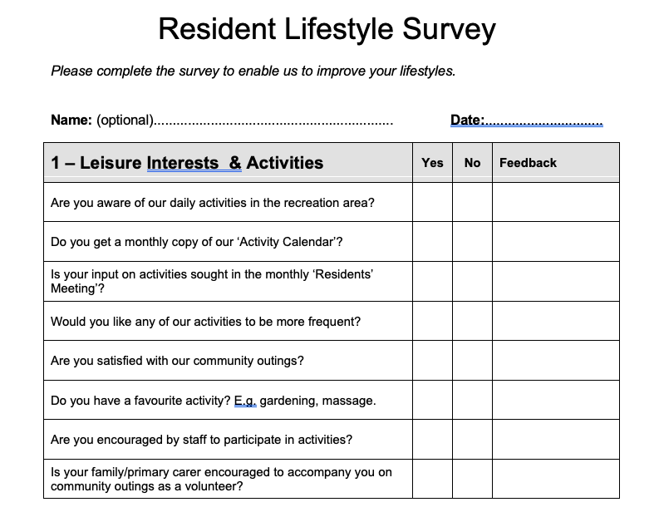
Example
Questionnaire Design
The time to get up
The time to eat breakfast
The time to start work
The time to go to bed

Slide 10
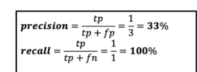
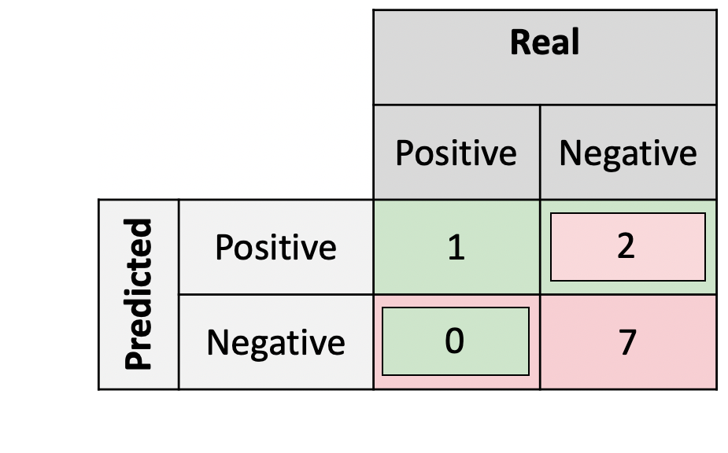

Example
Measures
Activity recognition measures:
Accuracy
p-value of t-test
F1 score

Slide 11
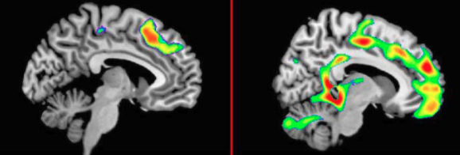
Example
Measures
To distinguish between diagnostic groups

Slide 12

Example
2016-04-01 12:39:44.825323 MainEntryway OFF Other_Activity
2016-04-01 12:40:20.932096 BathroomASink ON Take_Medicine
2016-04-01 12:40:21.219997 BedroomABed ON Relax
2016-04-01 12:40:22.435275 MainEntryway ON Other_Activity
2016-04-01 12:40:23.53145 MainEntryway OFF Other_Activity
2016-04-01 12:40:23.62437 BedroomABed OFF Relax
2016-04-01 12:40:25.521123 BedroomABed ON Relax
2016-04-01 12:40:26.099618 BathroomASink OFF Bed_Toilet_Transition
2016-04-01 12:40:26.532888 MainEntryway OFF Other_Activity
2016-04-01 12:40:29.812875 BedroomABed OFF Relax
2016-04-01 12:40:30.058532 BathroomAArea OFF Bed_Toilet_Transition
2016-04-01 12:40:31.500912 BedroomABed ON Relax
2016-04-01 12:40:31.820019 BedroomDArea OFF Relax
2016-04-01 12:40:35.434451 BedroomABed OFF Relax
2016-04-01 12:40:38.343873 EntrywayB OFF Other_Activity
Feature Extraction
Temporal Features
Duration
Frequency
Distance
…
Spatial Features
Location
Transition between locations
…

Slide 13

Behavior modeling programs
Modeling
Traffic (car sensor; GPS)
Crowd Flow
Home/Building/City
Nature
Healthcare
Other areas

Slide 14


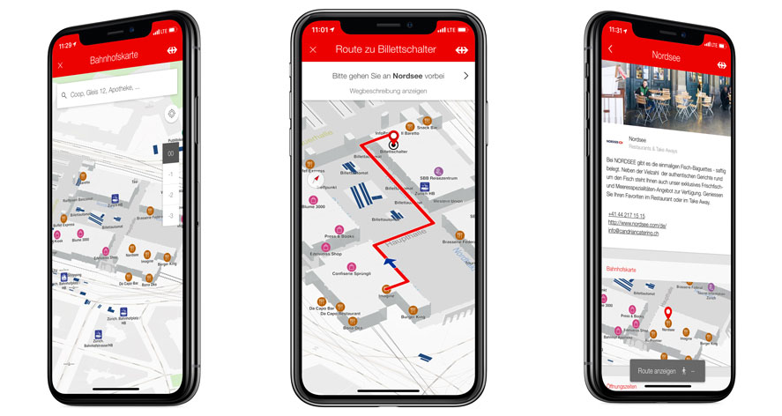
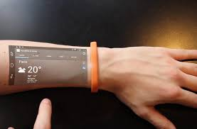
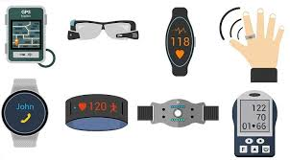
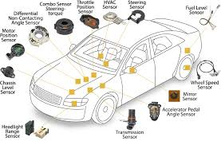
The meaning of behavior

