Slide 1
mining Internet of Things Data
Beiyu Lin

Slide 2
Data Properties of smart environment
Notes:
Ubiquitous (u – bit – quick – tis)
Actuator (act – true- ate – or)

Slide 3
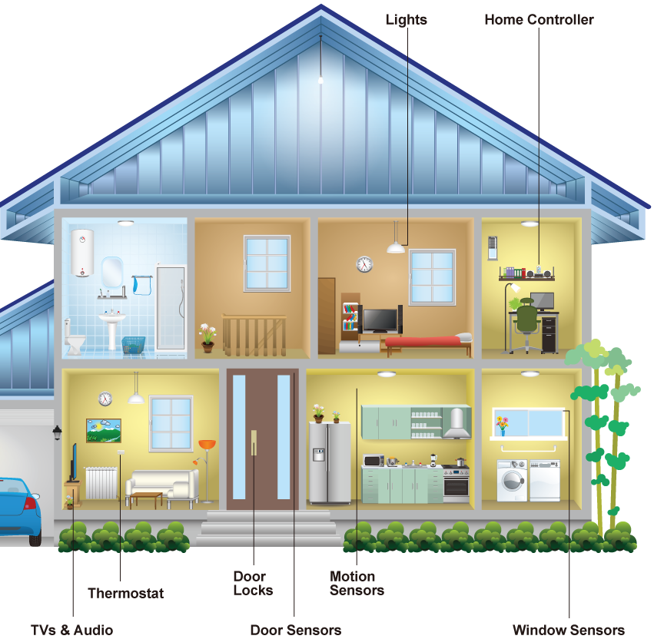
Sensor Data
Sensor types: infrared motion(narrow/wide-area), ambient light, magnetic, and temperature sensors.
2011-06-13 | 21:48:43 | Bathroom | ON | Personal_Hygiene
2011-06-13 | 21:48:44 | Bathroom | OFF | Personal_Hygiene
2011-06-13 | 22:47:02 | Bedroom | ON | Personal_Hygiene
2011-06-13 | 22:47:04 | Bedroom | OFF | Sleep
2011-06-13 | 22:47:06 | Bedroom | ON | Sleep
………………
2011-06-14 | 10:11:24 | Kitchen | ON | Wash_Dishes
2011-06-14 | 10:11:25 | Kitchen | OFF | Wash_Dishes
2011-06-14 | 10:11:40 | Kitchen | ON | Cook
2011-06-14 | 10:11:41 | Kitchen | OFF | Wash_Dishes
Notes:
Here is an examples of smart home and sensor data.
Our sensors includes infrared motion/ambient light sensors, magnetic doors/ windows, and temperature sensors. All of these are ambient sensors that are only updated if there is a significant change in a state, for example, a door opening or closing.
(point to the graph)
For the motion sensors, we have narrow-area and wide-area sensors. The Narrow-area motion sensors are placed on the ceilings above some specific items in the house, including above the stove, entryway, and dining chairs. This is because this kind of sensors can perceive motions that occur in a one-meter diameter area.
Wide-area motion sensors are installed on the ceiling in large rooms such as the kitchen, living rooms, and bedrooms, and have a much wider coverage so as to recognize motions happening anywhere in the room.
Magnetic sensors are used for external windows and doors, as well as for internal cabinets, and doors in bathrooms and living rooms.
Temperature sensors are placed in most of the rooms to both perceive key activities such as bathing and cooking, and to sense significant temperature changes at
those points in each room.
===========
Here is a sample of our SH sensor data. It includes timestamp, sensor location, sensor event (ON/OFF, OPEN/CLOSE), activities ( such as, cook, eat, sleep, personal hygiene).
Q: how many of you ran out of a building because of false fire alarm?
Similar to smoke detectors, smart home sensor may also send false information. That is, computational challenges exist in sensor data.

Slide 4

Sensor Data—Computational Challenges
Missing values |  | Sensor failures
Sensor jitters |  | Guest in the house
Processing features in real time… |  | Residents test sensors for fun…
Notes:
Sensor data are very noisy. It may be because of sensor failures, visitors in the home and so on.
computational challenges includes imputing missing value, cleaning sensor jitters, and processing features in real time from sensor data
Missing values: It can be expected that transmitted sensor data are lost or corrupted due to many reasons, such as power outage at the sensor's node, random occurrences of local interferences, or a higher bit error rate of the wireless radio transmissions as compared with wired communications.
Jitter: for example, given 10 minutes, it should be only have 1 event detected by the sensor. But due to …., it sends back 10 events.
To tackle these challenges, I have designed methods that have been applied to two multi-disciplinary research projects: Indoor Air Quality and Clinician In the Loop (CIL).
https://en.wikipedia.org/wiki/Jitter#Jitter_metrics
https://www.reddit.com/r/techsupportmacgyver/comments/9up1t3/my_office_conference_rooms_have_very_sensitive/

Slide 5
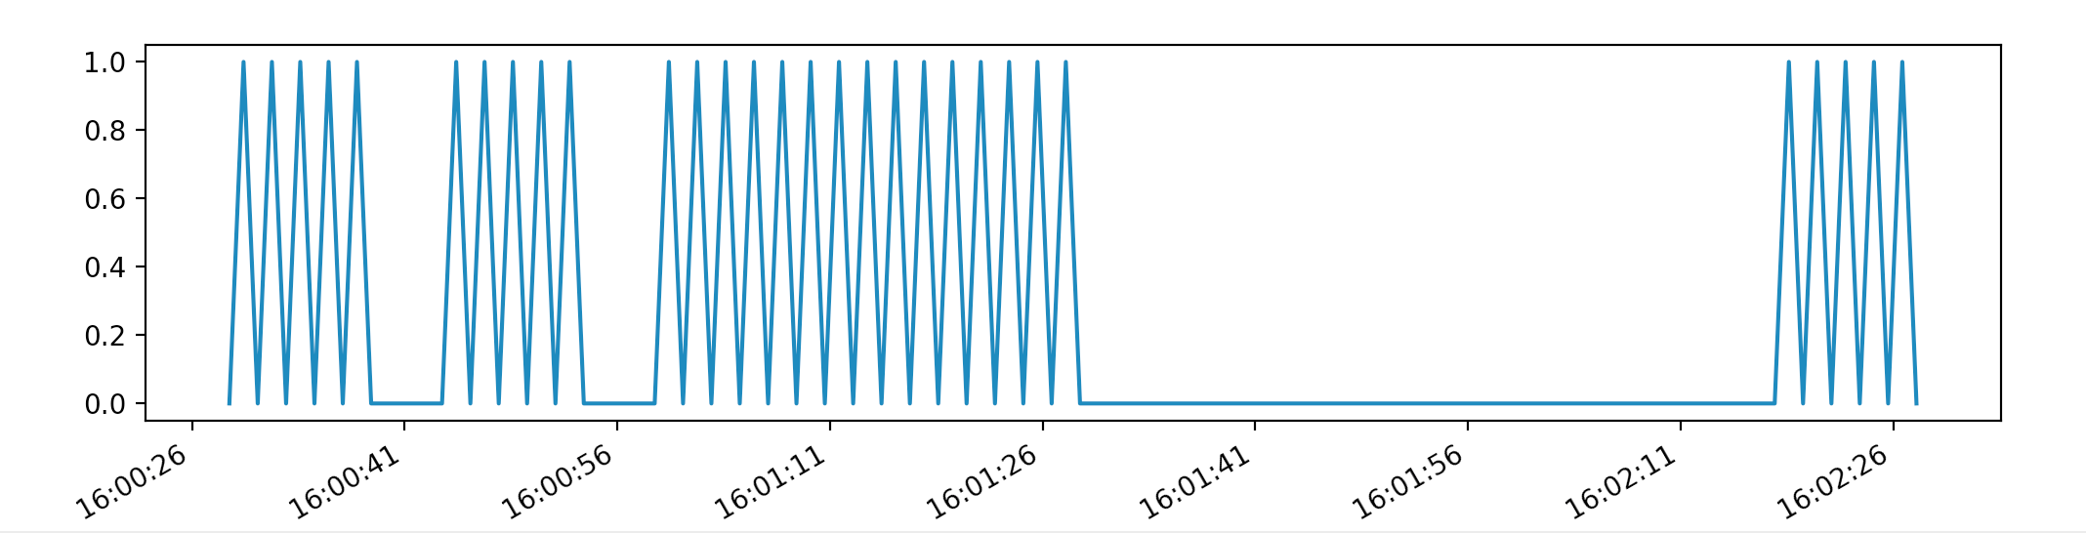
Sensor Data—Computational Challenges
Clean jitters
open
close
open
large gap
Notes:
Here, I show one algorithm to clean jitters. The algorithm automatically learns the next large gap. The interval before this large gap would be an interval with “open” at the beginning and “close” at the end.
Once we imputed the missing values and cleaned the jitters, we can handle the next computational challenge: processing features in real time from streaming data.
For different projects, the features are designed different for real time processing.

Slide 6
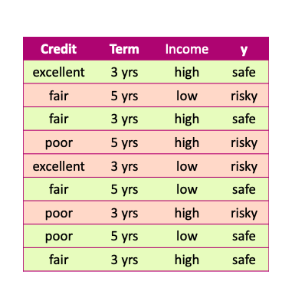
Data
x and y values are known

Slide 7
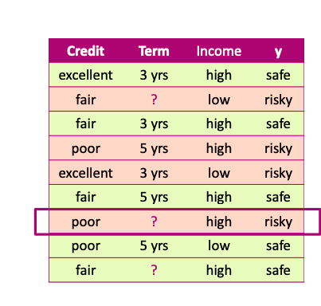
Missing values
Unknown values

Slide 8
Missing values Impact
Missing values impact both training and prediction
Training data: unknown values
Prediction: input for prediction has unknown values

Slide 9
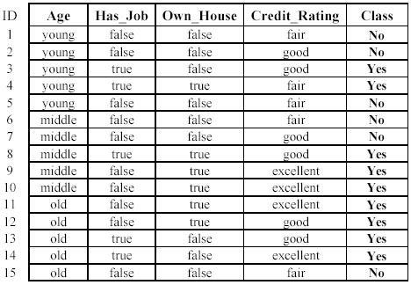
Missing values Impact
Training data: “unknown” values

Slide 10
Missing values Impact
Prediction: input at prediction time with “unknown” values

Slide 11
Handling missing values
Strategy 1: Purification by skipping

Slide 12
Purification by skipping / removing

Slide 13
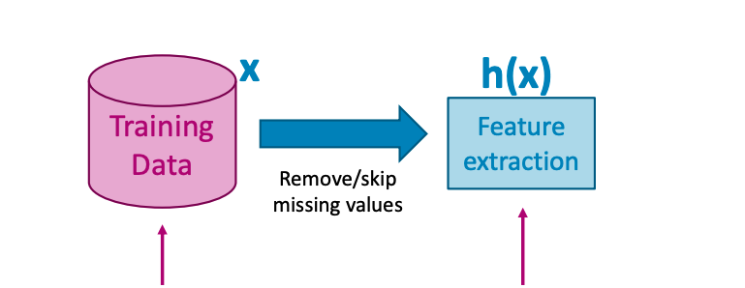
Purification by skipping / removing
Original data with missing values
Data without any missing values

Slide 14
The challenge with skipping / revoming

Slide 15
The challenge with skipping / revoming
Warning: more than 50% of the data are removed!

Slide 16
The challenge with skipping / removing
Idea 2: Skip features with many missing values

Slide 17
The challenge with skipping / removing
Strategy 1: Skip data points with a missing value
- make sure only a few points are skipped
Strategy 2: Skip features with many missing values
- make sure only a few features are skipped

Slide 18
skipping / removing missing values: pros and cons
Pros:
Easy to understand and implement
Applied to all machine learning model
Cons:
Removing data points and features may take off some important information
Unclear when it’s better to remove data points or features
Doesn’t help if data is missing at prediction part

Slide 19
Handling missing values
Strategy 2: Purification by imputing

Slide 20
Main drawback of skipping method
Data is precious.
Do not throw it away.

Slide 21
Can we keep all the data?
Use other data point in the column to “guess” the “missing part”.

Slide 22
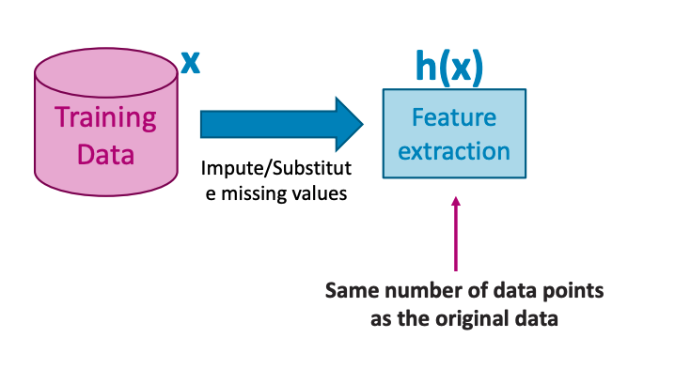
Idea: PURIFICATION BY IMPUTING
Original data with missing values
Same number of data points

Slide 23
Idea: PURIFICATION BY IMPUTING
false
Fill in each missing value with a calculated guess
true
fair

Slide 24
Example: replace with the most common value
false
Fill in each missing value with a calculated guess

Slide 25
Common (simple) rules for imputing
Impute each feature with missing values:
Categorical features: Most popular value of non-missing
Numerical features: Average or median value of non-missing

Slide 26
Missing value imputation: pros and cons
Pros
• Easy to understand and implement
• works for all machine learning models
(logistic regression, decision trees, …)
• works for missing values in the prediction part
use the same imputation rules
Cons
• May have systematic errors
Example: a feature is missing in the entire dataset in one place but is not missing in another dataset.

Slide 27
Missing value Code
Let us do coding together!

Slide 28
STATE OF ART ALGORITHMS FOR SMART ENVIRONMENT
Paper1:
Pavement performance monitoring and anomaly recognition based on crowdsourcing spatiotemporal data
Paper II:
Visual Assistant for Crowdsourced Anomaly Event Recognition in Smart City
Paper III:
Algorithms for cyber security in smart environment

