Slide 1




Working With Arrays of Data
Consider a program that:
Gets 5 numbers from the user
Outputs the average
What variables are needed?
What are the steps the program should take?

Slide 2
for (int i = 0; i < 5; i++){ cin >> num[i];}
For loop:
i = 0, check i< 5 true, run the statement inside of {}
cin >> num[0];
i = 1, check i<5 T, run the statement inside of {}
cin >> num[1];
i = 2, check i < 5 T, run the statement inside of {}
cin >> num[2];
….
i = 4, check i< 5 T, run the statement inside of {}
cin >> num[4];
i = 5, check i < 5 F, jump out of the for loop.

Slide 3
Working With Arrays of Data
Consider a program that:
Gets 5 numbers from the user
Outputs the average
What variables are needed?
What are the steps the program should take?
But what if it takes 100 numbers instead of 5? 1000?

Slide 4
Working With Arrays of Data
Using arrays, we can:
Allocate all 5 integers at once ⬄ give the length of an array
Give them a single name ⬄ array name
Access them by index
Each element of an array has: value and index.

Slide 5
Naming Arrays of Data
When you declare a variable the computer:
Allocates space for it
Gives it a name
The space allocation is based on the type of the variable
Main memory is one long sequence of bytes
An integer (int) takes 4 bytes on most systems
1 byte = 8 bits; An integer = 32 bits
So why not allocate multiple ints and give them one name?
Requires a new syntax for allocation
Requires a way to specify which int you want to work with

Slide 6
Arrays
Array: a collection of a fixed number of components wherein all of the components have the same data type
In a one-dimensional array, the components are arranged in a list form
Syntax for declaring a one-dimensional array:
intExp evaluates to a positive integer

Slide 7
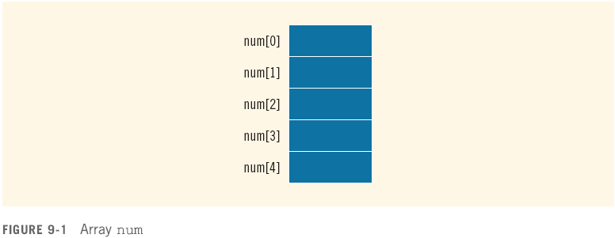
Arrays (continued)
Example:
int num[5];

Slide 8
Accessing Array Components
General syntax:
where indexExp, called an index, is any expression whose value is a nonnegative integer
Index value specifies the position of the component in the array
[] is the array subscripting operator
The array index always starts at 0

Slide 9
Accessing Array Components (continued)

Slide 10
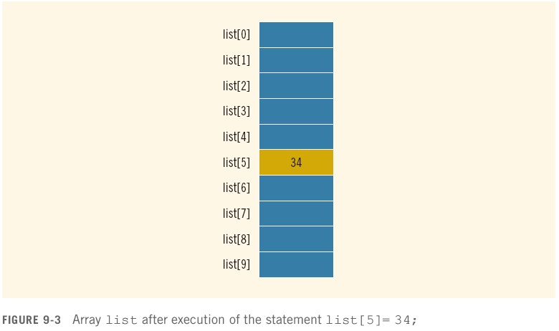
Accessing Array Components (continued)

Slide 11
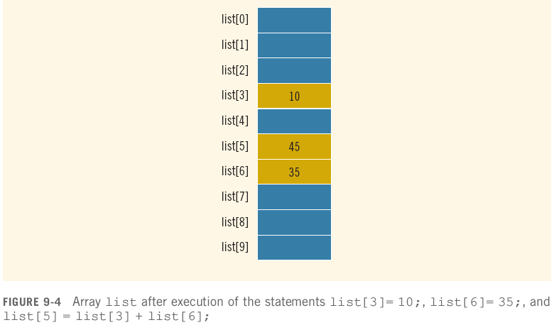
Accessing Array Components (continued)

Slide 12
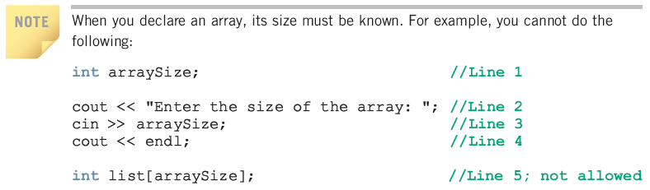
Accessing Array Components (continued)

Slide 13
Working With Arrays of Data
Using arrays, we can:
Allocate all 5 integers at once
Give them a single name
Access them by index
Using arrays together with for loops, we can:
Allocate any number of integers
Give them a single name
Access them by index
Repeat instructions over any number of integers
Usually by using a for loop counter

Slide 14
Processing arrays
For loop is almost always the answer
How do you print an array?
How do you search an array?
How do you copy an array?
Etc…
The for loop counter is used as the array index
To access each element in the array sequentially
for( int i=0; i<length; i++ )
{
cout << some_array[i] << endl;
}
Notice that you have to know the length of the array!

Slide 15
Size, length, count, etc.
Every array has 2 critical numbers associated with it
Maximum Size: how many elements can it store?
Also called size some times
Actual Count: how many valid pieces of data are in it
Also called length, size, count, etc.
(not technical terms)
Every array element always has a value
You can’t really delete anything from an array, only overwrite things
Data is always stored in contiguous elements!
Starting from element 0, no empty spaces
The last valid element is always at index length-1

Slide 16
Summary
Array variables allow you to allocate and name a sequence of values
The elements are accessed by index
Data is stored from element index 0 to element index length-1
This works really well with for loops
If the question involves an array, the answer is usually a for loop!
Computers are really good at counting and repetitive tasks
Arrays allow you, the programmer, to specify things once and allow the computer to do it ten times, a hundred times, a million times…

Slide 17
Exercises
Declare an array of 150 doubles
Declare a constant SIZE and use it in the array declaration
Syntax checks!
(you rarely access individual array elements like this)
Set the 10th element in the array of doubles to 5.6
Print the 10th element
e.g. “The 10th element is 5.6”
assign the 72nd element to the value of the 12th element
Ask the user to enter a value and store it in the 113th element
Set the 43rd – 46th elements to the values 7, 8, 9, 10
Use a for loop!

Slide 18
Exercises
Store 100 copies of the number 50 in your array
Declare an integer length, set it to 100
Set the first length elements to 50
Print all the valid elements in the array
Your answer should use length
Store the numbers 1 through 100 in your array
e.g. first element is 1, second element is 2, etc.
Using a for loop, set the first 10 elements in the array to the value of the last 10 valid elements (in reverse)
e.g. first element ends up with 100, second with 99, etc.

