Slide 1
Supervised Learning

Slide 2
Road Map
Basic concepts
Decision tree induction
Evaluation of classifiers
Rule induction
Classification using association rules
K-nearest neighbor

Slide 3
An example application
An emergency room in a hospital measures 17 variables (e.g., blood pressure, age, etc) of newly admitted patients.
A decision is needed: whether to put a new patient in an intensive-care unit.
Due to the high cost of ICU, those patients who may survive less than a month are given higher priority.
Problem: to predict high-risk patients and discriminate them from low-risk patients.

Slide 4
Another application
A credit card company receives thousands of applications for new cards. Each application contains information about an applicant,
age
Marital status
annual salary
outstanding debts
credit rating
etc.
Problem: to decide whether an application should approved, or to classify applications into two categories, approved and not approved.

Slide 5
Machine learning and our focus
Like human learning from past experiences.
A computer does not have “experiences”.
A computer system learns from data, which represent some “past experiences” of an application domain.
Our focus: learn a target function that can be used to predict the values of a discrete class attribute , e.g., approve or not-approved, and high-risk or low risk.
The task is commonly called: Supervised learning, classification, or inductive learning.
Classification (discrete)
Regression (numeric; continuous)

Slide 6
The data and the goal
Data: A set of data records (also called examples, instances or cases) described by
k attributes: A₁, A₂, … A_{k}.
a class: Each example is labelled with a pre-defined class.
Goal: To learn a classification model from the data that can be used to predict the classes of new (future, or test) cases/instances.
Notes:
Induction is different from deduction and DBMS does not not support induction;
The result of induction is higher-level information or knowledge: general statements about data
There are many approaches. Refer to the lecture notes for CS3244 available at the Co-Op.
We focus on three approaches here, other examples:
Other approaches
Instance-based learning
other neural networks
Concept learning (Version space, Focus, Aq11, …)
Genetic algorithms
Reinforcement learning

Slide 7
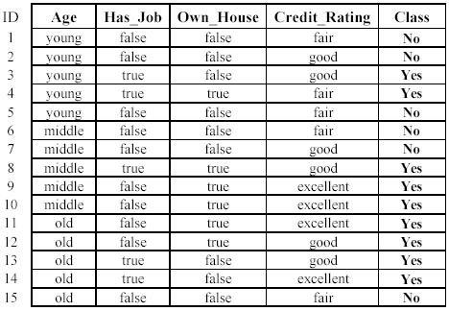
An example: data (loan application)
Approved or not

Slide 8
An example: the learning task
Learn a classification model from the data
Use the model to classify future loan applications into
Yes (approved) and
No (not approved)
What is the class for following case/instance?

Slide 9
Supervised vs. unsupervised Learning
Supervised learning: classification is seen as supervised learning from examples.
Supervision: The data (observations, measurements, etc.) are labeled with pre-defined classes. It is like that a “teacher” gives the classes (supervision).
Test data are classified into these classes too.
Unsupervised learning (clustering)
Class labels of the data are unknown
Given a set of data, the task is to establish the existence of classes or clusters in the data

Slide 10
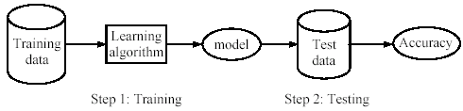
Supervised learning process: two steps
Learning (training): Learn a model using the training data
Testing: Test the model using unseen test data to assess the model accuracy

Slide 11
What do we mean by learning?
Given
a data set D,
a task T and
a performance measure M,
a computer system is said to learn from D to perform the task T if after learning the system’s performance on T improves as measured by M.
In other words, the learned model helps the system to perform T better as compared to no learning.

Slide 12
An example
Data: Loan application data
Task: Predict whether a loan should be approved or not.
Performance measure: accuracy.
No learning: classify all future applications (test data) to the majority class (i.e., Yes):
Accuracy = 9/15 = 60%.
We can do better than 60% with learning.

Slide 13
Fundamental assumption of learning
Assumption: The distribution of training examples is identical to the distribution of test examples (including future unseen examples).
train/test: credit card application information In practice, this assumption is often violated to certain degree.
Strong violations will clearly result in poor classification accuracy.
To achieve good accuracy on the test data, training examples must be sufficiently representative of the test data.

Slide 14
Road Map
Basic concepts
Decision tree induction
Evaluation of classifiers
Rule induction
Classification using association rules
Naïve Bayesian classification
Naïve Bayes for text classification
Support vector machines
K-nearest neighbor
Ensemble methods: Bagging and Boosting
Summary

Slide 15
Introduction
Decision tree learning is one of the most widely used techniques for classification.
Its classification accuracy is competitive with other methods, and
it is very efficient.
The classification model is a tree, called decision tree.
C4.5 (one kind of decision tree) by Ross Quinlan is perhaps the best known system. It can be downloaded from the Web.
(python do the decision tree; weka software application to train and test ML models).

Slide 16
The loan data (reproduced)
Approved or not

Slide 17
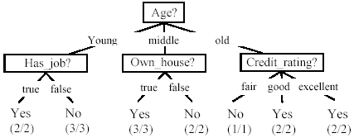
A decision tree from the loan data
Decision nodes and leaf nodes (classes)

Slide 18

Use the decision tree
No

Slide 19
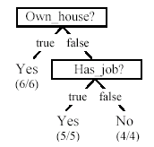
Is the decision tree unique?
No. Here is a simpler tree.
We want smaller tree and accurate tree.
Easy to understand and perform better.
Finding the best tree is NP-hard.
All current tree building algorithms are heuristic algorithms

Slide 20


From a decision tree to a set of rules
A decision tree can be converted to a set of rules
Each path from the root to a leaf is a rule.

Slide 21
Algorithm for decision tree learning
Basic algorithm (a greedy divide-and-conquer algorithm)
Assume attributes/features are categorical now (continuous attributes can be handled too)
Tree is constructed in a top-down recursive manner
At start, all the training examples are at the root
Examples are partitioned recursively based on selected attributes
Attributes are selected on the basis of an impurity function (e.g., information gain)
Conditions for stopping partitioning
All examples for a given node belong to the same class
There are no remaining attributes for further partitioning – majority class is the leaf
There are no examples left

Slide 22
Choose an attribute to partition data
The key to building a decision tree - which attribute to choose in order to branch.
The objective is to reduce impurity or uncertainty in data as much as possible.
A subset of data is pure if all instances belong to the same class.
The heuristic in C4.5 is to choose the attribute with the maximum Information Gain or Gain Ratio based on information theory.

Slide 23
The loan data (reproduced)
Approved or not

Slide 24
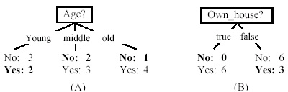
Two possible roots, which is better?
Fig. (B) seems to be better.

Slide 25
Information theory
Information theory provides a mathematical basis for measuring the information content.
To understand the notion of information, think about it as providing the answer to a question, for example, whether a coin will come up heads.
If one already has a good guess about the answer, then the actual answer is less informative.
If one already knows that the coin is rigged so that it will come with heads with probability 0.99, then a message (advanced information) about the actual outcome of a flip is worth less than it would be for a honest coin (50-50).

Slide 26
Information theory (cont …)
For a fair (honest) coin, you have no information, and you are willing to pay more (say in terms of $) for advanced information - less you know, the more valuable the information.
Information theory uses this same intuition, but instead of measuring the value for information in dollars, it measures information contents in bits.
One bit of information is enough to answer a yes/no question about which one has no idea, such as the flip of a fair coin

Slide 27
Information theory: Entropy measure
The entropy formula,
Pr(c_{j}) is the probability of class c_{j} in data set D
We use entropy as a measure of impurity or disorder of data set D. (Or, a measure of information in a tree)

Slide 28
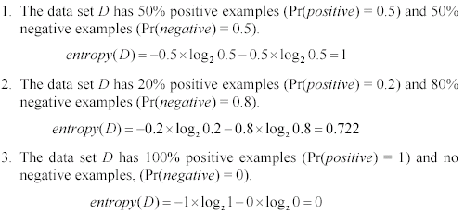
Entropy measure: let us get a feeling
As the data become purer and purer, the entropy value becomes smaller and smaller. This is useful to us!

Slide 29

Information gain
Given a set of examples D, we first compute its entropy:
If we make attribute A_{i}, with v values, the root of the current tree, this will partition D into v subsets D₁, D₂ …, D_{v} . The expected entropy if A_{i} is used as the current root:

Slide 30
Information gain (cont …)
Information gained by selecting attribute A_{i} to branch or to partition the data is
We choose the attribute with the highest gain to branch/split the current tree.

Slide 31
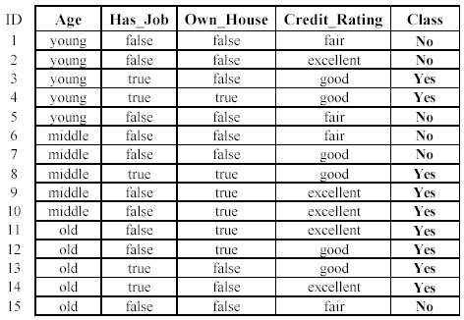

An example
Own_house is the best choice for the root.

Slide 32
An example

Slide 33
We build the final tree
We can use information gain ratio to evaluate the impurity as well (see the handout)

Slide 34
Handling continuous attributes
Handle continuous attribute by splitting into two intervals (can be more) at each node.
How to find the best threshold to divide?
Use information gain or gain ratio again
Sort all the values of an continuous attribute in increasing order {v₁, v₂, …, v_{r}},
Age: {20,30,40,50,60,70,80,99,98,99,101,102}
Age: <= 40; >40 => calculate the entropy:
One possible threshold between two adjacent values v_{i} and v_{i+1}. Try all possible thresholds and find the one that maximizes the gain (or gain ratio/ minimize the entropy)

Slide 35
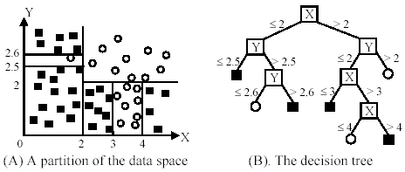
An example in a continuous space

Slide 36
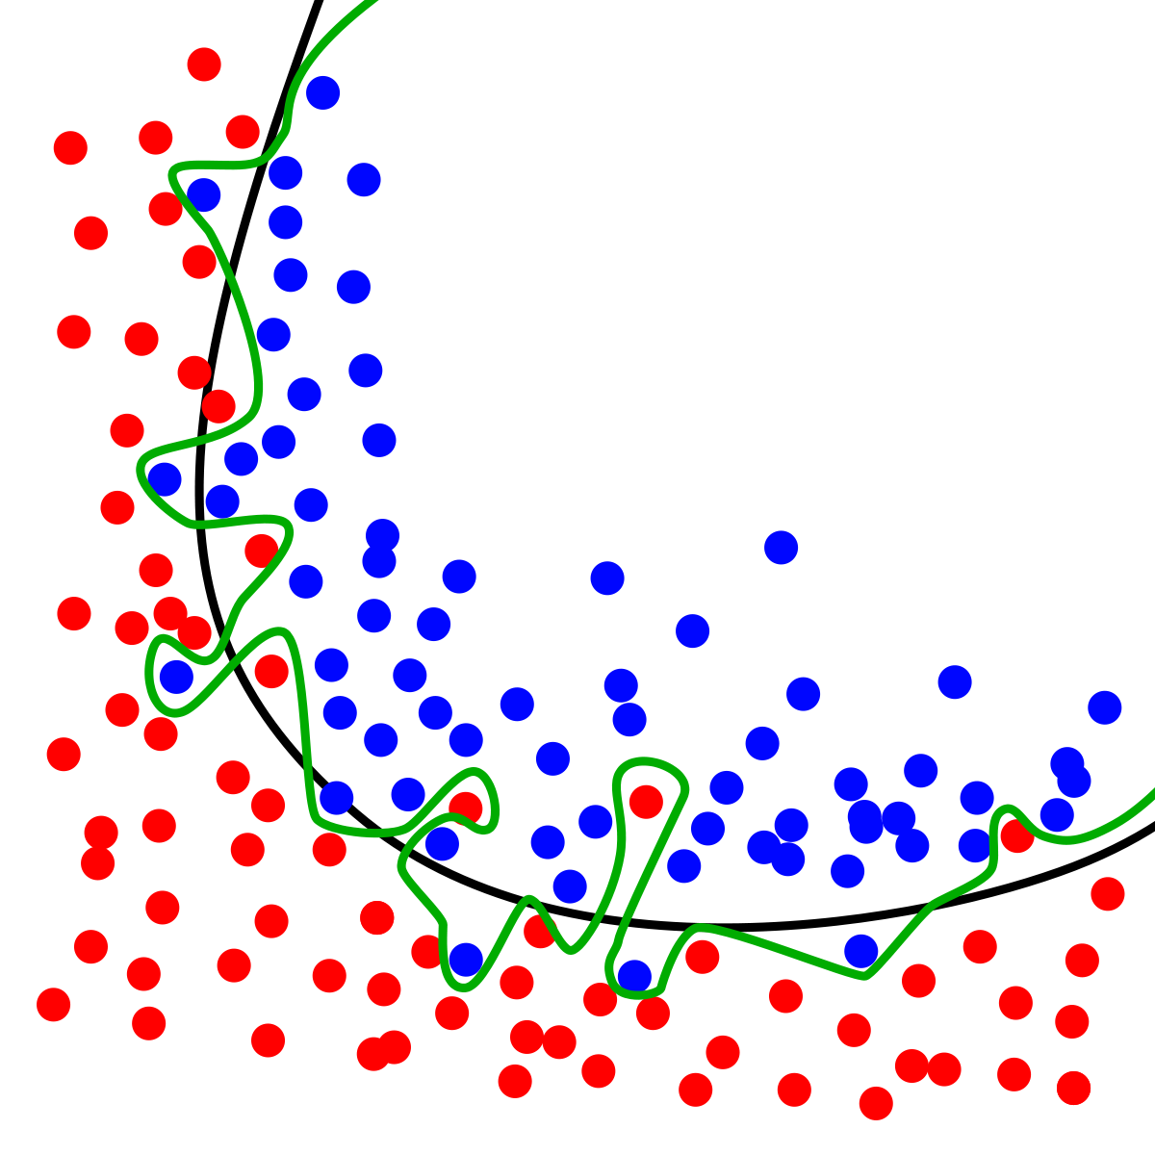

Slide 37
Avoid overfitting in classification
Overfitting: A tree may overfit the training data
Good accuracy on training data but poor on test data
Symptoms: tree too deep and too many branches, some may reflect anomalies due to noise or outliers
Two approaches to avoid overfitting
Pre-pruning: Halt tree construction early
Difficult to decide because we do not know what may happen subsequently if we keep growing the tree.
Post-pruning: Remove branches or sub-trees from a “fully grown (over fitted)” tree.
This method is commonly used. C4.5 uses a statistical method to estimates the errors at each node for pruning.
A validation set may be used for pruning as well.

Slide 38
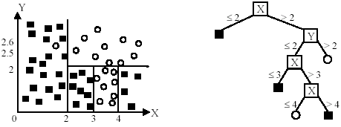
An example
Likely to overfit the data

Slide 39
Other issues in decision tree learning
From tree to rules, and rule pruning
Handling of miss values
Handing skewed distributions
Handling attributes and classes with different costs.
Attribute construction
Etc.

Slide 40
Road Map
Basic concepts
Decision tree induction
Evaluation of classifiers
Rule induction
Classification using association rules
Naïve Bayesian classification
Naïve Bayes for text classification
Support vector machines
K-nearest neighbor
Ensemble methods: Bagging and Boosting
Summary

Slide 41

Evaluating classification methods
Predictive accuracy
Efficiency
time to construct the model
time to use the model
Robustness: handling noise and missing values
Scalability: efficiency in disk-resident databases
Interpretability:
understandable and insight provided by the model
Compactness of the model: size of the tree, or the number of rules.

Slide 42
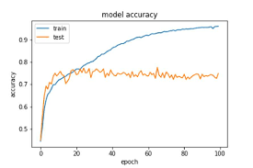

Slide 43
Evaluation methods
Holdout set: The available data set D is divided into two disjoint subsets,
the training set D_{train} (for learning a model)
the test set D_{test} (for testing the model)
Important: training set should not be used in testing and the test set should not be used in learning.
Unseen test set provides a unbiased estimate of accuracy.
The test set is also called the holdout set. (the examples in the original data set D are all labeled with classes.)
This method is mainly used when the data set D is large.

Slide 44
Evaluation methods (cont…)
n-fold cross-validation: The available data is partitioned into n equal-size disjoint subsets.
Use each subset as the test set and combine the rest n-1 subsets as the training set to learn a classifier.
The procedure is run n times, which give n accuracies.
The final estimated accuracy of learning is the average of the n accuracies.
10-fold and 5-fold cross-validations are commonly used.
This method is used when the available data is not large.

Slide 45
Evaluation methods (cont…)
Leave-one-out cross-validation: This method is used when the data set is very small.
It is a special case of cross-validation
Each fold of the cross validation has only a single test example and all the rest of the data is used in training.
If the original data has m examples, this is m-fold cross-validation

Slide 46
Evaluation methods (cont…)
Validation set: the available data is divided into three subsets,
a training set,
a validation set and
a test set.
A validation set is used frequently for estimating parameters in learning algorithms.
In such cases, the values that give the best accuracy on the validation set are used as the final parameter values.
Cross-validation can be used for parameter estimating as well.

Slide 47
Classification measures
Accuracy is only one measure (error = 1-accuracy).
Accuracy is not suitable in some applications.
In text mining, we may only be interested in the documents of a particular topic, which are only a small portion of a big document collection.
In classification involving skewed or highly imbalanced data, e.g., network intrusion and financial fraud detections, we are interested only in the minority class.
High accuracy does not mean any intrusion is detected.
E.g., 1% intrusion. Achieve 99% accuracy by doing nothing.
The class of interest is commonly called the positive class, and the rest negative classes.

Slide 48
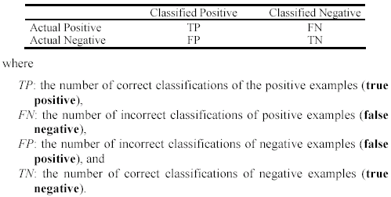
Precision and recall measures
Used in information retrieval and text classification.
We use a confusion matrix to introduce them.

Slide 49

Precision and recall measures (cont…)
Precision p is the number of correctly classified positive examples divided by the total number of examples that are classified as positive.
Recall r is the number of correctly classified positive examples divided by the total number of actual positive examples in the test set.

Slide 50

An example
This confusion matrix gives
precision p = 100% and
recall r = 1%
because we only classified one positive example correctly and no negative examples wrongly.
Note: precision and recall only measure classification on the positive class.

Slide 51
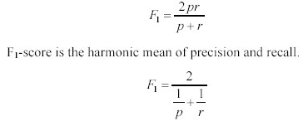
F₁-value (also called F₁-score)
It is hard to compare two classifiers using two measures. F₁ score combines precision and recall into one measure
The harmonic mean of two numbers tends to be closer to the smaller of the two.
For F₁-value to be large, both p and r much be large.

Slide 52


Receive operating characteristics curve
It is commonly called the ROC curve.
It is a plot of the true positive rate (TPR) against the false positive rate (FPR).
True positive rate:
False positive rate:

Slide 53


Sensitivity and Specificity
In statistics, there are two other evaluation measures:
Sensitivity: Same as TPR
Specificity: Also called True Negative Rate (TNR)
Then we have

Slide 54
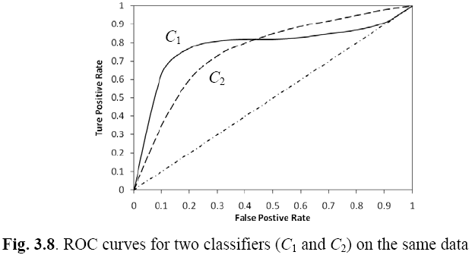
Example ROC curves

Slide 55
Area under the curve (AUC)
Which classifier is better, C₁ or C₂?
It depends on which region you talk about.
Can we have one measure?
Yes, we compute the area under the curve (AUC)
If AUC for C_{i} is greater than that of C_{j}, it is said that C_{i} is better than C_{j}.
If a classifier is perfect, its AUC value is 1
If a classifier makes all random guesses, its AUC value is 0.5.

Slide 56
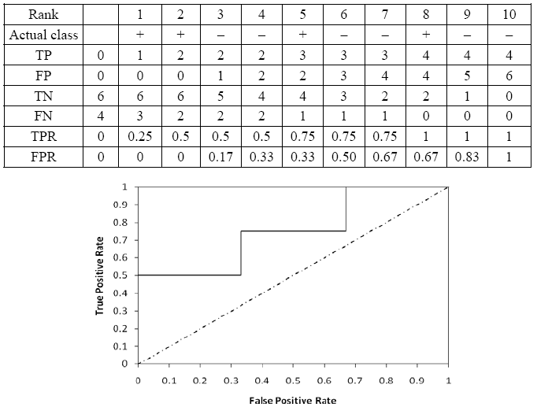
Drawing an ROC curve

Slide 57
Another evaluation method: Scoring and ranking
Scoring is related to classification.
We are interested in a single class (positive class), e.g., buyers class in a marketing database.
Instead of assigning each test instance a definite class, scoring assigns a probability estimate (PE) to indicate the likelihood that the example belongs to the positive class.

Slide 58
Ranking and lift analysis
After each example is given a PE score, we can rank all examples according to their PEs.
We then divide the data into n (say 10) bins. A lift curve can be drawn according how many positive examples are in each bin. This is called lift analysis.
Classification systems can be used for scoring. Need to produce a probability estimate.
E.g., in decision trees, we can use the confidence value at each leaf node as the score.

Slide 59
An example
We want to send promotion materials to potential customers to sell a watch.
Each package cost $0.50 to send (material and postage).
If a watch is sold, we make $5 profit.
Suppose we have a large amount of past data for building a predictive/classification model. We also have a large list of potential customers.
How many packages should we send and who should we send to?

Slide 60
An example
Assume that the test set has 10000 instances. Out of this, 500 are positive cases.
After the classifier is built, we score each test instance. We then rank the test set, and divide the ranked test set into 10 bins.
Each bin has 1000 test instances.
Bin 1 has 210 actual positive instances
Bin 2 has 120 actual positive instances
Bin 3 has 60 actual positive instances
…
Bin 10 has 5 actual positive instances

Slide 61
Lift curve
Bin 1 2 3 4 5 6 7 8 9 10

