Slide 1
mining for Internet of Things Data
Beiyu Lin

Slide 2
Course Information
Outline: https://beiyulincs.github.io/teach/spring_22/iot.html
Syllabus: https://beiyulincs.github.io/teach/spring_22/syllabus_cs_789.pdf
Notes:
Data science is the application of computational and statistical techniques to address or gain insight into some problem in the real world.
Computational
Statisticals
Real world problems

Slide 3
Outline
What is IoT?
What is IoT Data?
Why IoT is important?
Data Learning and its Applications
Real Life Examples

Slide 4
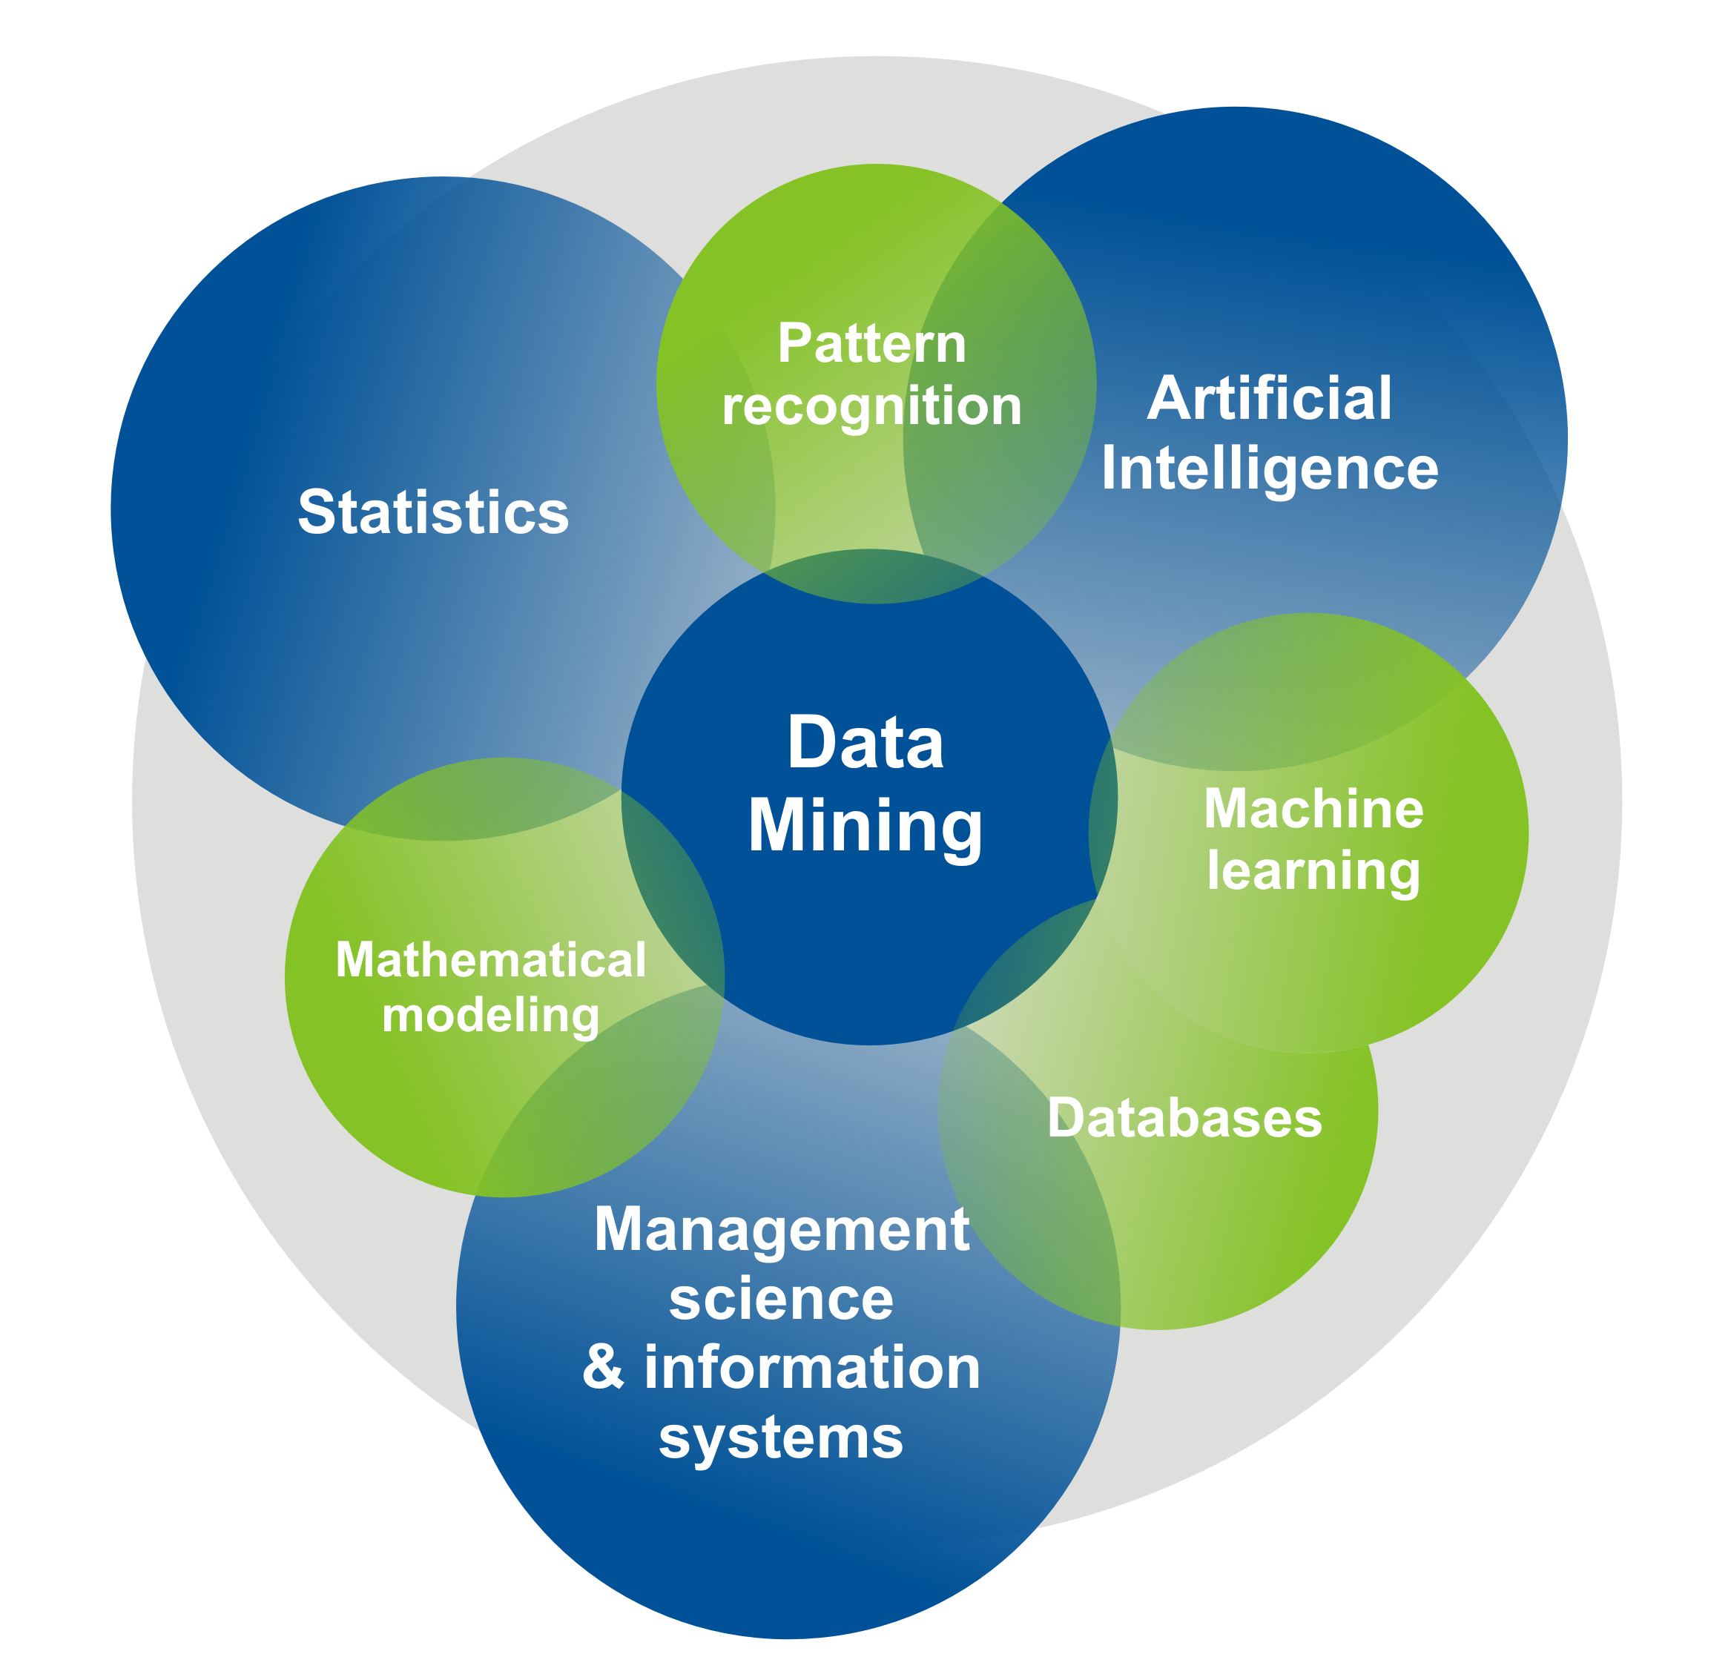

What is IOT?
Notes:
Data science is the application of computational and statistical techniques to address or gain insight into some problem in the real world.
Computational
Statisticals
Real world problems

Slide 5

What is Data mining
The process of discovering meaningful new
Correlations
Patterns
Trends
By learning from large amounts of stored data
Via
Pattern recognition
Statistical
Mathematical
Machine learning methods

Slide 6
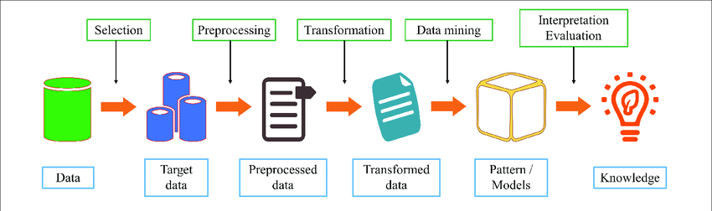
Data mining process

Slide 7
What is data mining
Data mining (knowledge discovery from data (KDD))
– Extraction of interesting (non-trivial, implicit, previously unknown and potentially useful) patterns or knowledge from huge amount of data
– Data mining: a misnomer (outliner)?
• Alternative names
– Knowledge discovery in data,
– knowledge extraction,
– data/pattern analysis,
– data archeology,
– data dredging, information harvesting, business intelligence, etc.

Slide 8
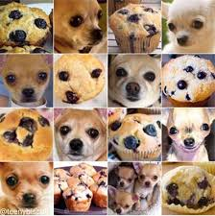

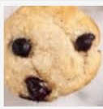
Data Mining in real life
Image Classification
Notes:
Data science is the application of computational and statistical techniques to address or gain insight into some problem in the real world.
Computational
Statisticals
Real world problems

Slide 9



Data Mining in real life
Document Categorization
Speech Recognition
Protein Classification
Fraud Detection
Playing Games
Spam Detection
Notes:
Data science is the application of computational and statistical techniques to address or gain insight into some problem in the real world.
Computational
Statisticals
Real world problems

Slide 10

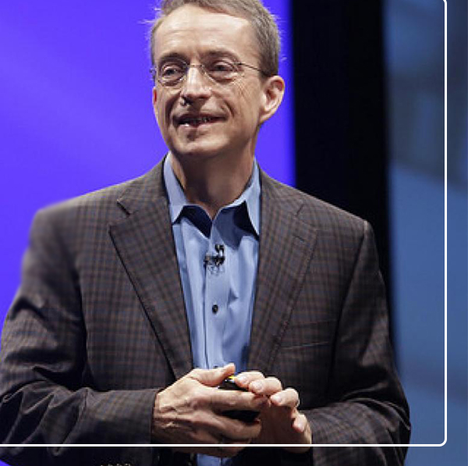
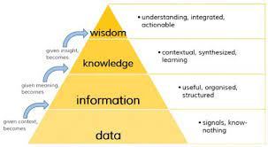
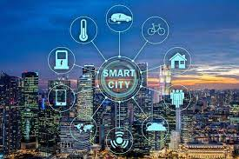
Why Data Mining
“The world is one big data problem.”
(by Andrew McAfee, co-director of the MIT Initiative)
“Data is the new science. Big Data holds the answers.” (Pat Gelsinger, CEO, VMWare)
transforming raw data into useful knowledge
Notes:
Data science is the application of computational and statistical techniques to address or gain insight into some problem in the real world.
Computational
Statisticals
Real world problems

Slide 11
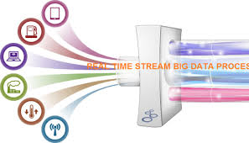
Why DATA mINING
Data analysis and decision support
– Market analysis and management
• Target marketing, customer relationship management (CRM), market basket analysis, cross selling, market segmentation
– Risk analysis and management
• Forecasting, customer retention, improved underwriting, quality control, competitive analysis
– Fraud detection and detection of unusual patterns (outliers)
Other Applications
– Text mining (news group, email, documents) and Web mining
– Stream data mining
– DNA and bio-data analysis
Notes:
Data science is the application of computational and statistical techniques to address or gain insight into some problem in the real world.
Computational
Statisticals
Real world problems

Slide 12
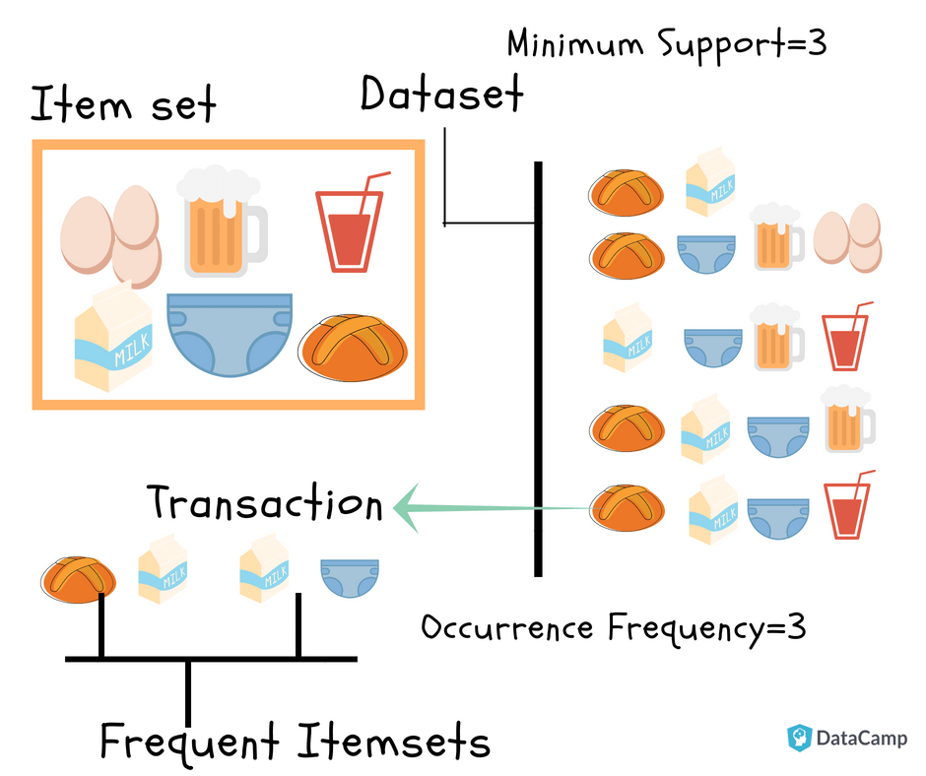
Data mining algorithms
Association rule
Categorization (supervised learning)
Clustering (unsupervised learning)
Mining Internet of Things (IoT) data

Slide 13

Association rule

Slide 14
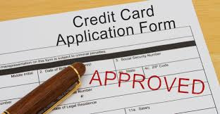

Supervised Classification
Decide whom credit card application should be approved.
Goal: use a person’s information seen so far to produce good prediction rule
for future applications.

Slide 15
Models – supervised Learning
Learn a classification model from the data
Use the model to classify future loan applications into
Yes (approved) and
No (not approved)
What is the class for following case/instance?

Slide 16
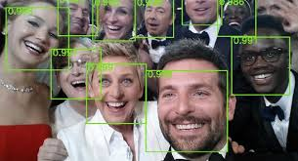
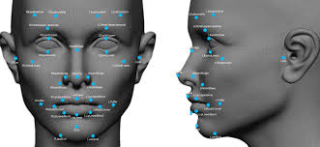
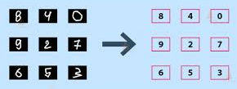
Models – supervised Learning (image classification)
Face Detection and Recognition
Handwritten digit recognition (convert hand-written digits to characters 0..9)

Slide 17
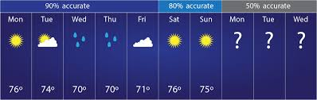
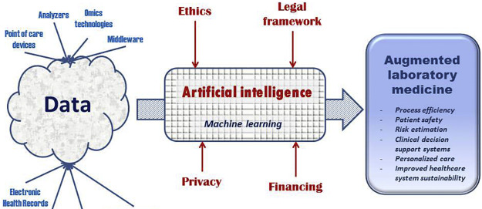
Models – supervised Learning (Other Examples)
Weather Prediction
Medicine
Computational Economics:
– predict if a stock will rise or fall
– predict if a user will click on an ad or not
• in order to decide which ad to show

Slide 18
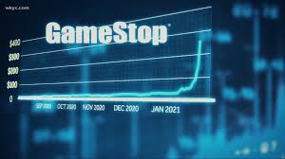
Models – supervised Learning (Regression)
Regression: Predicting a numeric value
Stock market
Weather prediction

Slide 19
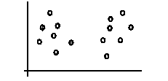
Models – unsupervised learning (clustering)

Slide 20
Thank you!

