Slide 1
Review
For example, storing the number 4 (an integer) is a two-step process:
First, allocate memory by declaring a variable of type integer
int my_variable;
Then, assign it the piece of data
My_variable = 4;
We say that my_variable has the value 4

Slide 2
Main Memory Organization
Bit
Smallest piece of memory
Stands for binary digit
Has values 0 (off) or 1 (on)
Byte
Is 8 consecutive bits
Integer
Usually 4 consecutive bytes
Has an address
4 bytes = 32 bits
8 bits
0 1 1 0 0 1 1 1
1 byte

Slide 3
Data Storage
All data is stored in binary bits in main memory
The meaning of a set of bits depends on the encoding
Encoding determines the length of a meaningful chunk
We use bytes (8-bits) as our most common unit
Encoding also determines how those bits should be read
8-bit Binary | 8-bit Integer | 8-bit Character (ASCII)
0100 0001 | 65 | ‘A’ (1 byte = 8 bites)
0100 0010 | 66 | ‘B’
0100 0011 | 67 | ‘C’

Slide 4
Simple Data Types
Data type: set of values together with a set of operations
C++ data types fall into three categories:

Slide 5
Simple Data Types
Three categories of simple data
Integral: integers (numbers without a decimal)
Floating-point: decimal numbers
Enumeration type: user-defined data type

Slide 6
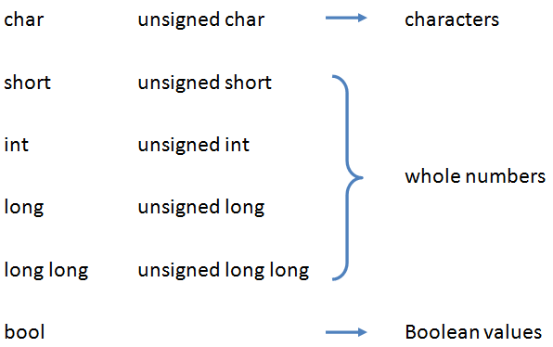
Simple Data Types (continued)
Integral data types are further classified into the following categories:

Slide 7
int Data Type
Examples:
-6728
0
78
+763
Positive integers do not need a + sign
No commas are used within an integer
Commas are used for separating items in a list
Personal banker: 100,000

Slide 8
char Data Type
The smallest integral data type
Used for characters: letters, digits, and special symbols ( 1 byte = 8 bites)
Each character is enclosed in single quotes
'A', 'a', '0', '*', '+', '$', '&',' '
A blank space is a character
char a;
a = ‘ ’;

Slide 9
bool Data Type
bool type
Two values: true and false
Manipulate logical (Boolean) expressions
true and false are called logical values
bool, true, and false are reserved words

Slide 10
Simple Data Types
Different compilers may allow different ranges of values
4*8=32 bits
1 or 0 (one char): 8 bits
8 bits

Slide 11
Floating-Point Data Types
C++ uses scientific notation to represent real numbers (floating-point notation)
Scientific notation for math:
75.924 <=> 7.5924X10 ⬄ 7.5924XE1; 100 ⬄ E2; 0.1 ⬄ 10^{-1} ⬄ E-1

Slide 12
Floating-Point Data Types (continued)
float: represents any real number
Range: -3.4E+38 to 3.4E+38 (four bytes)
double: represents any real number
Range: -1.7E+308 to 1.7E+308 (eight bytes)
On most newer compilers, data types double and long double are same

Slide 13
Floating-Point Data Types (continued)
Maximum number of significant digits (decimal places) for float values is 6 or 7
Maximum number of significant digits for double is 15
Precision: maximum number of significant digits
Float values are called single precision
Double values are called double precision

Slide 14
Arithmetic Operators
C++ arithmetic operators:
+, -, *, and / can be used with integral and floating-point data types
% can be used with integral data types only
Not:3.5 % 2
These are binary operators
They operate on 2 operands
+ | Addition
- | Subtraction
* | Multiplication
/ | Division
% | Modulus

Slide 15
Order of Precedence
All operations inside of () are evaluated first
*, /, and % are at the same level of precedence and are evaluated next
+ and – have the same level of precedence and are evaluated last
When operators are on the same level
Performed from left to right (associativity)
3 * 7 - 6 + 2 * 5 / 4 + 6 means
(((3 * 7) – 6) + ((2 * 5) / 4 )) + 6

Slide 16
Overflow and Underflow
Occurs when assigning a value that is too large (overflow) or too small (underflow) to be held in a variable
Variable contains value that is ‘wrapped around’ the set of possible values

Slide 17
Overflow Example
// Create a short int initialized to
// the largest value it can hold
// [-32767, 32767]
short int num = 32767;
cout << num; // Displays 32767
num = num + 1;
cout << num; // Displays -32768
Notes:
See pr3-10.cpp

Slide 18
Handling Overflow and Underflow
Different systems handle the problem differently. They may
display a warning / error message
display a dialog box and ask what to do
stop the program
continue execution with the incorrect value
Notes:
See pr3-11.cpp

Slide 19
Expressions
Entire expression is evaluated according to precedence rules
If all operands are integers
Expression is called an integral expression
Yields an integral result
Example: 2 + 3 * 5
If all operands are floating-point
Expression is called a floating-point expression
Yields a floating-point result
Example: 12.8 * 17.5 - 34.50

Slide 20
Mixed Expressions
Mixed expression:
Has operands of different data types
Contains integers and floating-point
Examples of mixed expressions:
2 + 3.5
6 / 4 + 3.9 = 1 + 3. 9 = 4. 9
5.4 * 2 – 13.6 + 18 / 2

Slide 21
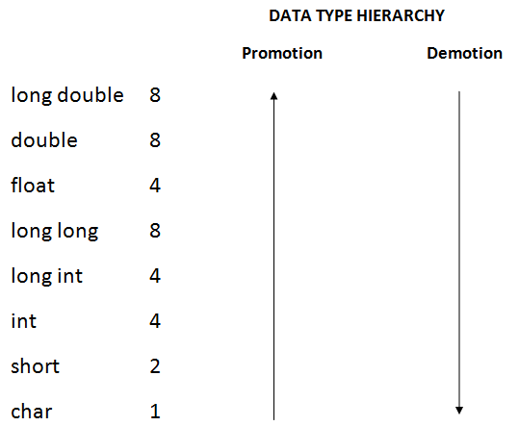
Mixed Expressions (cont'd.)
Data types are ranked by largest value they can hold

Slide 22
Mixed Expressions (cont'd.)
Evaluation rules:
If expression has different types of operands
char, short, unsigned short are automatically promoted to int
All operands are promoted to the data type with the highest rank in the expression
When using the = operator, the type of the expression on right will be converted to type of the variable on left (promotion or demotion)

Slide 23
Data Types and Conversion
The data type assigned to a literal or variable tells the computer how it is encoded
That is, how to interpret it
You can also tell the computer to treat a literal or variable with a different encoding
This is called type casting or type coercion
static_cast<dataTypeName>( expression )

Slide 24
Rounding off a number
Suppose we need to round a real number to the nearest hundredth (2 decimal digits), we could do it by using the following procedure:
Number to be rounded off: 2.3449
Move decimal point 2 places to the right -> 2.3449 * 100.0 => 234.49
Add 0.5 -> 234.49 + 0.5 => 234.99
Round the result downward (get the largest
integral value that is not greater than the result -> => 234.0
Divide it by 100.0 -> 234.0 / 100.0 => 2.34
Suppose we have a value in a variable called length (type double) and we want to round it off, we could use the following expression to implement the steps shown above:
length =
floor(
(length
* 100.0)
)
+ 0.5
/100.0

