Slide 1
Supervised Learning

Slide 2
Road Map
Basic concepts
Decision tree induction
Evaluation of classifiers
Rule induction
Classification using association rules
Naïve Bayesian classification
Naïve Bayes for text classification
Support vector machines
K-nearest neighbor
Ensemble methods: Bagging and Boosting
Summary

Slide 3
An example application
An emergency room in a hospital measures 17 variables (e.g., blood pressure, age, etc) of newly admitted patients.
A decision is needed: whether to put a new patient in an intensive-care unit.
Due to the high cost of ICU, those patients who may survive less than a month are given higher priority.
Problem: to predict high-risk patients and discriminate them from low-risk patients.

Slide 4
Another application
A credit card company receives thousands of applications for new cards. Each application contains information about an applicant,
  age
  Marital status
  annual salary
  outstanding debts
  credit rating
  etc.
Problem: to decide whether an application should approved, or to classify applications into two categories, approved and not approved.

Slide 5
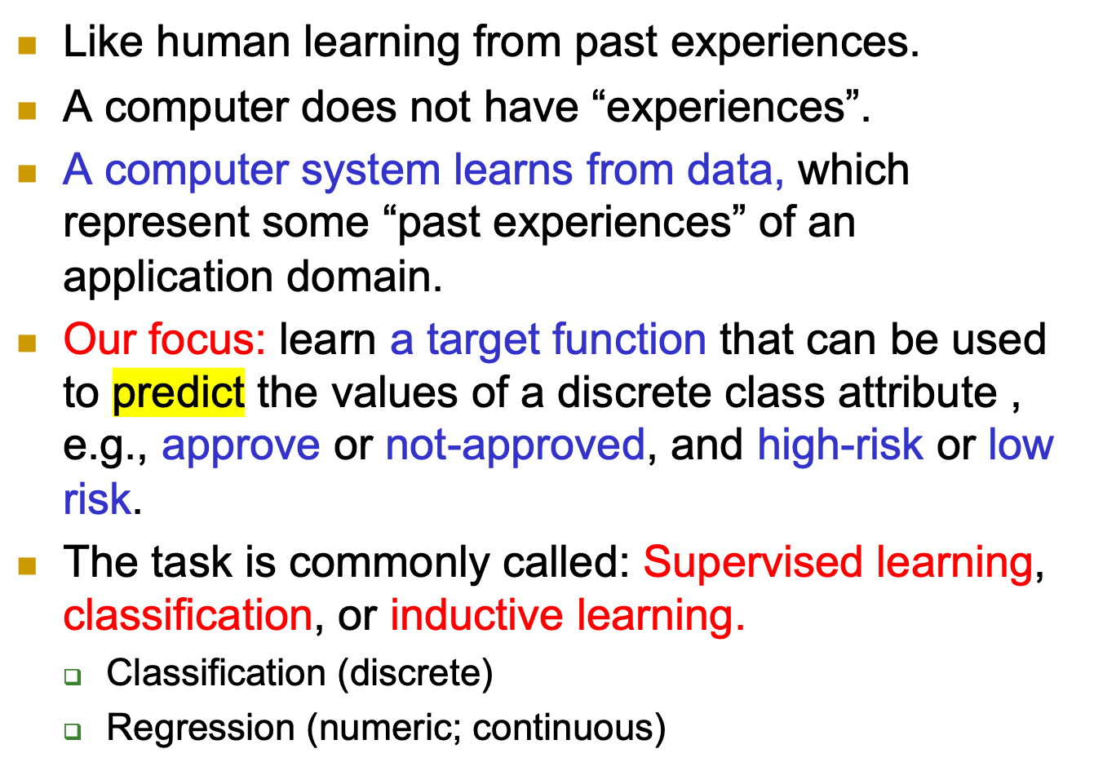
Machine learning and our focus

Slide 6
The data and the goal
Data: A set of data records (also called examples, instances or cases) described by
  k attributes: A₁, A₂, … A_{k}.
  a class: Each example is labelled with a pre-defined class.
Goal: To learn a classification model from the data that can be used to predict the classes of new (future, or test) cases/instances.
Notes:
Induction is different from deduction and DBMS does not not support induction;
The result of induction is higher-level information or knowledge: general statements about data
There are many approaches. Refer to the lecture notes for CS3244 available at the Co-Op.
We focus on three approaches here, other examples:
Other approaches
Instance-based learning
other neural networks
Concept learning (Version space, Focus, Aq11, …)
Genetic algorithms
Reinforcement learning

Slide 7
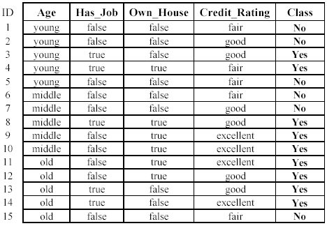
An example: data (loan application)
Approved or not

Slide 8
An example: the learning task
Learn a classification model from the data
Use the model to classify future loan applications into
  Yes (approved) and
  No (not approved)
What is the class for following case/instance?

Slide 9
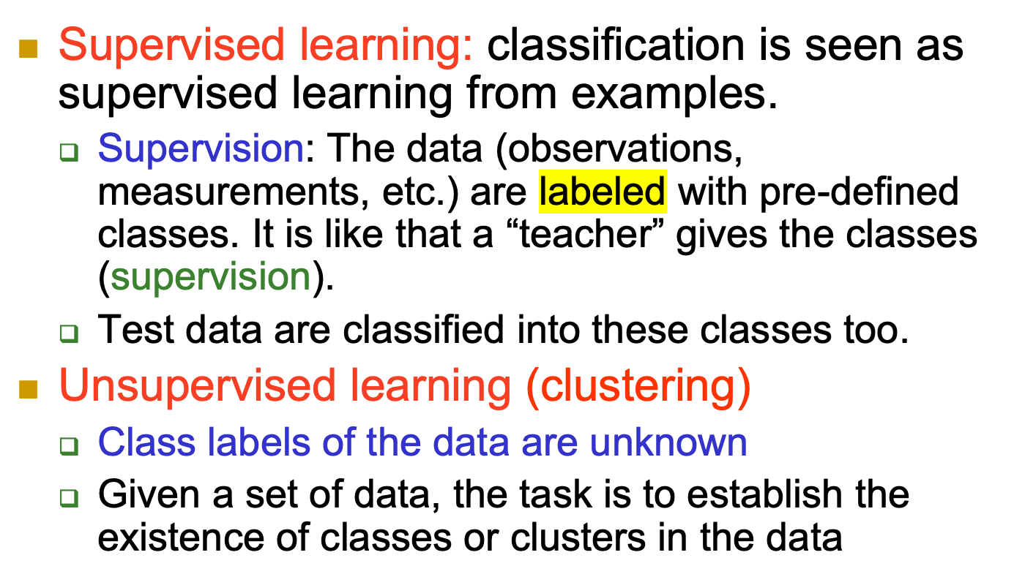
Supervised vs. unsupervised Learning

Slide 10
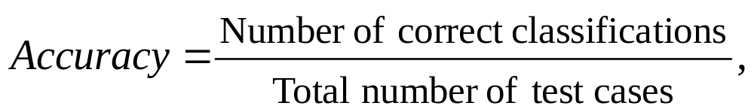
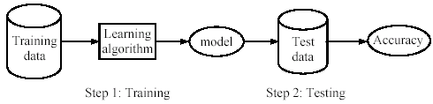
Supervised learning process: two steps
Learning (training): Learn a model using the training data
Testing: Test the model using unseen test data to assess the model accuracy

Slide 11
What do we mean by learning?
Given
  a data set D,
  a task T and
  a performance measure M,
a computer system is said to learn from D to perform the task T if after learning the system’s performance on T improves as measured by M.
In other words, the learned model helps the system to perform T better as compared to no learning.

Slide 12
An example
Data: Loan application data
Task: Predict whether a loan should be approved or not.
Performance measure: accuracy.
No learning: classify all future applications (test data) to the majority class (i.e., Yes):
Accuracy = 9/15 = 60%.
We can do better than 60% with learning.

Slide 13
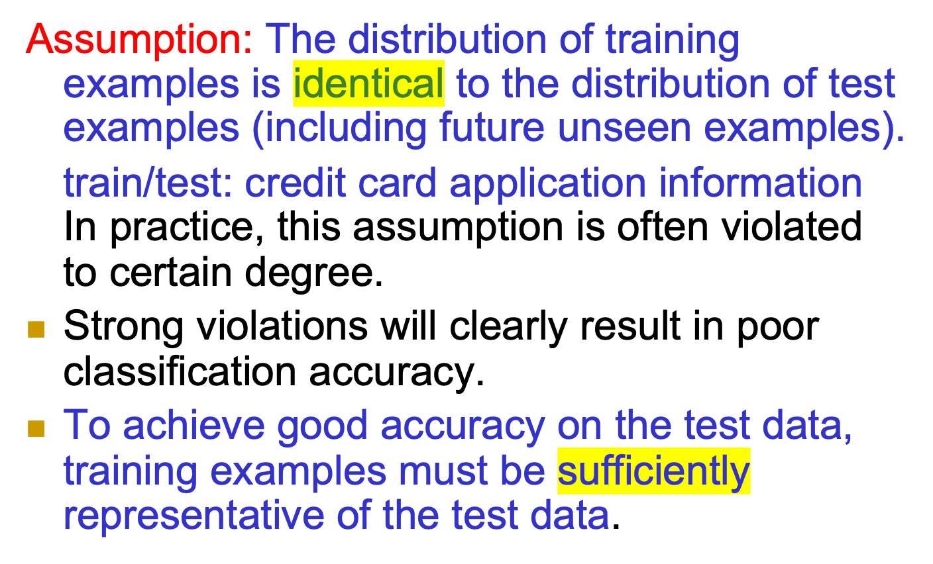
Fundamental assumption of learning

Slide 14
Road Map
Basic concepts
Decision tree induction
Evaluation of classifiers
Rule induction
Classification using association rules
Naïve Bayesian classification
Naïve Bayes for text classification
Support vector machines
K-nearest neighbor
Ensemble methods: Bagging and Boosting
Summary

Slide 15
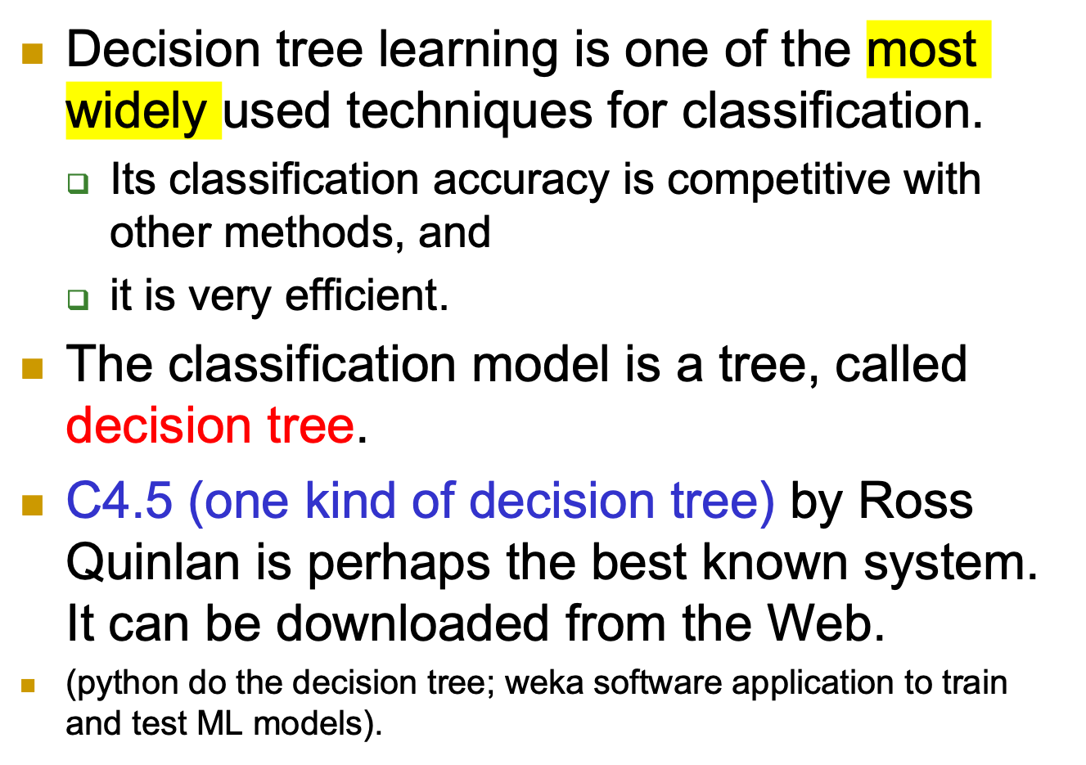
Introduction

Slide 16
The loan data (reproduced)
Approved or not

Slide 17
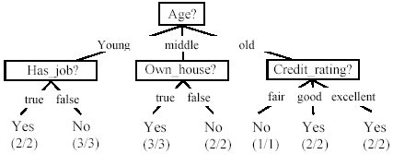
A decision tree from the loan data
Decision nodes and leaf nodes (classes)

Slide 18
Use the decision tree
No

Slide 19
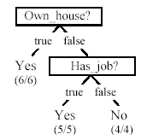
Is the decision tree unique?
No. Here is a simpler tree.
We want smaller tree and accurate tree.
  Easy to understand and perform better.
Finding the best tree is NP-hard.
All current tree building algorithms are heuristic algorithms

Slide 20

From a decision tree to a set of rules
A decision tree can be converted to a set of rules
Each path from the root to a leaf is a rule.

Slide 21
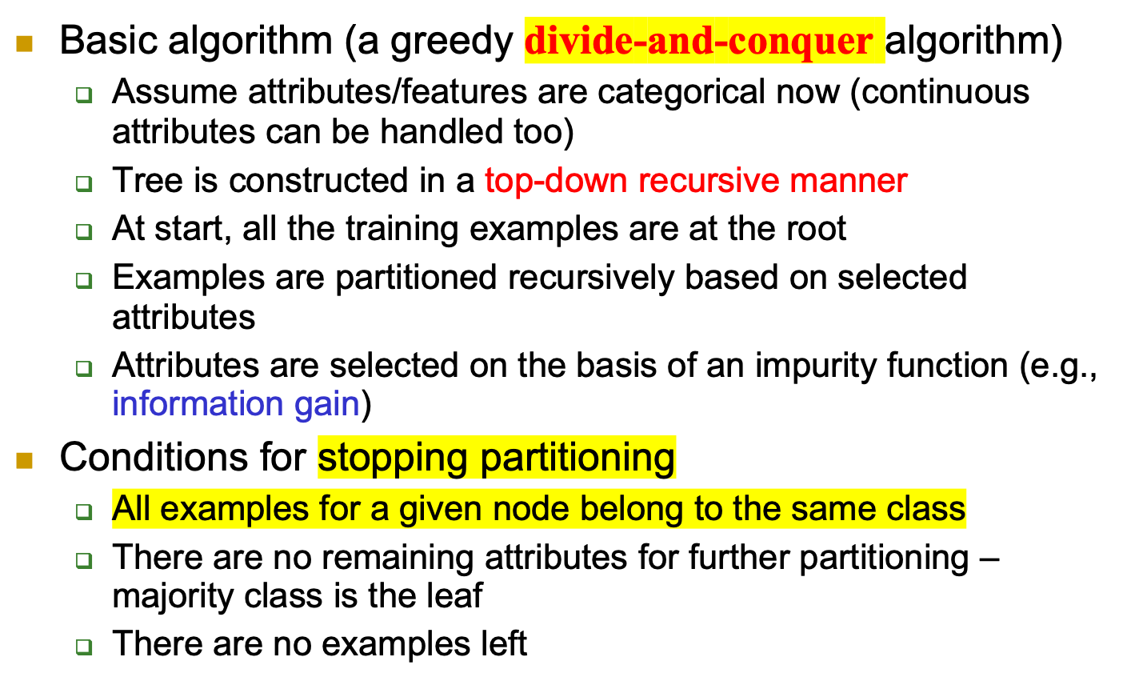
Algorithm for decision tree learning

Slide 22
Choose an attribute to partition data
The key to building a decision tree - which attribute to choose in order to branch.
The objective is to reduce impurity or uncertainty in data as much as possible.
  A subset of data is pure if all instances belong to the same class.
The heuristic in C4.5 is to choose the attribute with the maximum Information Gain or Gain Ratio based on information theory.

Slide 23
The loan data (reproduced)
Approved or not

Slide 24
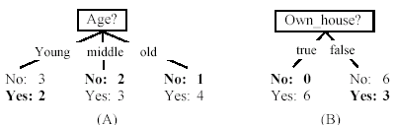
Two possible roots, which is better?
Fig. (B) seems to be better.

Slide 25
Information theory
Information theory provides a mathematical basis for measuring the information content.
To understand the notion of information, think about it as providing the answer to a question, for example, whether a coin will come up heads.
  If one already has a good guess about the answer, then the actual answer is less informative.
  If one already knows that the coin is rigged so that it will come with heads with probability 0.99, then a message (advanced information) about the actual outcome of a flip is worth less than it would be for a honest coin (50-50).

Slide 26
Information theory (cont …)
For a fair (honest) coin, you have no information, and you are willing to pay more (say in terms of $) for advanced information - less you know, the more valuable the information.
Information theory uses this same intuition, but instead of measuring the value for information in dollars, it measures information contents in bits.
One bit of information is enough to answer a yes/no question about which one has no idea, such as the flip of a fair coin

Slide 27
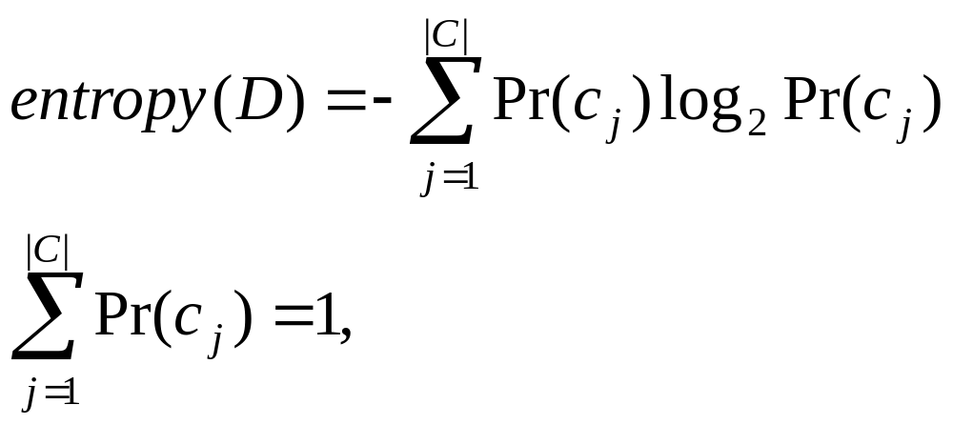
Information theory: Entropy measure
The entropy formula,
Pr(c_{j}) is the probability of class c_{j} in data set D
We use entropy as a measure of impurity or disorder of data set D. (Or, a measure of information in a tree)

Slide 28
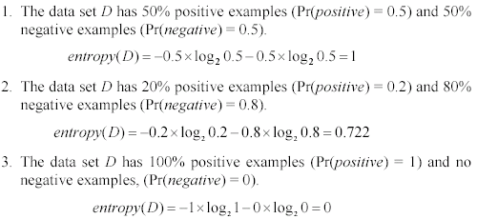
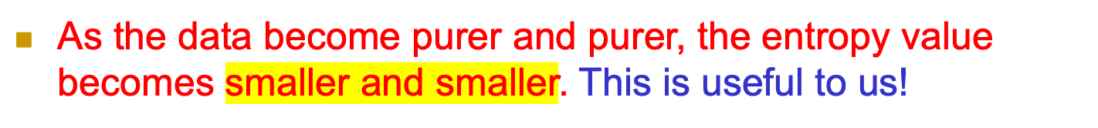
Entropy measure: let us get a feeling

Slide 29

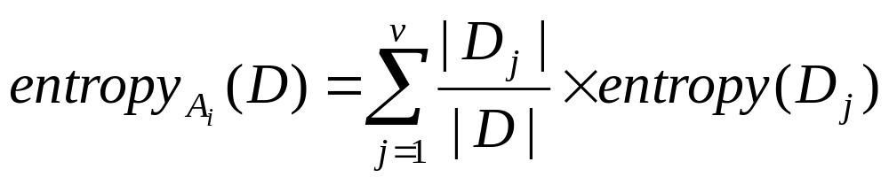
Information gain
Given a set of examples D, we first compute its entropy:
If we make attribute A_{i}, with v values, the root of the current tree, this will partition D into v subsets D₁, D₂ …, D_{v} . The expected entropy if A_{i} is used as the current root:

Slide 30
Information gain (cont …)
Information gained by selecting attribute A_{i} to branch or to partition the data is
We choose the attribute with the highest gain to branch/split the current tree.

Slide 31
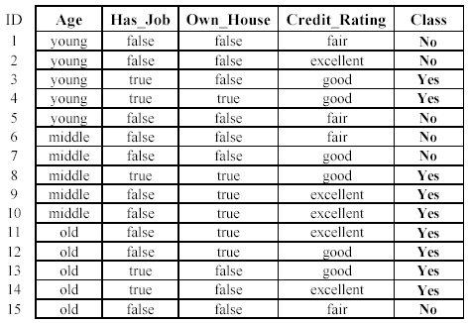
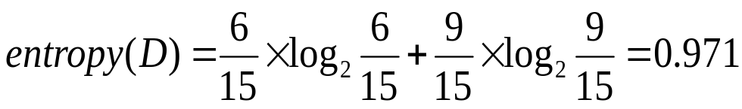
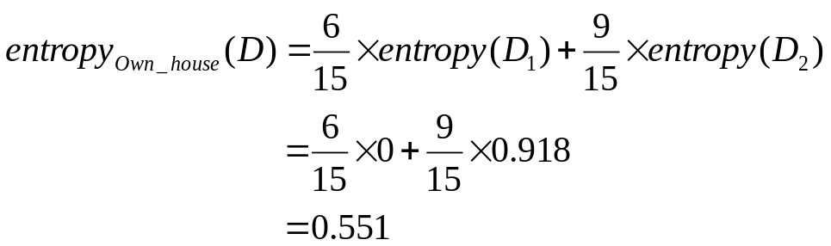
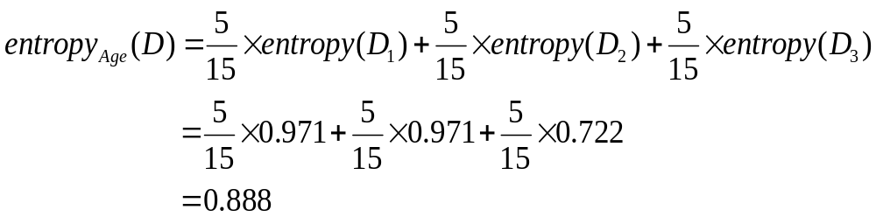
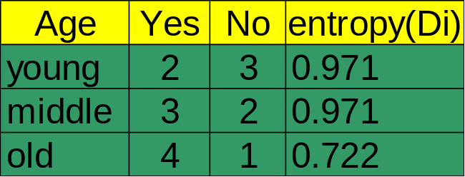

An example
Own_house is the best choice for the root.

Slide 32
An example

Slide 33
We build the final tree
We can use information gain ratio to evaluate the impurity as well (see the handout)

Slide 34
Handling continuous attributes
Handle continuous attribute by splitting into two intervals (can be more) at each node.
How to find the best threshold to divide?
  Use information gain or gain ratio again
  Sort all the values of an continuous attribute in increasing order {v₁, v₂, …, v_{r}},
  Age: {20,30,40,50,60,70,80,99,98,99,101,102}
  Age: <= 40; >40 => calculate the entropy:
  One possible threshold between two adjacent values v_{i} and v_{i+1}. Try all possible thresholds and find the one that maximizes the gain (or gain ratio/ minimize the entropy)

Slide 35
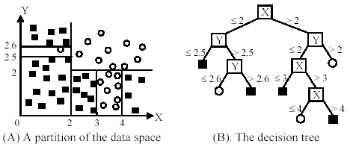
An example in a continuous space

Slide 36
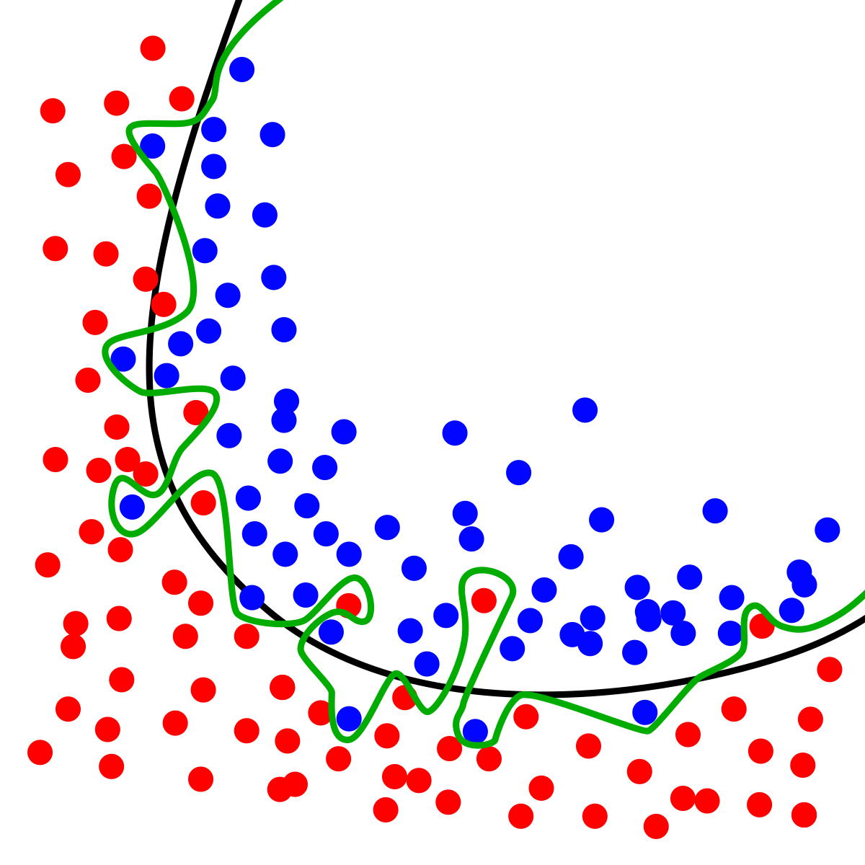

Slide 37
Avoid overfitting in classification
Overfitting: A tree may overfit the training data
  Good accuracy on training data but poor on test data
  Symptoms: tree too deep and too many branches, some may reflect anomalies due to noise or outliers
Two approaches to avoid overfitting
  Pre-pruning: Halt tree construction early
    Difficult to decide because we do not know what may happen subsequently if we keep growing the tree.
  Post-pruning: Remove branches or sub-trees from a “fully grown (over fitted)” tree.
    This method is commonly used. C4.5 uses a statistical method to estimates the errors at each node for pruning.
    A validation set may be used for pruning as well.

Slide 38
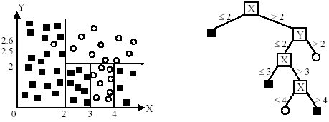
An example
Likely to overfit the data

Slide 39
Other issues in decision tree learning
From tree to rules, and rule pruning
Handling of miss values
Handing skewed distributions
Handling attributes and classes with different costs.
Attribute construction
Etc.

Slide 40
Road Map
Basic concepts
Decision tree induction
Evaluation of classifiers
Rule induction
Classification using association rules
Naïve Bayesian classification
Naïve Bayes for text classification
Support vector machines
K-nearest neighbor
Ensemble methods: Bagging and Boosting
Summary

Slide 41

Evaluating classification methods
Predictive accuracy
Efficiency
  time to construct the model
  time to use the model
Robustness: handling noise and missing values
Scalability: efficiency in disk-resident databases
Interpretability:
  understandable and insight provided by the model
Compactness of the model: size of the tree, or the number of rules.

Slide 42
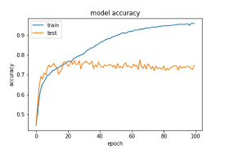

Slide 43
Evaluation methods
Holdout set: The available data set D is divided into two disjoint subsets,
  the training set D_{train} (for learning a model)
  the test set D_{test} (for testing the model)
Important: training set should not be used in testing and the test set should not be used in learning.
  Unseen test set provides a unbiased estimate of accuracy.
The test set is also called the holdout set. (the examples in the original data set D are all labeled with classes.)
This method is mainly used when the data set D is large.

Slide 44
Evaluation methods (cont…)
n-fold cross-validation: The available data is partitioned into n equal-size disjoint subsets.
Use each subset as the test set and combine the rest n-1 subsets as the training set to learn a classifier.
The procedure is run n times, which give n accuracies.
The final estimated accuracy of learning is the average of the n accuracies.
10-fold and 5-fold cross-validations are commonly used.
This method is used when the available data is not large.

Slide 45
Evaluation methods (cont…)
Leave-one-out cross-validation: This method is used when the data set is very small.
It is a special case of cross-validation
Each fold of the cross validation has only a single test example and all the rest of the data is used in training.
If the original data has m examples, this is m-fold cross-validation

Slide 46
Evaluation methods (cont…)
Validation set: the available data is divided into three subsets,
  a training set,
  a validation set and
  a test set.
A validation set is used frequently for estimating parameters in learning algorithms.
In such cases, the values that give the best accuracy on the validation set are used as the final parameter values.
Cross-validation can be used for parameter estimating as well.

Slide 47
Classification measures
Accuracy is only one measure (error = 1-accuracy).
Accuracy is not suitable in some applications.
In text mining, we may only be interested in the documents of a particular topic, which are only a small portion of a big document collection.
In classification involving skewed or highly imbalanced data, e.g., network intrusion and financial fraud detections, we are interested only in the minority class.
  High accuracy does not mean any intrusion is detected.
  E.g., 1% intrusion. Achieve 99% accuracy by doing nothing.
The class of interest is commonly called the positive class, and the rest negative classes.

Slide 48
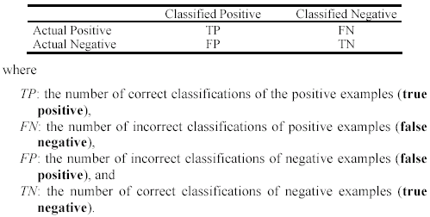
Precision and recall measures
Used in information retrieval and text classification.
We use a confusion matrix to introduce them.

Slide 49

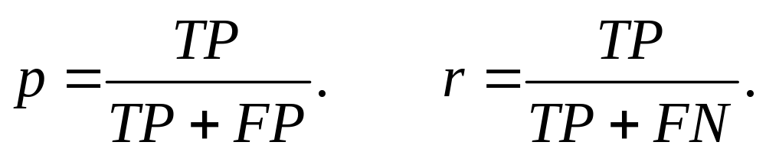
Precision and recall measures (cont…)
Precision p is the number of correctly classified positive examples divided by the total number of examples that are classified as positive.
Recall r is the number of correctly classified positive examples divided by the total number of actual positive examples in the test set.

Slide 50

An example
This confusion matrix gives
  precision p = 100% and
  recall r = 1%
  because we only classified one positive example correctly and no negative examples wrongly.
Note: precision and recall only measure classification on the positive class.

Slide 51
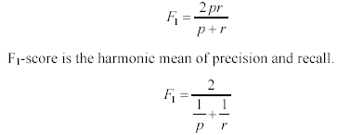
F₁-value (also called F₁-score)
It is hard to compare two classifiers using two measures. F₁ score combines precision and recall into one measure
The harmonic mean of two numbers tends to be closer to the smaller of the two.
For F₁-value to be large, both p and r much be large.

Slide 52


Receive operating characteristics curve
It is commonly called the ROC curve.
It is a plot of the true positive rate (TPR) against the false positive rate (FPR).
True positive rate:
False positive rate:

Slide 53


Sensitivity and Specificity
In statistics, there are two other evaluation measures:
  Sensitivity: Same as TPR
  Specificity: Also called True Negative Rate (TNR)
Then we have

Slide 54
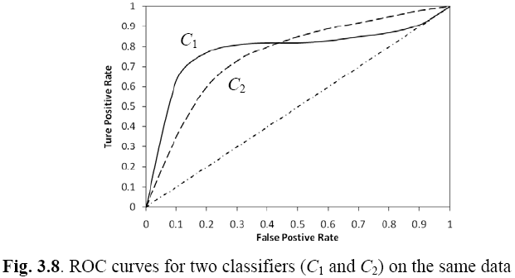
Example ROC curves

Slide 55
Area under the curve (AUC)
Which classifier is better, C₁ or C₂?
  It depends on which region you talk about.
Can we have one measure?
  Yes, we compute the area under the curve (AUC)
If AUC for C_{i} is greater than that of C_{j}, it is said that C_{i} is better than C_{j}.
  If a classifier is perfect, its AUC value is 1
  If a classifier makes all random guesses, its AUC value is 0.5.

Slide 56
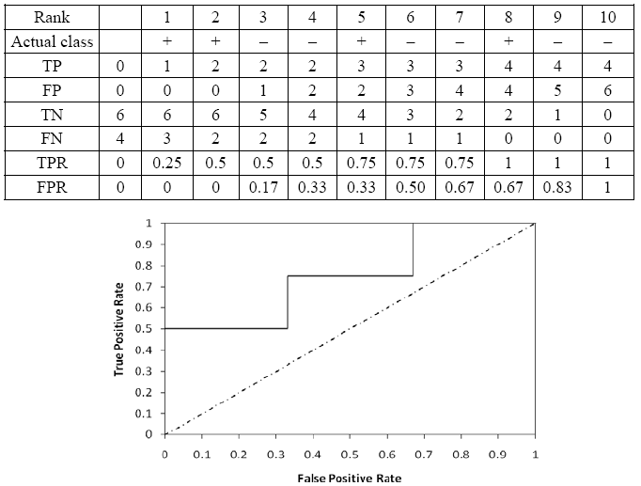
Drawing an ROC curve

Slide 57
Another evaluation method:
Scoring and ranking
Scoring is related to classification.
We are interested in a single class (positive class), e.g., buyers class in a marketing database.
Instead of assigning each test instance a definite class, scoring assigns a probability estimate (PE) to indicate the likelihood that the example belongs to the positive class.

Slide 58
Ranking and lift analysis
After each example is given a PE score, we can rank all examples according to their PEs.
We then divide the data into n (say 10) bins. A lift curve can be drawn according how many positive examples are in each bin. This is called lift analysis.
Classification systems can be used for scoring. Need to produce a probability estimate.
  E.g., in decision trees, we can use the confidence value at each leaf node as the score.

Slide 59
An example
We want to send promotion materials to potential customers to sell a watch.
Each package cost $0.50 to send (material and postage).
If a watch is sold, we make $5 profit.
Suppose we have a large amount of past data for building a predictive/classification model. We also have a large list of potential customers.
How many packages should we send and who should we send to?

Slide 60
An example
Assume that the test set has 10000 instances. Out of this, 500 are positive cases.
After the classifier is built, we score each test instance. We then rank the test set, and divide the ranked test set into 10 bins.
  Each bin has 1000 test instances.
  Bin 1 has 210 actual positive instances
  Bin 2 has 120 actual positive instances
  Bin 3 has 60 actual positive instances
  …
  Bin 10 has 5 actual positive instances

Slide 61
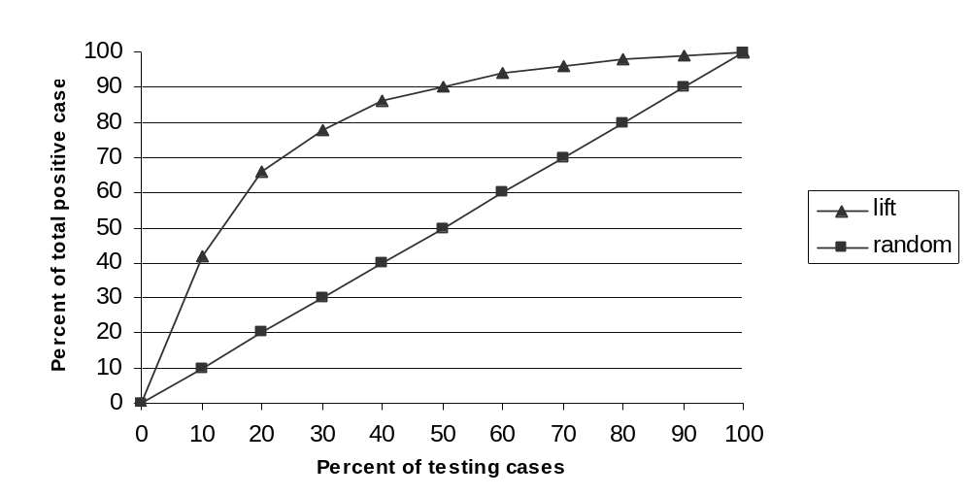
Lift curve
Bin 1 2 3 4 5 6 7 8 9 10

Slide 62
Road Map
Basic concepts
Decision tree induction
Evaluation of classifiers
Rule induction
Classification using association rules
Naïve Bayesian classification
Naïve Bayes for text classification
Support vector machines
K-nearest neighbor
Ensemble methods: Bagging and Boosting
Summary

Slide 63
Bayesian classification
Probabilistic view: Supervised learning can naturally be studied from a probabilistic point of view.
Let A₁ through A_{k} be attributes with discrete values. The class is C.
Given a test example d with observed attribute values a₁ through a_{k}.
Classification is basically to compute the following posteriori probability. The prediction is the class c_{j} such that
is maximal

Slide 64
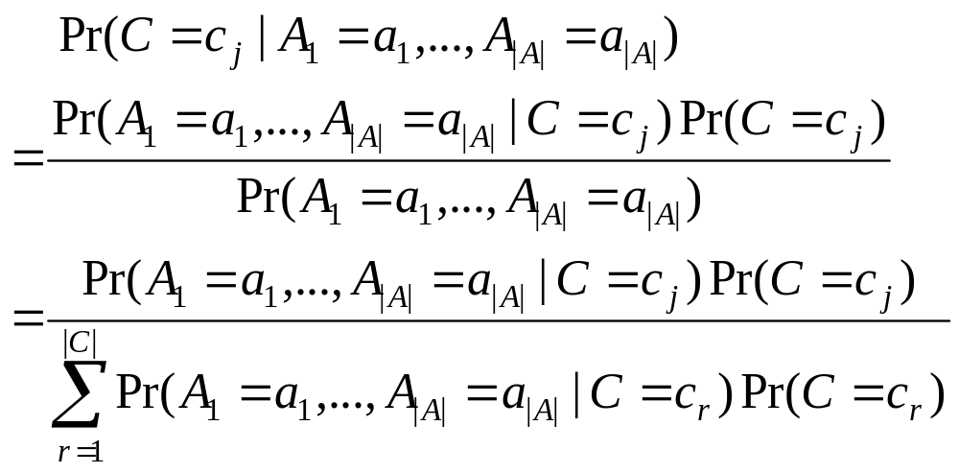
Apply Bayes’ Rule
Pr(C=c_{j}) is the class prior probability: easy to estimate from the training data.

Slide 65
Computing probabilities
The denominator P(A₁=a₁,...,A_{k}=a_{k}) is irrelevant for decision making since it is the same for every class.
We only need P(A₁=a₁,...,A_{k}=a_{k} | C=c_{i}), which can be written as
Pr(A₁=a₁|A₂=a₂,...,A_{k}=a_{k}, C=c_{j})* Pr(A₂=a₂,...,A_{k}=a_{k} |C=c_{j})
Recursively, the second factor above can be written in the same way, and so on.
Now an assumption is needed.

Slide 66
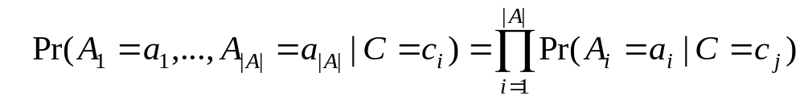
Conditional independence assumption
All attributes are conditionally independent given the class C = c_{j}.
Formally, we assume,
Pr(A₁=a₁ | A₂=a₂, ..., A_{|A|}=a_{|A|}, C=c_{j}) = Pr(A₁=a₁ | C=c_{j})
and so on for A₂ through A_{|A|}. I.e.,

Slide 67
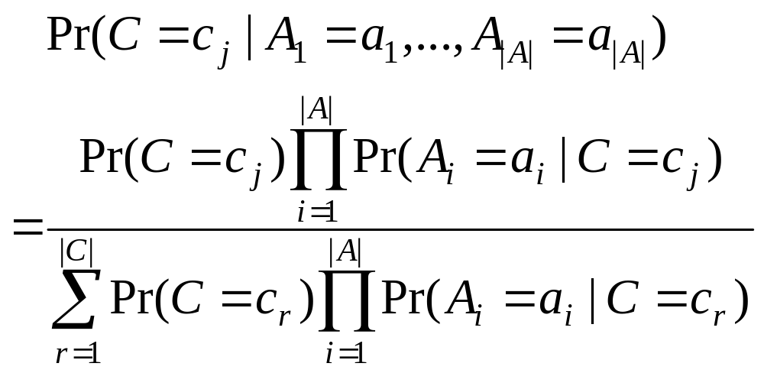
Final naïve Bayesian classifier
We are done!
How do we estimate P(A_{i} = a_{i}| C=c_{j})? Easy!.

Slide 68
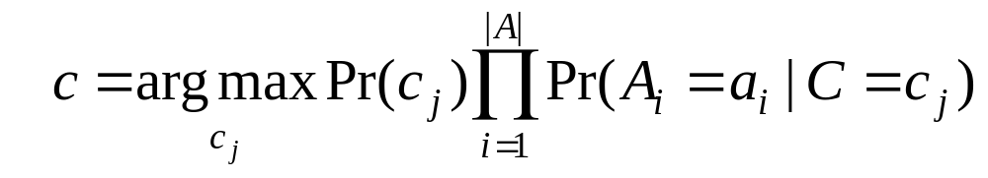
Classify a test instance
If we only need a decision on the most probable class for the test instance, we only need the numerator as its denominator is the same for every class.
Thus, given a test example, we compute the following to decide the most probable class for the test instance

Slide 69
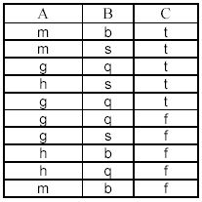
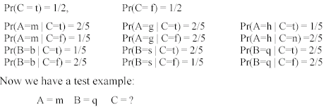
An example
Compute all probabilities required for classification

Slide 70
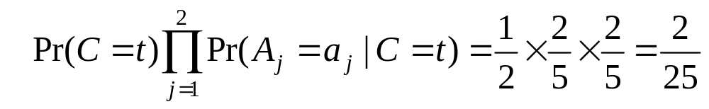
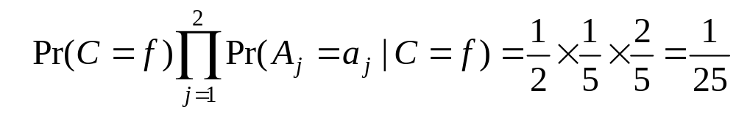
An Example (cont …)
For C = t, we have
For class C = f, we have
C = t is more probable. t is the final class.

Slide 71
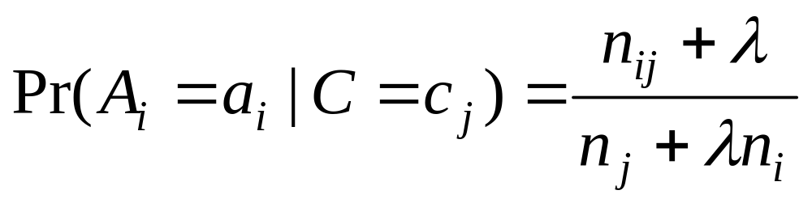
Additional issues
Numeric attributes: Naïve Bayesian learning assumes that all attributes are categorical. Numeric attributes need to be discretized.
Zero counts: An particular attribute value never occurs together with a class in the training set. We need smoothing.
Missing values: Ignored

Slide 72
On naïve Bayesian classifier
Advantages:
  Easy to implement
  Very efficient
  Good results obtained in many applications
Disadvantages
  Assumption: class conditional independence, therefore loss of accuracy when the assumption is seriously violated (those highly correlated data sets)

Slide 73
Discussions
Most assumptions made by naïve Bayesian learning are violated to some degree in practice.
Despite such violations, researchers have shown that naïve Bayesian learning produces very accurate models.
  The main problem is the mixture model assumption. When this assumption is seriously violated, the classification performance can be poor.
Naïve Bayesian learning is extremely efficient.

Slide 74
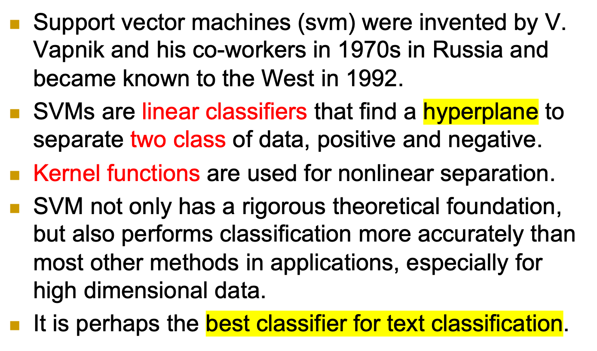
Introduction

Slide 75
x2 (8, 8)
(x2, y2) = ((8, 8, 11.3,…), 1)
x1 is a point (8.2, 5.8)
(x1, y1) = ((8.2, 4.8, 9.5, …., ), 1)
// bold of x1 means vector that capture / represent the characteristics of the point x1
y1 is the label for the point
x11 (1.5, 5.5)
(x11, y11)
=((1.5, 5.5, 5.7, ….), 0)

Slide 76
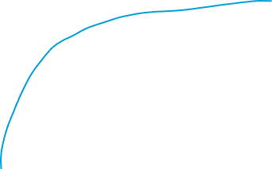
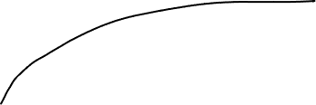
Over-fitting problem

Slide 77

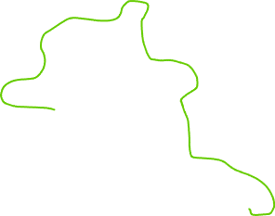
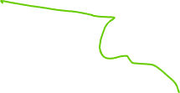
Over-fitting problem

Slide 78
x2 (8, 8)
(x2, y2) = ((8, 8, 11.3,…), 1)
x1 is a point (8.2, 5.8)
(x1, y1) = ((8.2, 4.8, 9.5, …., ), 1)
// bold of x1 means vector that capture / represent the characteristics of the point x1
y1 is the label for the point
x11 (1.5, 5.5)
(x11, y11)
=((1.5, 5.5, 5.7, ….), 0)

Slide 79
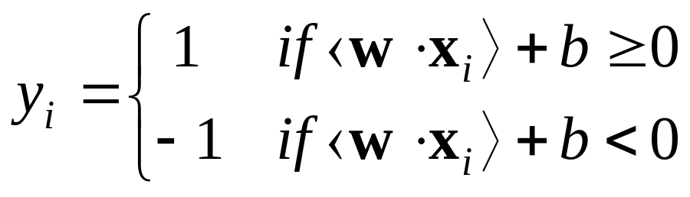
Basic concepts
Let the set of training examples D be
{(x₁, y₁), (x₂, y₂), …, (x_{r}, y_{r})},
where x_{i} = (x₁, x₂, …, x_{n}) is an input vector in a real-valued space X ⊆ R^{n} and y_{i} is its class label (output value), y_{i} ∈ {1, -1}.
1: positive class and -1: negative class. 1 or 0.
SVM finds a linear function of the form (w: weight vector)
f(x) = ⟨w ⋅ x⟩ + b

Slide 80
Training datasets based on 11 points:
((8.2, 4.8, 9.5, …., ), 1) predicted: 0
((8, 8, 11.3,…), 1)
…..
((1.5, 5.5, 5.7, ….), 0)
Predicted wrong for 2 times out of 11 datapoints, accuracy = 9/11= 81%

Slide 81
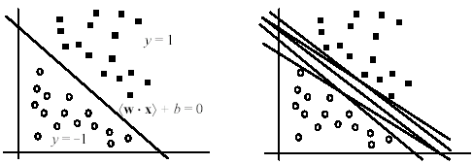

The hyperplane
The hyperplane that separates positive and negative training data is
⟨w ⋅ x⟩ + b = 0
It is also called the decision boundary (surface).
So many possible hyperplanes, which one to choose?

Slide 82

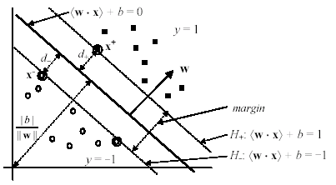

Maximal margin hyperplane
SVM looks for the separating hyperplane with the largest margin.
Machine learning theory says this hyperplane minimizes the error bound

Slide 83

Linear SVM: separable case
Assume the data are linearly separable.
Consider a positive data point (x⁺, 1) and a negative (x⁻, -1) that are closest to the hyperplane
<w ⋅ x> + b = 0.
We define two parallel hyperplanes, H₊ and H₋, that pass through x⁺ and x⁻ respectively. H₊ and H₋ are also parallel to <w ⋅ x> + b = 0.

Slide 84


Slide 85
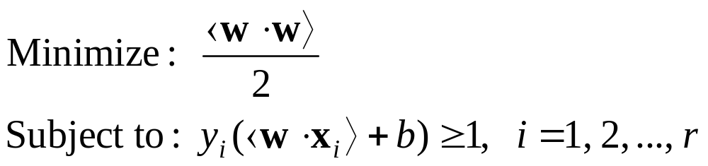
Linear SVM: Non-separable case
Linear separable case is the ideal situation.
Real-life data may have noise or errors.
  Class label incorrect or randomness in the application domain.
Recall in the separable case, the problem was
With noisy data, the constraints may not be satisfied. Then, no solution!

Slide 86
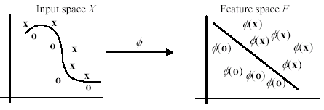
Geometric interpretation
In this example, the transformed space is also 2-D. But usually, the number of dimensions in the feature space is much higher than that in the input space

Slide 87
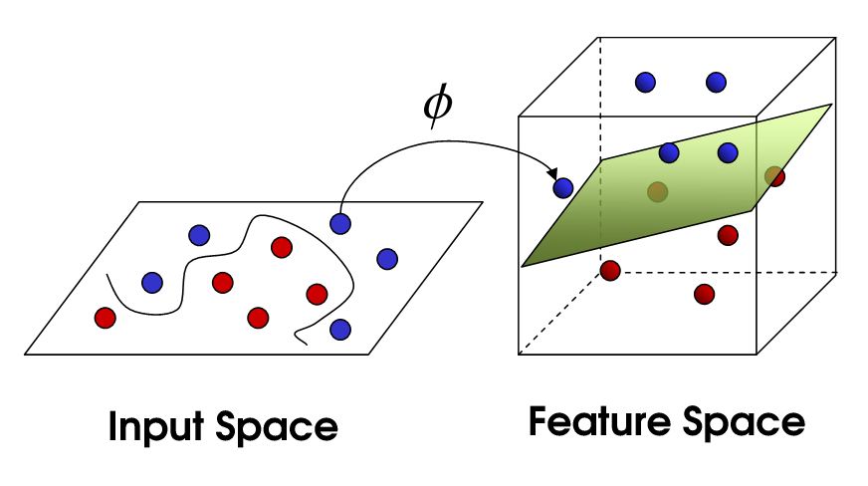

Slide 88

Kernel functions
(82)

Slide 89

An example kernel function
Polynomial kernel
K(x, z) = ⟨x ⋅ z⟩^{d}
Let us compute the kernel with degree d = 2 in a 2-dimensional space: x = (x₁, x₂) and z = (z₁, z₂).
This shows that the kernel ⟨x ⋅ z⟩² is a dot product in a transformed feature space
(83)
(84)

Slide 90
Some other issues in SVM
SVM works only in a real-valued / numerical space. For a categorical attribute (freshman, sophomore, junior, and senior), we need to convert its categorical values to numeric values (13, 14, 15, 16).
SVM does only two-class classification. For multi-class problems, some strategies can be applied, e.g., one-against-rest, and error-correcting output coding.
The hyperplane produced by SVM is hard to understand by human users. The matter is made worse by kernels. Thus, SVM is commonly used in applications that do not required human understanding.

Slide 91
Road Map
Basic concepts
Decision tree induction
Evaluation of classifiers
Rule induction
Classification using association rules
Naïve Bayesian classification
Naïve Bayes for text classification
Support vector machines
K-nearest neighbor
Ensemble methods: Bagging and Boosting
Summary

Slide 92
k-Nearest Neighbor Classification (kNN)
Unlike all the previous learning methods, kNN does not build model from the training data.
To classify a test instance d, define k-neighborhood P as k nearest neighbors of d
Count number n of training instances in P that belong to class c_{j}
Estimate Pr(c_{j}|d) as n/k
No training is needed. Classification time is linear in training set size for each test case.

Slide 93

kNNAlgorithm
k is usually chosen empirically via a validation set or cross-validation by trying a range of k values.
Distance function is crucial, but depends on applications.

Slide 94
Example: k=6 (6NN)
Government
Science
Arts
A new point
Pr(science| )?

Slide 95
Discussions
kNN can deal with complex and arbitrary decision boundaries.
Despite its simplicity, researchers have shown that the classification accuracy of kNN can be quite strong and in many cases as accurate as those elaborated methods.
kNN is slow at the classification time
kNN does not produce an understandable model

Slide 96
Road Map
Basic concepts
Decision tree induction
Evaluation of classifiers
Rule induction
Classification using association rules
Naïve Bayesian classification
Naïve Bayes for text classification
Support vector machines
K-nearest neighbor
Ensemble methods: Bagging and Boosting
Summary

Slide 97
Combining classifiers
So far, we have only discussed individual classifiers, i.e., how to build them and use them.
Can we combine multiple classifiers to produce a better classifier?
Yes, sometimes
We discuss two main algorithms:
  Bagging
  Boosting

Slide 98
Bagging
Breiman, 1996
Bootstrap Aggregating = Bagging
  Application of bootstrap sampling
    Given: set D containing m training examples
    Create a sample S[i] of D by drawing m examples at random with replacement from D
    S[i] of size m: expected to leave out 0.37 of examples from D

Slide 99
Bagging (cont…)
Training
  Create k bootstrap samples S[1], S[2], …, S[k]
  Build a distinct classifier on each S[i] to produce k classifiers, using the same learning algorithm.
Testing
  Classify each new instance by voting of the k classifiers (equal weights)

Slide 100
Bagging Example
Original | 1 | 2 | 3 | 4 | 5 | 6 | 7 | 8
Training set 1 | 2 | 7 | 8 | 3 | 7 | 6 | 3 | 1
Training set 2 | 7 | 8 | 5 | 6 | 4 | 2 | 7 | 1
Training set 3 | 3 | 6 | 2 | 7 | 5 | 6 | 2 | 2
Training set 4 | 4 | 5 | 1 | 4 | 6 | 4 | 3 | 8

Slide 101
Bagging (cont …)
When does it help?
  When learner is unstable
    Small change to training set causes large change in the output classifier
    True for decision trees, neural networks; not true for k-nearest neighbor, naïve Bayesian, class association rules
  Experimentally, bagging can help substantially for unstable learners, may somewhat degrade results for stable learners
Bagging Predictors, Leo Breiman, 1996

Slide 102
Boosting
A family of methods:
  We only study AdaBoost (Freund & Schapire, 1996)
Training
  Produce a sequence of classifiers (the same base learner)
  Each classifier is dependent on the previous one, and focuses on the previous one’s errors
  Examples that are incorrectly predicted in previous classifiers are given higher weights
Testing
  For a test case, the results of the series of classifiers are combined to determine the final class of the test case.

Slide 103
AdaBoost
Weighted
training set
called a weaker classifier
(x₁, y₁, w₁)
(x₂, y₂, w₂)
…
(x_{n}, y_{n}, w_{n})
Build a classifier h_{t} whose accuracy on training set > ½ (better than random)
Non-negative weights
sum to 1
Change weights

Slide 104

AdaBoost algorithm

Slide 105

Bagging, Boosting and C4.5
C4.5’s mean error rate over the
10 cross-validation.
Bagged C4.5
vs. C4.5.
Boosted C4.5 vs. C4.5.
Boosting vs. Bagging

Slide 106
Does AdaBoost always work?
The actual performance of boosting depends on the data and the base learner.
  It requires the base learner to be unstable as bagging.
Boosting seems to be susceptible to noise.
  When the number of outliners is very large, the emphasis placed on the hard examples can hurt the performance.

Slide 107
Road Map
Basic concepts
Decision tree induction
Evaluation of classifiers
Rule induction
Classification using association rules
Naïve Bayesian classification
Naïve Bayes for text classification
Support vector machines
K-nearest neighbor
Summary

Slide 108
Summary
Applications of supervised learning are in almost any field or domain.
We studied 8 classification techniques.
There are still many other methods, e.g.,
  Bayesian networks
  Neural networks
  Genetic algorithms
  Fuzzy classification
  This large number of methods also show the importance of classification and its wide applicability.
It remains to be an active research area.

