Slide 1

STUDY BUDDY-AI
Presented By
Student Name: BEJJIPARAPU SHRAVANI
College Name: Malla REDDY ENGINEERING COLLEGE FOR WOMEN
Department: B.Tech - INFORMATION TECHNOLOGY
Email ID: bejjiparapushravani@gmail.com
AICTE Student ID: STU67e2bad44fad81742912212

Slide 2
OUTLINE
Problem Statement
Proposed System/Solution
System Development Approach
Algorithm & Deployment
Result (Output Image)
Conclusion
Future Scope
References

Slide 3
Problem Statement
Students often experience difficulty maintaining concentration and motivation during prolonged study sessions. Emotional states such as stress, fatigue, and frustration can negatively impact their ability to focus and retain information. Despite the availability of various study aids and productivity tools, most fail to consider the emotional and mental well-being of the user. There is a lack of systems that can recognize a student's current mood and adapt the study environment accordingly. This gap affects both academic performance and mental health, especially during high-pressure periods like exams.

Slide 4
Proposed Solution
The proposed solution is an AI-powered study assistant called Study Buddy AI that detects a student’s mood through voice input and provides real-time support. Based on the emotional state, it plays relaxing music, displays motivational quotes, or suggests breaks. The system aims to improve focus and well-being during study sessions by offering personalized and mood-aware assistance through a simple GUI.
Objectives of the Proposed System:
To detect the user's mood through voice input and basic natural language processing.
To provide personalized support like music, motivational quotes, or break suggestions based on mood
To improve focus and well-being during study sessions through an interactive and user-friendly interface.

Slide 5
Data Collection
Voice samples expressing different moods (e.g., stress, tiredness, motivation) were recorded. Keyword-based mood mapping and supportive content (quotes, music) were manually curated.
Preprocessing
Voice input was converted to text using Speech Recognition. The text was cleaned and keywords were extracted for mood classification.
AI & ML Algorithm
A simple rule-based logic was implemented to classify mood from keywords. Based on the detected mood, the system responds with quotes, music, or break reminders.

Slide 6
Deployment
Evaluation
Future enhancements include adding machine learning-based sentiment analysis for more accurate mood detection. The system can also be evolved into a cross-platform web or mobile app for wider accessibility and smarter features.
The StudyBuddy AI application was deployed locally using Python, with a GUI built using Tkinter. It integrates SpeechRecognition for voice input and gTTS for audio output, allowing real-time interaction.

Slide 7
System Approach
Programming Language: Python 3.10
GUI Framework: Tkinter (for desktop application interface)
Speech Processing: SpeechRecognition, PyAudio
Text-to-Speech Engine: gTTS (Google Text-to-Speech)
Voice Playback: playsound
Mood Logic: Rule-based classification using keyword mapping
Deployment: Local system using Python interpreter
Libraries:
SpeechRecognition
PyAudio
gTTS (Google Text-to-Speech)
playsound
Tkinter

Slide 8
Dataset Used
Source: Custom voice samples and text corpora collected manually Includes keywords representing emotional states like tired, emotional, stressed Additional datasets for motivational quotes, relaxing music, and break reminders.
Implementation Details
GUI built using Tkinter to allow user interaction Voice input processed via SpeechRecognition and converted to text Mood detected by keyword matching; output includes quotes, music, or alerts via gTTS and playsound

Slide 9
Algorithm & Deployment
Algorithm Used: Rule-Based + Voice Recognition
StudyBuddy AI uses a rule-based approach that interprets voice input using speech recognition and identifies mood by matching keywords. This method is effective for real-time emotional feedback and personalization. Input: Voice Command Output: Mood Classification → Motivational Quote, Break Reminder, or Music Voice Tools: SpeechRecognition, gTTS, playsound.
Deployment
Deployed using a local Flask server Runs on http://127.0.0.1:5000 with a simple front-end or GUI using Tkinter

Slide 10
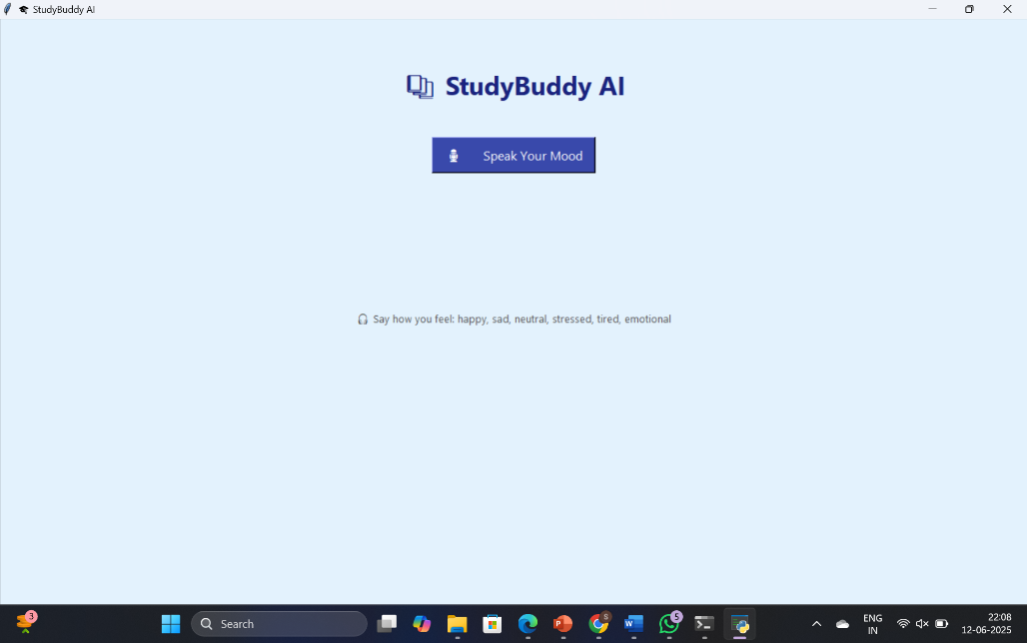

Result
The model can predicts the mood.
Screenshots of project are given below.
1.Speak your mood
2.After that it plays music relate to mood

Slide 11
Conclusion
The StudyBuddy AI project successfully demonstrates how mood-based interaction can enhance the learning experience. By using voice recognition and rule-based mood detection, the system provides personalized support through motivational quotes, break reminders, and calming music. This solution promotes better focus, reduces stress, and improves study habits—making it a valuable companion for students in their academic journey.

Slide 12
Future scope
Advanced Mood Detection: Integrate machine learning or facial emotion recognition for more accurate and real-time mood analysis.
Multi-Language Support: Expand accessibility by supporting regional languages for voice input and responses.
Mobile App Integration: Develop a mobile version for easier access and on-the-go usage for students.
Personalized Study Plans: Incorporate AI to suggest personalized study schedules and productivity tips.
Cloud-Based Deployment: Shift to cloud platforms for broader accessibility and real-time data synchronization.

Slide 13
References
Kaggle: Emotion Detection Dataset Maintained By: Independent contributors Access: https://www.kaggle.com/datasets/praveengovi/emotions-dataset-for-nlp Used for training emotion recognition models
Poria, S., Cambria, E., & Gelbukh, A. (2015) Title: Deep Convolutional Neural Network Text Representation for Emotion Recognition Demonstrates CNN-based models for emotion classification from voice/text input
Google Text-to-Speech (gTTS) Documentation Link: https://pypi.org/project/gTTS/ Used for converting motivational messages into voice output
GitHub Link: https://github.com/BejjiparapuShravani/StudyBuddy-AI

Slide 14
Thank you

