Slide 1
项目案例： 商品实时推荐系统
2022/6/28

Slide 2
目录
1
项目背景与挖掘目标
2
数据采集
3
数据缓存
4
实时数据处理

Slide 3
实时数据处理
1.Flink实时统计目标
编程读取Kafka缓存数据
每日销售额、每日访问流量实时统计
每日每家门店总销售额实时统计
每日商品销量实时统计,并选出10大热销商品

Slide 4
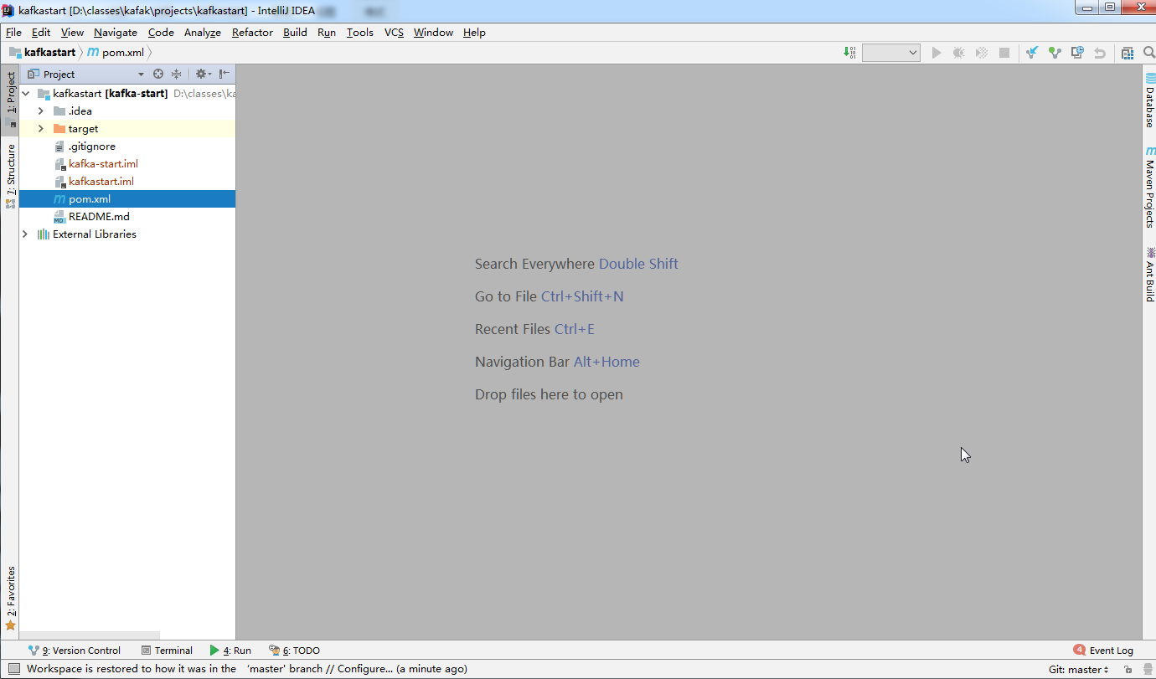
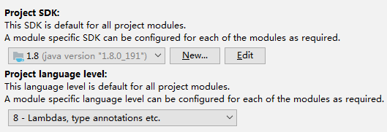
开发环境说明
Intellij IDEA && Maven && JDK

Slide 5
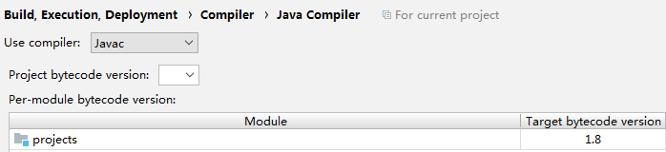
Pom配置
Compiler Configuration
<properties> <maven.compiler.target>1.8</maven.compiler.target> <maven.compiler.source>1.8</maven.compiler.source> </properties>
<build> <plugins> <plugin> <groupId>org.apache.maven.plugins</groupId> <artifactId>maven-compiler-plugin</artifactId> <version>3.6.1</version> <configuration> <source>1.8</source> <target>1.8</target> </configuration> </plugin> </plugins> </build>

Slide 6
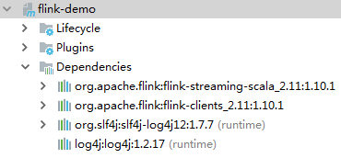
Pom配置
Flink Dependency
<!-- https://mvnrepository.com/artifact/org.apache.flink/flink-streaming-scala --> <dependency> <groupId>org.apache.flink</groupId> <artifactId>flink-streaming-scala_2.11</artifactId> <version>1.10.1</version> </dependency> <!-- https://mvnrepository.com/artifact/org.apache.flink/flink-clients --> <dependency> <groupId>org.apache.flink</groupId> <artifactId>flink-clients_2.11</artifactId> <version>1.10.1</version> </dependency>
<dependency> <groupId>org.slf4j</groupId> <artifactId>slf4j-log4j12</artifactId> <version>1.7.7</version> <scope>runtime</scope> </dependency> <dependency> <groupId>log4j</groupId> <artifactId>log4j</artifactId> <version>1.2.17</version> <scope>runtime</scope> </dependency>
<dependency> <groupId>org.apache.flink</groupId> <artifactId>flink-connector-kafka_2.11</artifactId> <version>1.10.1</version> </dependency>
<dependency> <groupId>mysql</groupId> <artifactId>mysql-connector-java</artifactId> <version>5.1.45</version> </dependency>

Slide 7
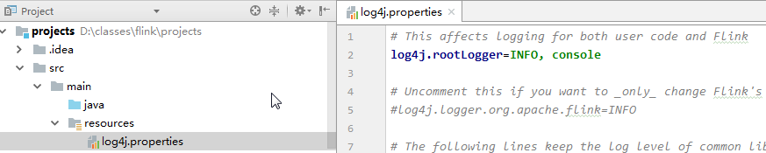
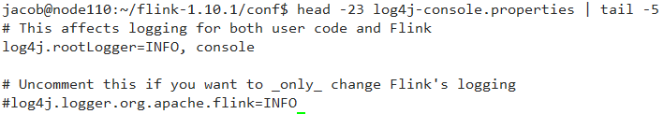
Log配置
log4j.properties

Slide 8
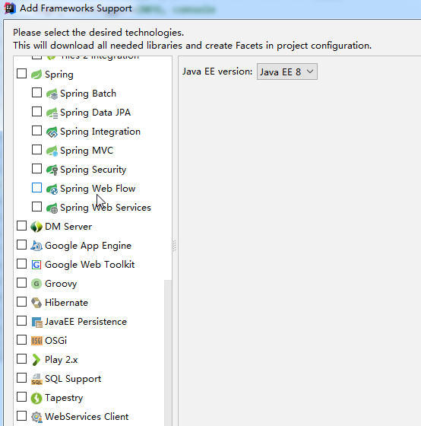
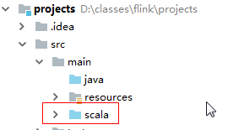
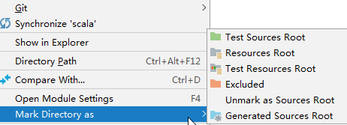
添加Scala支持

Slide 9
实时数据处理
项目开发1
编程读取Kafka缓存数据
每日访问流量、每日销售额实时统计
设计与创建MYSQL结果存储表
打包程序
提交任务
查看运行结果
用户实时日志数据流
Flume采集
Kafka集群
Flink集群
MYSQL

Slide 10
实时数据处理
MYSQL数据存储定义
package mysqlsink import java.sql._ import org.apache.flink.configuration.Configuration import org.apache.flink.streaming.api.functions.sink.RichSinkFunction import otherClass.ItemViewCount import java.time.LocalDate class wordcountsink extends RichSinkFunction[ItemViewCount] with Serializable { var conn:Connection = null var ps:PreparedStatement = null val username="root" val password="root" val drivername="com.mysql.jdbc.Driver" val url="jdbc:mysql://master:3306/test" override def invoke(value: ItemViewCount): Unit = { Class.forName(drivername) conn = DriverManager.getConnection(url,username,password) val sql="insert into wctable values (?,?,?)" ps = conn.prepareStatement(sql) ps.setString(1,value.getword()) ps.setInt(2,value.getcount()) ps.setString(3,LocalDate.now().toString) ps.executeUpdate() if(ps!=null){ps.close()} if(conn!=null){conn.close()} } }

Slide 11
实时数据处理
项目开发1-创建MYSQL表
创建每日访问流量表（datetime时间字段， visitcount 每天访问流量字段）
create table visitcount_everyday(datetime varchar(20),visitcount double);
创建每日的销售额（ datetime时间字段， salevolume每天访销售额字段）
create table salevolume(datetime varchar(20),salevolume double);
创建 数据库 create database fk_shop;

Slide 12
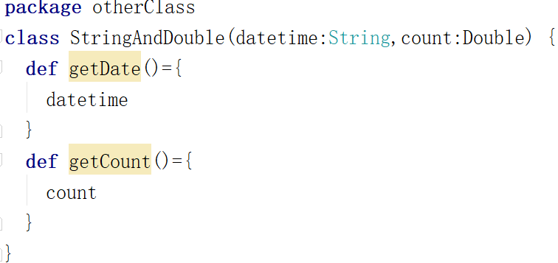
实时数据处理
项目开发1-创建对应的mysqlsink
package mysqlsink import java.sql.DriverManager import java.sql._ import org.apache.flink.streaming.api.functions.sink.RichSinkFunction import otherClass.StringAndDouble class MySqlSinkToSale(table:String) extends RichSinkFunction[StringAndDouble]{ var conn:Connection=_ var ps:PreparedStatement=_ val user="root" val password="root" val driver="com.mysql.jdbc.Driver" val url="jdbc:mysql://192.168.128.130:3306/test" override def invoke(value: StringAndDouble): Unit = { Class.forName(driver) conn=DriverManager.getConnection(url,user,password) val sql = "insert into "+table+" values(?,?)" ps=conn.prepareStatement(sql) ps.setString(1,value.getDate()) ps.setDouble(2,value.getCount()) ps.executeUpdate() if(ps!=null) ps.close() if(conn!=null) conn.close() } }
Notes:
package mysqlsink import org.apache.flink.streaming.api.functions.sink.RichSinkFunction import java.sql._ import objectclass.StringAndDouble /*** * 开发1 * @param table */ class SaleSQLSink(table:String) extends RichSinkFunction[StringAndDouble] with Serializable { //定义连接的MYSQL配置参数 var conn:Connection=_ var ps:PreparedStatement=_ val user="root" val password="123456" val driver="com.mysql.jdbc.Driver" val url="jdbc:mysql://192.168.10.102:3306/fk_shop" override def invoke(value: StringAndDouble): Unit = { Class.forName(driver) conn = DriverManager.getConnection(url,user,password) val sql="insert into "+table+" values(?,?)" ps = conn.prepareStatement(sql) ps.setString(1,value.getDate()) ps.setDouble(2,value.getSale()) ps.executeUpdate() if(ps!=null) ps.close() if(conn!=null) conn.close() } }

Slide 13
实时数据处理
项目开发1-实现Flink数据处理
package flinkclass import java.util.Properties import mysqlsink.SaleSQLSink import objectclass.StringAndDouble import org.apache.flink.streaming.api.scala.StreamExecutionEnvironment import org.apache.flink.streaming.api.scala._ import org.apache.flink.streaming.api.windowing.time.Time import org.apache.flink.streaming.connectors.kafka.FlinkKafkaConsumer import org.apache.flink.api.common.serialization.SimpleStringSchema object SaleVolumn { def main(args: Array[String]): Unit = { val env = StreamExecutionEnvironment.getExecutionEnvironment //配置Kafka参数 val pro = new Properties() pro.setProperty("bootstrap.servers","192.168.128.130:9092") pro.setProperty("group.id","test") //创建数据源 val stream = env.addSource(new FlinkKafkaConsumer[String]("shop",new SimpleStringSchema(),pro)) //数据处理过程 val data = stream.map(x=>x.split(",")).filter(x=>x.nonEmpty && x.length==11) .map{x=>if(x(7).contains("buy")) (x(x.length-1),(x(5).toDouble,1.0)) else (x(x.length-1),(0.0,1.0))}.keyBy(0).timeWindow(Time.minutes(1)).reduce((x,y)=>(x._1,(x._2._1+y._2._1,x._2._2+y._2._2))) //保存每日销售额到MYSQL表 data.map(x=>new StringAndDouble(x._1,x._2._1)).addSink(new SaleSQLSink("salevolume")) //保存每日点击流到mysql表 data.map(x=>new StringAndDouble(x._1,x._2._2)).addSink(new SaleSQLSink("visitcount_everyday")) env.execute() }}
Notes:
package flinkclass import java.util.Properties import mysqlsink.SaleSQLSink import objectclass.StringAndDouble import org.apache.flink.streaming.api.scala.StreamExecutionEnvironment import org.apache.flink.streaming.api.scala._ import org.apache.flink.streaming.api.windowing.time.Time import org.apache.flink.streaming.connectors.kafka.FlinkKafkaConsumer import org.apache.flink.api.common.serialization.SimpleStringSchema /*** *01 统计每日的销售额、统计每日点击流 */ object SaleVolumn { def main(args: Array[String]): Unit = { //初始化环境变量 val env = StreamExecutionEnvironment.getExecutionEnvironment //配置Kafka参数 val pro = new Properties() //kafak的代理 pro.setProperty("bootstrap.servers","node1:9092") //kafka 组ID pro.setProperty("group.id","test") //创建数据源 val stream = env.addSource(new FlinkKafkaConsumer[String]("shop",new SimpleStringSchema(),pro)) //数据处理过程 //id0 用户名1,年龄2,性别3,商品id4,价格5, 门店id6,购买行为7,手机号8,邮箱9, 购买时间10 //471655345890,Vpxwe,44,woman,650012,538.29,313019,fav,13516482705,YUvRxnSWcO@gmail.com,2019-08-04 val data = stream.map(x=>x.split(",")).filter(x=>x.nonEmpty && x.length==11) .map{x=>if(x(7).contains("buy")) (x(x.length-1),(x(5).toDouble,1.0)) else (x(x.length-1),(0.0,1.0))} .keyBy(0).timeWindow(Time.minutes(1)) //timeWindow 设置时间1分钟执行一次 .reduce((x,y)=>(x._1,(x._2._1+y._2._1,x._2._2+y._2._2))) //(2022-12-1,(100,1),(0.0,1)) //保存每日销售额到MYSQL表 data.map(x=>new StringAndDouble(x._1,x._2._1)).addSink(new SaleSQLSink("salevolume")) //保存每日点击流到mysql表 data.map(x=>new StringAndDouble(x._1,x._2._2)).addSink(new SaleSQLSink("visitcount_everyday")) env.execute() } }

Slide 14
实时数据处理
项目开发2
统计每日每家门店总销售额
设计与创建MYSQL结果存储表

Slide 15
实时数据处理
项目开发2-创建门店日销售额表
create table store_sale( datetime varchar(20), store_id varchar(20), sale double);

Slide 16
实时数据处理
项目开发2-创建flink数据存储mysql sink
package mysqlsink import org.apache.flink.streaming.api.functions.sink.RichSinkFunction import otherClass.date_store_sale import java.sql._ class Storesqlsink(table:String) extends RichSinkFunction[date_store_sale] with Serializable { var conn:Connection=_ var ps:PreparedStatement=_ val user="root" val password="root" val driver="com.mysql.jdbc.Driver" val url="jdbc:mysql://master:3306/fk_shop" override def invoke(value: date_store_sale): Unit = { Class.forName(driver) conn=DriverManager.getConnection(url,user,password) val sql="insert into "+table+" values(?,?,?)" ps=conn.prepareStatement(sql) ps.setString(1,value.getDate()) ps.setString(2,value.getStore()) ps.setDouble(3,value.getSale()) ps.executeUpdate() if(ps!=null) ps.close() if(conn!=null) conn.close() } }
package objectclass class date_store_sale (datetime:String,store:String,sale:Double){ def getDate()={ datetime } def getStore()={ store } def getSale()={ sale } }
Notes:
package mysqlsink import org.apache.flink.streaming.api.functions.sink.RichSinkFunction import objectclass.date_store_sale import java.sql._ class Storesqlsink(table:String) extends RichSinkFunction[date_store_sale] with Serializable { var conn:Connection=_ var ps:PreparedStatement=_ val user="root" val password="123456" val driver="com.mysql.jdbc.Driver" val url="jdbc:mysql://192.168.10.102:3306/fk_shop" override def invoke(value: date_store_sale): Unit = { Class.forName(driver) conn=DriverManager.getConnection(url,user,password) val sql="insert into "+table+" values(?,?,?)" ps=conn.prepareStatement(sql) ps.setString(1,value.getDate()) ps.setString(2,value.getStore()) ps.setDouble(3,value.getSale()) ps.executeUpdate() if(ps!=null) ps.close() if(conn!=null) conn.close() } }

Slide 17
实时数据处理
项目开发2-Flink数据处理
package flink_kafka import java.util.Properties import mysqlsink.Storesqlsink import org.apache.flink.api.common.serialization.SimpleStringSchema import org.apache.flink.streaming.api.scala.StreamExecutionEnvironment import org.apache.flink.streaming.connectors.kafka.FlinkKafkaConsumer import org.apache.flink.streaming.api.windowing.time.Time import otherClass.date_store_sale object StoreSale { def main(args: Array[String]): Unit = { val env = StreamExecutionEnvironment.getExecutionEnvironment //kafka集群参数配置 val pro = new Properties() pro.setProperty("bootstrap.servers","master:9092") pro.setProperty("group.id","test") //创建源 val stream = env.addSource(new FlinkKafkaConsumer[String]("shop",new SimpleStringSchema(),pro)) //数据转换 val data=stream.map(x=>x.split(",")).filter(x=>x.nonEmpty && x.length==11 && x(7).contains("buy")).map(x=>((x(x.length-1),x(6)),x(5).toDouble)).keyBy(0).timeWindow(Time.minutes(1)).sum(1).map(x=>new date_store_sale(x._1._1,x._1._2,x._2)) //数据存储 data.addSink(new Storesqlsink("store_sale"))
env.execute() } }
Notes:
package flinkclass import java.util.Properties import mysqlsink.{SaleSQLSink, Storesqlsink} import org.apache.flink.streaming.api.scala.StreamExecutionEnvironment import org.apache.flink.streaming.api.scala._ import org.apache.flink.streaming.api.windowing.time.Time import org.apache.flink.streaming.connectors.kafka.FlinkKafkaConsumer import org.apache.flink.api.common.serialization.SimpleStringSchema import objectclass.date_store_sale /** * 开发2 统计每日每家门店总销售额 */ object StoreSale { def main(args: Array[String]): Unit = { val env = StreamExecutionEnvironment.getExecutionEnvironment //kafka集群参数配置 val pro = new Properties() pro.setProperty("bootstrap.servers","node1:9092") pro.setProperty("group.id","test") //创建源 val stream = env.addSource(new FlinkKafkaConsumer[String]("shop",new SimpleStringSchema(),pro)) //数据转换 //id0,用户名1,年龄2,性别3,商品id4,价格5, 门店id6,购买行为7,手机号8,邮箱9, 购买时间10 //471655345890,Vpxwe,44,woman,650012,538.29,313019,fav,13516482705,YUvRxnSWcO@gmail.com,2019-08-04 val data=stream.map(x=>x.split(",")). filter(x=>x.nonEmpty && x.length==11 && x(7).contains("buy")) .map(x=>((x(x.length-1),x(6)),x(5).toDouble)) .keyBy(0).timeWindow(Time.minutes(1)) .sum(1).map(x=>new date_store_sale(x._1._1,x._1._2,x._2)) //数据存储 data.addSink(new Storesqlsink("store_sale")) env.execute() } }

Slide 18
实时数据处理
项目开发3
商品销量实时统计,并选出10大热销商品

Slide 19
实时数据处理
项目开发3-flink数据处理
package flinkclass import java.util.Properties import objectclass.StringAndDouble import org.apache.flink.streaming.api.scala.StreamExecutionEnvironment import org.apache.flink.streaming.api.scala._ import org.apache.flink.streaming.api.windowing.time.Time import org.apache.flink.streaming.connectors.kafka.FlinkKafkaConsumer import org.apache.flink.api.common.serialization.SimpleStringSchema import org.apache.flink.streaming.api.windowing.windows.TimeWindow import org.apache.flink.streaming.api.scala.function.ProcessWindowFunction import org.apache.flink.util.Collector object GoodsOrder { def main(args: Array[String]): Unit = { val env = StreamExecutionEnvironment.getExecutionEnvironment //kafka集群参数配置 val pro = new Properties() pro.setProperty("bootstrap.servers","master:9092") pro.setProperty("group.id","test") //创建源 val stream = env.addSource(new FlinkKafkaConsumer[String]("shop",new SimpleStringSchema(),pro))
Notes:
package flinkclass import java.util.Properties import objectclass.StringAndDouble import org.apache.flink.streaming.api.scala.StreamExecutionEnvironment import org.apache.flink.streaming.api.scala._ import org.apache.flink.streaming.api.windowing.time.Time import org.apache.flink.streaming.connectors.kafka.FlinkKafkaConsumer import org.apache.flink.api.common.serialization.SimpleStringSchema import org.apache.flink.streaming.api.windowing.windows.TimeWindow import org.apache.flink.streaming.api.scala.function.ProcessWindowFunction import org.apache.flink.util.Collector /** * 开发3 商品销量实时统计,并选出10大热销商品 */ object GoodsOrder { def main(args: Array[String]): Unit = { val env = StreamExecutionEnvironment.getExecutionEnvironment //kafka集群参数配置 val pro = new Properties() pro.setProperty("bootstrap.servers","node1:9092") pro.setProperty("group.id","test") //创建源 val stream = env.addSource(new FlinkKafkaConsumer[String]("shop",new SimpleStringSchema(),pro)) //数据转换 // ProcessWindowFunction[In,Out,Key,Window] val data=stream.map(x=>x.split(",")).filter(x=>x.nonEmpty && x.length==11 && x(7) .contains("buy")).map(x=>new StringAndDouble(x(4),1.0)) .keyBy(x=>x.getDate()).timeWindow(Time.minutes(1)) .process(new ProcessWindowFunction[StringAndDouble,String,String,TimeWindow]{ override def process(key: String, context: Context, elements: Iterable[StringAndDouble], out: Collector[String]): Unit = { val getsum = elements.toList.groupBy(x=>x.getDate()).map{tmp=>val ll=tmp._2.map(x=>x.getSale()).sum;(tmp._1,ll)} val e = getsum.toList.sortBy(x=>x._2).reverse.take(10) e.map(x=>out.collect(System.currentTimeMillis().toString()+":"+x._1+":"+x._2)) } }) //数据存储 data.print() env.execute() } }

Slide 20
实时数据处理
项目开发3-flink数据处理
//数据转换 // ProcessWindowFunction[In,Out,Key,Window] val data=stream.map(x=>x.split(",")).filter(x=>x.nonEmpty && x.length==11 && x(7).contains("buy")).map(x=>new StringAndDouble(x(4),1.0)).keyBy(x=>x.getDate()).timeWindow(Time.minutes(1)).process(new ProcessWindowFunction[StringAndDouble,String,String,TimeWindow]{ override def process(key: String, context: Context, elements: Iterable[StringAndDouble], out: Collector[String]): Unit = { val getsum = elements.toList.groupBy(x=>x.getDate()).map{tmp=>val ll=tmp._2.map(x=>x.getSale()).sum;(tmp._1,ll)} val e = getsum.toList.sortBy(x=>x._2).reverse.take(10) e.map(x=>out.collect(System.currentTimeMillis().toString()+":"+x._1+":"+x._2)) } }) //数据存储 data.print() env.execute() } }

Slide 21
问题反馈： http://www.tipdm.org/tj/841.jhtml

