Slide 1


Full Course 2024
Rust
for Beginners
Introduction >>>

Slide 2
What is Rust ?

Slide 3


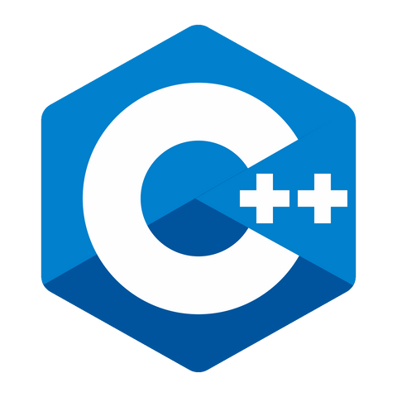
Rust is a Systems Programming Language like C and C++

Slide 4


Slide 5

For 7 consecutive years:
RUST >>>The most admired language
by developers

Slide 6
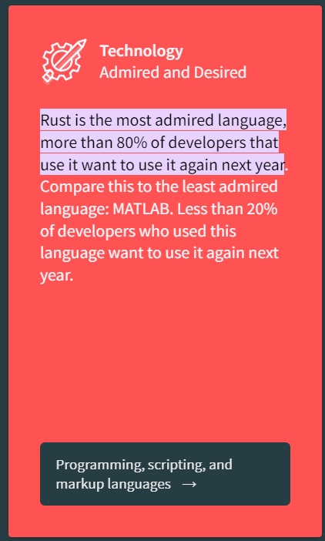


Slide 7
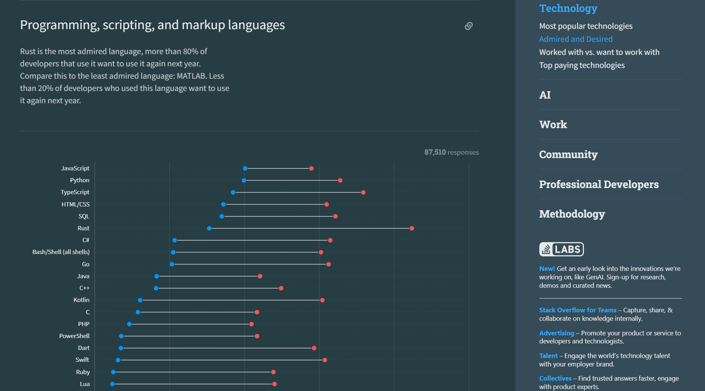

Slide 8
What is the secret?

Slide 9
FINDING
THE BALANCE

Slide 10

FINDING
THE BALANCE
Speed Safety
Concurrency Portability

Slide 11


MEMORY MANAGEMENT
high-level languages like python provides garbage collection

Slide 12
MEMORY MANAGEMENT
lower-level languages like C++ provide functions for memory allocation

Slide 13
MEMORY MANAGEMENT
Rust uses a concept called ownership and borrowing [Chapter 4 and 5]

Slide 14

CARGO
PACKAGE MANAGER

Slide 15
LET US
INSTALL RUST &
RUN OUR FIRST PROGRAM

