Slide 1
Catching Stardust
Game Development I

Slide 2
Description of the game
Story driven detective game
Collect clues and find the killer
Travel between unique planets to collect clues

Slide 3
Core mechanics
Investigation and exploration
Interrogation
Space travel
Clue analysis
Decision making
Audio and atmosphere

Slide 4
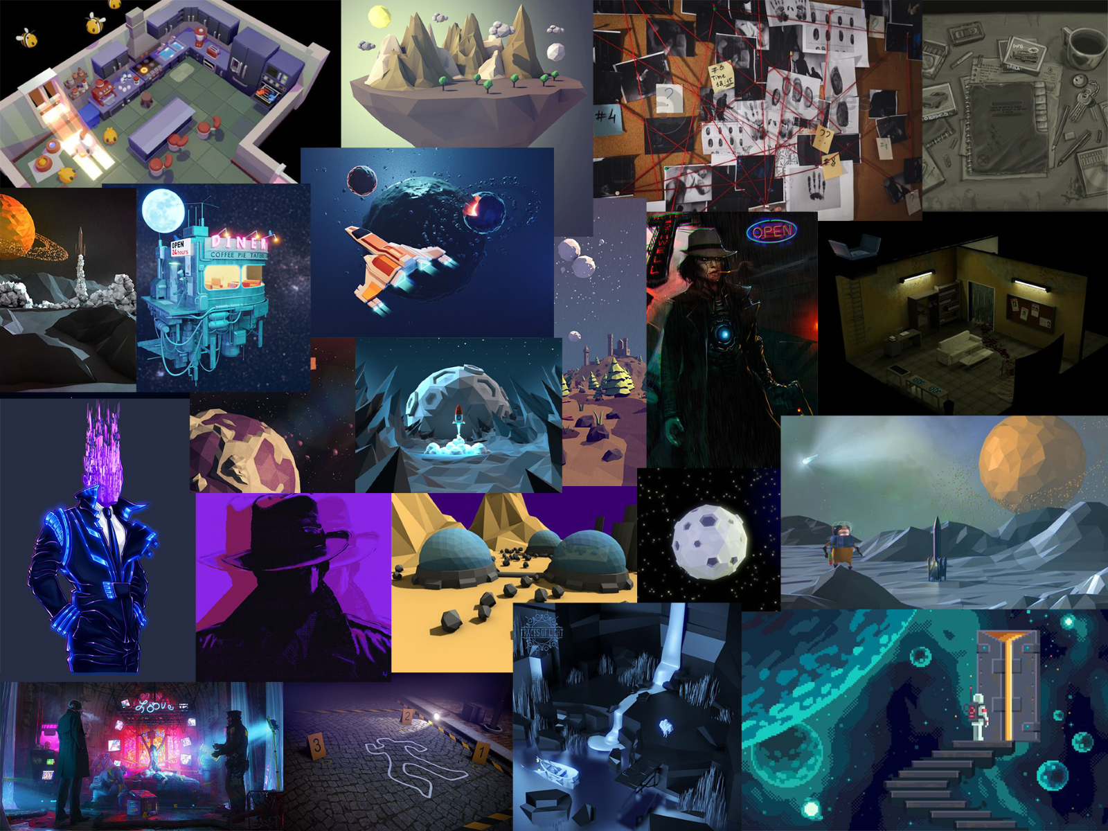
Visuals
Low-poly
2D or 3D?

Slide 5
THANK YOU FOR YOUR ATTENTION !

