Slide 1
Animation 1. Changes in macroalgae amount (% lab tray coverage) from each quadrat (A) demonstrate shifts in abundance across an environmental gradient ranging from pH 8.1 to 6.7. The mean abundance (% lab tray coverage) of each species in quadrats A-C compared with quadrats G-I (B) show that several species of macroalgae are absent from the most acidic environments (e.g. Jania rubens, Valonia utriclaris, Flabelia petiolate) as new species arise or increase in abundance (e.g. Dictyota dichotoma, Sarcassum vulgare, Chondracanthus acicularis). [Note: This is an animation that alternates between with and without panel gridlines every 8 seconds (visible from slideshow mode). Hopefully we can determine which is better, and I enjoyed making my first gif!]
Notes:
Graphical techniques that I learned:
Plot A. I didn’t like that the default plotted points for the values of zero, so for my size call for the points I used ‘size = ifelse(coverage==0, NA, coverage))’ so points are only plotted when the microalgae species was actually in the quadrat sample. Here, zeros in the data plot nothing.
Plot A. Adding the background shaded rectangles in traditional colors of a pH scale.
I used ‘annotate("rect", xmin = 0.5, xmax = 9.5, ymin = 0, ymax = 27, alpha = .2, fill = "#78c679")’ (repeat 2x more times with new xmin, xmax, and fill color.)
At first I didn’t realize I could still use x and y values to describe the position of the shaded area in my plot, since my data was categorical on both axis. But, it turns out the lower left point is assumed to be at x = 1, y =1 and each data row is a unit of 1. I expanded the rectangle above the original plot to make room for the pH text as well.
I added a second call of geom_point() after plotting the rectangles. The rectangles initially were a layer on top of the original points, making the original points faded. However when I moved the geom_point() to after the rectangle annotation, I would get an error. So I just added the geom_point() call AGAIN, and the are replotted on top of the shaded rectangle. So, in reality, I plotted each point twice!
I added an invisible rectangle to plot B so that the y-axis was expanded in the same way as plot A. That way, the tick marks all lined up together nicely.
Pushing two plots next to each other so they could share the axis labels.
For plot A, I moved the legend to the left and the scale to the right, but then didn’t write the text using ‘theme(axis.text.y = element_blank())’.
For plot B, I changed the left margin to -30 (negative 30, moved it to the left) with ‘theme(plot.margin = margin(t=0,r = 0,b =0,l = -30)’ I believe these values are pixels, and so it was trial and error related to the size I wanted the plot and the distance from plot A.
And used ‘theme(axis.text.y = element_text(hjust=.5,face = "italic")’ to center justify (the hjust scale is from 0-1, left-right, so .5 means center) and italicize the macroalgae labels.
When I put plot A and B together, I wanted the labels A and B near the actual plot area, so I used ‘plot_grid(label_x = c(.15,.25))’ to move the lables along the x axis away from where they naturally would be. I’m not sure if I like that the A is beyond the legend, but it matches where the B is on the other plot. I’m still thinking about this one.
4) I used gifmaker.me to bounce between two versions of the plot, once with and one without gridlines (only works in ppt slideshow mode). I took my original ‘plot + theme(panel.grid.major = element_blank)’ to ensure everything else stayed the exact same. I don’t know whether I prefer with or without gridlines.

Slide 2
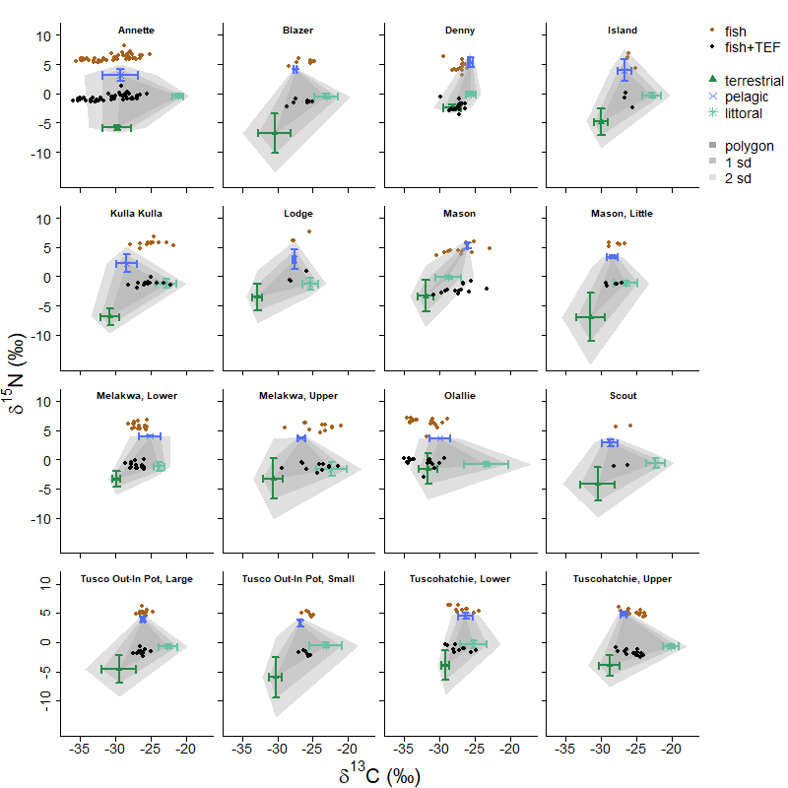
Figure 2. In lake ecosystems CO₂ is made biologically available to the rest of the food web by plants in three main habitats, littoral (submerged illuminated edge), pelagic (open water) and terrestrial (land surrounding the lake). It turns out there is natural and consistent variation among these groups in how many molecules have extra neutrons! Data used in mixing models for each lake show the mean (± SD) of the carbon and nitrogen stable isotope ratios for terrestrial, pelagic, and littoral basal resources. The points show the stable isotope ratios of fish prior to (brown) and after (black) adjusting with trophic enrichment values from Bunn 2013. An isotope biplot for each lake is expected, even if this plot ends up in the supplementary materials of a publication.
Notes:
Ensure that a caption on the figure results in the figure being self-explanatory. You may choose figures from your own research or from the Porzio paper. In the comments in PowerPoint, highlight graphical techniques that you learnt and R code, so that others can benefit from your graphical knowledge.
This is created in base R. I have not successfully recreated this plot in ggplot so alongside working to recreate it in ggplot, I am improving it in base. One of my takeaways is the miracle that is “facet_wrap()” in ggplot. In base R, it loops through data from 16 lakes and creates the same plot each time, however, to get the axis different for four types of plots (y only, x only, x and y, and none) I had to write several if else statements! Essentially 15 lines of code in base that ggplot does in one. However, in this plot I am doing the calculation of the mean of one type of data, but not the others.

